Slide 1
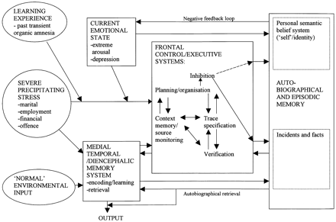
Fig. 1 Social factors and brain systems influencing autobiographical memory retrieval and personal identity. ...
Notes:
Fig. 1 Social factors and brain systems influencing autobiographical memory retrieval and personal identity. The figure shows (i) frontal lobe processes involved in confabulation (trace specification/verification; context memory/source monitoring), and (ii) social factors (in ovals) and brain systems (in rectangles) involved in psychogenic amnesia: inhibition leads to impaired retrieval of incidents and facts, and severe inhibition affects orientation in person. (Adapted from Cogn Neuropsychol 2000; 17: 585–621.)
Unless provided in the caption above, the following copyright applies to the content of this slide:

