Slide 1
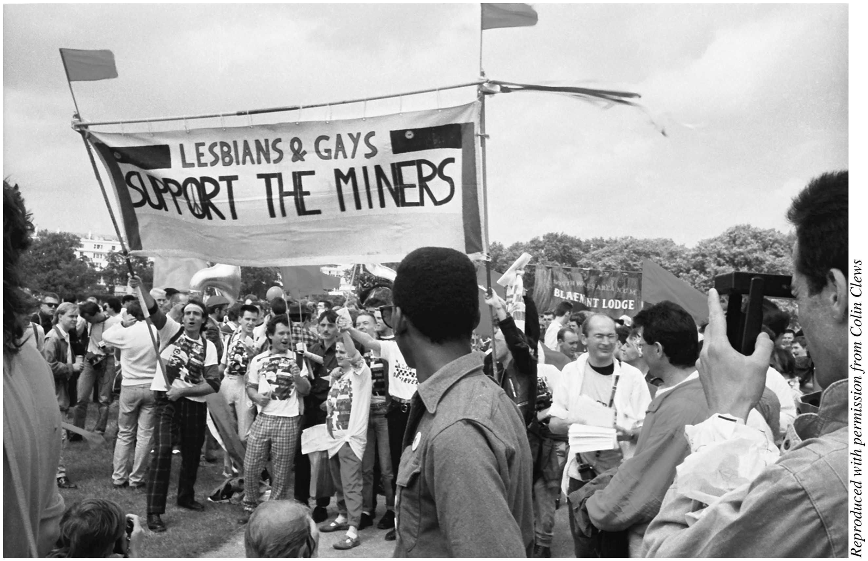
Fig. 1. LGSM banner at Lesbian and Gay Pride 1985 in London. The NUM Blaenant Lodge banner is in the background. ...
Notes:
Fig. 1. LGSM banner at Lesbian and Gay Pride 1985 in London. The NUM Blaenant Lodge banner is in the background. Photo by Colin Clews. See http://www.gayinthe80s.com/2012/09/10/1984-lesbians-and-gays-support-the-miners- part-one/.
Unless provided in the caption above, the following copyright applies to the content of this slide: © The Author 2014. Published by Oxford University Press on behalf of History Workshop Journal, all rights reserved.

Slide 2
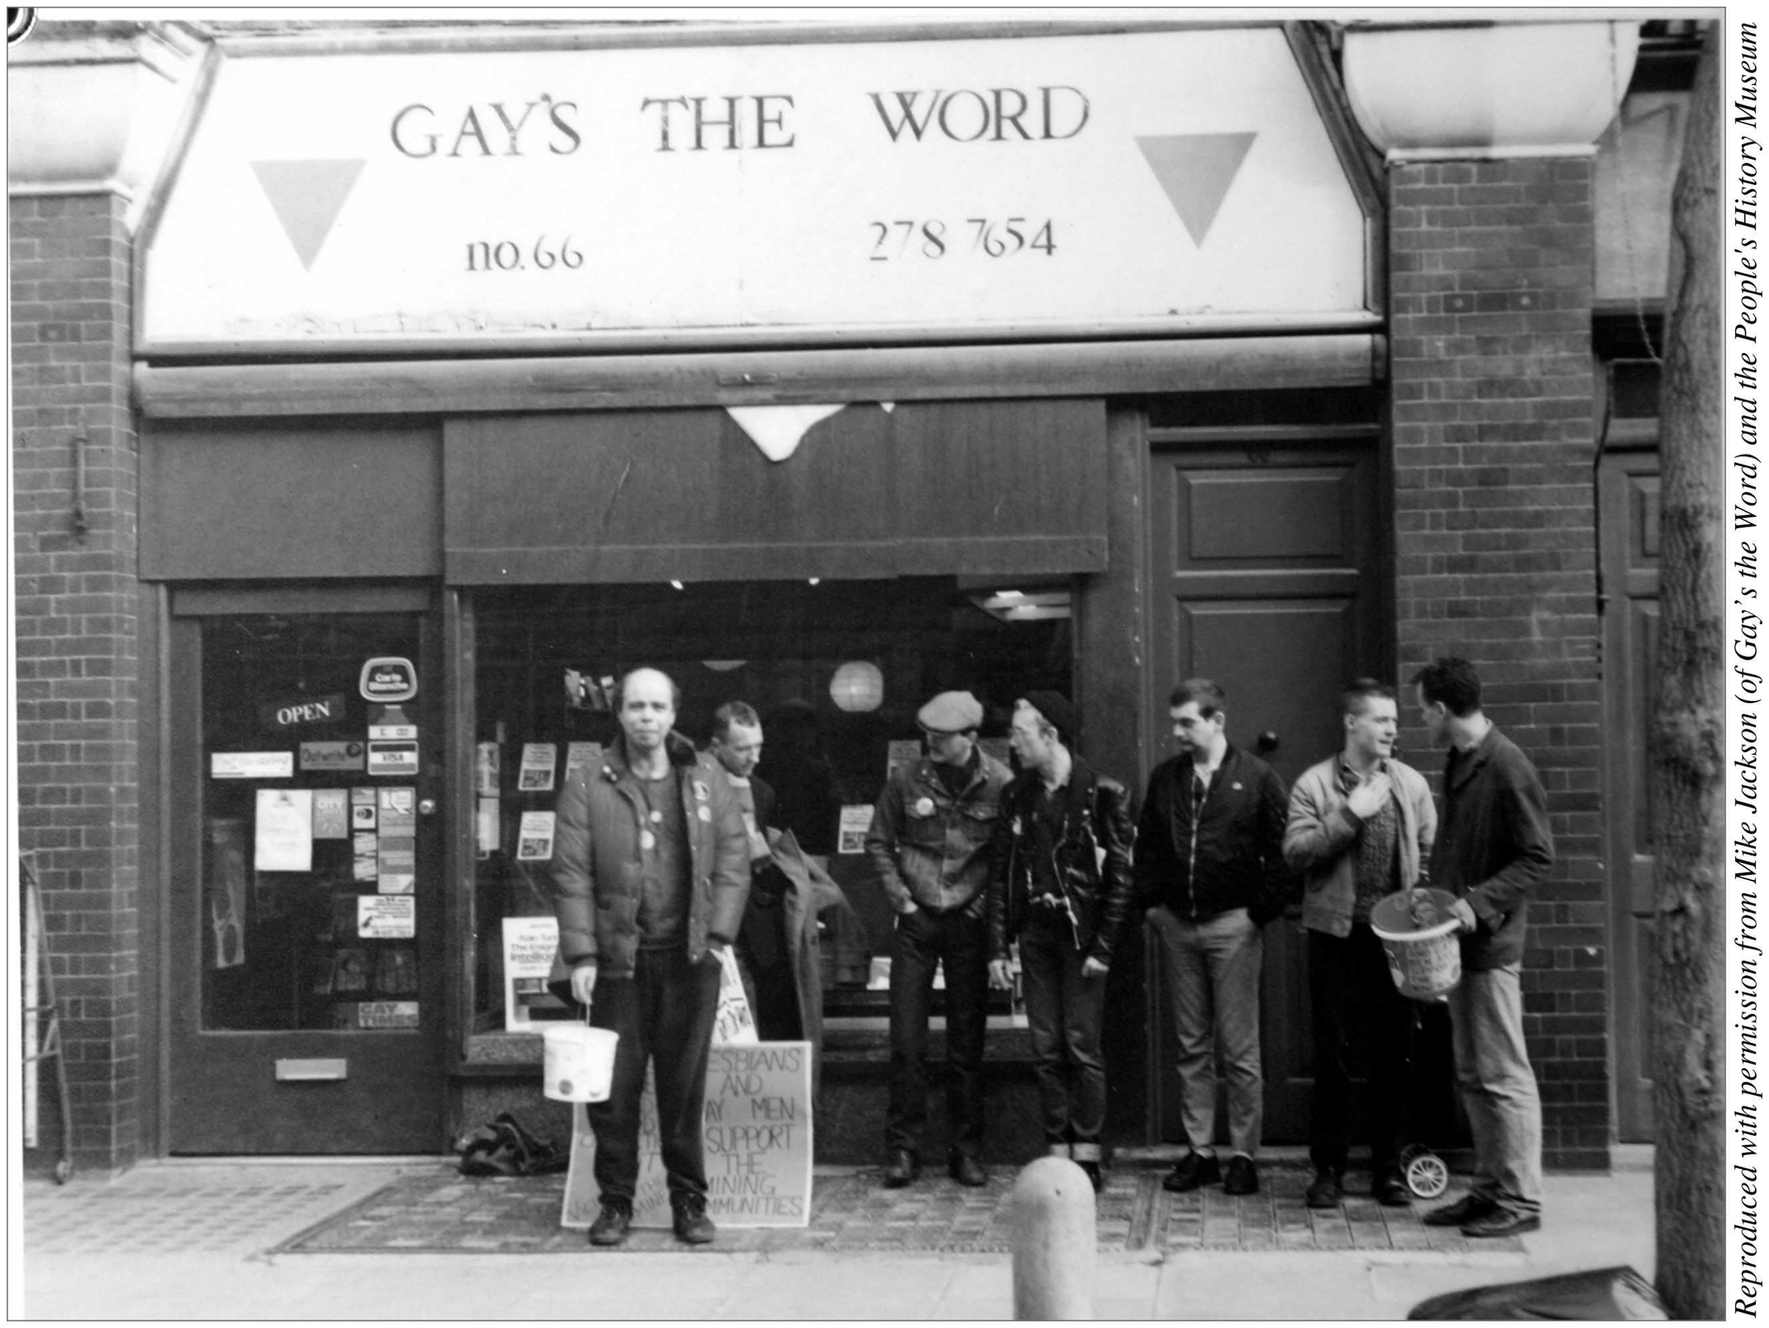
Fig. 2. Members of Lesbians and Gays Support the Miners collecting for the miners outside Gay's the Word bookshop in ...
Notes:
Fig. 2. Members of Lesbians and Gays Support the Miners collecting for the miners outside Gay's the Word bookshop in central London. Photographer unknown.
Unless provided in the caption above, the following copyright applies to the content of this slide: © The Author 2014. Published by Oxford University Press on behalf of History Workshop Journal, all rights reserved.

Slide 3
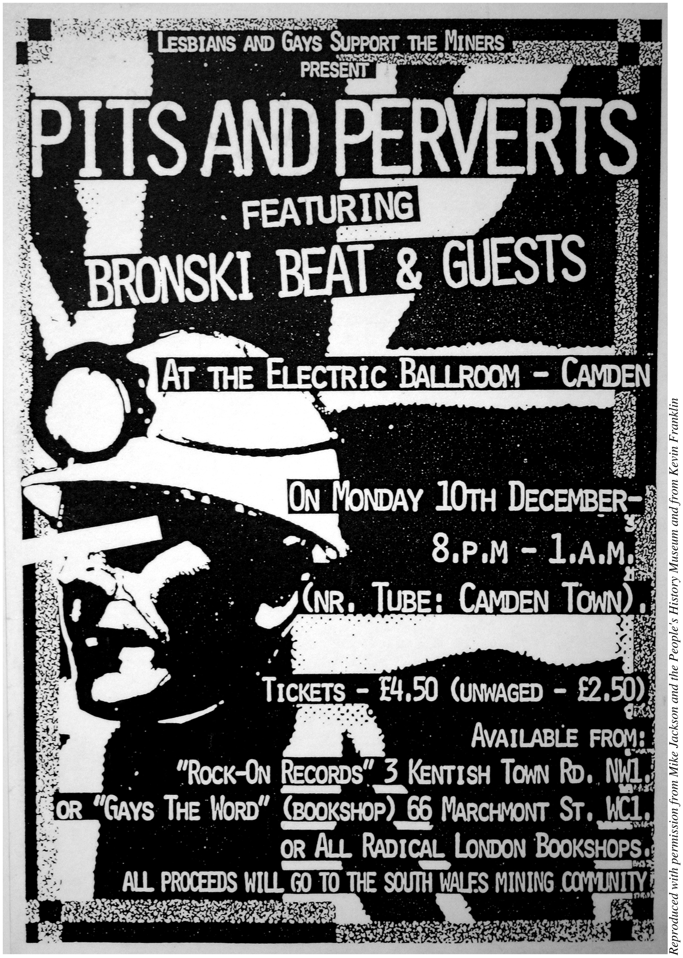
Fig. 3. Promotional poster for LGSM's ‘Pits and Perverts' fundraiser, designed by Kevin Franklin.
Notes:
Fig. 3. Promotional poster for LGSM's ‘Pits and Perverts' fundraiser, designed by Kevin Franklin.
Unless provided in the caption above, the following copyright applies to the content of this slide: © The Author 2014. Published by Oxford University Press on behalf of History Workshop Journal, all rights reserved.

