Slide 1
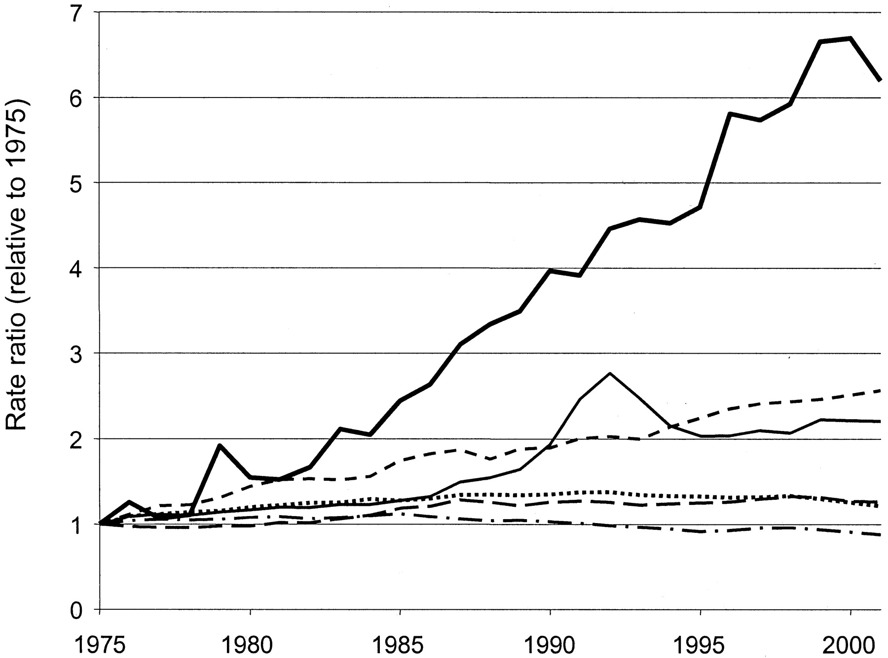
Fig. 1. Relative change in incidence of esophageal adenocarcinoma and other malignancies (1975–2001). Data from the ...
Notes:
Fig. 1. Relative change in incidence of esophageal adenocarcinoma and other malignancies (1975–2001). Data from the National Cancer Institute’s Surveillance, Epidemiology, and End Results program with age-adjustment using the 2000 U.S. standard population. Baseline was the average incidence between 1973 and 1975. Solid black line = esophageal adenocarcinoma; short dashed line = melanoma; line = prostate cancer; dashed line = breast cancer; dotted line = lung cancer; dashes and dotted line = colorectal cancer.
Unless provided in the caption above, the following copyright applies to the content of this slide: © Oxford University Press

Slide 2
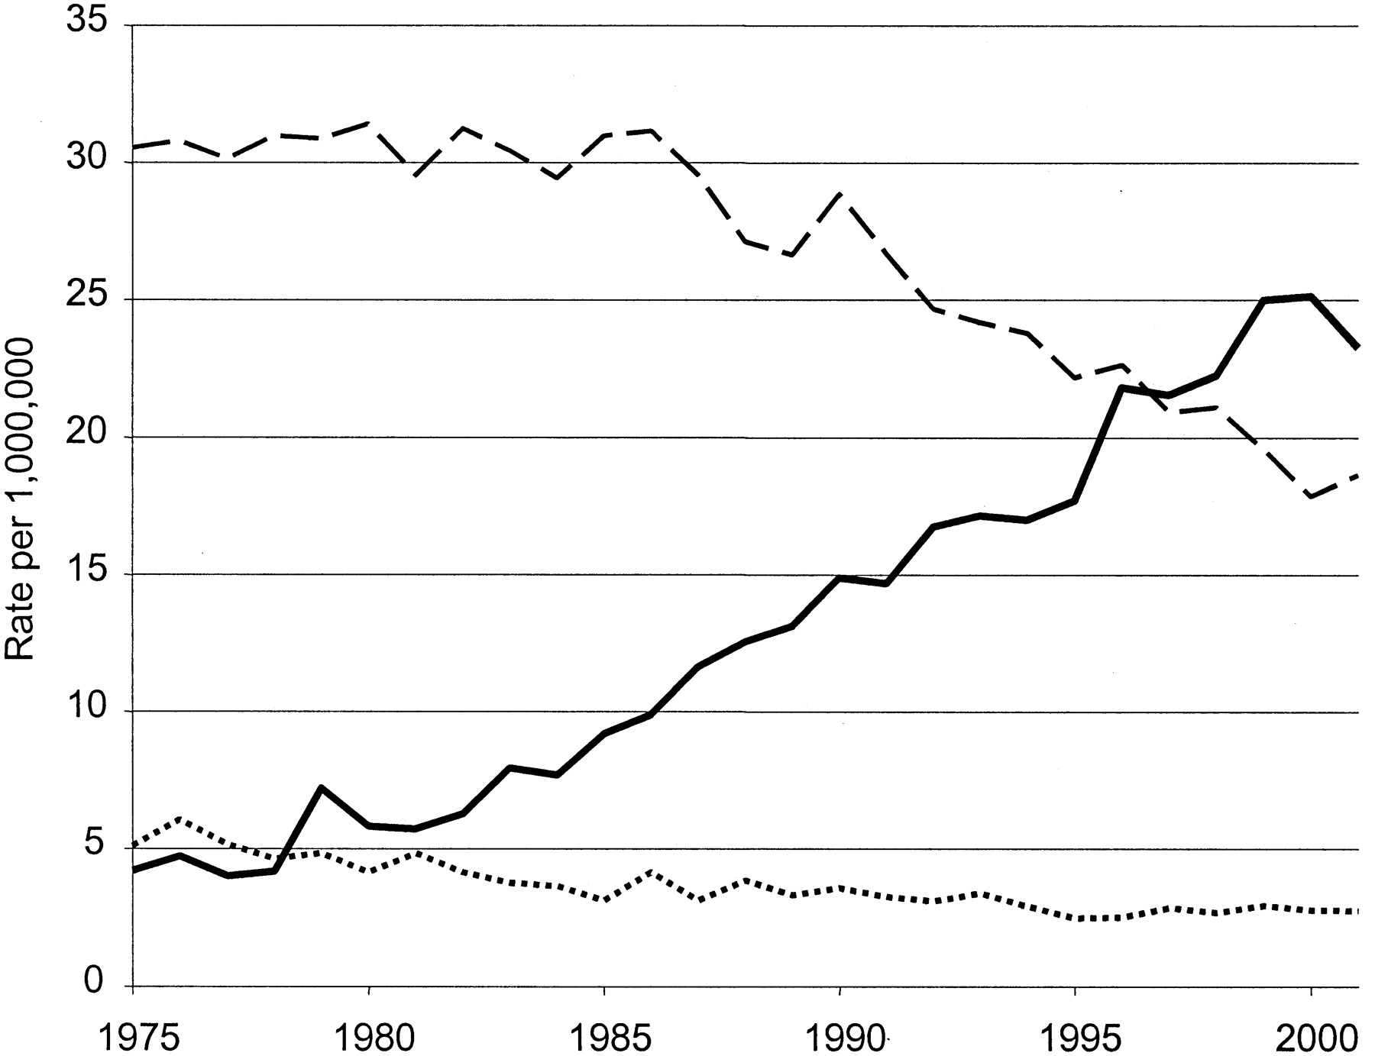
Fig. 2. Histology and esophageal cancer incidence (1975–2001). Data from the National Cancer Institute’s ...
Notes:
Fig. 2. Histology and esophageal cancer incidence (1975–2001). Data from the National Cancer Institute’s Surveillance, Epidemiology, and End Results program with age-adjustment using the 2000 U.S. standard population. Solid black line = adenocarcinoma; dashed line = squamous cell carcinoma; dotted line = not otherwise specified.
Unless provided in the caption above, the following copyright applies to the content of this slide: © Oxford University Press

Slide 3
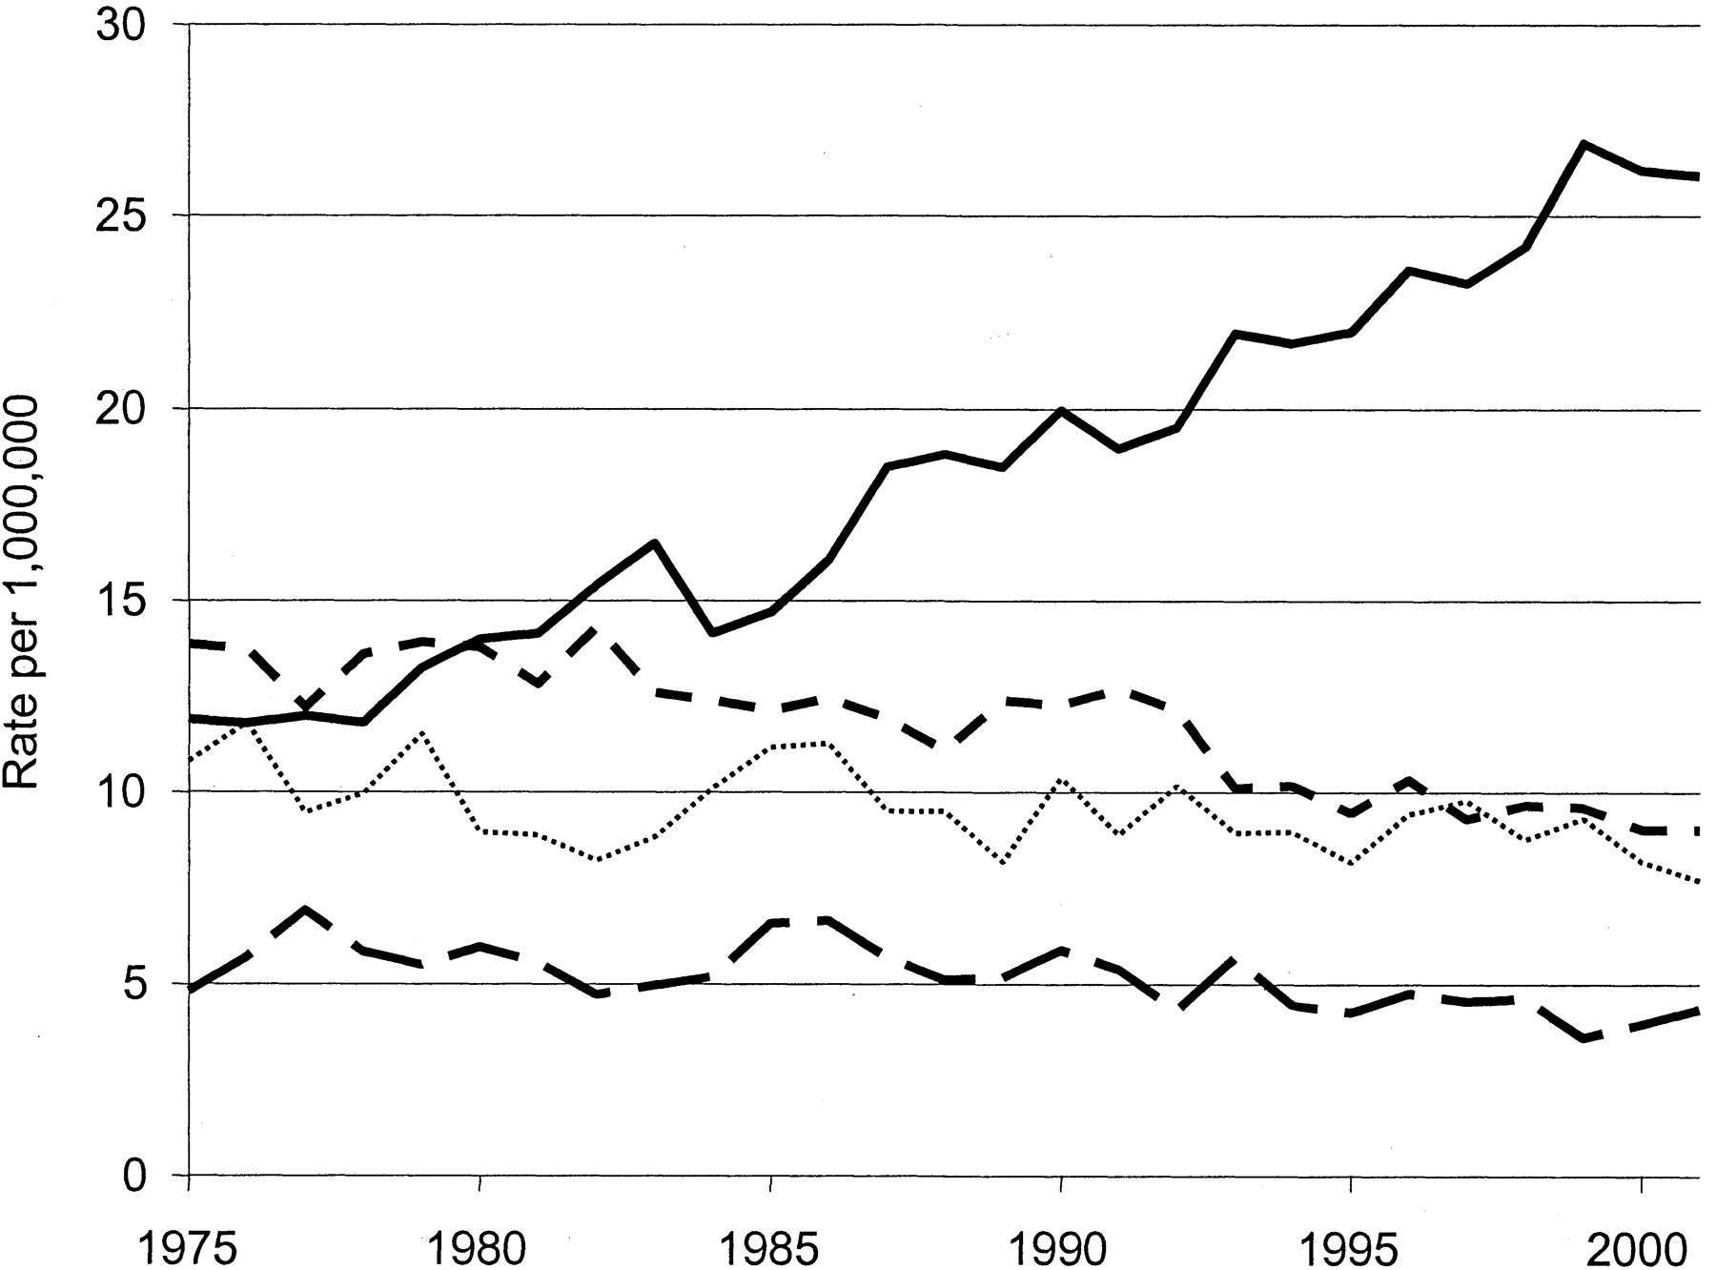
Fig. 3. Anatomic location and esophageal cancer incidence (1975–2001). Data from the National Cancer Institute’s ...
Notes:
Fig. 3. Anatomic location and esophageal cancer incidence (1975–2001). Data from the National Cancer Institute’s Surveillance, Epidemiology, and End Results program with age-adjustment using the 2000 U.S. standard population. Solid black line = lower third of the esophagus; short dashed line = middle third of the esophagus; long dashed line = upper third of the esophagus; dotted line = not clearly categorized.
Unless provided in the caption above, the following copyright applies to the content of this slide: © Oxford University Press

Slide 4
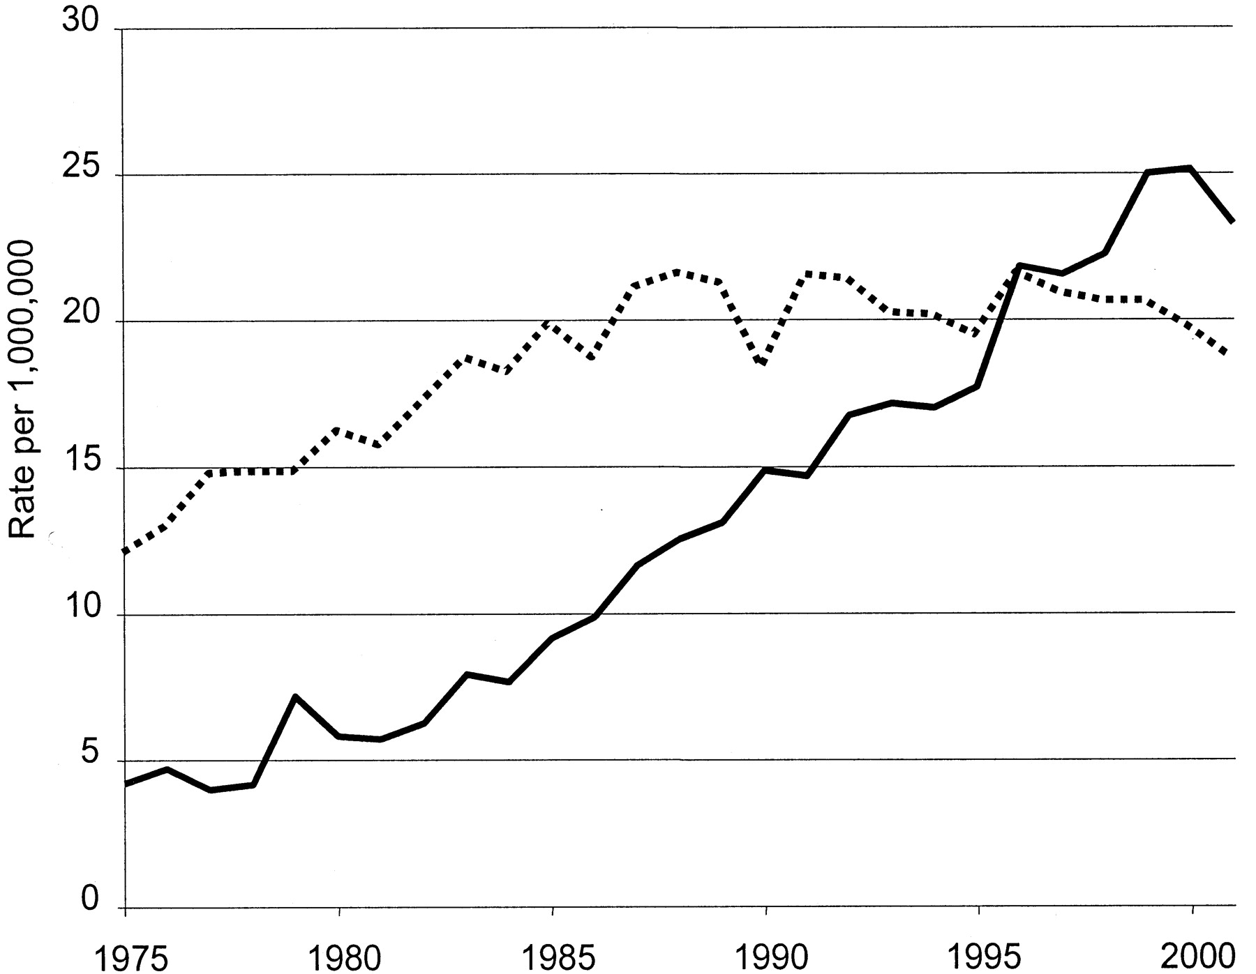
Fig. 4. Trends in incidence of adenocarcinoma of the cardia and the esophagus (1975–2001). Data from the National ...
Notes:
Fig. 4. Trends in incidence of adenocarcinoma of the cardia and the esophagus (1975–2001). Data from the National Cancer Institute’s Surveillance, Epidemiology, and End Results program with age-adjustment using the 2000 U.S. standard population. Solid black line = adenocarcinoma of the esophagus; dotted line = adenocarcinoma of the gastric cardia.
Unless provided in the caption above, the following copyright applies to the content of this slide: © Oxford University Press

Slide 5
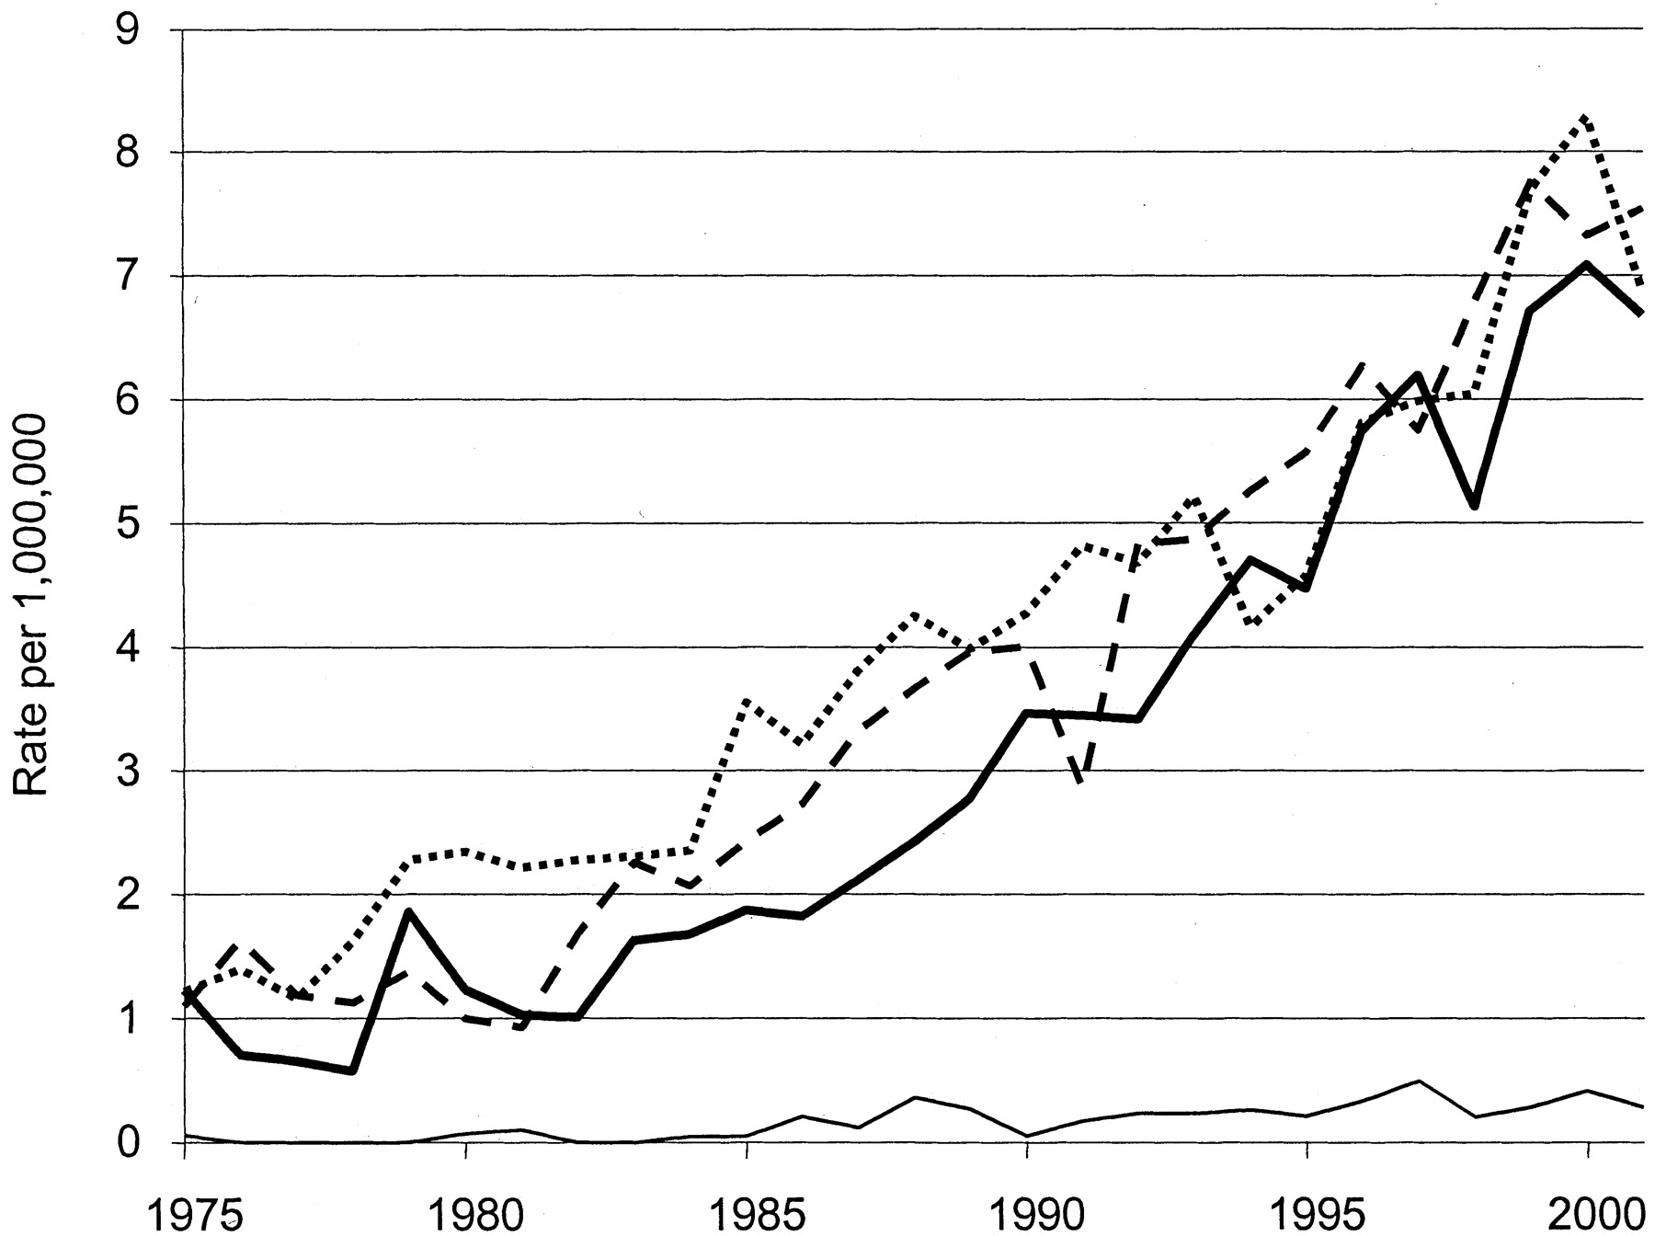
Fig. 5. Trends in stages of esophageal adenocarcinoma at diagnosis (1975–2001). Data from the National Cancer ...
Notes:
Fig. 5. Trends in stages of esophageal adenocarcinoma at diagnosis (1975–2001). Data from the National Cancer Institute’s Surveillance, Epidemiology, and End Results program with age-adjustment using the 2000 U.S. standard population. Dotted line = distant; dashed line = regional; solid black line = localized; line = in situ.
Unless provided in the caption above, the following copyright applies to the content of this slide: © Oxford University Press

Slide 6
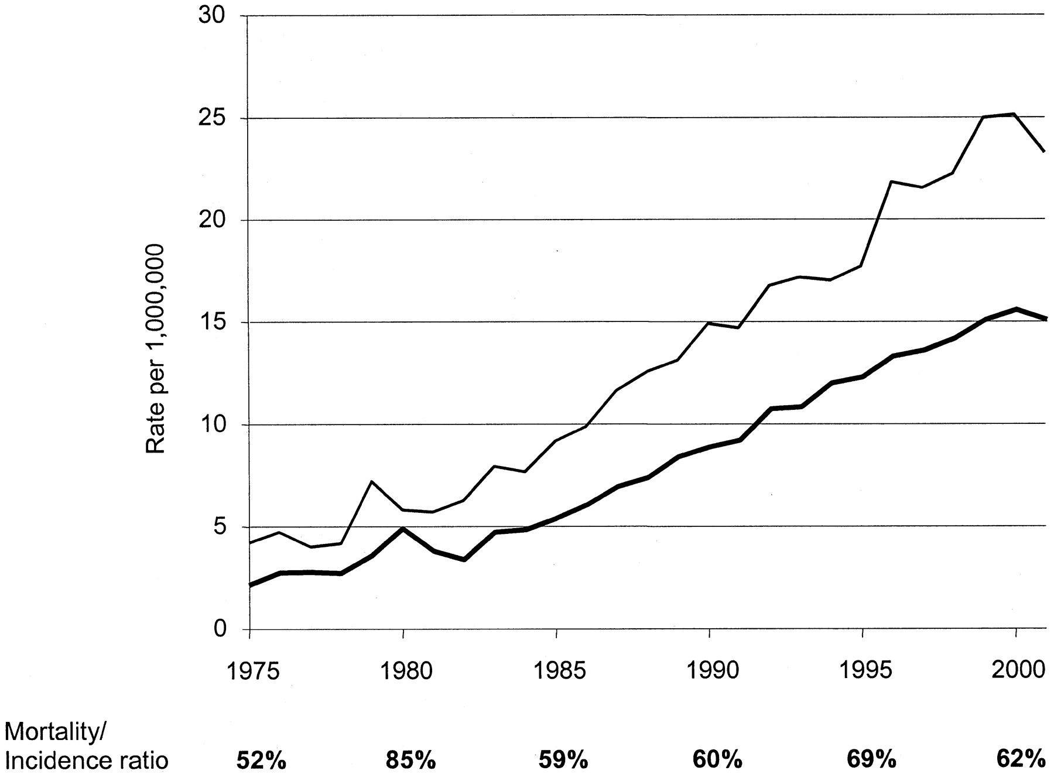
Fig. 6. Disease-specific mortality and incidence of esophageal adenocarcinoma (1975–2001). Data from the National ...
Notes:
Fig. 6. Disease-specific mortality and incidence of esophageal adenocarcinoma (1975–2001). Data from the National Cancer Institute’s Surveillance, Epidemiology, and End Results program with age-adjustment using the 2000 U.S. standard population. Baseline was the average incidence (or mortality) between 1973 and 1975. Line = incidence; solid black line = mortality.
Unless provided in the caption above, the following copyright applies to the content of this slide: © Oxford University Press

