Slide 1
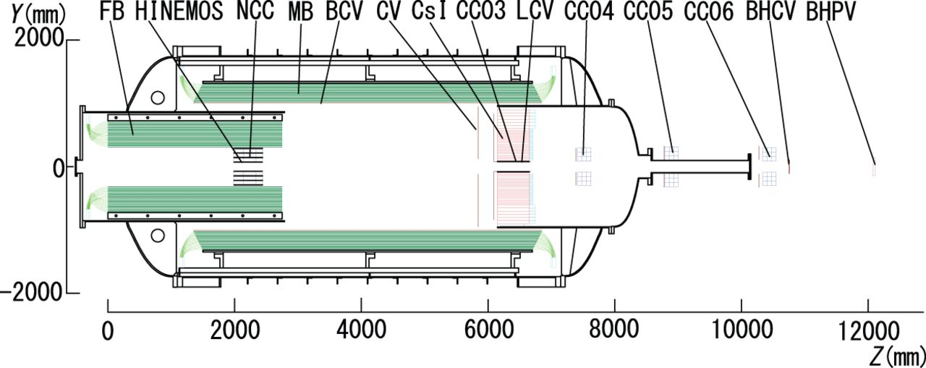
Fig. 1. Cross-sectional view of the KOTO detector. “CV” indicates the charged-particle counter that we have ...
Notes:
Fig. 1. Cross-sectional view of the KOTO detector. “CV” indicates the charged-particle counter that we have developed. Most of the detectors, including the CV, are installed in a cylindrical vacuum chamber. We search for the $K_L \rightarrow \pi ^0 \nu \bar {\nu }$ decay in flight that occurs in the central region of the vacuum chamber.
Unless provided in the caption above, the following copyright applies to the content of this slide: © The Author(s) 2016. Published by Oxford University Press on behalf of the Physical Society of Japan.This is an Open Access article distributed under the terms of the Creative Commons Attribution License (http://creativecommons.org/licenses/by/4.0/), which permits unrestricted reuse, distribution, and reproduction in any medium, provided the original work is properly cited.

Slide 2
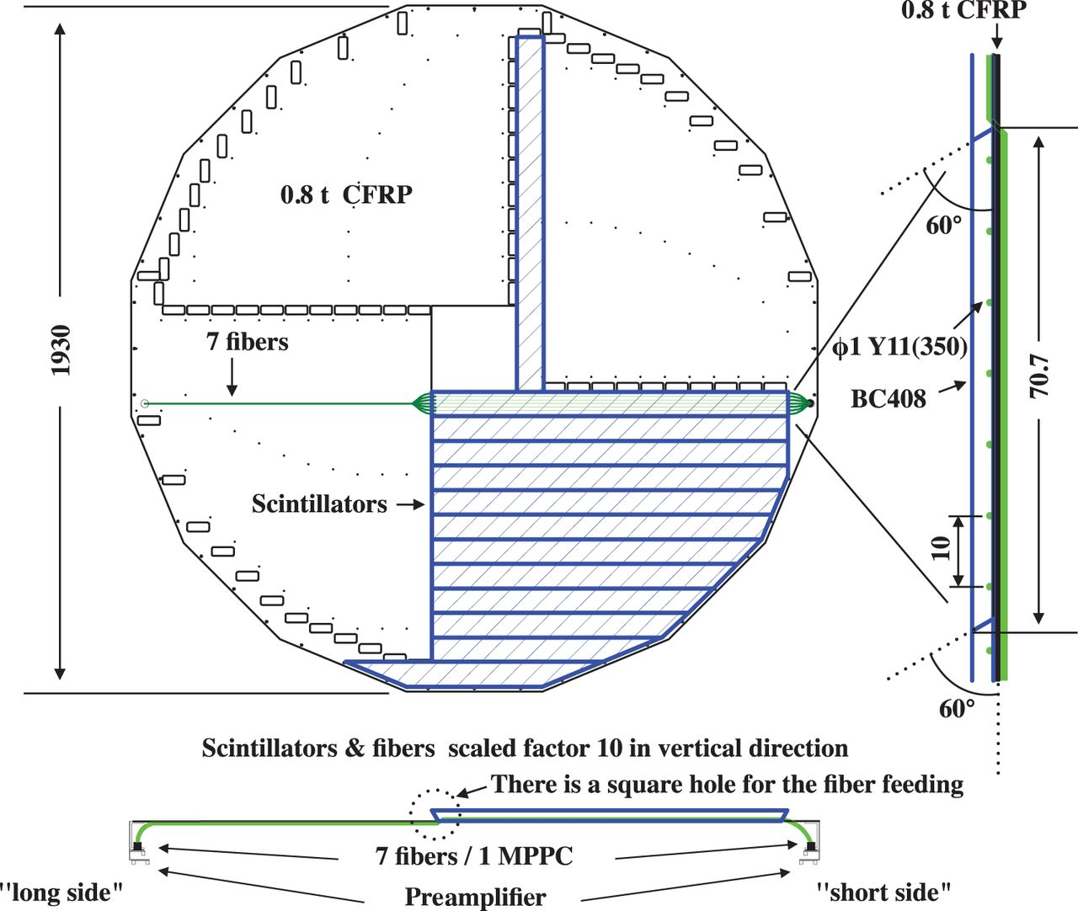
Fig. 2. Schematic view of a CV front layer. The figure at the bottom shows the side view of the scintillator near the ...
Notes:
Fig. 2. Schematic view of a CV front layer. The figure at the bottom shows the side view of the scintillator near the center viewed from the bottom. We call the ends of a strip the “long side” and the “short side”, according to the length of fibers extending out of the strip. In the bottom figure, the “long side” is the left side and the “short side” is the right side of the strip. The figure on the right shows a side view of the scintillator viewed from the right. Each layer has a quadrant structure with 90$^\circ $ symmetry. Plastic scintillator strips are tied onto an octagonal supporting CFRP plate with fluorocarbon wires passing through the cutouts in the edges of the strips. Rectangular holes on the CFRP plate are for routing WLS fibers to MPPCs at the outer circumference.
Unless provided in the caption above, the following copyright applies to the content of this slide: © The Author(s) 2016. Published by Oxford University Press on behalf of the Physical Society of Japan.This is an Open Access article distributed under the terms of the Creative Commons Attribution License (http://creativecommons.org/licenses/by/4.0/), which permits unrestricted reuse, distribution, and reproduction in any medium, provided the original work is properly cited.

Slide 3
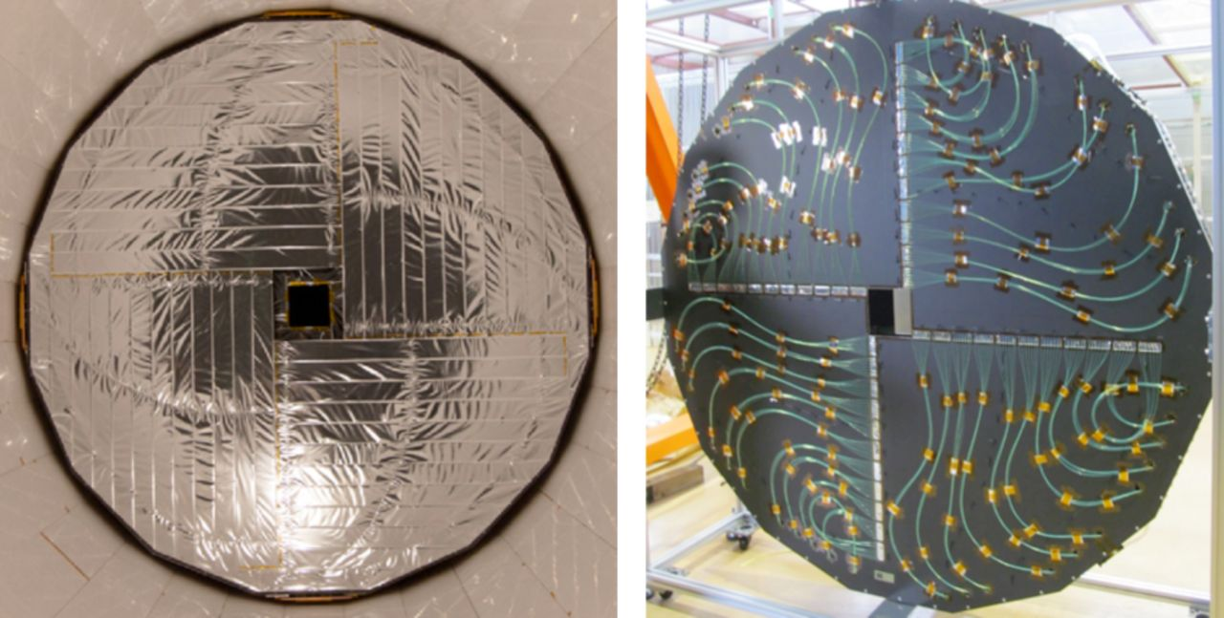
Fig. 3. Photographs of the CV layers. The left photograph shows an upstream view of the front layer. The scintillator ...
Notes:
Fig. 3. Photographs of the CV layers. The left photograph shows an upstream view of the front layer. The scintillator strips are wrapped with aluminized mylar sheets. The right photograph shows a downstream view of the rear layer. The wavelength-shifting fibers, which come from the scintillators on the upstream side of the CFRP plate through the holes, are routed to MPPCs on the outer supporting ring.
Unless provided in the caption above, the following copyright applies to the content of this slide: © The Author(s) 2016. Published by Oxford University Press on behalf of the Physical Society of Japan.This is an Open Access article distributed under the terms of the Creative Commons Attribution License (http://creativecommons.org/licenses/by/4.0/), which permits unrestricted reuse, distribution, and reproduction in any medium, provided the original work is properly cited.

Slide 4
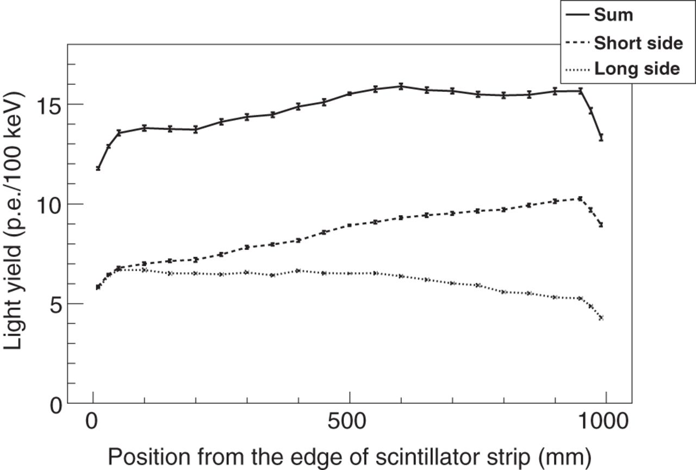
Fig. 4. Example of the light yield distribution as a function of the position of the $^{90}$Sr $\beta $ source. The ...
Notes:
Fig. 4. Example of the light yield distribution as a function of the position of the $^{90}$Sr $\beta $ source. The horizontal axis indicates the distance of the source from the “long side” end of the strip. The configuration of “short side” and “long side” were mentioned in the caption of Fig. 2. The measured light yield was attenuated along the distance from the readout. The light yield was low in the regions where the fibers are not embedded in the scintillator.
Unless provided in the caption above, the following copyright applies to the content of this slide: © The Author(s) 2016. Published by Oxford University Press on behalf of the Physical Society of Japan.This is an Open Access article distributed under the terms of the Creative Commons Attribution License (http://creativecommons.org/licenses/by/4.0/), which permits unrestricted reuse, distribution, and reproduction in any medium, provided the original work is properly cited.

Slide 5
Fig. 5. Schematic of the MPPC bias and readout circuit. The left part indicates the MPPC and the bias voltage ...
Notes:
Fig. 5. Schematic of the MPPC bias and readout circuit. The left part indicates the MPPC and the bias voltage connection, and the right part indicates the preamplifier circuit.
Unless provided in the caption above, the following copyright applies to the content of this slide: © The Author(s) 2016. Published by Oxford University Press on behalf of the Physical Society of Japan.This is an Open Access article distributed under the terms of the Creative Commons Attribution License (http://creativecommons.org/licenses/by/4.0/), which permits unrestricted reuse, distribution, and reproduction in any medium, provided the original work is properly cited.

Slide 6
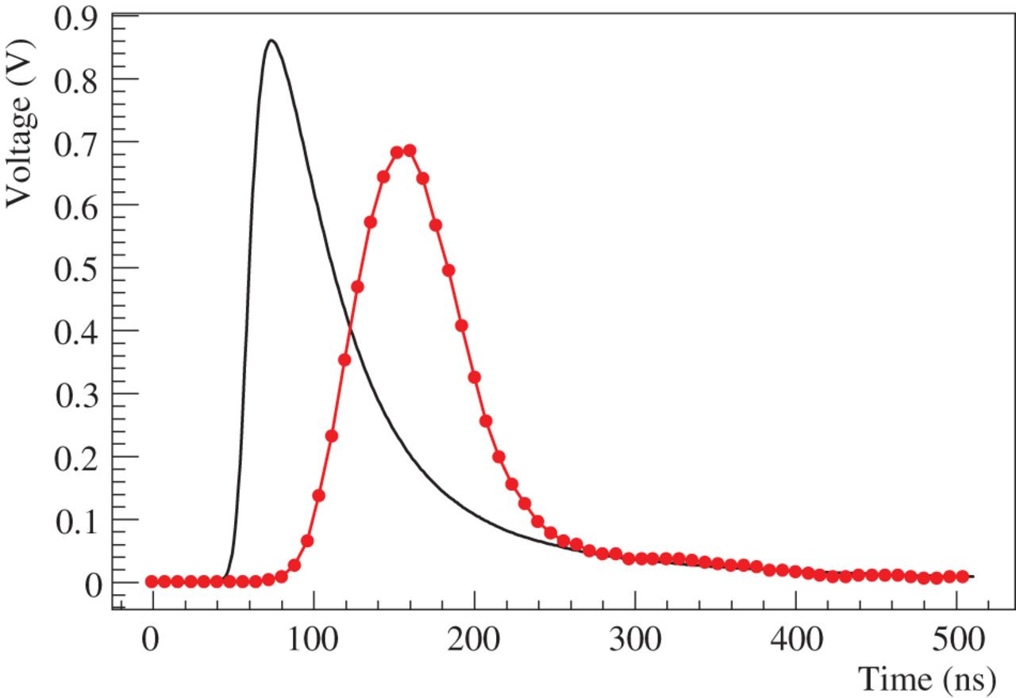
Fig. 6. Example of a CV pulse shape of charged particles. The smooth line shows the output of the preamplifier. The ...
Notes:
Fig. 6. Example of a CV pulse shape of charged particles. The smooth line shows the output of the preamplifier. The dots indicate data recorded by a 125 MHz ADC module, drawn with a poly-line through the data points. Both waveforms were obtained by averaging over 10 000 pulses.
Unless provided in the caption above, the following copyright applies to the content of this slide: © The Author(s) 2016. Published by Oxford University Press on behalf of the Physical Society of Japan.This is an Open Access article distributed under the terms of the Creative Commons Attribution License (http://creativecommons.org/licenses/by/4.0/), which permits unrestricted reuse, distribution, and reproduction in any medium, provided the original work is properly cited.

Slide 7
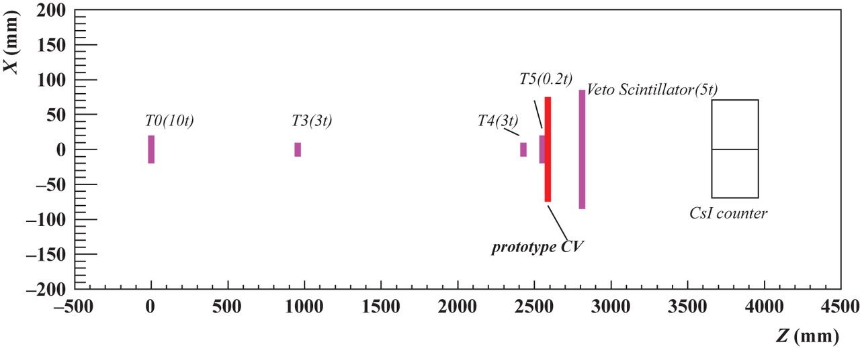
Fig. 7. Plan view of the setup for the performance study at ELPH at Tohoku University. Four plastic scintillators ...
Notes:
Fig. 7. Plan view of the setup for the performance study at ELPH at Tohoku University. Four plastic scintillators (T0, T3, T4, and T5) defined the positron beam, while another scintillator (veto scintillator) and an electromagnetic calorimeter (CsI counter) were located behind the prototype strip to identify annihilation events.
Unless provided in the caption above, the following copyright applies to the content of this slide: © The Author(s) 2016. Published by Oxford University Press on behalf of the Physical Society of Japan.This is an Open Access article distributed under the terms of the Creative Commons Attribution License (http://creativecommons.org/licenses/by/4.0/), which permits unrestricted reuse, distribution, and reproduction in any medium, provided the original work is properly cited.

Slide 8
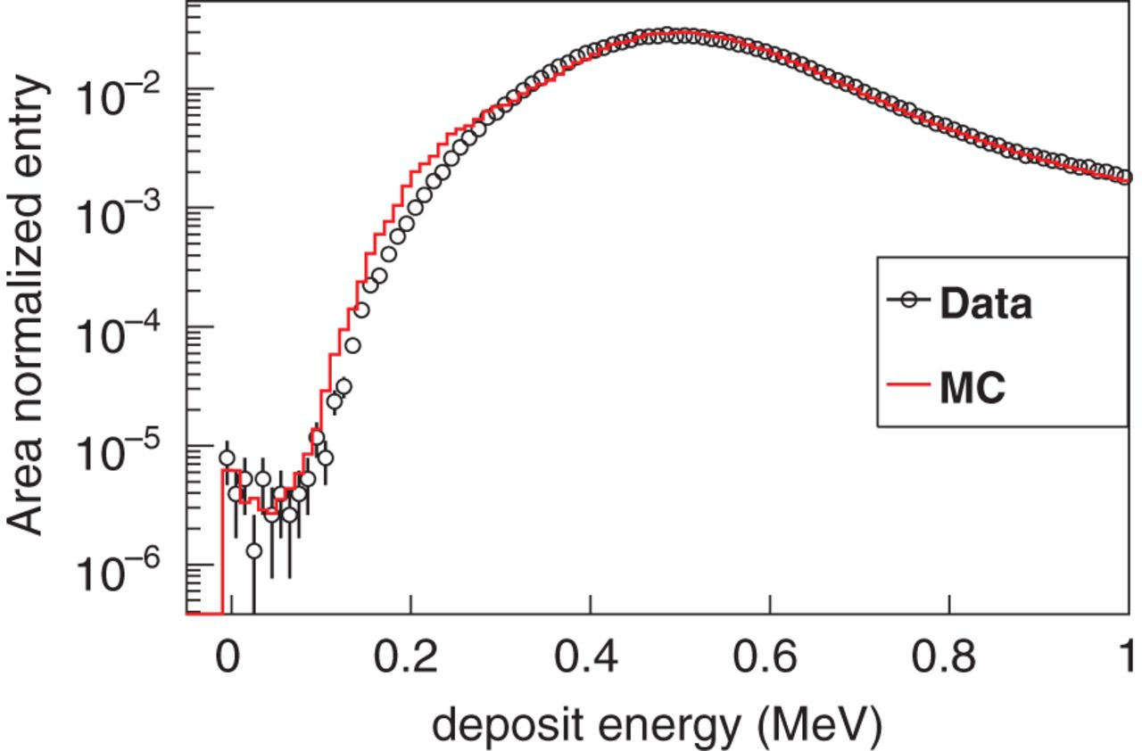
Fig. 8. Energy deposit in the prototype strip. The energy scale of the data was determined so that the peak values in ...
Notes:
Fig. 8. Energy deposit in the prototype strip. The energy scale of the data was determined so that the peak values in the data and the simulation matched each other. The spectrum of the data was normalized to the area over a full energy range. The simulated spectrum was also normalized in the same way. The energy spectrum of the simulation was smeared with the measured light yield in this measurement (6.8 p.e./100 keV).
Unless provided in the caption above, the following copyright applies to the content of this slide: © The Author(s) 2016. Published by Oxford University Press on behalf of the Physical Society of Japan.This is an Open Access article distributed under the terms of the Creative Commons Attribution License (http://creativecommons.org/licenses/by/4.0/), which permits unrestricted reuse, distribution, and reproduction in any medium, provided the original work is properly cited.

Slide 9
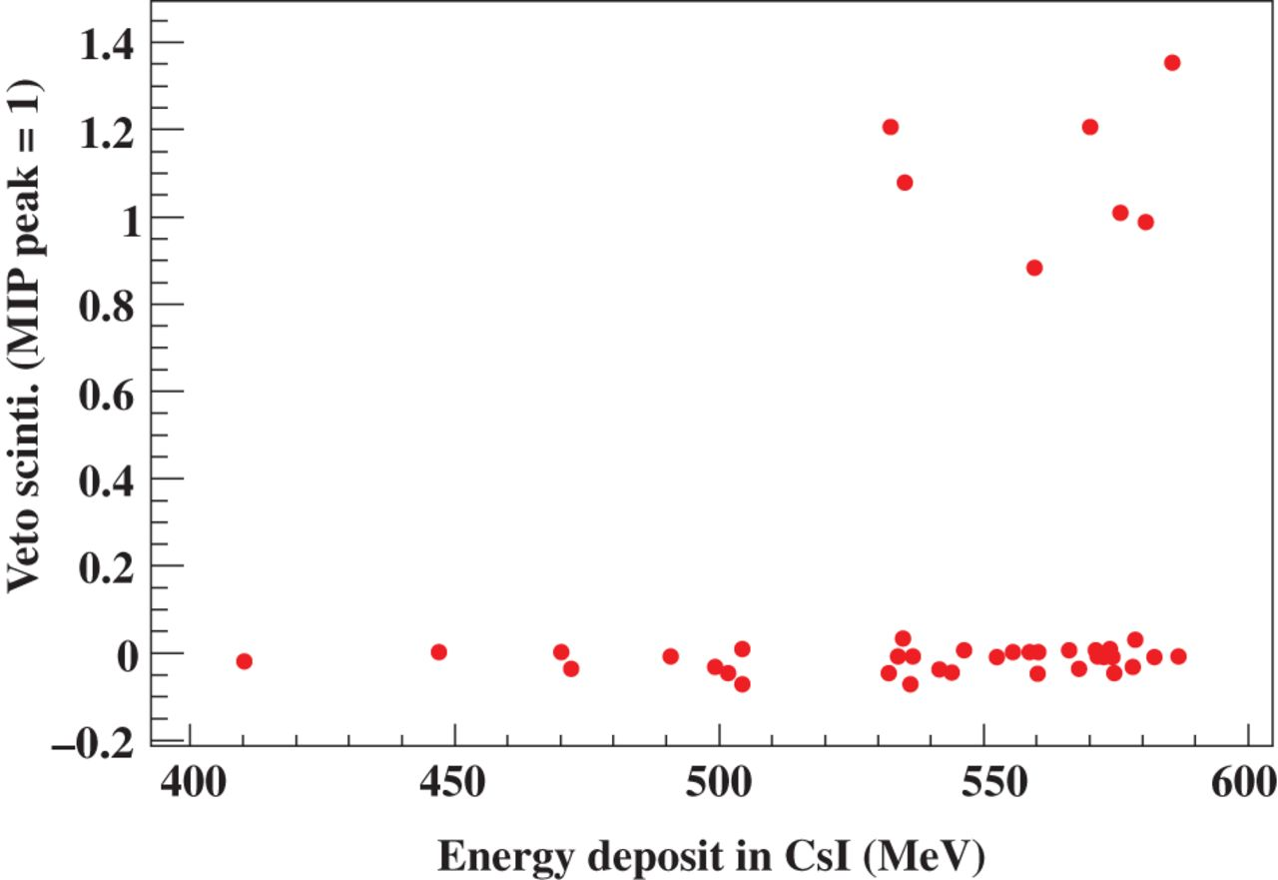
Fig. 9. Correlation between the energy deposits in the CsI counter and the veto scintillator. The energy deposit in ...
Notes:
Fig. 9. Correlation between the energy deposits in the CsI counter and the veto scintillator. The energy deposit in the veto scintillator is normalized by the MIP peak value.
Unless provided in the caption above, the following copyright applies to the content of this slide: © The Author(s) 2016. Published by Oxford University Press on behalf of the Physical Society of Japan.This is an Open Access article distributed under the terms of the Creative Commons Attribution License (http://creativecommons.org/licenses/by/4.0/), which permits unrestricted reuse, distribution, and reproduction in any medium, provided the original work is properly cited.

Slide 10
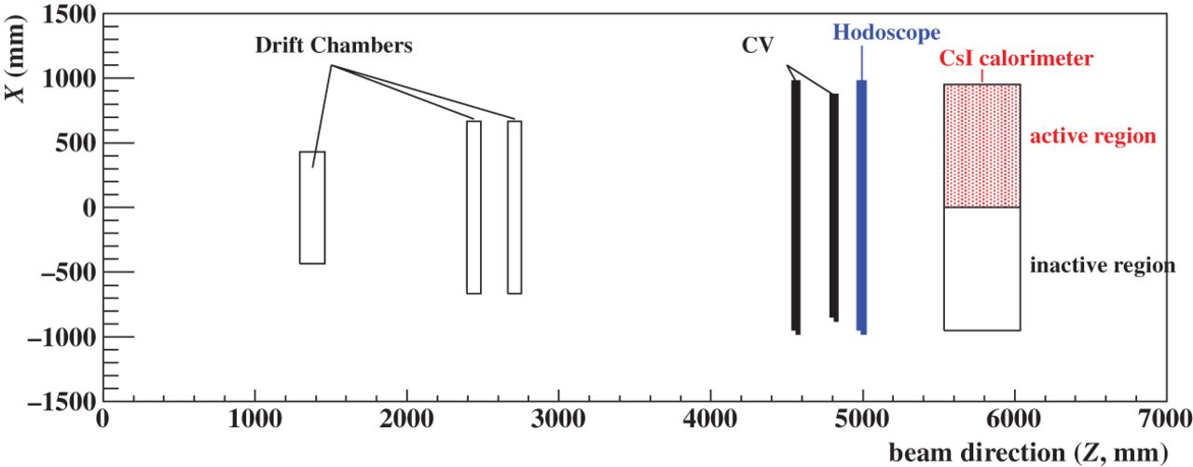
Fig. 10. Setup of the performance study at the KL beam line. Three sets of drift chambers were used to track charged ...
Notes:
Fig. 10. Setup of the performance study at the KL beam line. Three sets of drift chambers were used to track charged particles, and a hodoscope placed downstream of the CV layers was used to trigger events.
Unless provided in the caption above, the following copyright applies to the content of this slide: © The Author(s) 2016. Published by Oxford University Press on behalf of the Physical Society of Japan.This is an Open Access article distributed under the terms of the Creative Commons Attribution License (http://creativecommons.org/licenses/by/4.0/), which permits unrestricted reuse, distribution, and reproduction in any medium, provided the original work is properly cited.

Slide 11
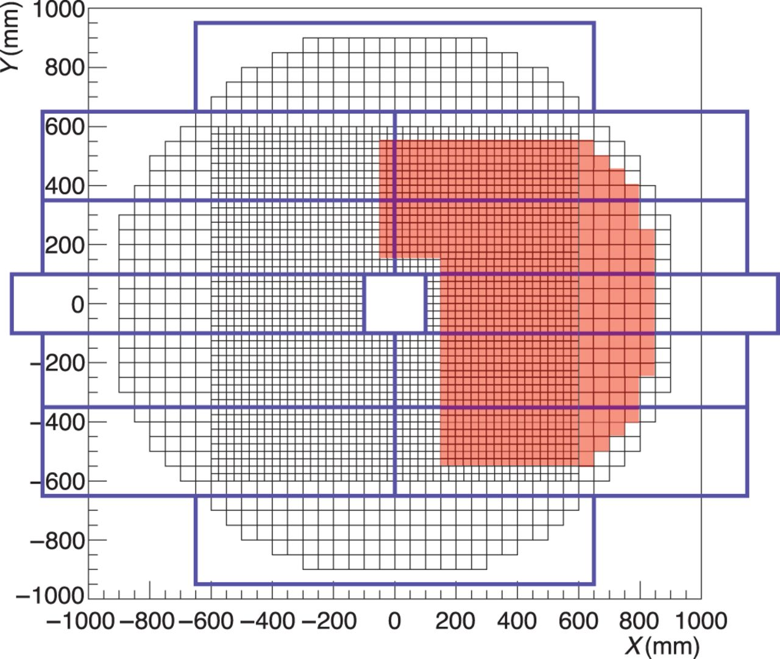
Fig. 11. Rear view of the trigger hodoscope and the calorimeter. Twelve scintillator plates, represented as ...
Notes:
Fig. 11. Rear view of the trigger hodoscope and the calorimeter. Twelve scintillator plates, represented as rectangular boxes, covered the whole region of the CV and the calorimeter. The two sizes of squares in the array show the small and large CsI crystals in the calorimeter. In this study, only the region of the calorimeter shown in red was used for the inefficiency measurement.
Unless provided in the caption above, the following copyright applies to the content of this slide: © The Author(s) 2016. Published by Oxford University Press on behalf of the Physical Society of Japan.This is an Open Access article distributed under the terms of the Creative Commons Attribution License (http://creativecommons.org/licenses/by/4.0/), which permits unrestricted reuse, distribution, and reproduction in any medium, provided the original work is properly cited.

Slide 12
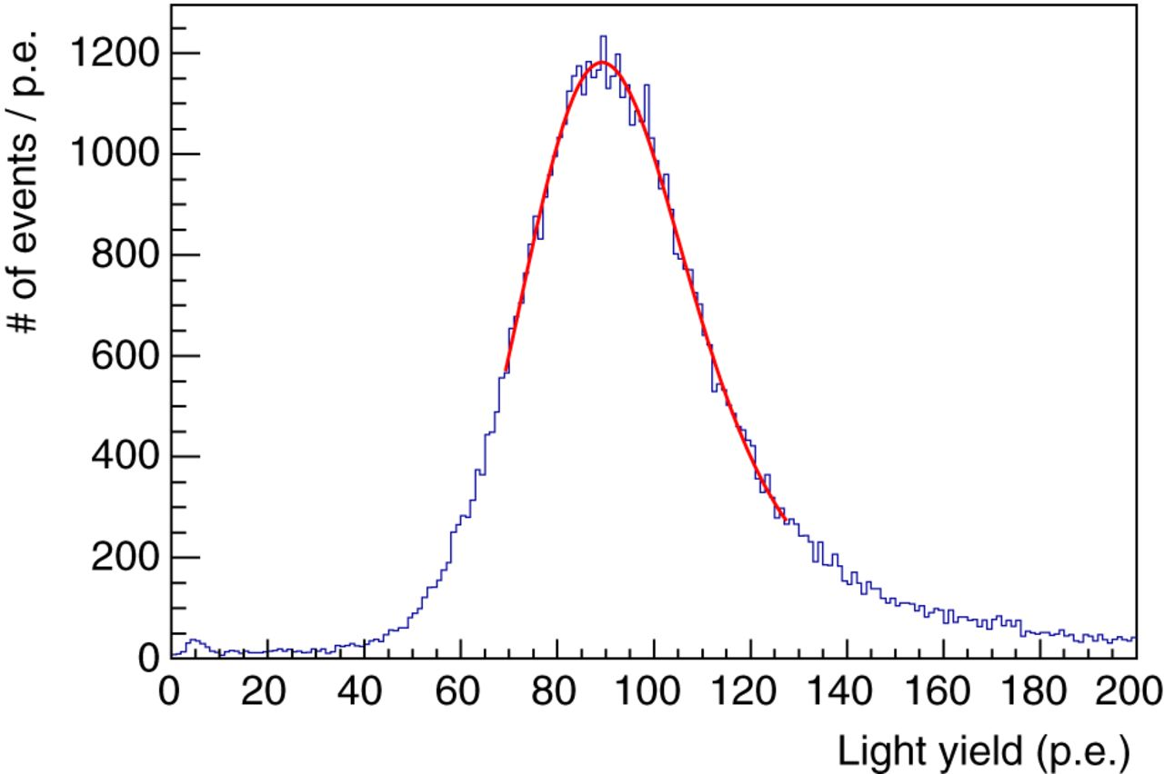
Fig. 12. Example of the light yield distribution of a CV strip. The histogram indicates the data, and the curve around ...
Notes:
Fig. 12. Example of the light yield distribution of a CV strip. The histogram indicates the data, and the curve around the peak shows the fit corresponding to the convoluted function of Landau and Gaussian distributions. The events around $0\,{\rm p.e.}$ are due to scattering or decay in flight after the chambers.
Unless provided in the caption above, the following copyright applies to the content of this slide: © The Author(s) 2016. Published by Oxford University Press on behalf of the Physical Society of Japan.This is an Open Access article distributed under the terms of the Creative Commons Attribution License (http://creativecommons.org/licenses/by/4.0/), which permits unrestricted reuse, distribution, and reproduction in any medium, provided the original work is properly cited.

Slide 13
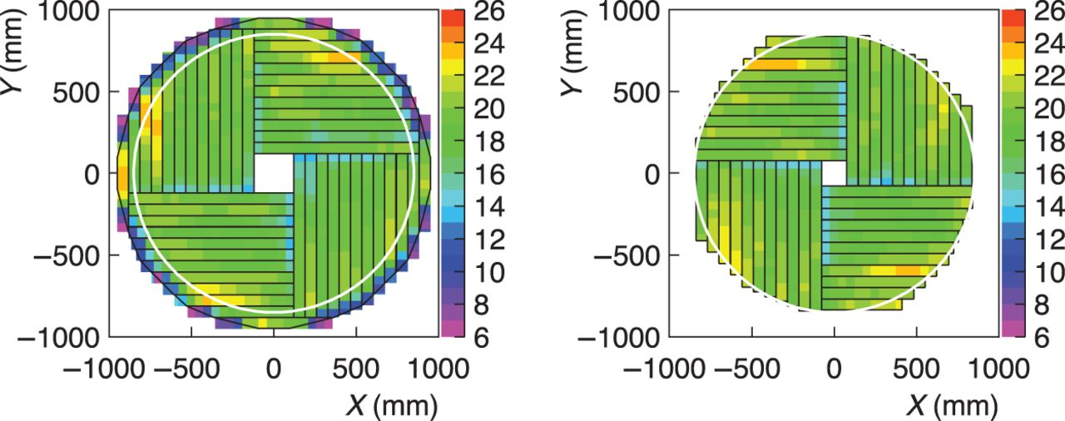
Fig. 13. Position dependence of the light yield. The left and right panels correspond to the results of the CV front ...
Notes:
Fig. 13. Position dependence of the light yield. The left and right panels correspond to the results of the CV front and rear layers, respectively. Color indicates the light yield in units of ${\rm p.e.}/100\,{\rm keV}$, as shown in the legend. The white circle shows a radius of $850\,{\rm mm}$. Smaller yields were observed at the ends of strips, which were due to smaller light collection in the regions where the fibers were not embedded in the scintillator (the outer ends of the strips in the rear layer do not have these regions of reduced light yield and thus no decreases were observed). Because the length of the WLS fibers for the long side at the outer strips is shorter than that at the inner strips due to the routing of the WLS fibers, the light yield in the outer region tends to be higher than that in the inner region. Higher light yields in some outer strips came from fluctuations in the scintillator thickness.
Unless provided in the caption above, the following copyright applies to the content of this slide: © The Author(s) 2016. Published by Oxford University Press on behalf of the Physical Society of Japan.This is an Open Access article distributed under the terms of the Creative Commons Attribution License (http://creativecommons.org/licenses/by/4.0/), which permits unrestricted reuse, distribution, and reproduction in any medium, provided the original work is properly cited.

Slide 14
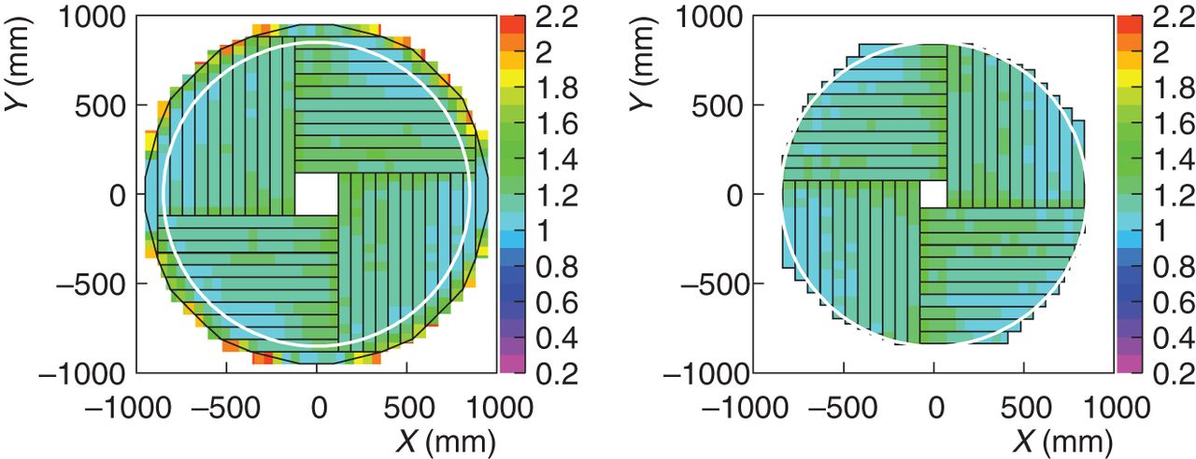
Fig. 14. Position dependence of the timing resolution ($\sigma _{\rm Mean}$). The left and right panels correspond to ...
Notes:
Fig. 14. Position dependence of the timing resolution ($\sigma _{\rm Mean}$). The left and right panels correspond to the results of the CV front and rear layers, respectively. Color indicates the timing resolution in units of ns, as shown in the legend.
Unless provided in the caption above, the following copyright applies to the content of this slide: © The Author(s) 2016. Published by Oxford University Press on behalf of the Physical Society of Japan.This is an Open Access article distributed under the terms of the Creative Commons Attribution License (http://creativecommons.org/licenses/by/4.0/), which permits unrestricted reuse, distribution, and reproduction in any medium, provided the original work is properly cited.

Slide 15
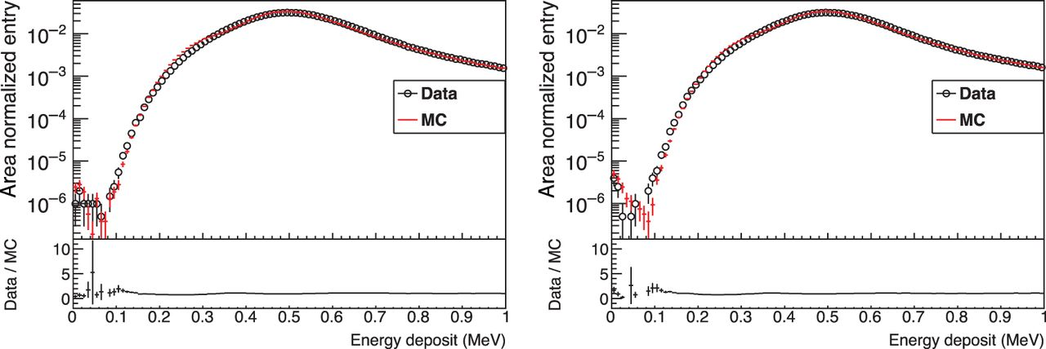
Fig. 15. Energy deposit distribution of the CV layers after applying all the cuts. The left and right panels ...
Notes:
Fig. 15. Energy deposit distribution of the CV layers after applying all the cuts. The left and right panels correspond to the results of the front and rear layers, respectively. The dots show the data and the histogram shows simulation results. These spectra were normalized in the same way as in Fig. 8. The small discrepancy in the region around 300 keV was considered to be due to the reproducibility of the response in the region where the WLS fibers were embedded. In addition, the discrepancy in the region lower than 150 keV was considered to be due to the reproducibility at the boundary of the scintillator. The light collection at the boundary is smaller.
Unless provided in the caption above, the following copyright applies to the content of this slide: © The Author(s) 2016. Published by Oxford University Press on behalf of the Physical Society of Japan.This is an Open Access article distributed under the terms of the Creative Commons Attribution License (http://creativecommons.org/licenses/by/4.0/), which permits unrestricted reuse, distribution, and reproduction in any medium, provided the original work is properly cited.

Slide 16
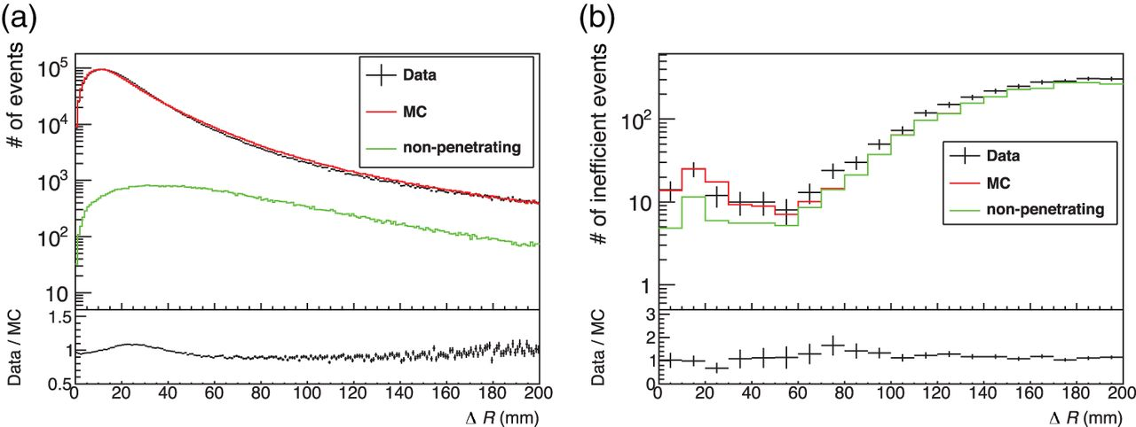
Fig. 16. (a) Distribution of “near-tracks” as a function of $\Delta R$. (b) Distribution as a function of $\Delta R$ ...
Notes:
Fig. 16. (a) Distribution of “near-tracks” as a function of $\Delta R$. (b) Distribution as a function of $\Delta R$ of the tracks that had energy deposits of less than 100 keV at the front layer or rear layer. The histogram labeled “non-penetrating” shows the events in which an uncharged particle hit the corresponding CV strip, according to the true information obtained from the simulation. The histogram for the simulation was normalized to the number of measured “near-tracks” for (a) and inefficient events for (b), respectively.
Unless provided in the caption above, the following copyright applies to the content of this slide: © The Author(s) 2016. Published by Oxford University Press on behalf of the Physical Society of Japan.This is an Open Access article distributed under the terms of the Creative Commons Attribution License (http://creativecommons.org/licenses/by/4.0/), which permits unrestricted reuse, distribution, and reproduction in any medium, provided the original work is properly cited.

Slide 17
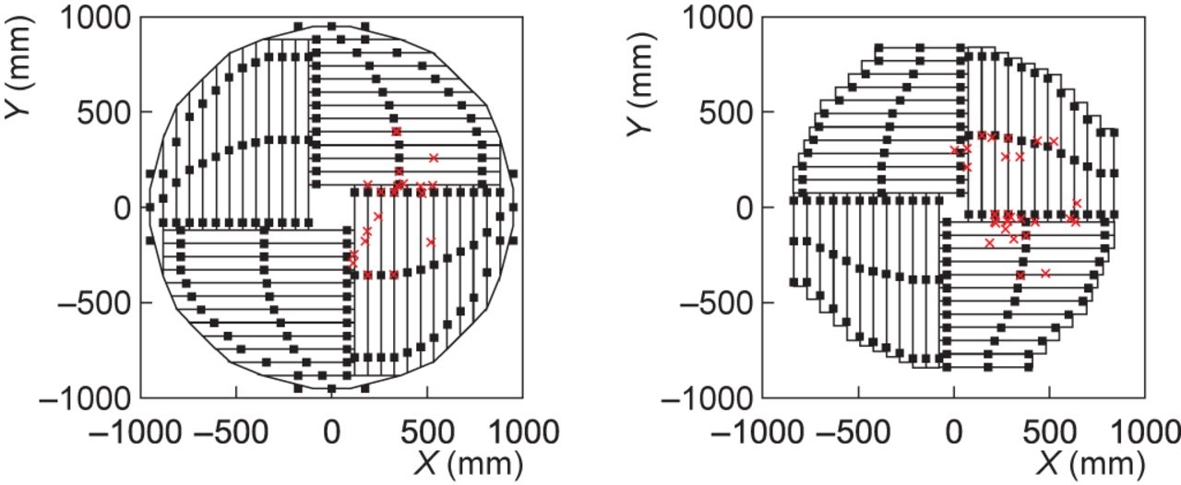
Fig. 17. Hit positions of the inefficiency tracks in the CV layers. The left and right panels show the front and rear ...
Notes:
Fig. 17. Hit positions of the inefficiency tracks in the CV layers. The left and right panels show the front and rear layers, respectively. The crosses show the positions calculated by the chamber tracking. The squares on the edges of the strips indicate the position of the cutouts used to hold the scintillator strips in place. The sizes of the cutouts are magnified 50 times in the plot.
Unless provided in the caption above, the following copyright applies to the content of this slide: © The Author(s) 2016. Published by Oxford University Press on behalf of the Physical Society of Japan.This is an Open Access article distributed under the terms of the Creative Commons Attribution License (http://creativecommons.org/licenses/by/4.0/), which permits unrestricted reuse, distribution, and reproduction in any medium, provided the original work is properly cited.

