Slide 1
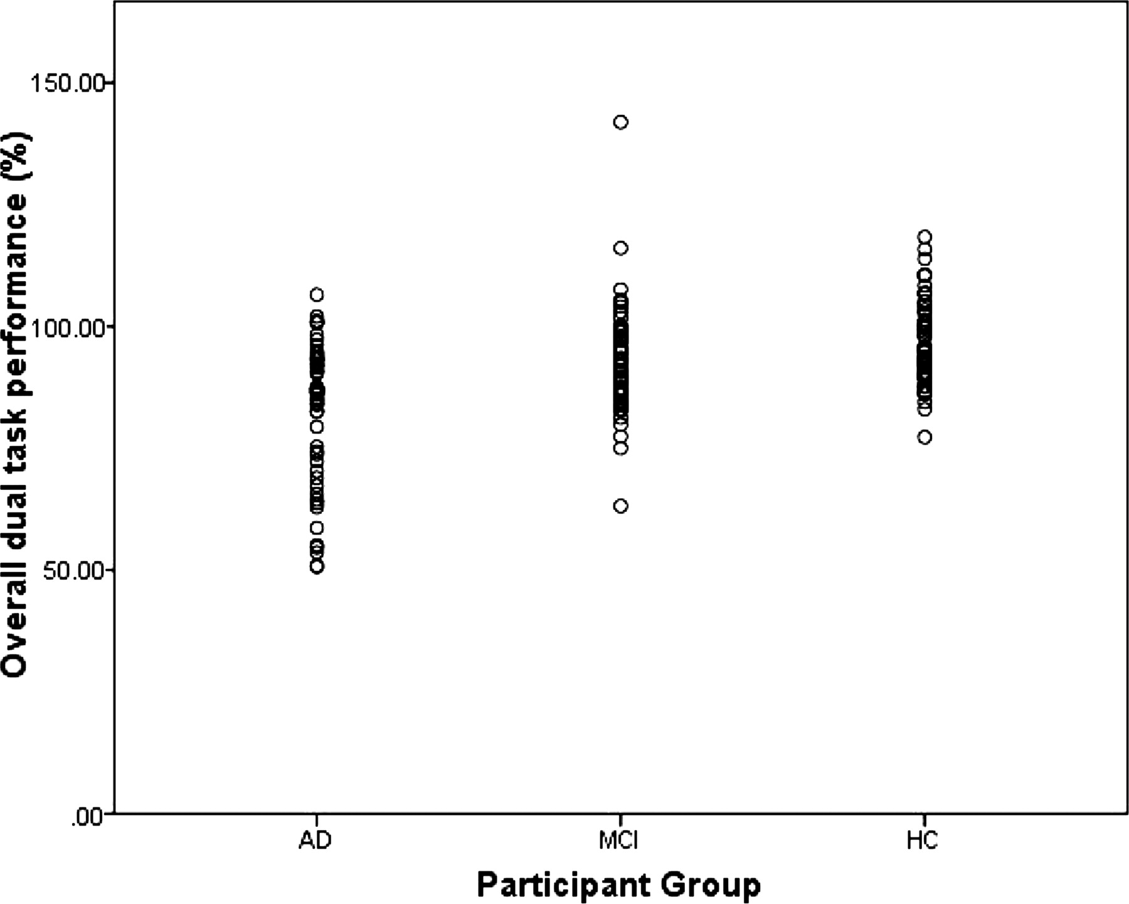
Fig. 1. A scatterplot of overall dual-task performance for AD, MCI, and healthy older adults.
Notes:
Fig. 1. A scatterplot of overall dual-task performance for AD, MCI, and healthy older adults.
Unless provided in the caption above, the following copyright applies to the content of this slide: © The Author 2011. Published by Oxford University Press. All rights reserved. For permissions, please e-mail: journals.permissions@oup.com.

Slide 2
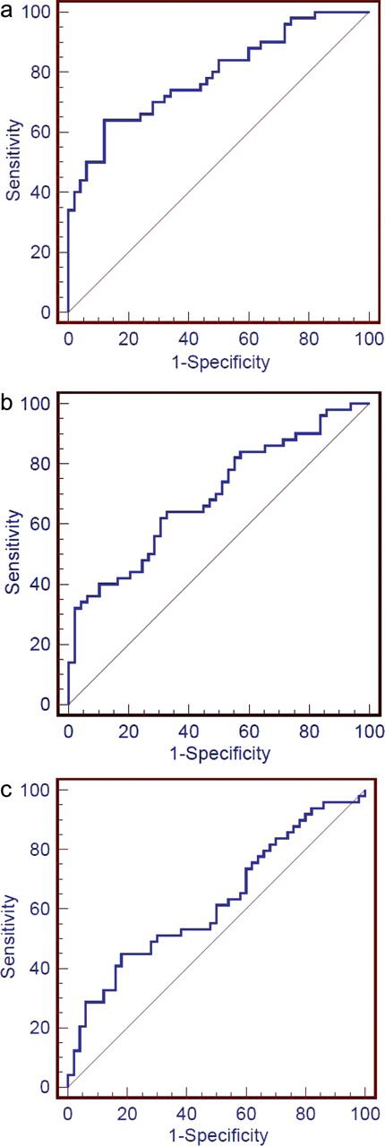
Fig. 2. (a) ROC curve depicting sensitivity and specificity of the overall dual-task measure. This curve compares the ...
Notes:
Fig. 2. (a) ROC curve depicting sensitivity and specificity of the overall dual-task measure. This curve compares the AD group using the healthy older adults as a reference group (higher sensitivity scores indicate higher performance). (b) ROC curve depicting sensitivity and specificity of the overall dual-task measure. This curve compares the AD group using the MCI patients as a reference group (higher sensitivity scores indicate higher performance). (c) ROC curve depicting sensitivity and specificity of the overall dual-task measure. This curve compares the MCI patients using the healthy older adults as a reference group (higher sensitivity scores indicate higher performance).
Unless provided in the caption above, the following copyright applies to the content of this slide: © The Author 2011. Published by Oxford University Press. All rights reserved. For permissions, please e-mail: journals.permissions@oup.com.

