Slide 1
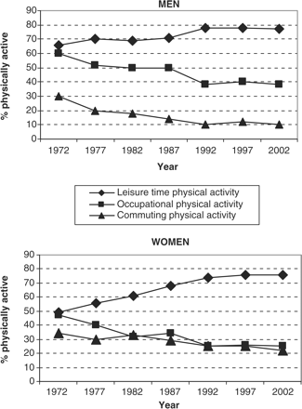
Figure 1 The 30-year trends of leisure time, occupational and commuting physical activity in men (upper panel) and ...
Notes:
Figure 1 The 30-year trends of leisure time, occupational and commuting physical activity in men (upper panel) and women (lower panel)
Unless provided in the caption above, the following copyright applies to the content of this slide: © The Author 2007. Published by Oxford University Press on behalf of the European Public Health Association. All rights reserved.

