Slide 1
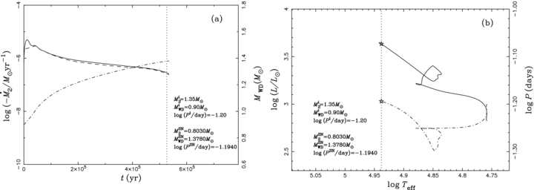
Figure 1 A representative case of binary evolution calculations, in which the binary system is in the weak He-shell ...
Notes:
Figure 1 A representative case of binary evolution calculations, in which the binary system is in the weak He-shell flashes phase at the moment of the SN explosion. In panel (a), the solid, dashed and dash–dotted curves show and MWD varying with time, respectively. In panel (b), the evolutionary track of the donor star is shown as a solid curve and the evolution of orbital period is shown as a dash–dotted curve. Dotted vertical lines in both panels and asterisks in panel (b) indicate the position where the WD is expected to explode as a SN Ia. The initial binary parameters and the parameters at the moment of the SN Ia explosion are also given in these two panels.
Unless provided in the caption above, the following copyright applies to the content of this slide: © 2009 The Authors. Journal compilation © 2009 RAS

Slide 2
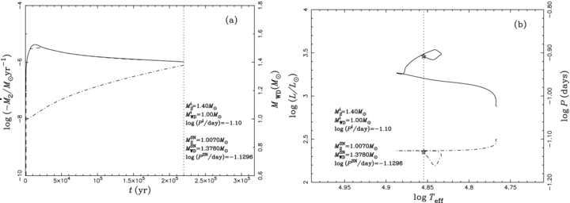
Figure 2 Similar to Fig. 1, but the binary system is in the stable He-shell burning phase at the moment of the SN ...
Notes:
Figure 2 Similar to Fig. 1, but the binary system is in the stable He-shell burning phase at the moment of the SN explosion.
Unless provided in the caption above, the following copyright applies to the content of this slide: © 2009 The Authors. Journal compilation © 2009 RAS

Slide 3
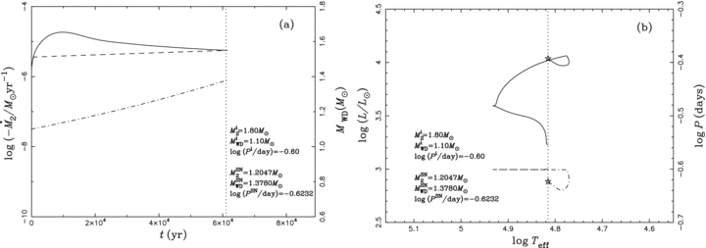
Figure 3 Similar to Fig. 1, but the binary system is in the optically thick wind phase at the moment of the SN ...
Notes:
Figure 3 Similar to Fig. 1, but the binary system is in the optically thick wind phase at the moment of the SN explosion.
Unless provided in the caption above, the following copyright applies to the content of this slide: © 2009 The Authors. Journal compilation © 2009 RAS

Slide 4
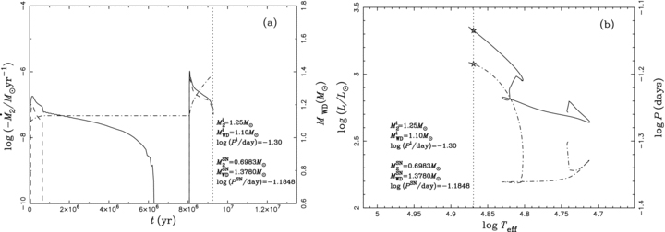
Figure 4 Similar to Fig. 1, but this case differs from those of Figs 1–3. Before the SN explosion, the binary system ...
Notes:
Figure 4 Similar to Fig. 1, but this case differs from those of Figs 1–3. Before the SN explosion, the binary system experiences two mass transfer phases.
Unless provided in the caption above, the following copyright applies to the content of this slide: © 2009 The Authors. Journal compilation © 2009 RAS

Slide 5
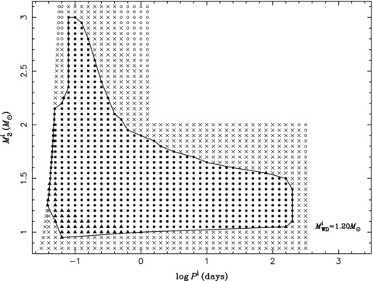
Figure 5 Final outcomes of the binary evolution calculations in the initial orbital period–secondary mass (log ...
Notes:
Figure 5 Final outcomes of the binary evolution calculations in the initial orbital period–secondary mass (log Pi, Mi2) plane of the CO WD + He star system for an initial WD mass of 1.2 M⊙. The filled symbols are for those resulting in SN Ia explosions, i.e. the filled squares, circles and triangles denote that the WD explodes in the optically thick wind phase, the stable He-shell burning phase and the weak He-shell flash phase, respectively (see Cases 1–3 in Section 3.1). Crosses indicate systems that may experience He novae, preventing the WD from reaching 1.378 M⊙, and open circles are those under dynamically unstable mass transfer.
Unless provided in the caption above, the following copyright applies to the content of this slide: © 2009 The Authors. Journal compilation © 2009 RAS

Slide 6
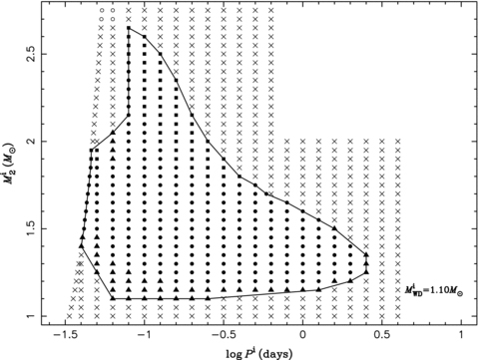
Figure 6 Similar to Fig. 5, but for an initial WD mass of 1.1 M⊙.
Notes:
Figure 6 Similar to Fig. 5, but for an initial WD mass of 1.1 M⊙.
Unless provided in the caption above, the following copyright applies to the content of this slide: © 2009 The Authors. Journal compilation © 2009 RAS

Slide 7
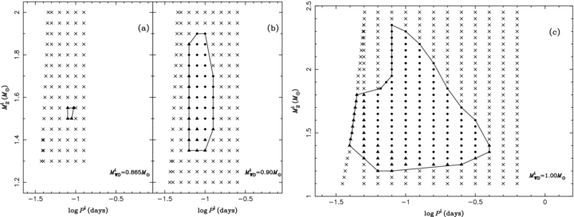
Figure 7 Similar to Fig. 5, but for initial WD masses of 0.865, 0.9 and 1.0 M⊙.
Notes:
Figure 7 Similar to Fig. 5, but for initial WD masses of 0.865, 0.9 and 1.0 M⊙.
Unless provided in the caption above, the following copyright applies to the content of this slide: © 2009 The Authors. Journal compilation © 2009 RAS

Slide 8
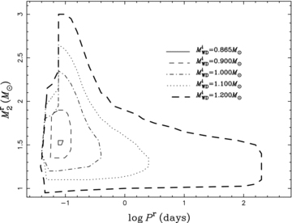
Figure 8 Regions in the orbital period–secondary mass plane (log P^{r}, M^{r}₂) for WD ...
Notes:
Figure 8 Regions in the orbital period–secondary mass plane (log Pr, Mr2) for WD binaries (at the onset of the RLOF stage) that produce SNe Ia for initial WD masses of 0.865, 0.90, 1.0, 1.1 and 1.2 M⊙. The region almost vanishes for MiWD= 0.865 M⊙.
Unless provided in the caption above, the following copyright applies to the content of this slide: © 2009 The Authors. Journal compilation © 2009 RAS

