Slide 1
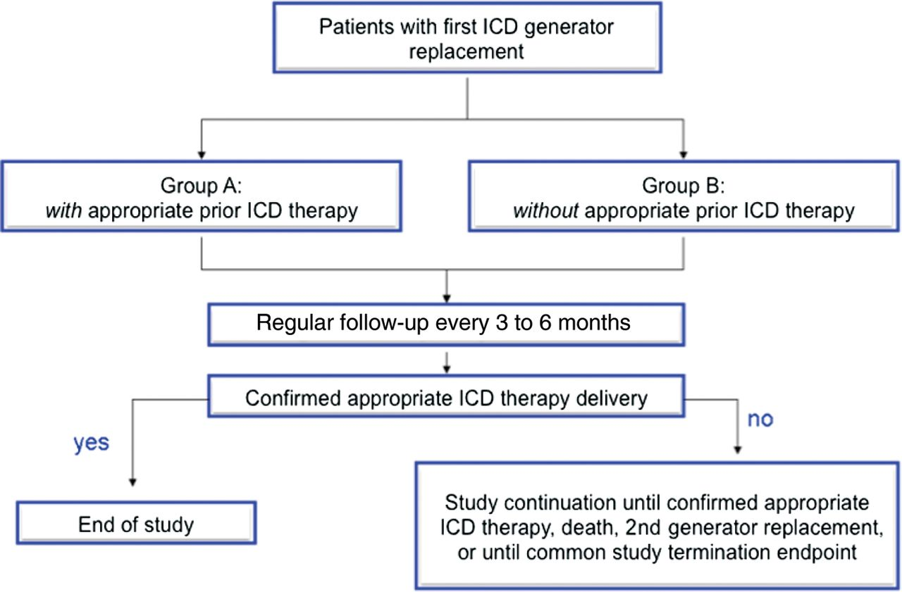
Figure 1 Study design.
Notes:
Figure 1 Study design.
Unless provided in the caption above, the following copyright applies to the content of this slide: Published on behalf of the European Society of Cardiology. All rights reserved. © The Author 2012. For permissions please email: journals.permissions@oup.com

Slide 2
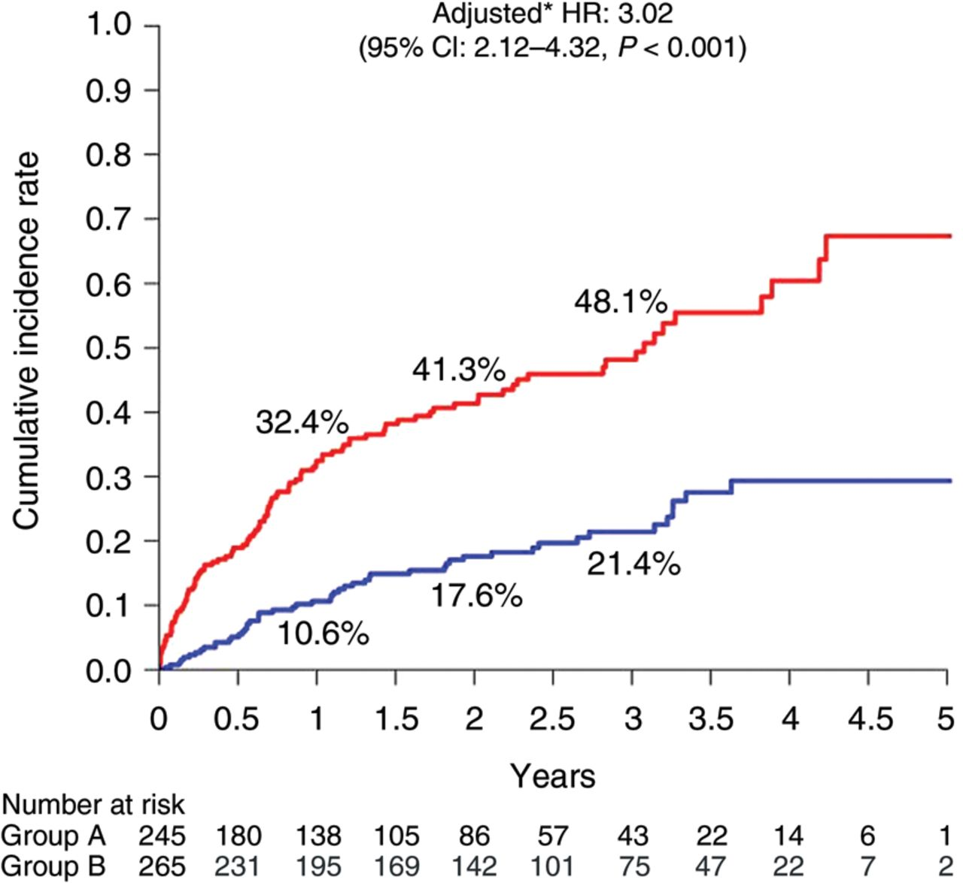
Figure 2 Cumulative incidence of appropriate implantable cardioverter/defibrillator therapy after elective implantable ...
Notes:
Figure 2 Cumulative incidence of appropriate implantable cardioverter/defibrillator therapy after elective implantable cardioverter/defibrillator generator replacement for patients with (red line) and without (blue line) prior appropriate implantable cardioverter/defibrillator therapy.
Unless provided in the caption above, the following copyright applies to the content of this slide: Published on behalf of the European Society of Cardiology. All rights reserved. © The Author 2012. For permissions please email: journals.permissions@oup.com

Slide 3
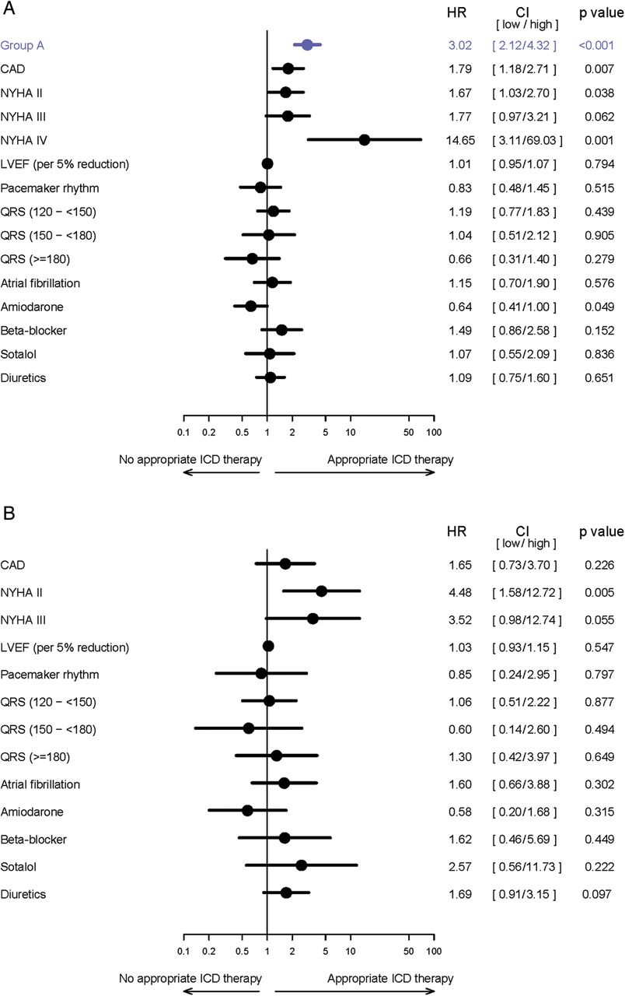
Figure 3 (A) Hazard ratios for appropriate implantable cardioverter/defibrillator interventions after elective ...
Notes:
Figure 3 (A) Hazard ratios for appropriate implantable cardioverter/defibrillator interventions after elective implantable cardioverter/defibrillator replacement according to selected clinical characteristics in patients with and without former appropriate implantable cardioverter/defibrillator therapy (groups A and B). (B) Hazard ratios for appropriate implantable cardioverter/defibrillator intervention after elective implantable cardioverter/defibrillator replacement according to selected clinical characteristics in patients without former appropriate implantable cardioverter/defibrillator therapy (group B only).
Unless provided in the caption above, the following copyright applies to the content of this slide: Published on behalf of the European Society of Cardiology. All rights reserved. © The Author 2012. For permissions please email: journals.permissions@oup.com

