Slide 1
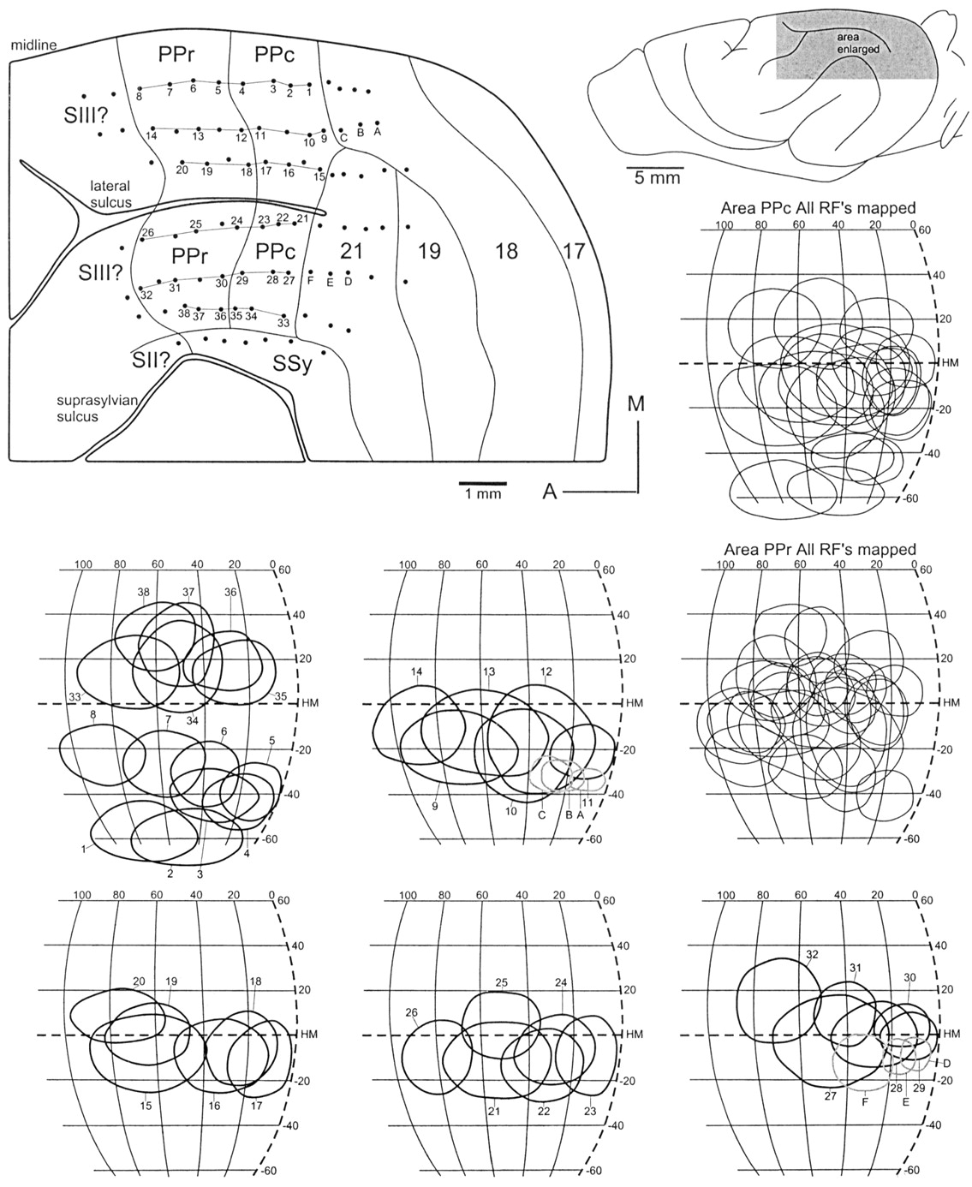
Figure 1. Reconstruction of the retinotopy within areas PPc (posterior parietal caudal area) and PPr (rostral area), ...
Notes:
Figure 1. Reconstruction of the retinotopy within areas PPc (posterior parietal caudal area) and PPr (rostral area), with examples of receptive field progressions. Numbers at recording sites correspond to the illustrated receptive fields. A reversal in the progression of receptive fields around the zero meridian corresponds to the PPc/PPr boundary. Receptive fields in the lower portion of the visual field are found medially, on the lateral gyrus, while the upper visual field is found on the suprasylvian gyrus. The figurines to the right show all the receptive fields recorded within areas PPc and PPr in the present case. A, anterior; HM, horizontal meridian; M, medial; RF, receptive field; SII?, second somatosensory area; SIII?, third somatosensory area (tentative); SSy, suprasylvian visual areas.
Unless provided in the caption above, the following copyright applies to the content of this slide: © Oxford University Press

Slide 2
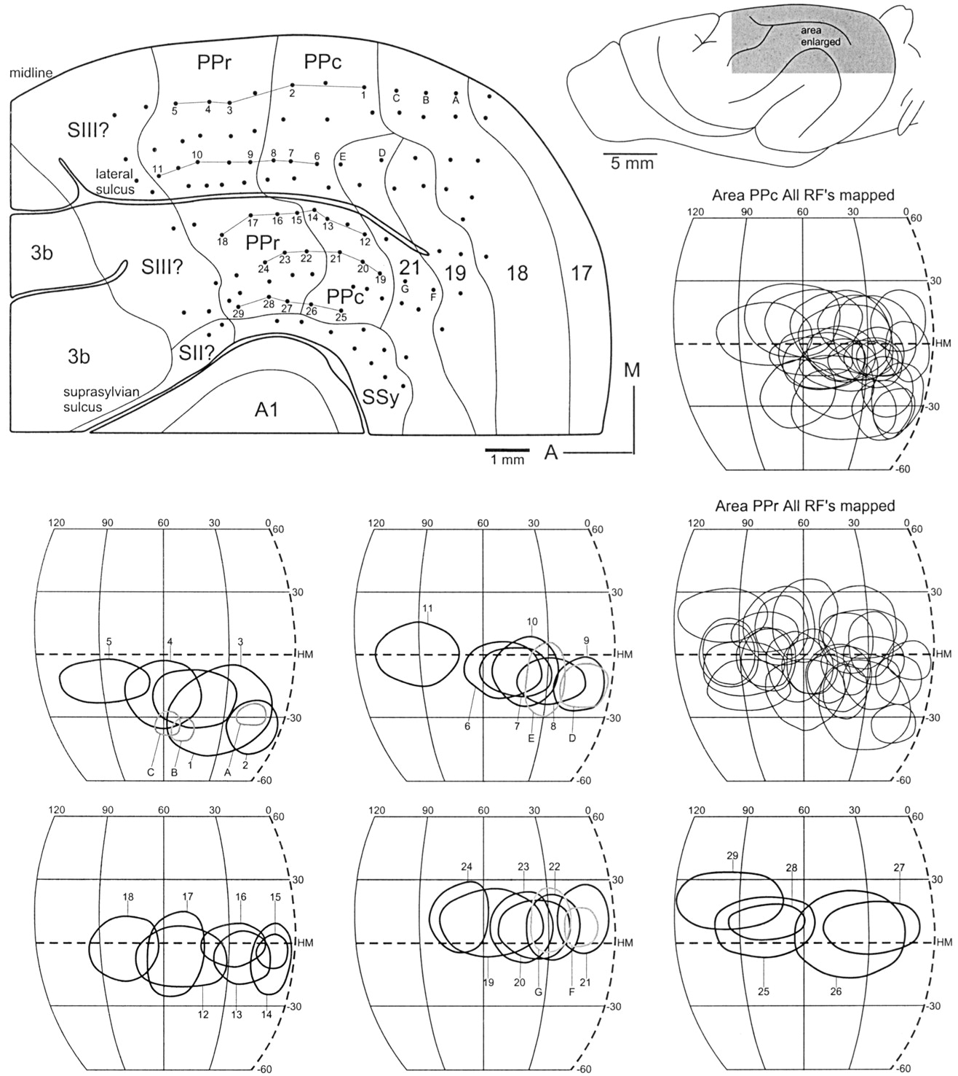
Figure 2. A second example of the retinotopy of areas PPr and PPc. Conventions as in Figure 2. A1, primary auditory ...
Notes:
Figure 2. A second example of the retinotopy of areas PPr and PPc. Conventions as in Figure 2. A1, primary auditory cortex; 3b, primary somatosensory cortex.
Unless provided in the caption above, the following copyright applies to the content of this slide: © Oxford University Press

Slide 3
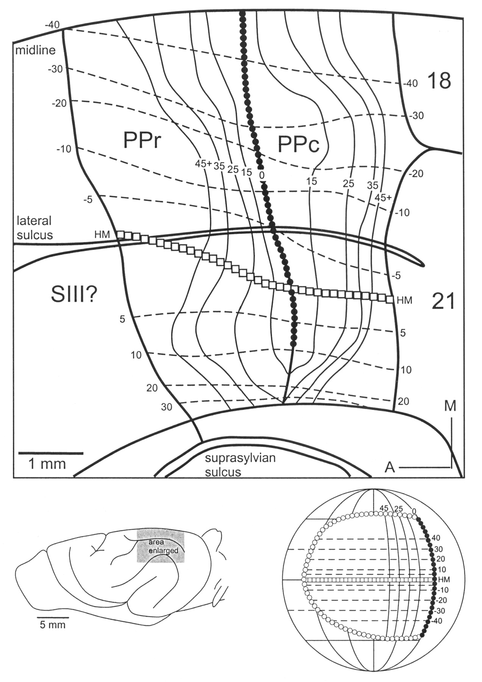
Figure 3. Summary diagram of the retinotopy within areas PPc and PPr. Isoelevation lines run antero-posteriorly and ...
Notes:
Figure 3. Summary diagram of the retinotopy within areas PPc and PPr. Isoelevation lines run antero-posteriorly and course, for the most part, parallel to the lateral sulcus. Isoazimuth lines runs roughly parallel to the representation of the zero meridian at the PPc/PPr boundary. Numbers denote values of isoelevation (dashed lines) and isoazimuth (thin solid lines). Open squares represent the horizontal meridian (HM) and filled circles the zero meridian (0°; see globe figurine). This figure is an ‘average’ figure and is derived from several cases.
Unless provided in the caption above, the following copyright applies to the content of this slide: © Oxford University Press

Slide 4
Figure 4. Extent of visual field representation, with each area compared to areas 17, 18, 19 and 21 (Law et al., 1988; ...
Notes:
Figure 4. Extent of visual field representation, with each area compared to areas 17, 18, 19 and 21 (Law et al., 1988; Manger et al., 2002). Areas PPc and PPr represent approximately the same amount of the visual field, both with a bias towards the lower visual field. Meridians are at 30° from each other.
Unless provided in the caption above, the following copyright applies to the content of this slide: © Oxford University Press

Slide 5
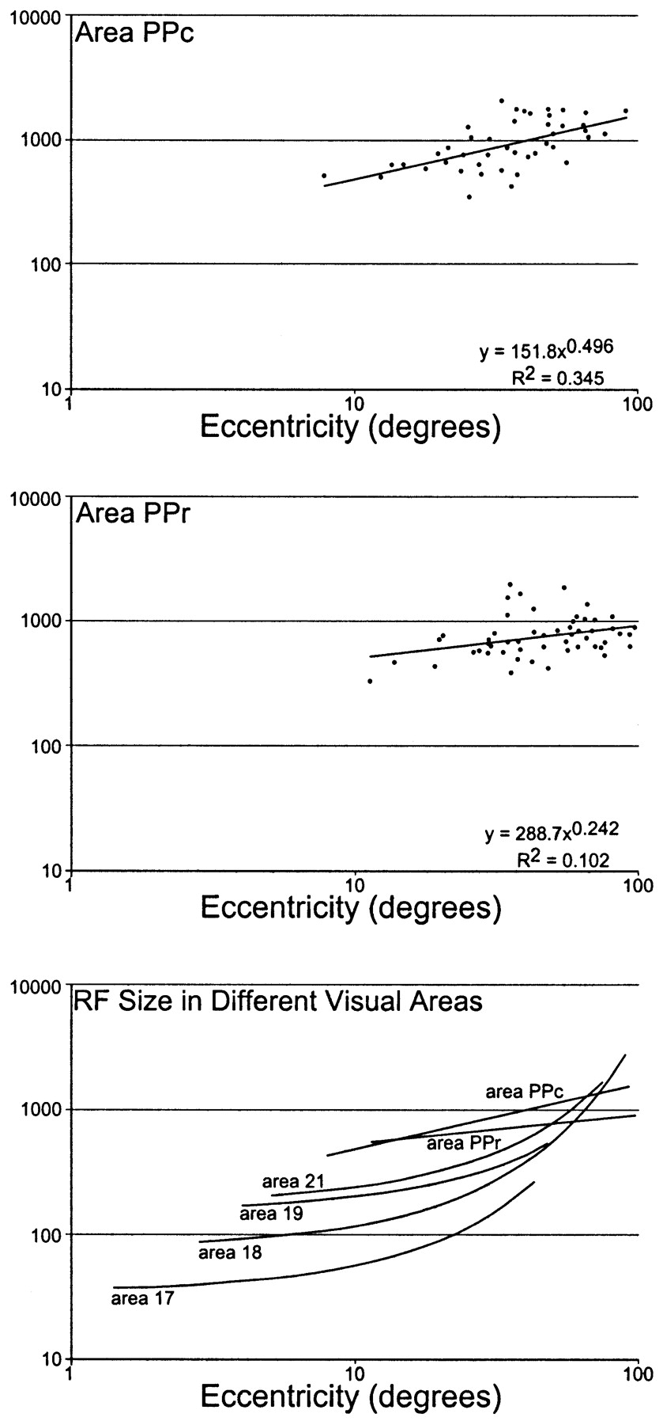
Figure 5. Plots of multi-unit receptive field size (degrees²) against eccentricity. Eccentricity is given as ...
Notes:
Figure 5. Plots of multi-unit receptive field size (degrees2) against eccentricity. Eccentricity is given as the distance (in degrees) of the center of the receptive field from the intersection of the zero and horizontal meridians. The data were plotted in Excel and an equation describing the line of best fit and its correlation coefficient (R2) generated. In both areas the receptive field sizes are large but comparable and there is a weak tendency for the receptive fields to increase in size with increasing eccentricity. Receptive fields in both PPc and PPr are significantly larger than those in the occipital visual areas of the ferret (Manger et al., 2002).
Unless provided in the caption above, the following copyright applies to the content of this slide: © Oxford University Press

Slide 6
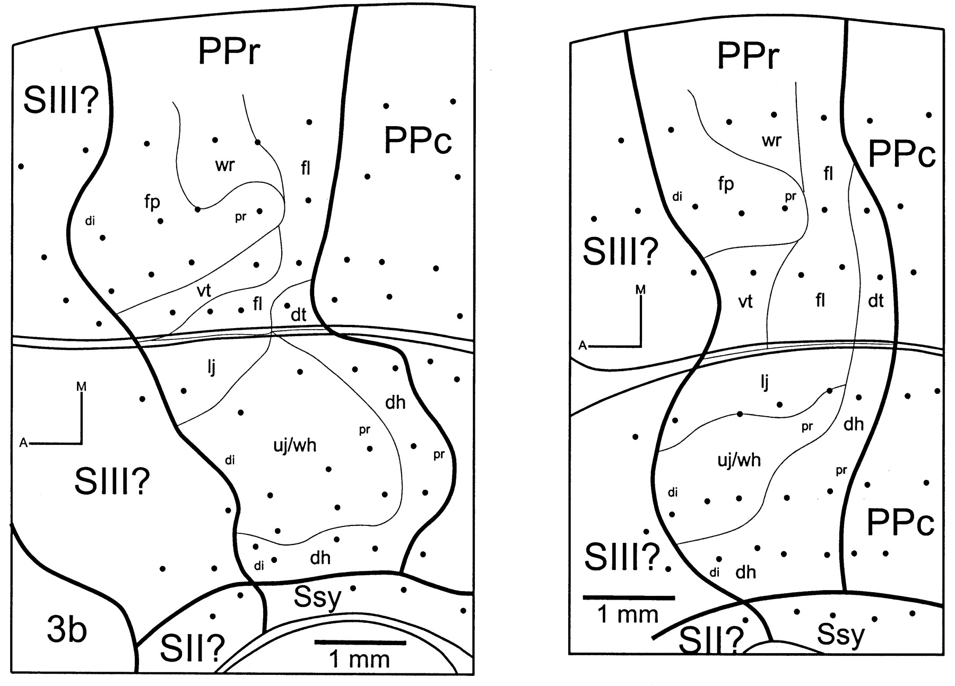
Figure 6. Reconstructions of the somatotopic map found in area PPr in two cases. The representation of the head is ...
Notes:
Figure 6. Reconstructions of the somatotopic map found in area PPr in two cases. The representation of the head is found on the suprasylvian gyrus and that of the post-cranial body on the lateral gyrus. The rostrum and digit tips are found anterior in the field, while the dorsal midline is located at the posterior border of the field. 3b, primary somatosensory cortex; A, anterior; di, distal; dh, dorsal head; dt, dorsal trunk; fl, forelimb; fp, forepaw; lj, lower jaw; M, medial; pr, proximal; Ssy, suprasylvian visual areas; SII?, second somatosensory area; SIII?, third somatosensory area (tentative); uj/wh, upper jaw/whiskers; vt, ventral trunk; wr, wrist.
Unless provided in the caption above, the following copyright applies to the content of this slide: © Oxford University Press

Slide 7
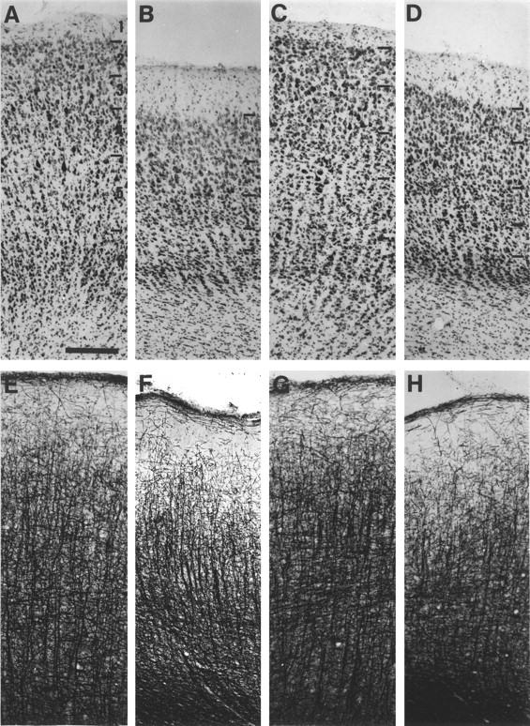
Figure 7. Architecture of areas PPc (A, B, E, F) and PPr (C, D, G, H). Photomicrographs from sections stained with ...
Notes:
Figure 7. Architecture of areas PPc (A, B, E, F) and PPr (C, D, G, H). Photomicrographs from sections stained with cresyl violet (A–D) or myelin (E–H). (A) and (E) are from area PPc on the suprasylvian gyrus, while (B) and (F) area from area PPc on the lateral gyrus. (C) and (G) are from suprasylvian gyrus and (D) and (H) from lateral gyrus in area PPr. Note the lack of cytoarchitectural differences between (A) and (C), and (B) and (D), constrasted with the differences between (A) and (B), and (C) and (D). (E) and (F) show similarities in the radial fascicle morphology, as do (G) and (H); however, the differences between these two are striking. Moreover, within (G) and (H) there is a marked increase in tangential fibre density in layer 4. Scale bar = 200 μm.
Unless provided in the caption above, the following copyright applies to the content of this slide: © Oxford University Press

Slide 8
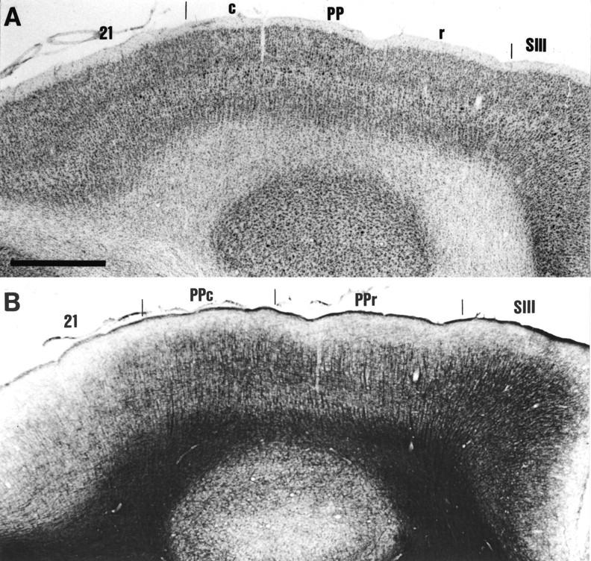
Figure 8. Architecture of areas PPc and PPr and surrounding regions. Low-power photomicrographs of adjacent ...
Notes:
Figure 8. Architecture of areas PPc and PPr and surrounding regions. Low-power photomicrographs of adjacent parasagittal sections through the suprasylvian gyrus stained for Nissl (A) and myelin (B). In the Nissl-stained section, it can be seen that the thickness of layer 4 in posterior parietal cortex distinguishes this region from area 21 posteriorly and area SIII anteriorly. In the myelin-stained section, posterior parietal cortex is differentiated from area 21 by increased myelin density and from area SIII by lower myelin density. Areas PPc and PPr can also be distinguished by their individual features (see Fig. 7). Scale bar = 1 mm for both photomicrographs.
Unless provided in the caption above, the following copyright applies to the content of this slide: © Oxford University Press

Slide 9
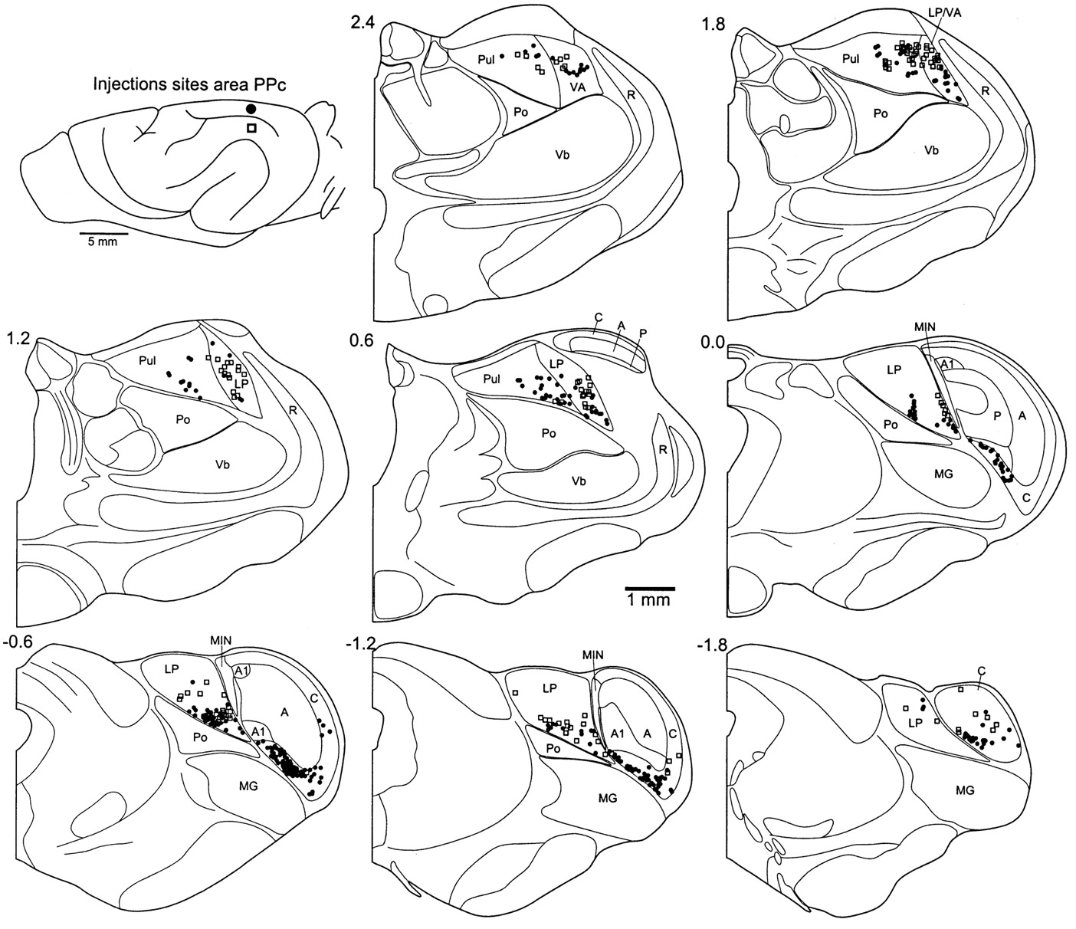
Figure 9. The location of retrogradely labeled neurons in the thalamus of the ferret following injections in the upper ...
Notes:
Figure 9. The location of retrogradely labeled neurons in the thalamus of the ferret following injections in the upper (open squares) and lower (closed circles) field representations in area PPc (posterior parietal caudal area). Labeled neurons were found throughout the C lamina of the LGN and the lateral posterior nucleus (LP), and in the medial portion of the pulvinar (Pul) and the caudal portion of the ventral anterior nucleus (VA). Numbers next to each thalamic section figurine represent the approximate stereotaxic location in millimeters anterior or posterior to stereotaxic zero. A, A lamina of LGN; A1, A1 lamina of LGN; LGN, lateral geniculate nucleus; MIN, medial interlaminar nucleus; MG, medial geniculate nucleus; Po, posterior nucleus; R, reticular nucleus; Vb, ventrobasal complex.
Unless provided in the caption above, the following copyright applies to the content of this slide: © Oxford University Press

Slide 10
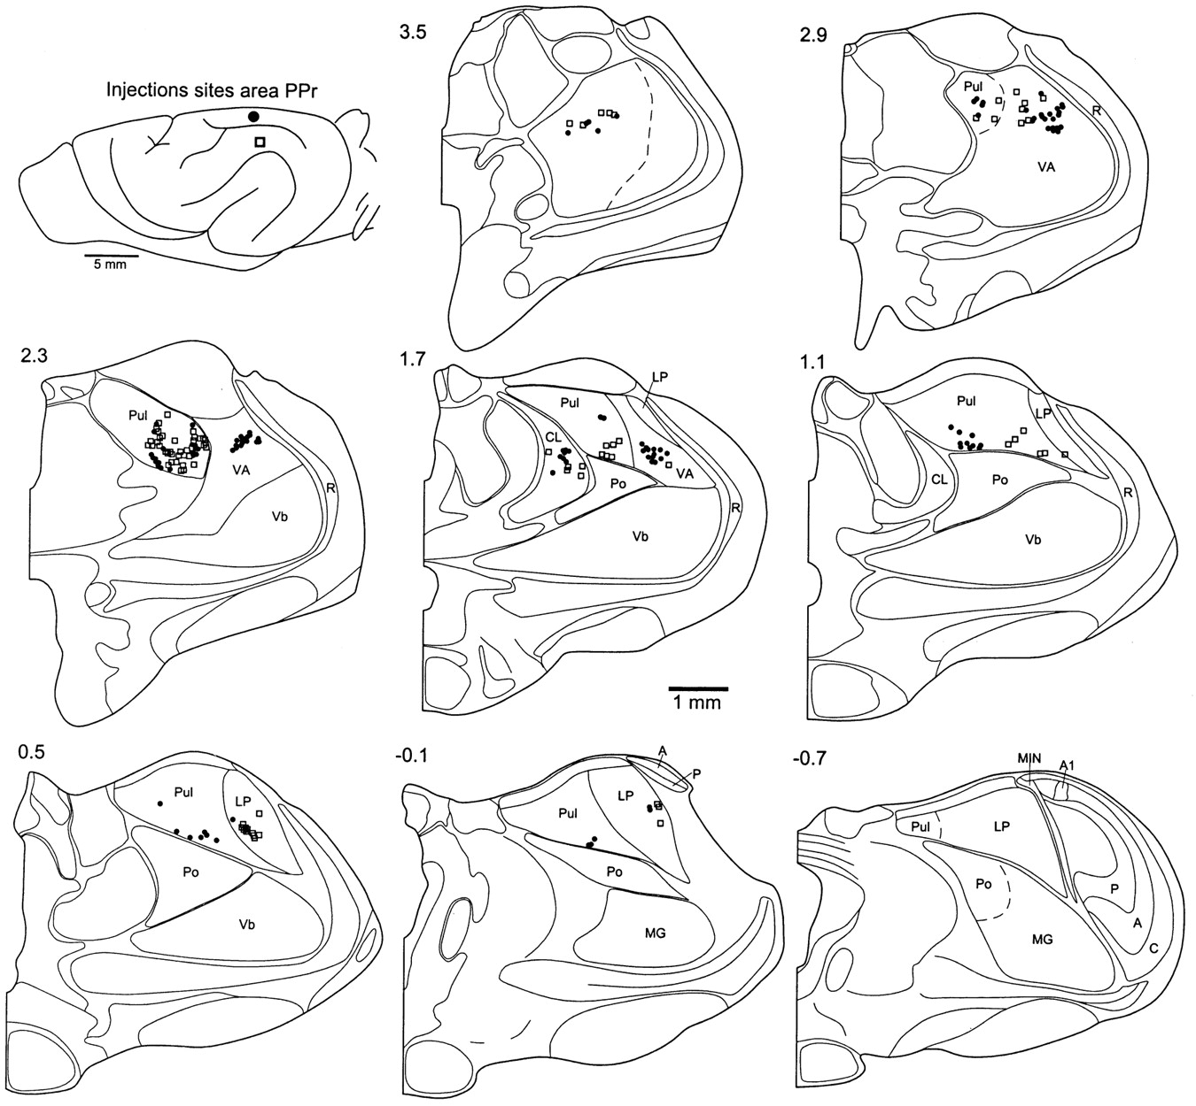
Figure 10. The location of retrogradely labeled neurons in the thalamus of the ferret following injections in the upper ...
Notes:
Figure 10. The location of retrogradely labeled neurons in the thalamus of the ferret following injections in the upper (open squares) and lower (closed circles) field representations in area PPr (posterior parietal rostral area). Conventions and abbreviations as in Figure 8. Labeled neurons were found in the most rostral portion of the lateral posterior nucleus (LP), throughout both medial and lateral portions of the pulvinar (Pul) and into the ventral anterior nucleus (VA). Unlike area PPc, area PPr does not receive projections from the lateral geniculate nucleus.
Unless provided in the caption above, the following copyright applies to the content of this slide: © Oxford University Press

Slide 11
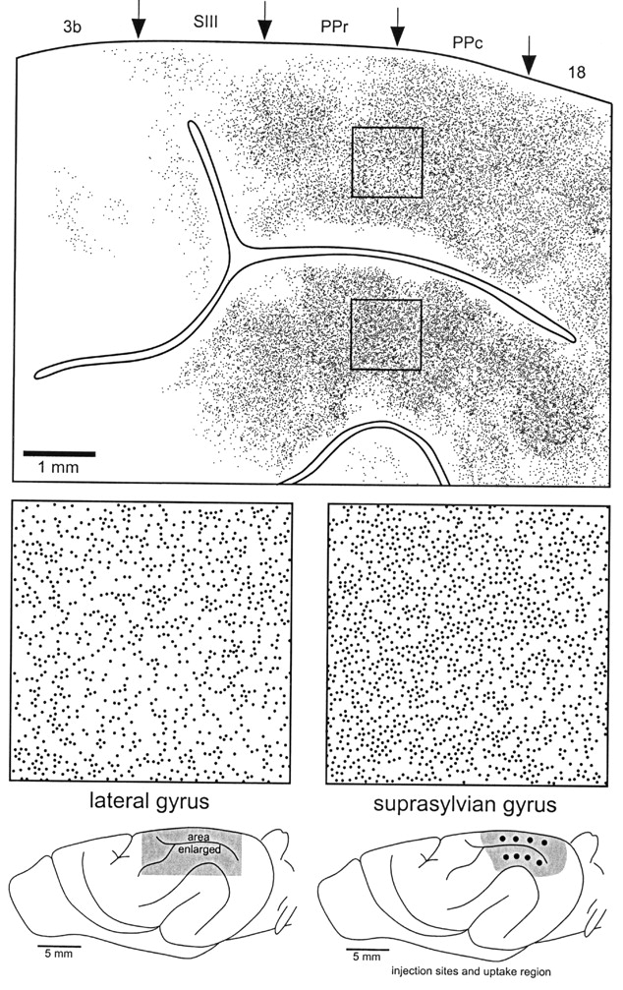
Figure 11. Distribution of callosally projecting neurons in a semi-flattened section of the parietal cortex of the ...
Notes:
Figure 11. Distribution of callosally projecting neurons in a semi-flattened section of the parietal cortex of the ferret. Each labeled neuron is represented by a dot. The distribution is fairly homogeneous across posterior parietal cortex; however, the upper visual field representation (on the suprasylvian gyrus) exhibits a higher density of callosal neurons than the lower visual field representation (on the lateral gyrus). No correspondence of callosally projecting neurons to the zero meridian was found. There is a marked drop in the number of labeled neurons at the posterior border of primary somatosensory cortex; however, the third somatosensory area (SIII) contains many neurons. Approximate area boundaries are marked. The figurines at the bottom of the figure represent the area enlarged and the injection sites and uptake region from the opposite hemisphere.
Unless provided in the caption above, the following copyright applies to the content of this slide: © Oxford University Press

Slide 12
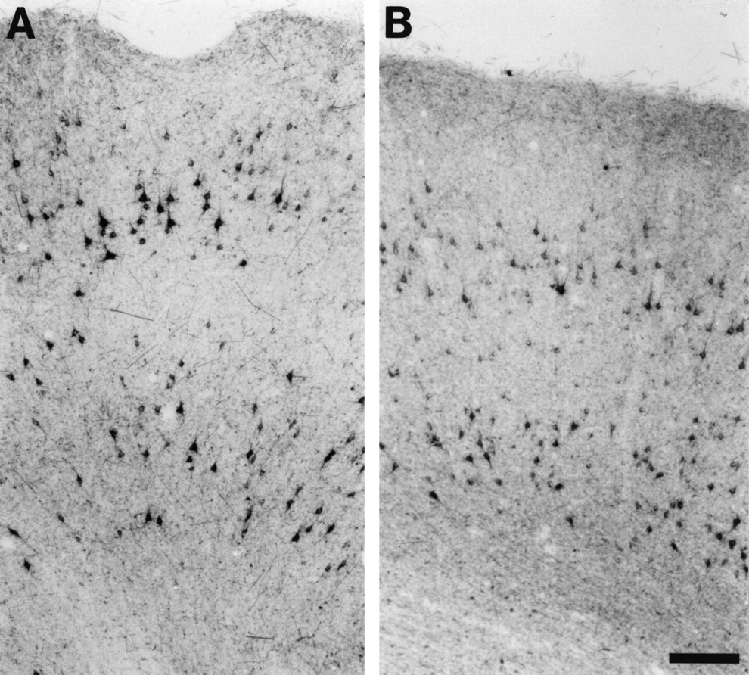
Figure 12. Photomicrographs of callosally projecting neurons labeled with WGA-HRP at the border of PPc and PPr. (A) is ...
Notes:
Figure 12. Photomicrographs of callosally projecting neurons labeled with WGA-HRP at the border of PPc and PPr. (A) is taken on the suprasylvian gyrus, (B) on the lateral gyrus. Note the numerous larger pyramidal neurons in the supragranular layers and the somewhat larger cells in the infragranular layers of (A) as compared to (B). Scale bar = 100 μm.
Unless provided in the caption above, the following copyright applies to the content of this slide: © Oxford University Press

Slide 13
Figure 13. Frequency histograms of the somatal areas of callosally projecting neurons in the posterior parietal cortex. ...
Notes:
Figure 13. Frequency histograms of the somatal areas of callosally projecting neurons in the posterior parietal cortex. These histograms quantify the observable differences shown in Figure 11. An interesting feature is that the clear differences from direct observation (Fig. 12) amount to quantification differences of only ~10% (see text).
Unless provided in the caption above, the following copyright applies to the content of this slide: © Oxford University Press

Slide 14
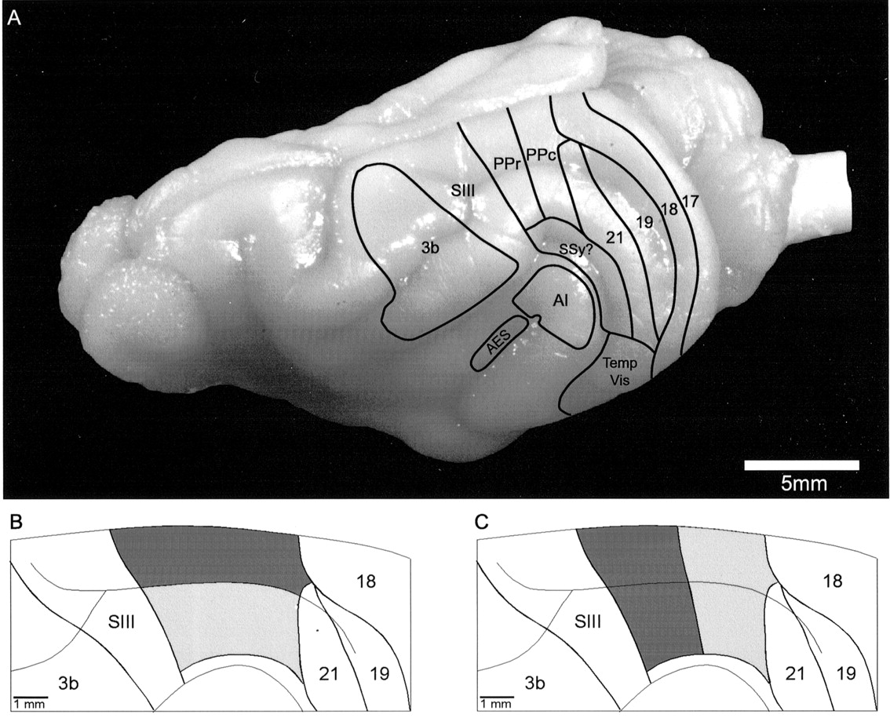
Figure 14. Summary figure of our present understanding of the subdivisions of the visual cortex of the ferret. (A) ...
Notes:
Figure 14. Summary figure of our present understanding of the subdivisions of the visual cortex of the ferret. (A) Dorsolateral photograph of the cortex of the ferret brain with the known area outlined. The locations of suprasylvian, temporal and anterior ectosylvian visual areas are based on preliminary data. (B) Parcellation of posterior parietal cortex based on cytoarchitecture, tangential fiber density in layers 3 and 6, and density of callosal connectivity. (C) Parcellation of the same based on electrophysiological maps, radial fascicle morphology, tangential fiber density in layer 4 and thalamocortical connectivity. We have adopted the scheme shown in (C) in the present study. 3b, primary somatosensory cortex; A1, primary auditory cortex; AES, anterior ectosylvian visual area; PPc, posterior parietal caudal area; PPr, posterior parietal rostral area; SSy?, unexplored suprasylvian visual regions; Temp Vis, temporal visual areas.
Unless provided in the caption above, the following copyright applies to the content of this slide: © Oxford University Press

