Slide 1
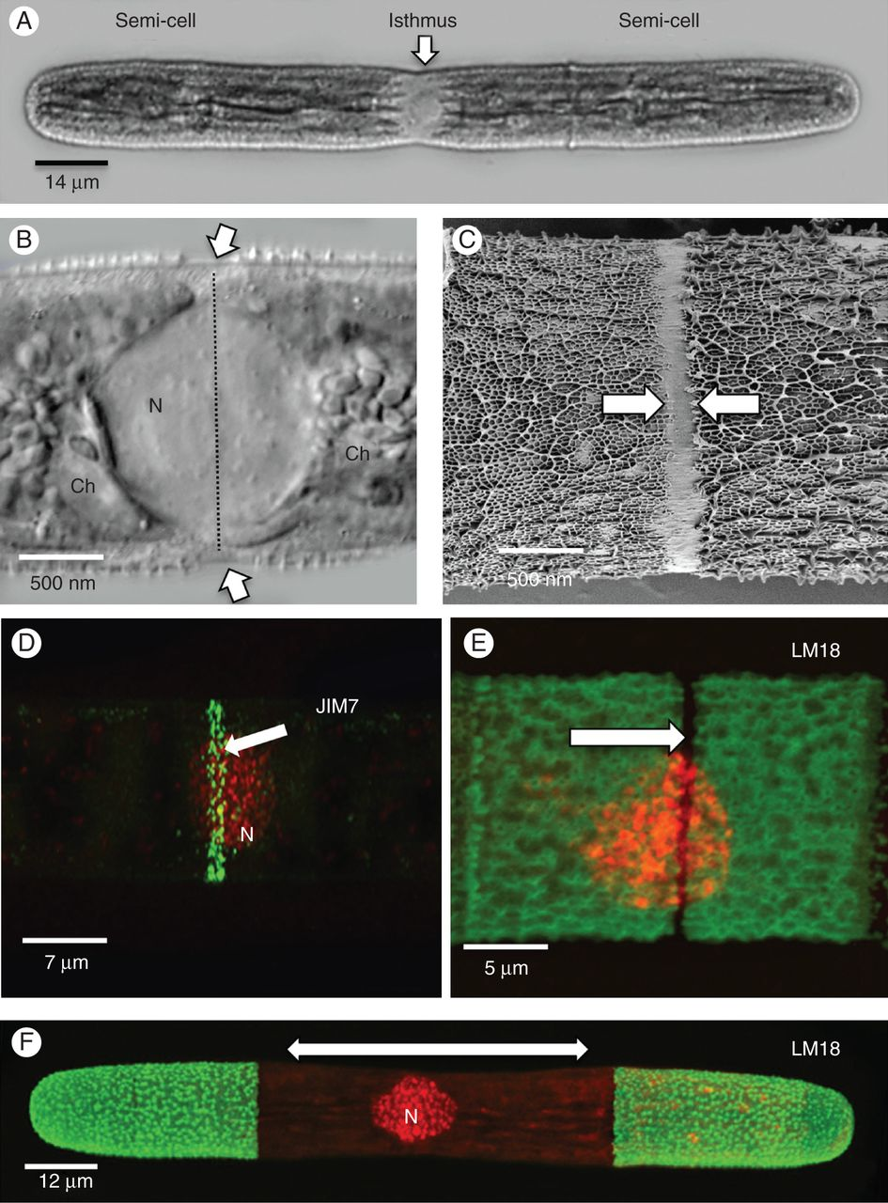
Fig. 1. General expansion mechanics during pre-division. (A) DIC image of cell prior to cell division. The isthmus ...
Notes:
Fig. 1. General expansion mechanics during pre-division. (A) DIC image of cell prior to cell division. The isthmus zone is positioned at the cell centre between the two semi-cells. (B) The nucleus (N) is situated in the cytoplasm of the isthmus between two chloroplasts (Ch). External to this zone is a 1-μm-wide band where the cell wall is incompletely formed (arrows and line). This zone is the expansion band where new wall material is deposited during the ‘bi-directional’ expansion mechanism. (C) FESEM image showing the absence of the outer layer at the isthmus (arrows). (D) LM20 labels a narrow band (arrow) where high esterified HG is secreted at the isthmus. (E) LM18, an mAb with specificity for low esterified HG, labels all of the cell wall except for the narrow band (arrow) found at the isthmus. This unlabelled band corresponds with the LM20-labelled band seen in (D). (F) When LM18-labelled cells are placed back in culture for 24 h, new deposited wall is unlabelled (arrow) and illustrates bi-directional expansion occurring at the central isthmus (N, nucleus).
Unless provided in the caption above, the following copyright applies to the content of this slide: © The Author 2014. Published by Oxford University Press on behalf of the Annals of Botany Company. All rights reserved. For Permissions, please email: journals.permissions@oup.com

Slide 2
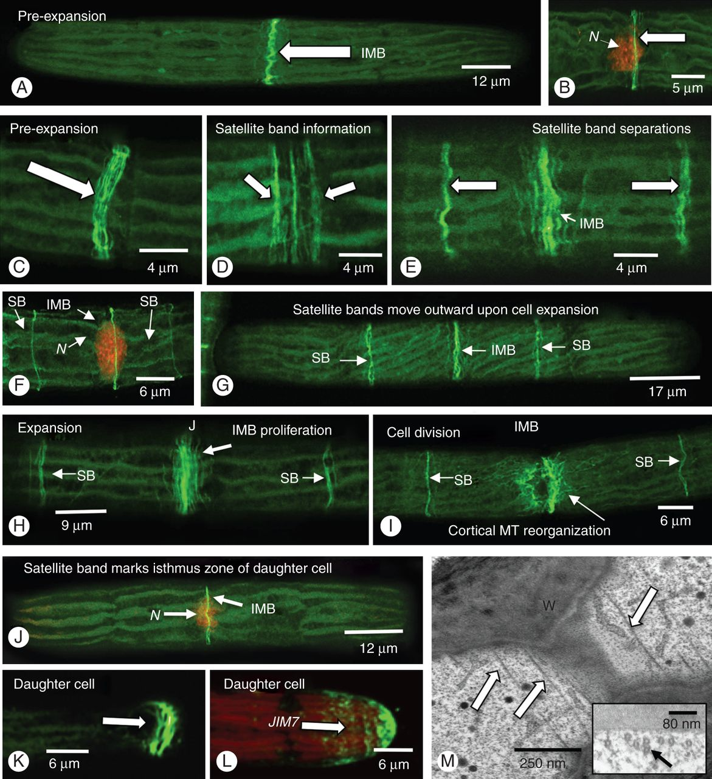
Fig. 2. Cortical microtubular bands. (A) Throughout most of the cell cycle, including the pre-division expansion ...
Notes:
Fig. 2. Cortical microtubular bands. (A) Throughout most of the cell cycle, including the pre-division expansion phase, a band of microtubules (IMB or isthmus microtubule band) that are aligned perpendicular to the long axis of the cell is found at the isthmus (arrows). (B) This band (arrow) surrounds the central nucleus (N) as labelled with SYTO9. (C) The IMB consists of 10–15 microtubules and starts to expand as the cell enters pre-division expansion. (D) At this time, two satellite bands (arrows) emerge from the periphery of the IMB. (E) As expansion begins, the satellite bands (arrows) move away from the IMB. (F) The IMB remains at the isthmus as marked by the nucleus (N). The two satellite bands displace outward toward both poles (SB, arrows). (G) As expansion continues, the satellite bands (SB) move further away from the IMB. (H) During the expansion process, the IMB grows (arrow) and the satellite bands move further towards the poles. (I) As the cell enters into cell division, the IMB disassembles (arrow), probably contributing to the mitotic spindle and phragmoplast. The satellite bands (SB) remain intact. (J) After cytokinesis, a satellite band is found at the isthmus of each daughter cell (N, nucleus). This band now constitutes the new IMB. (K) Immediately after cytokinesis, remnants of the cell division apparatus remain for a short period at the pole of the expanding semi-cell of a daughter cell (arrow). (L) This zone also is a site of additional wall deposition, as noted by LM 20 labelling (arrow). (M) TEM analysis reveals the parallel arrays of microtubules at the isthmus (arrows) just inside the cell wall (W). Inset: cross-section of this zone.
Unless provided in the caption above, the following copyright applies to the content of this slide: © The Author 2014. Published by Oxford University Press on behalf of the Annals of Botany Company. All rights reserved. For Permissions, please email: journals.permissions@oup.com

Slide 3
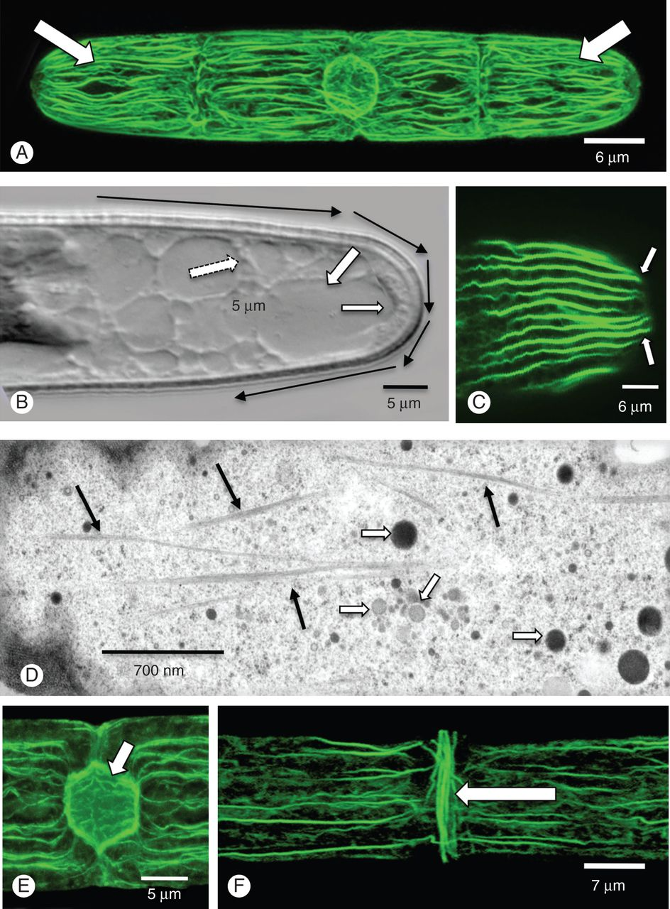
Fig. 3. The cortical actin network. (A) The cortical cytoplasm is highlighted by numerous actin filament bundles that ...
Notes:
Fig. 3. The cortical actin network. (A) The cortical cytoplasm is highlighted by numerous actin filament bundles that run parallel to the long axis of the cell (arrows; rhodamine phalloidin labelling). (B) These bundles are located in the cortical cytoplasm (small arrow) that most likely fuel cytoplasmic streaming around the cell (black arrows). The cortical cytoplasmic channels are interspersed with vacuoles (large arrows). (C) At the polar zones, the bundles curve around back into the cell (arrows). (D) TEM analysis shows the numerous bundles in the cortical cytoplasm (dark arrows). Multiple vesicles are found in this zone. (E) At the nucleus, the actin filament bundles line the nuclear envelope (arrow). (F) When the cell enters into pre-division expansion, a band of actin filament bundles appears aligned perpendicular to the long axis (arrow) at the same position of the IMB.
Unless provided in the caption above, the following copyright applies to the content of this slide: © The Author 2014. Published by Oxford University Press on behalf of the Annals of Botany Company. All rights reserved. For Permissions, please email: journals.permissions@oup.com

Slide 4
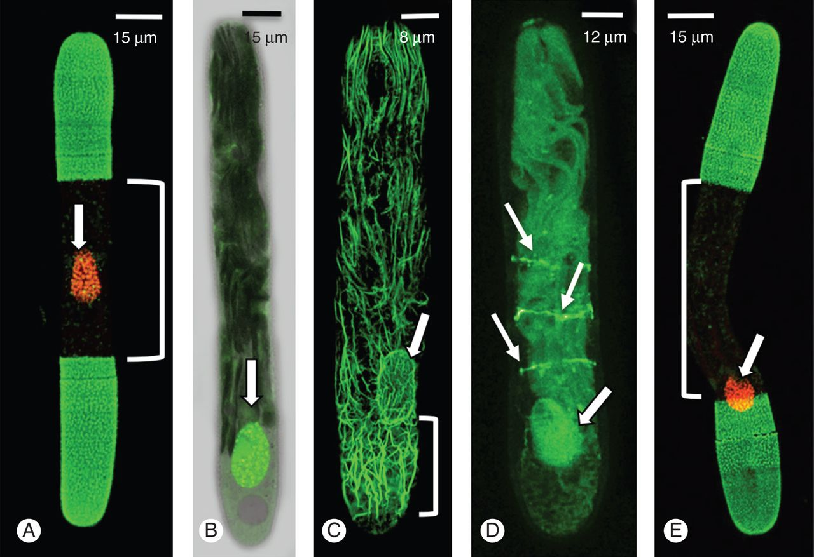
Fig. 4. Effects of centrifugation on expansion. (A) A non-centrifuged cell labelled with LM18 and SYTO9. Wall ...
Notes:
Fig. 4. Effects of centrifugation on expansion. (A) A non-centrifuged cell labelled with LM18 and SYTO9. Wall expansion is roughly equally on either side of the nucleus (N). (B) DIC image of a cell centrifuged for 4 min at 12 000g. The nucleus (arrow) is displaced to one end of the cell. (C) Rhodamine phalloidin labelling of a centrifuged cell. Note that the nucleus (arrow) of actin filaments accumulates at the ‘centrifugal’ end. (D) The microtubule bands remain at the isthmus while the nucleus is at the ‘centrifugal’ end (arrow). (E) When placed back into culture for 24 h, expansion still occurs at the isthmus. The position of the displaced nucleus does not affect where expansion occurs.
Unless provided in the caption above, the following copyright applies to the content of this slide: © The Author 2014. Published by Oxford University Press on behalf of the Annals of Botany Company. All rights reserved. For Permissions, please email: journals.permissions@oup.com

Slide 5
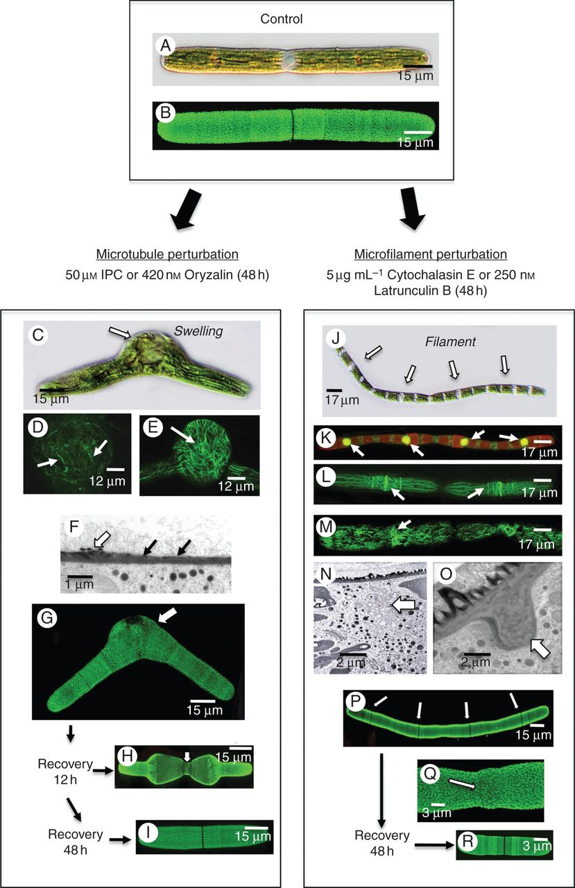
Fig. 5. Effects of microtubule and actin perturbation agents. (A) DIC image of an untreated cell. (B) LM18 labelling ...
Notes:
Fig. 5. Effects of microtubule and actin perturbation agents. (A) DIC image of an untreated cell. (B) LM18 labelling of an untreated cell highlighting the pectin lattice. (C) DIC image of a cell treated with 50 µm IPC for 24 h. Note the distinct swelling at the isthmus. (D) Anti-tubulin labelling of the swollen isthmus region of an IPC-treated cell. No banding is noted and the microtubules are in disarray. (E) Rhodamine phalloidin labelling of the swollen isthmus of an IPC-treated cell. The actin network is disorganized. (F) TEM image of the cell wall at the interface of the regular wall and the isthmus at the swollen isthmus. The cell wall in the isthmus is thinner (arrows) and has no pectin lattice (white arrow). (G) LM18 labelling of an IPC-treated cell. Note the irregular labelling at the swollen isthmus zone. (H) LM18 labelling of a cell washed free of IPC and allowed to recover for 2 h. Note that the cell is thinner at the isthmus. (I) Forty-eight hours after recovery, cells return to normal shape. (J) Pseudofilament formed after cells are treated with cytochalasin E for 48 h. Note the individual cell units (arrows). (K) SYTO9 labelling of pseudofilament demonstrates that each cell unit contains a nucleus. (L) Anti-microtubule labelling of a psuedofilament. Note that the microtubule bands are still present. (M) Rhodamine phalloidin labelling of a pseudofilament showing the disorganization of the cortical actin filaments. No actin filament band is seen near the nucleus. (N) TEM image of the zone between cellular units in a cytochalasin E-treated cell. Note that the cytoplasm consists of a collection of vesicles (arrow). (O) TEM image of the isthmus region of a cytochalasin E-treated cell. Note the large wall plug found at the cell periphery (arrow). (P) LM18 labelling of the pseudofilament showing that little alteration to the pectin lattice (arrows). (Q) LM18 labelling of the isthmus zone between units. Note that the lattice remains intact. (R) Upon 48 h of recovery, cells return to a unicellular phenotype.
Unless provided in the caption above, the following copyright applies to the content of this slide: © The Author 2014. Published by Oxford University Press on behalf of the Annals of Botany Company. All rights reserved. For Permissions, please email: journals.permissions@oup.com

Slide 6
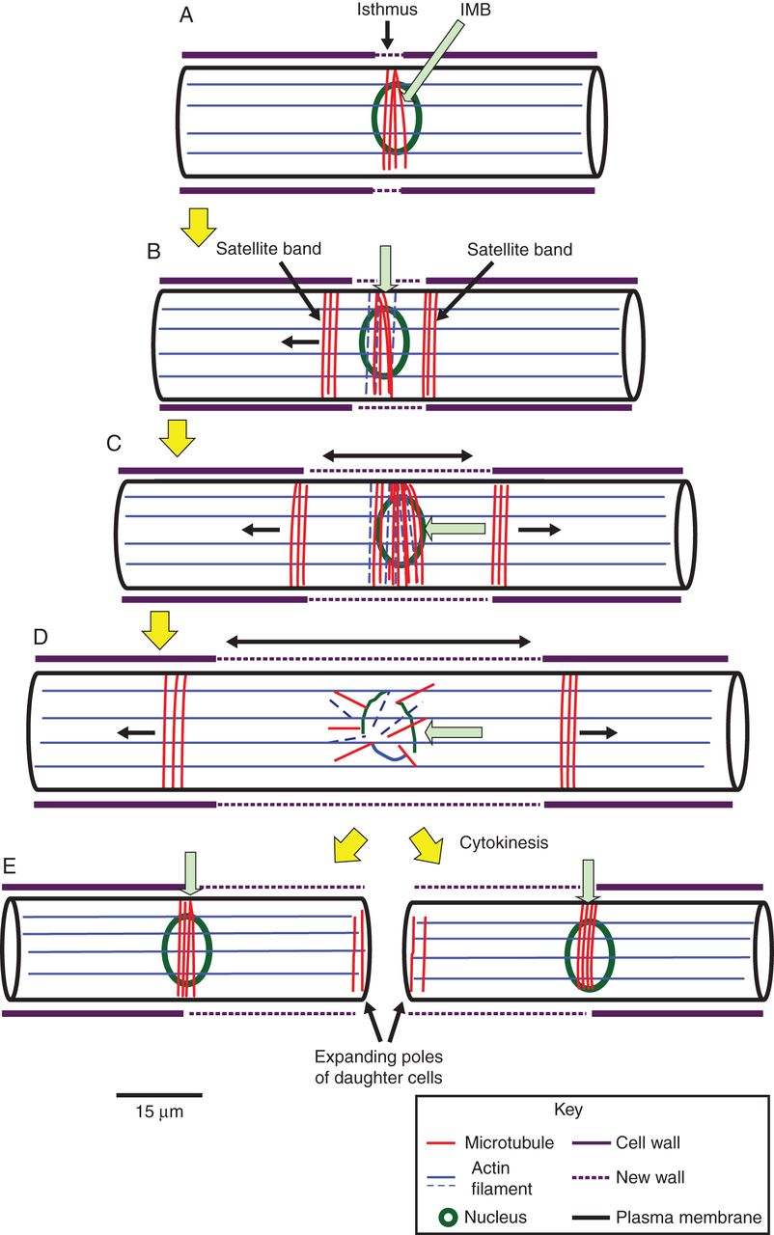
Fig. 6. Putative model of cytoskeletal dynamics. (A) The interphase cell is highlighted by a network of actin ...
Notes:
Fig. 6. Putative model of cytoskeletal dynamics. (A) The interphase cell is highlighted by a network of actin filament bundles that run parallel to the long axis of the cell. In addition, the isthmus microtubule band (IMB) marks the cortical cytoplasm at the isthmus. (B) At the onset of pre-division expansion, two satellite microtubule bands appear on either side of the IMB (green arrow). (C) As the cell undergoes its bidirectional expansion (double arrow), the satellite bands move toward the poles (single arrows). The IMB (green arrow) increases in size at the isthmus and an actin band forms in the same location as the IMB. The satellite bands displace further toward the poles (single arrow). (D) During cell division, the satellite bands continue to move toward the poles and the IMB and actin band disassembles (green arrow). (E) After cytokinesis, each satellite band becomes the IMB of a daughter cell (green arrows). At the poles of the expanding semi-cell of each daughter cell, an assemblage of microtubules is found. Most likely it is derived from microtubule remnants of the cytokinetic machinery and marks the site of residual expansion at the poles.
Unless provided in the caption above, the following copyright applies to the content of this slide: © The Author 2014. Published by Oxford University Press on behalf of the Annals of Botany Company. All rights reserved. For Permissions, please email: journals.permissions@oup.com

