Slide 1
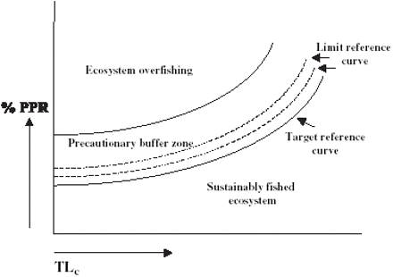
Figure 1 General theoretical framework based on the composite index %PPR–TL_{c} and ecosystem overfishing ...
Notes:
Figure 1 General theoretical framework based on the composite index %PPR–TLc and ecosystem overfishing status (after Tudela, 2003).
Unless provided in the caption above, the following copyright applies to the content of this slide: © 2005 International Council for the Exploration of the Sea

Slide 2
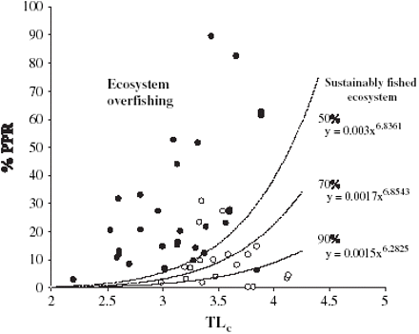
Figure 2 Ecosystem-based reference framework based on %PPR–TL_{c}, with reference functions related to 50%, ...
Notes:
Figure 2 Ecosystem-based reference framework based on %PPR–TLc, with reference functions related to 50%, 70%, and 90% belonging to a sustainably fished situation.
Unless provided in the caption above, the following copyright applies to the content of this slide: © 2005 International Council for the Exploration of the Sea

Slide 3
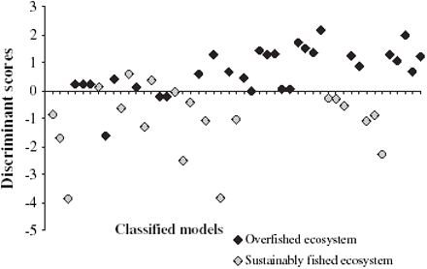
Figure 3 Discriminant scores from canonical discriminant analysis of pairs of %PPR–TL_{c} (the sequence of ...
Notes:
Figure 3 Discriminant scores from canonical discriminant analysis of pairs of %PPR–TLc (the sequence of models following that in Table 2a).
Unless provided in the caption above, the following copyright applies to the content of this slide: © 2005 International Council for the Exploration of the Sea

Slide 4
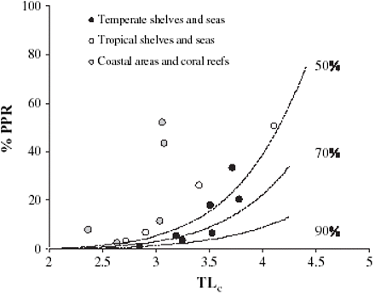
Figure 4 Previously unclassified pairs of %PPR–TL_{c} (Table 2b) plotted within the ecosystem-based ...
Notes:
Figure 4 Previously unclassified pairs of %PPR–TLc (Table 2b) plotted within the ecosystem-based operational reference framework.
Unless provided in the caption above, the following copyright applies to the content of this slide: © 2005 International Council for the Exploration of the Sea

