Slide 1
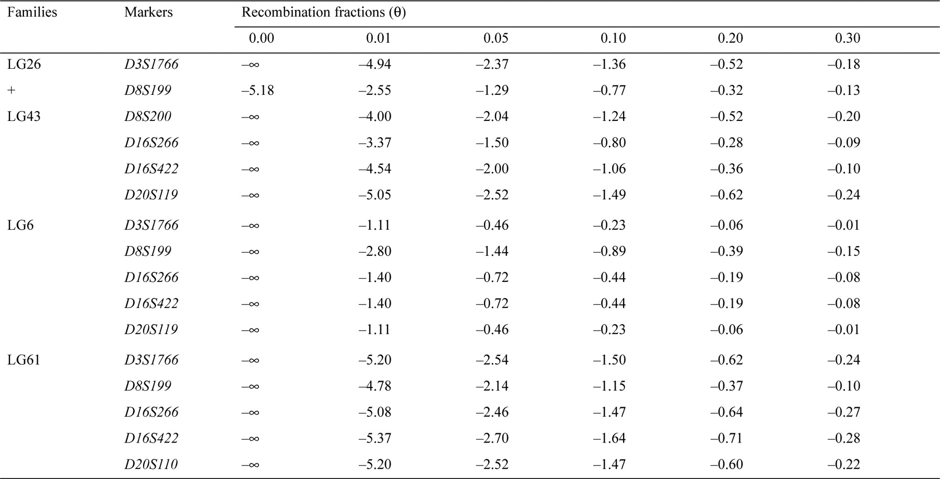
Table 1 Results of two-point linkage analysis between the disease gene and the informative markers from the candidate ...
Notes:
Table 1 Results of two-point linkage analysis between the disease gene and the informative markers from the candidate region of the DGC
Unless provided in the caption above, the following copyright applies to the content of this slide: © 1996 Oxford University Press

Slide 2
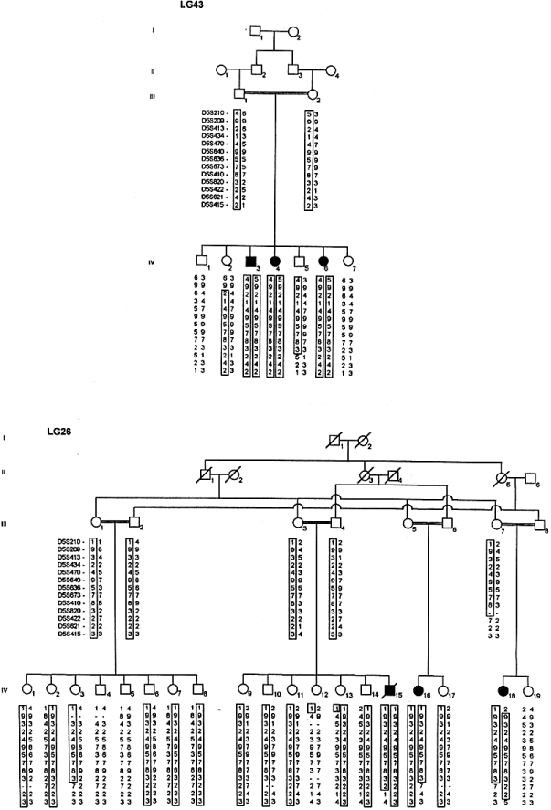
Figure 1 Haplotypes with 5q33–34 markers in the two 5q-linked families. The frequencies of the alleles for each ...
Notes:
Figure 1 Haplotypes with 5q33–34 markers in the two 5q-linked families. The frequencies of the alleles for each marker loci that are in homozygosity in the affecteds of both families are the following: D5S470 (27%); D5S640 (26%), D5S636 (16%), D5S673 (36.5%), D5S410 (21%) and D5S820 (31%).
Unless provided in the caption above, the following copyright applies to the content of this slide: © 1996 Oxford University Press

Slide 3
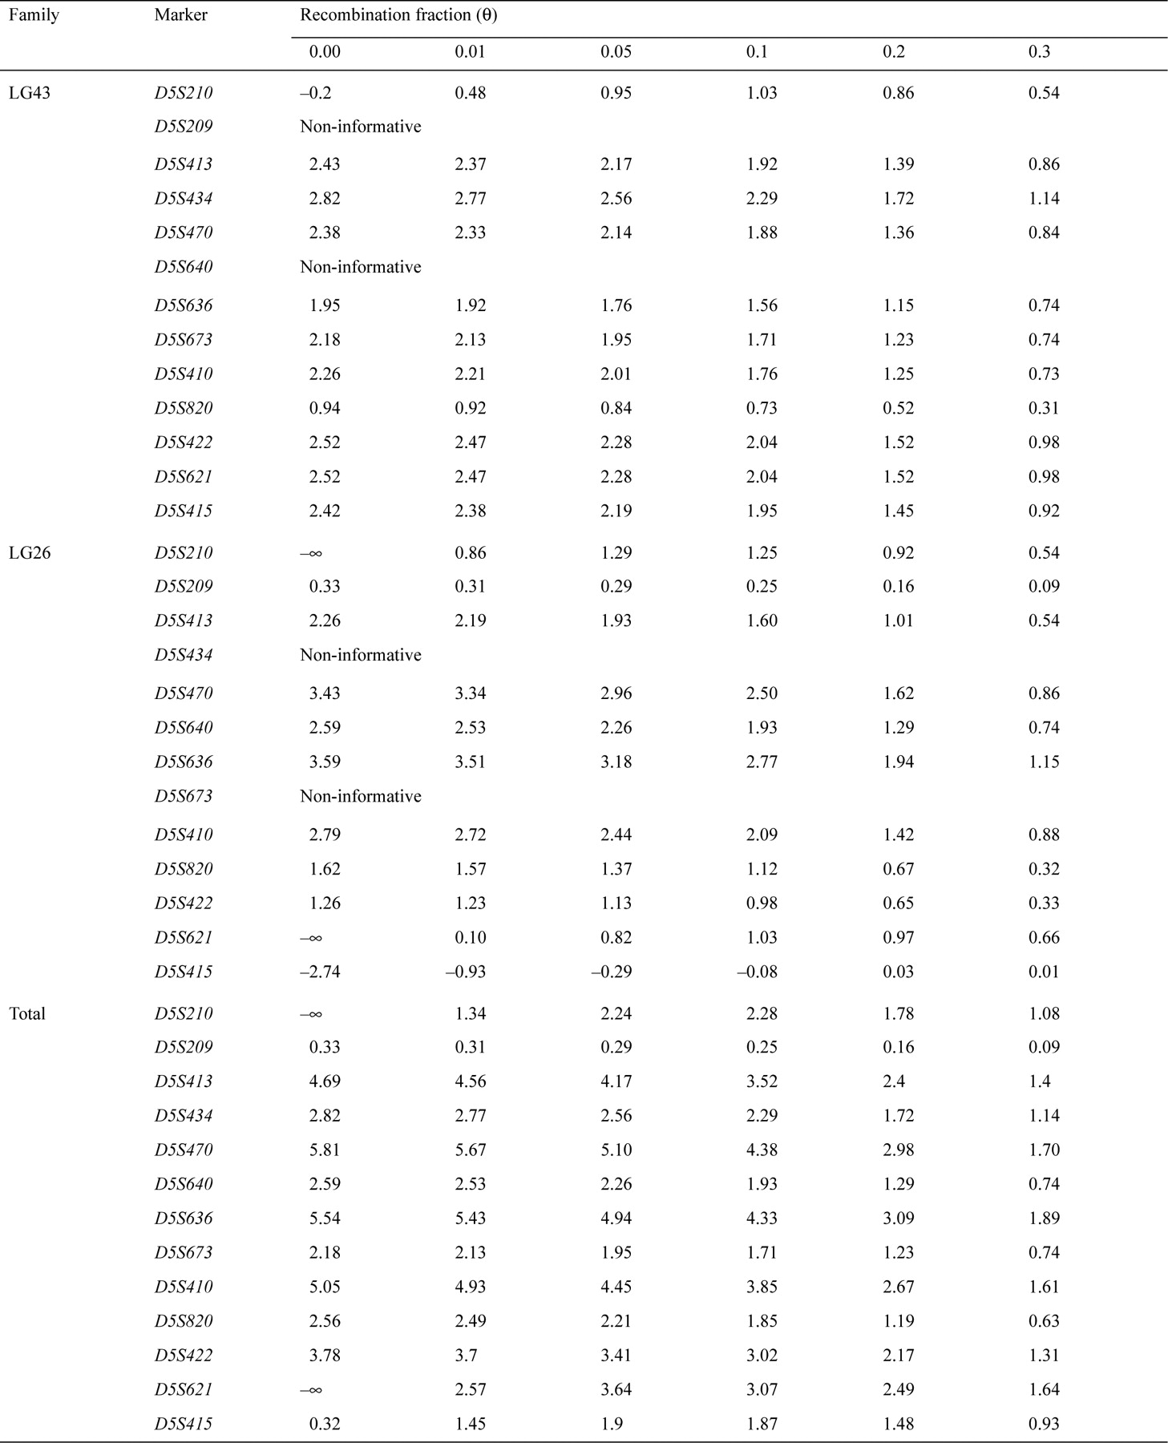
Table 2 Two-point linkage analysis between the disease gene and 5q33–34 markers
Notes:
Table 2 Two-point linkage analysis between the disease gene and 5q33–34 markers
Unless provided in the caption above, the following copyright applies to the content of this slide: © 1996 Oxford University Press

