Slide 1
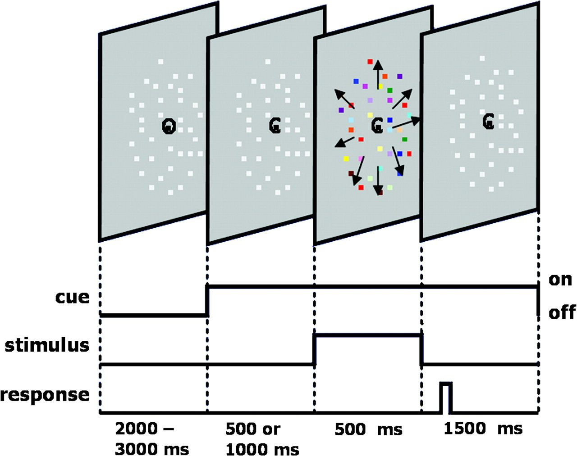
Figure 1. Schematic illustration of a trial sequence. Subjects covertly attended to either color or motion depending on ...
Notes:
Figure 1. Schematic illustration of a trial sequence. Subjects covertly attended to either color or motion depending on a visual cue (for color: C, for motion: M) and discriminated an attribute of the attended feature of the following stimulus as quickly and accurately as possible.
Unless provided in the caption above, the following copyright applies to the content of this slide: © The Author 2007. Published by Oxford University Press. All rights reserved. For permissions, please e-mail: journals.permissions@oxfordjournals.org

Slide 2
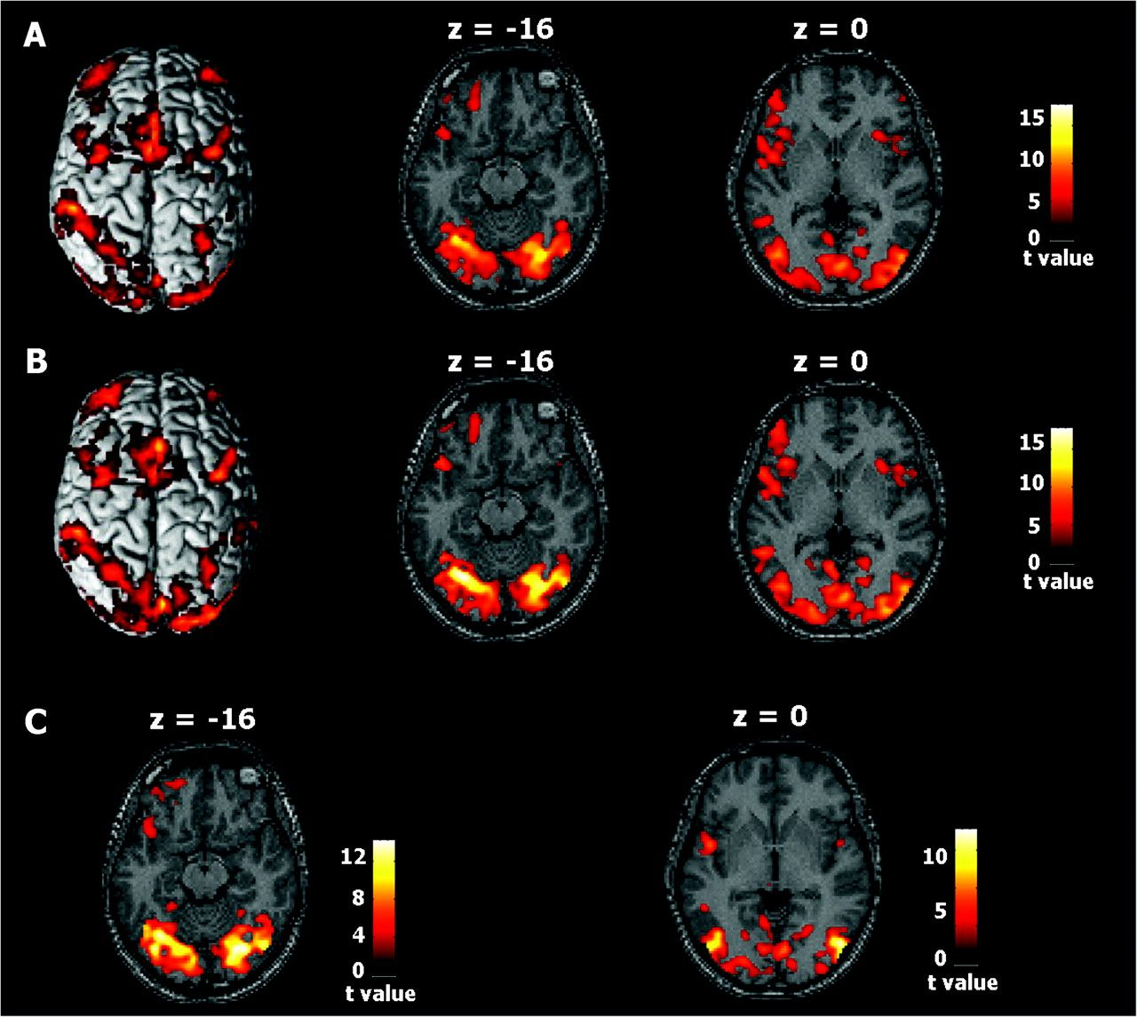
Figure 2. Activated brain areas in the fMRI experiments for subject YS. (A) Results of the selective attention fMRI ...
Notes:
Figure 2. Activated brain areas in the fMRI experiments for subject YS. (A) Results of the selective attention fMRI experiment in the color condition (P < 0.001, uncorrected; extent threshold of 30 voxels). (B) Results from the selective attention fMRI experiment in the motion condition (P < 0.001, uncorrected; extent threshold of 30 voxels). (C) Bilateral responses to the color stimulus (left) and motion stimulus (right) in the visual area specification experiment (P < 0.001, uncorrected; extent threshold of 30 voxels).
Unless provided in the caption above, the following copyright applies to the content of this slide: © The Author 2007. Published by Oxford University Press. All rights reserved. For permissions, please e-mail: journals.permissions@oxfordjournals.org

Slide 3
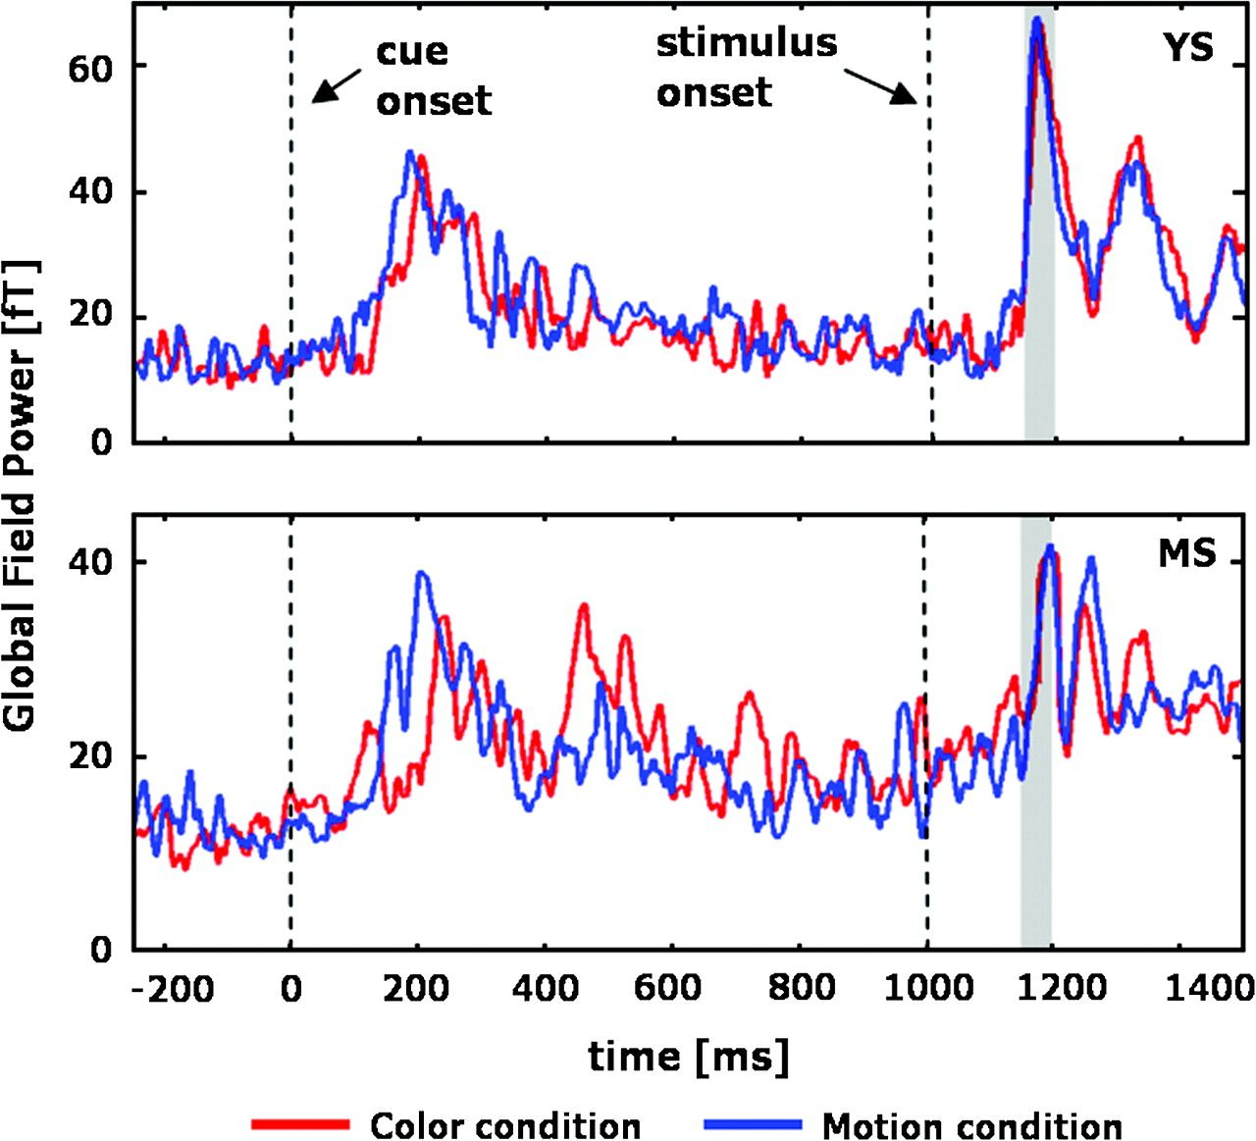
Figure 3. GFP plotted as a function of time for subject YS and MS. The onset times of the visual cue (0 ms) and ...
Notes:
Figure 3. GFP plotted as a function of time for subject YS and MS. The onset times of the visual cue (0 ms) and stimulus (1000 ms) are demarcated by vertical dotted lines. GFP is shown for attention to color (red line) and attention to motion (blue line). The gray shading shows the period of time used for the specification of ROIs.
Unless provided in the caption above, the following copyright applies to the content of this slide: © The Author 2007. Published by Oxford University Press. All rights reserved. For permissions, please e-mail: journals.permissions@oxfordjournals.org

Slide 4
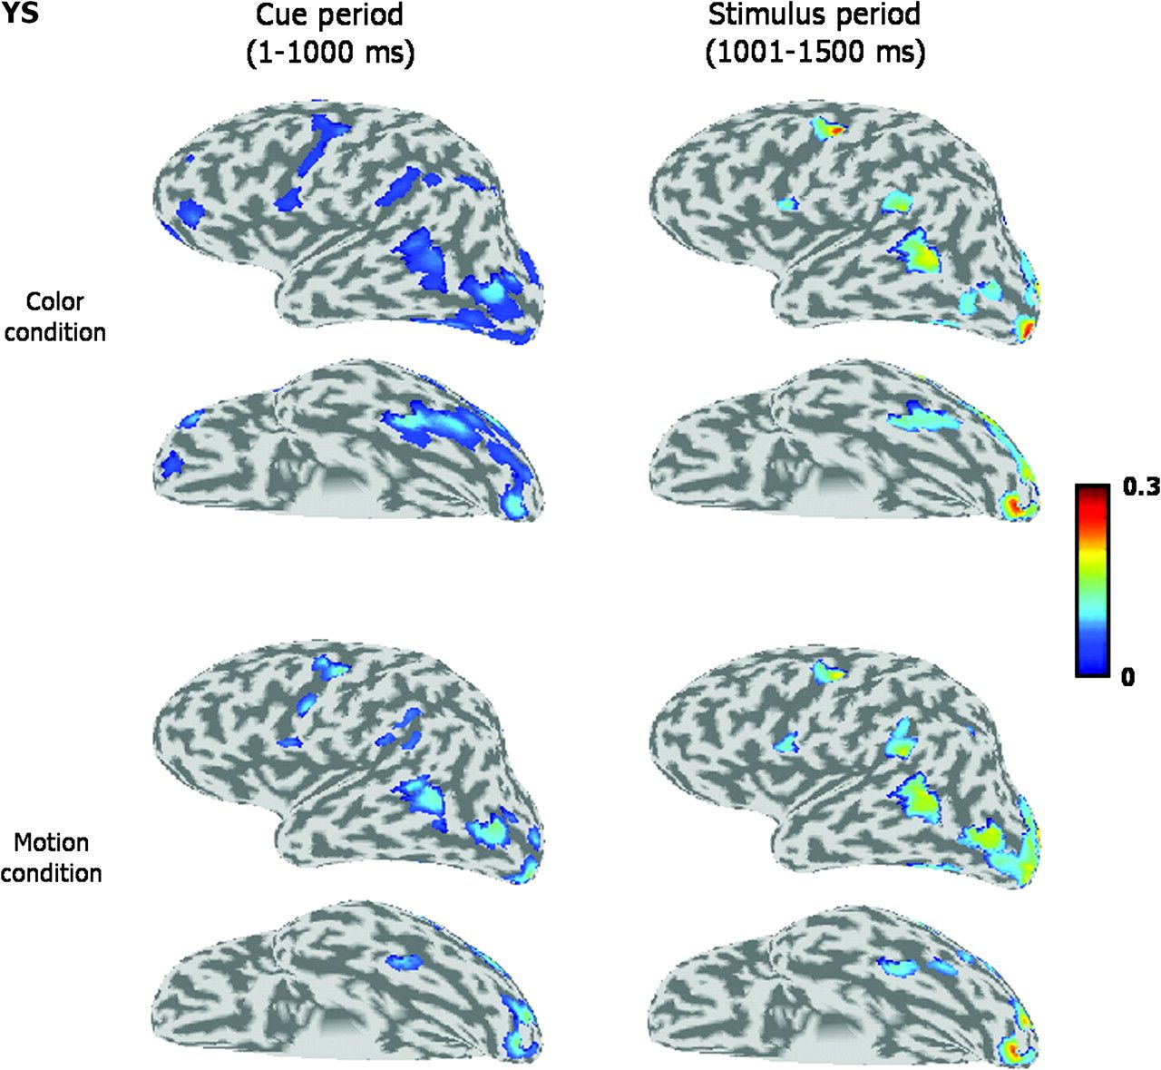
Figure 4. The spatial map of the mean current amplitude in the left inflated brain of subject YS during the cue period ...
Notes:
Figure 4. The spatial map of the mean current amplitude in the left inflated brain of subject YS during the cue period (left) and the stimulus period (right) in the color condition (top) and the motion condition (bottom).
Unless provided in the caption above, the following copyright applies to the content of this slide: © The Author 2007. Published by Oxford University Press. All rights reserved. For permissions, please e-mail: journals.permissions@oxfordjournals.org

Slide 5
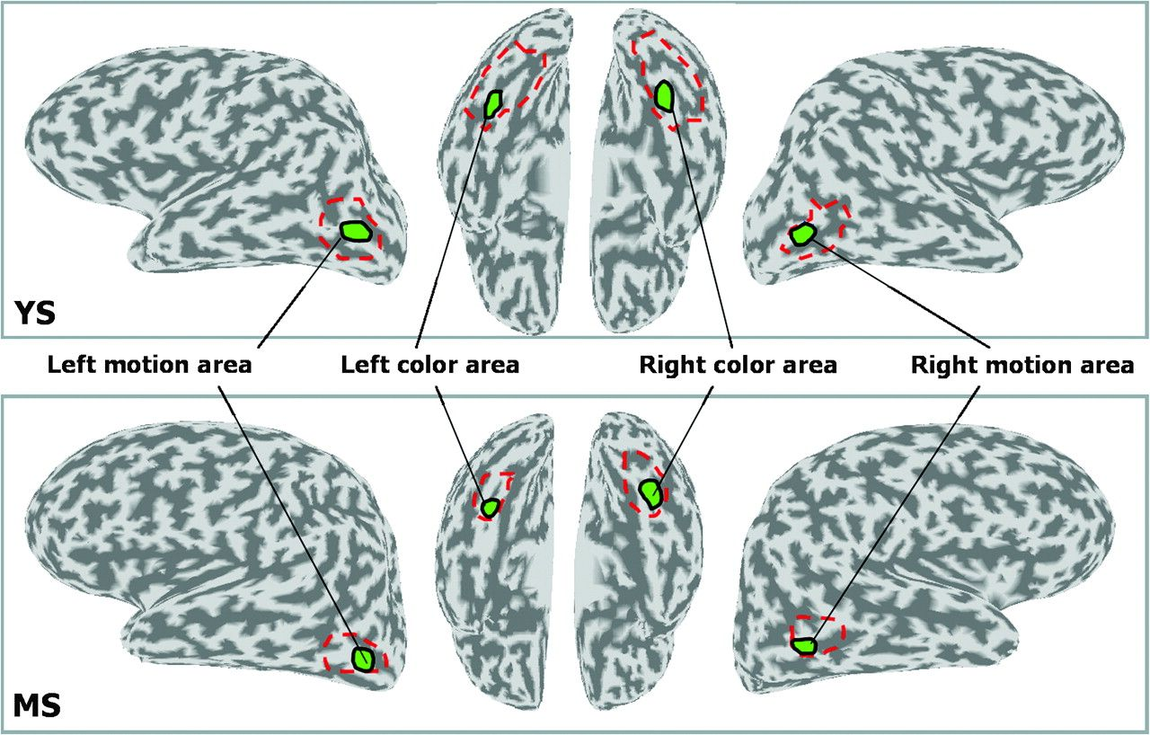
Figure 5. Four ROIs within feature-sensitive areas for subject YS and MS. Each ROI (indicated by green enclosure) was ...
Notes:
Figure 5. Four ROIs within feature-sensitive areas for subject YS and MS. Each ROI (indicated by green enclosure) was placed within the region determined by the visual area specification fMRI experiment (indicated by red broken lines). The Talairach coordinates of the ROI center for subject YS are (−34, −64, −16) for the left color-sensitive area; (45, −62, −14) for the right color-sensitive area; (−44, −67, 0) for the left motion-sensitive area; and (46, −66, 2) for the right motion-sensitive area. The Talairach coordinates of the ROI center for subject MS are (−32, −50, −20) for the left color-sensitive area; (36, −54, −18) for the right color-sensitive area; (−49, −61, −2) for the left motion-sensitive area; and (58, −60, −1) for the right motion-sensitive area.
Unless provided in the caption above, the following copyright applies to the content of this slide: © The Author 2007. Published by Oxford University Press. All rights reserved. For permissions, please e-mail: journals.permissions@oxfordjournals.org

Slide 6
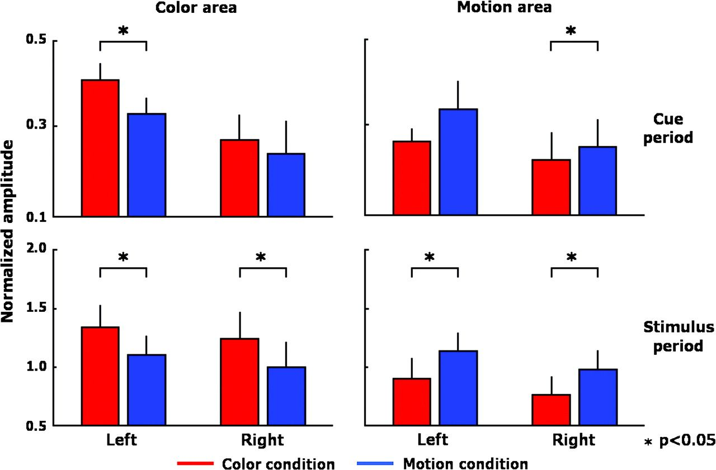
Figure 6. Comparison of the mean current amplitudes within each feature-sensitive area and each period (6 subjects). ...
Notes:
Figure 6. Comparison of the mean current amplitudes within each feature-sensitive area and each period (6 subjects). Each bar (+SE) shows the mean current amplitudes for color (red bars) and the motion (blue bars) conditions.
Unless provided in the caption above, the following copyright applies to the content of this slide: © The Author 2007. Published by Oxford University Press. All rights reserved. For permissions, please e-mail: journals.permissions@oxfordjournals.org

Slide 7
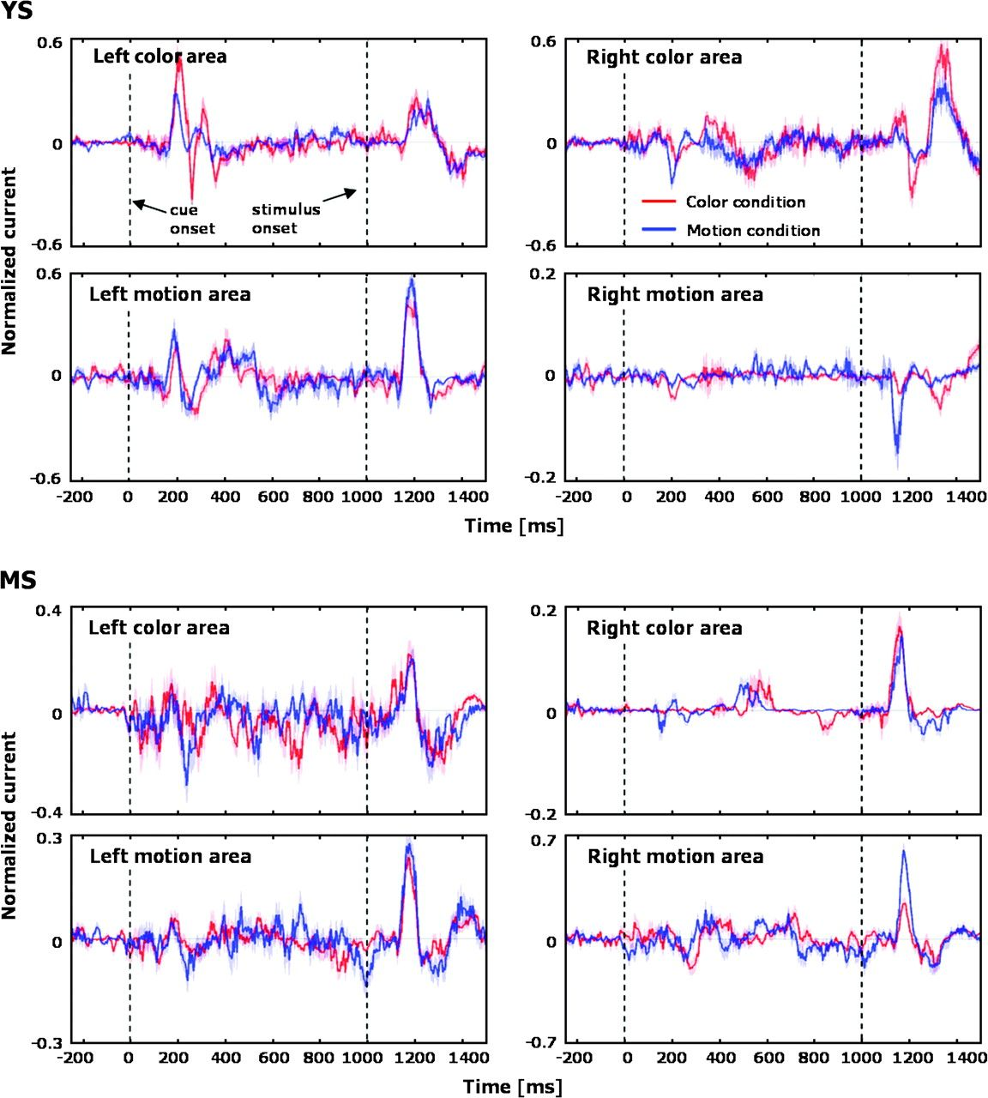
Figure 7. Trial average of the estimated current time courses within each feature-sensitive area for subject YS and MS. ...
Notes:
Figure 7. Trial average of the estimated current time courses within each feature-sensitive area for subject YS and MS. The onset times of the cue (0 ms) and the stimulus (1000 ms) are demarcated by vertical broken lines. Current is shown for attention to color (red line) and attention to motion (blue line). Red and blue shadings indicate the SE for the color and motion conditions, respectively.
Unless provided in the caption above, the following copyright applies to the content of this slide: © The Author 2007. Published by Oxford University Press. All rights reserved. For permissions, please e-mail: journals.permissions@oxfordjournals.org

Slide 8
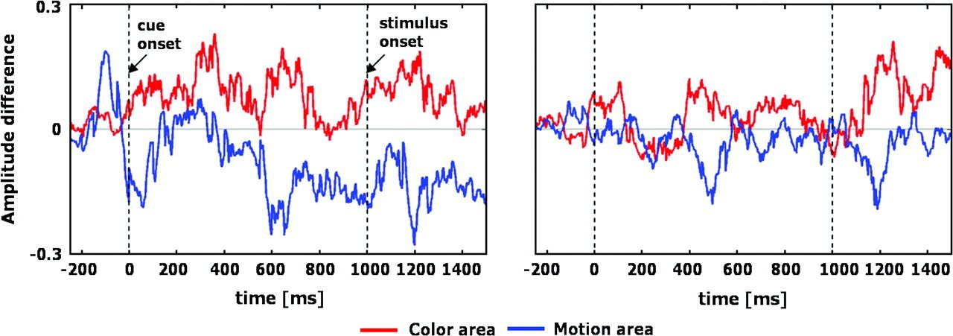
Figure 8. Mean differences of current amplitudes in the left hemisphere (left) and right hemisphere (right) across ...
Notes:
Figure 8. Mean differences of current amplitudes in the left hemisphere (left) and right hemisphere (right) across subjects, as calculated by subtraction of the amplitude of the motion condition from that in the color condition. Red and blue lines show the time course for color- and motion-sensitive areas, respectively.
Unless provided in the caption above, the following copyright applies to the content of this slide: © The Author 2007. Published by Oxford University Press. All rights reserved. For permissions, please e-mail: journals.permissions@oxfordjournals.org

Slide 9
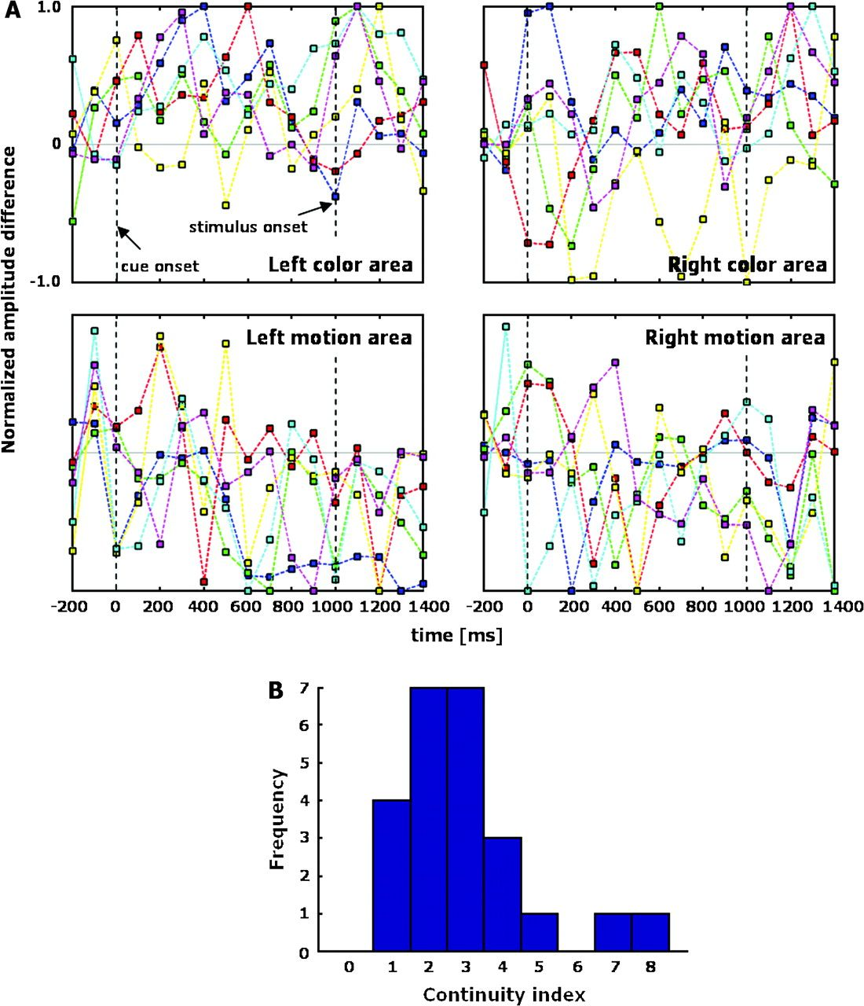
Figure 9. (A) Normalized difference of the estimated current amplitudes plotted for each subject within each ...
Notes:
Figure 9. (A) Normalized difference of the estimated current amplitudes plotted for each subject within each feature-sensitive area. Each colored broken line corresponds to 1 subject, and each square marker corresponds to the amplitude difference between 2 conditions averaged over 100 ms. (B) Histogram of a continuity index for all feature-sensitive areas and all subjects. See text for a definition of the continuity index.
Unless provided in the caption above, the following copyright applies to the content of this slide: © The Author 2007. Published by Oxford University Press. All rights reserved. For permissions, please e-mail: journals.permissions@oxfordjournals.org

