Slide 1
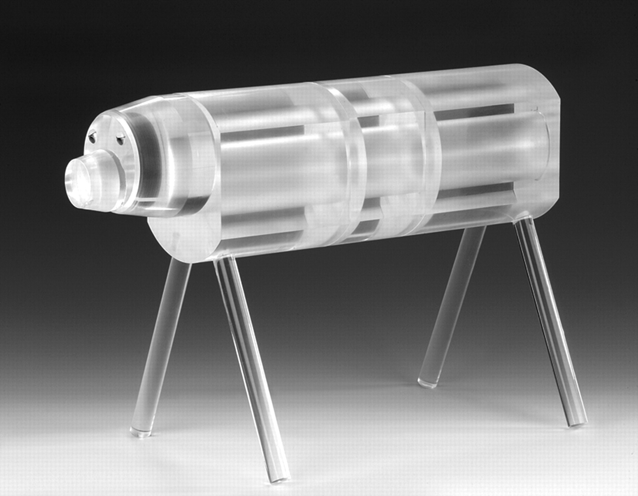
Figure 1. Cat phantom made of polymethylmethacrylate.
Notes:
Figure 1. Cat phantom made of polymethylmethacrylate.
Unless provided in the caption above, the following copyright applies to the content of this slide: © The Author 2010. Published by Oxford University Press. All rights reserved. For Permissions, please email: journals.permissions@oup.com

Slide 2
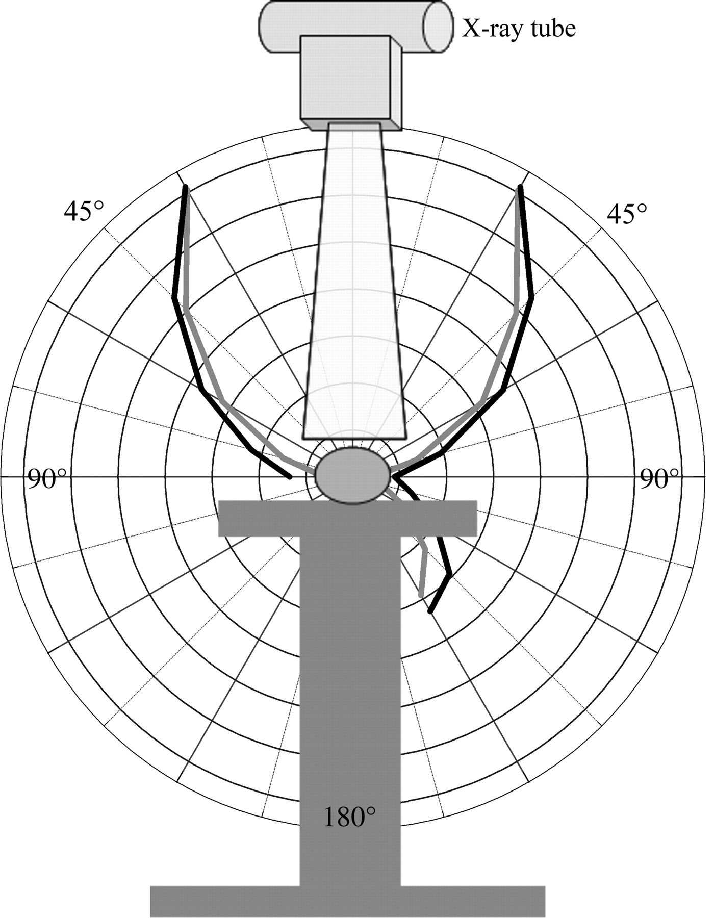
Figure 2. Schematic diagram of the angular distribution of scattered radiation during an X-ray examination of an animal ...
Notes:
Figure 2. Schematic diagram of the angular distribution of scattered radiation during an X-ray examination of an animal with a RQR5 radiation quality. The lines show the measured (Grey: secondary standard chamber HS01) and simulated (Black: MCNP5) dose distribution of the cat phantom (Figure 1), but without any table (only drawn for illustration).
Unless provided in the caption above, the following copyright applies to the content of this slide: © The Author 2010. Published by Oxford University Press. All rights reserved. For Permissions, please email: journals.permissions@oup.com

