Slide 1
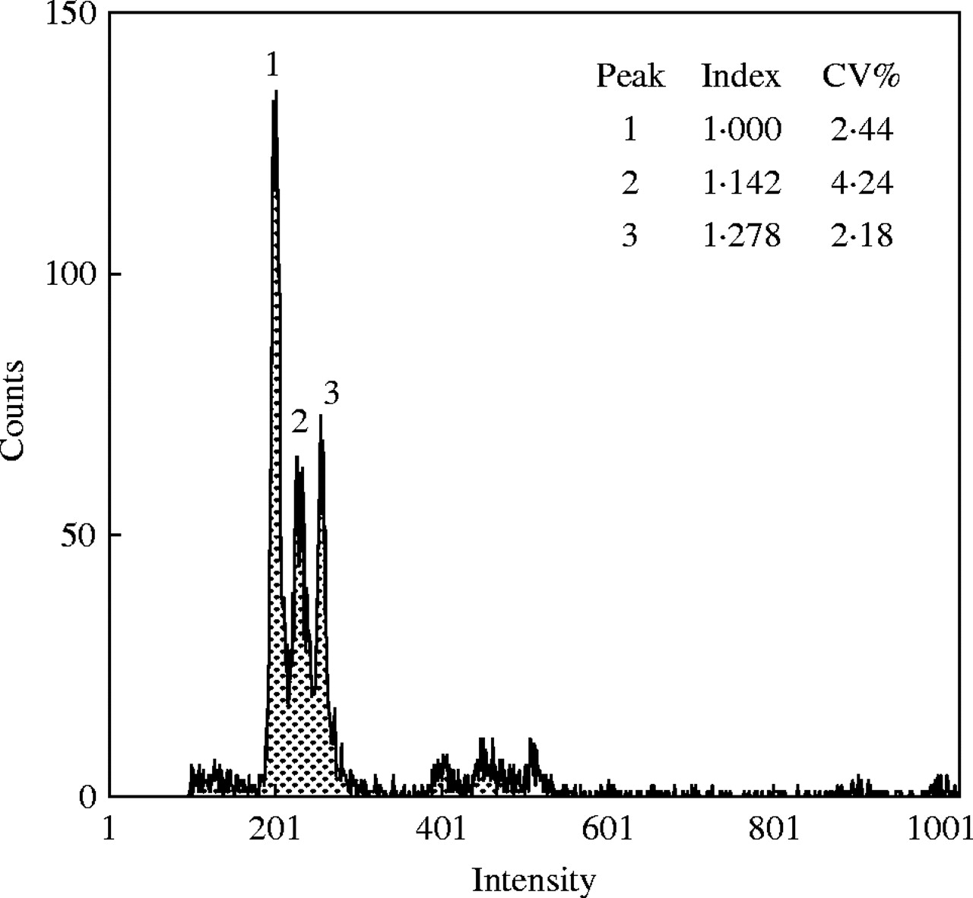
Fig. 1. Simultaneous DNA flow cytometric separation of two individuals of Dasypyrum villosum from two accessions (IPK ...
Notes:
Fig. 1. Simultaneous DNA flow cytometric separation of two individuals of Dasypyrum villosum from two accessions (IPK Gatersleben germplasm collection) differing, on average, about 1·08-fold in genome size. The G1 peaks: (1) Pisum sativum ‘Kleine Rheinländerin’; (2) D. villosum GRA 992/88; (3) GRA 1305/91. From R. Obermayer and J. Greilhuber (unpubl. res.).
Unless provided in the caption above, the following copyright applies to the content of this slide: Annals of Botany 95/1 © Annals of Botany Company 2005; all rights reserved

Slide 2
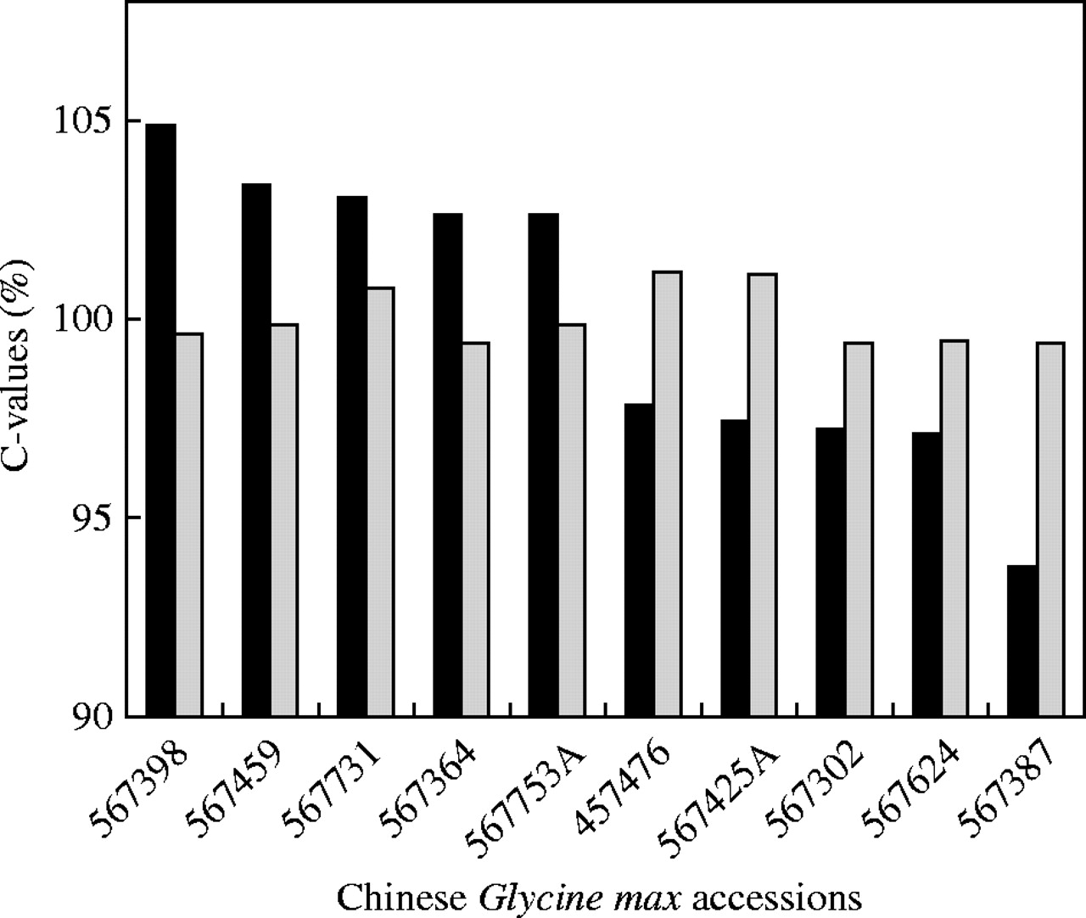
Fig. 2. Genome size variation in Chinese Glycine max (USDA germplasm collection). Five accessions ranking highest and ...
Notes:
Fig. 2. Genome size variation in Chinese Glycine max (USDA germplasm collection). Five accessions ranking highest and lowest, respectively, in Rayburn et al. (1997) (filled columns) as re-analysed by Obermayer and Greilhuber (1999) (open columns).
Unless provided in the caption above, the following copyright applies to the content of this slide: Annals of Botany 95/1 © Annals of Botany Company 2005; all rights reserved

Slide 3
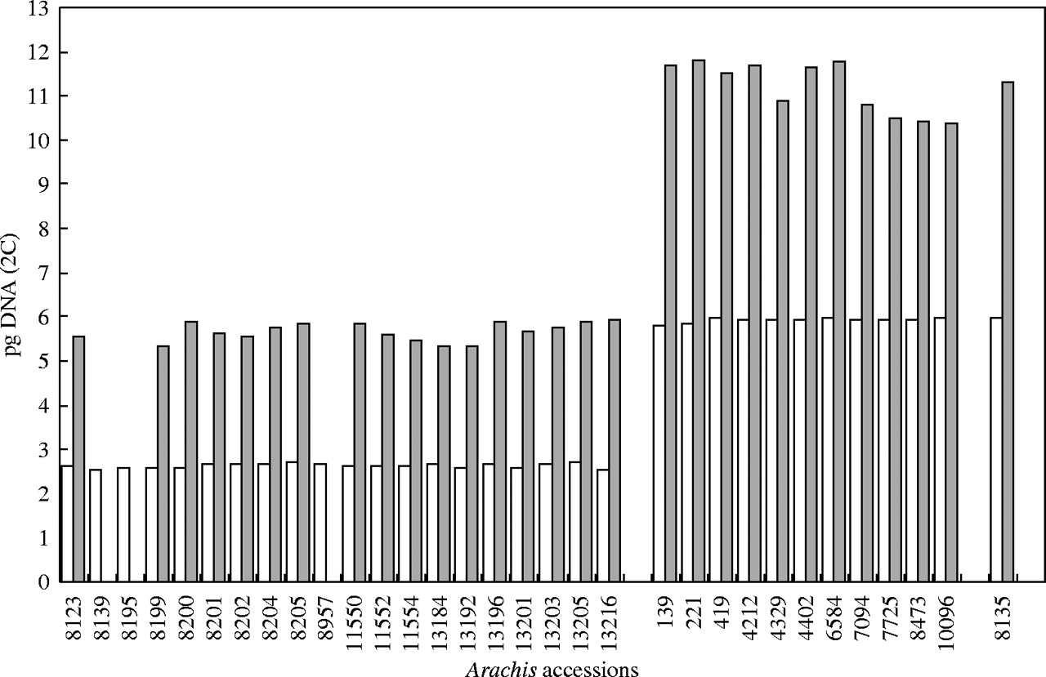
Fig. 3. A comparison of genome size measurement results in accessions of Arachis duranensis (rows 8123–13216), A. ...
Notes:
Fig. 3. A comparison of genome size measurement results in accessions of Arachis duranensis (rows 8123–13216), A. hypogaea (rows 139–10096) and its wild progenitor A. monticola (row 8135) (ICRISAT germplasm collection, Patancheru, India) by Singh et al. (1996) (dark columns) and by Temsch and Greilhuber (2000, 2001) (white columns). Original figure by E. M. Temsch.
Unless provided in the caption above, the following copyright applies to the content of this slide: Annals of Botany 95/1 © Annals of Botany Company 2005; all rights reserved

Slide 4
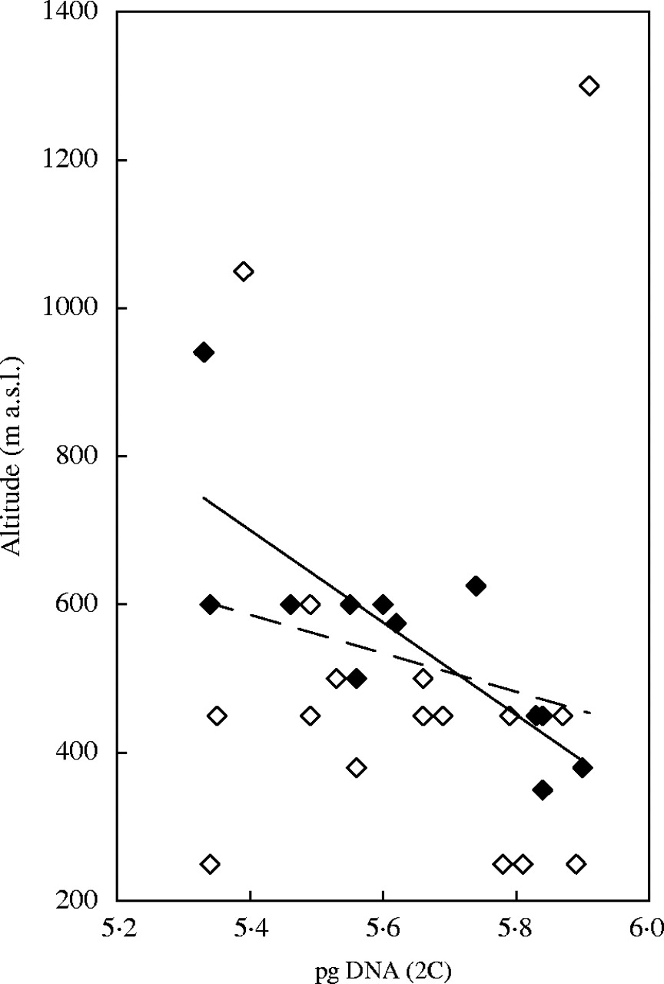
Fig. 4. Diagram showing the available data in Arachis duranensis on the altitude above sea level of collection sites ...
Notes:
Fig. 4. Diagram showing the available data in Arachis duranensis on the altitude above sea level of collection sites (Stalker et al., 2003) correlated against the genome size measurements by Singh et al. (1996). The data points included by Singh et al. (1996) are shown in black (r = −0·778, P ≤ 0·005), those not included are shown in white. The overall correlation is not significant (r = −0·210, P = 0·283). Original figure by E. M. Temsch.
Unless provided in the caption above, the following copyright applies to the content of this slide: Annals of Botany 95/1 © Annals of Botany Company 2005; all rights reserved

Slide 5
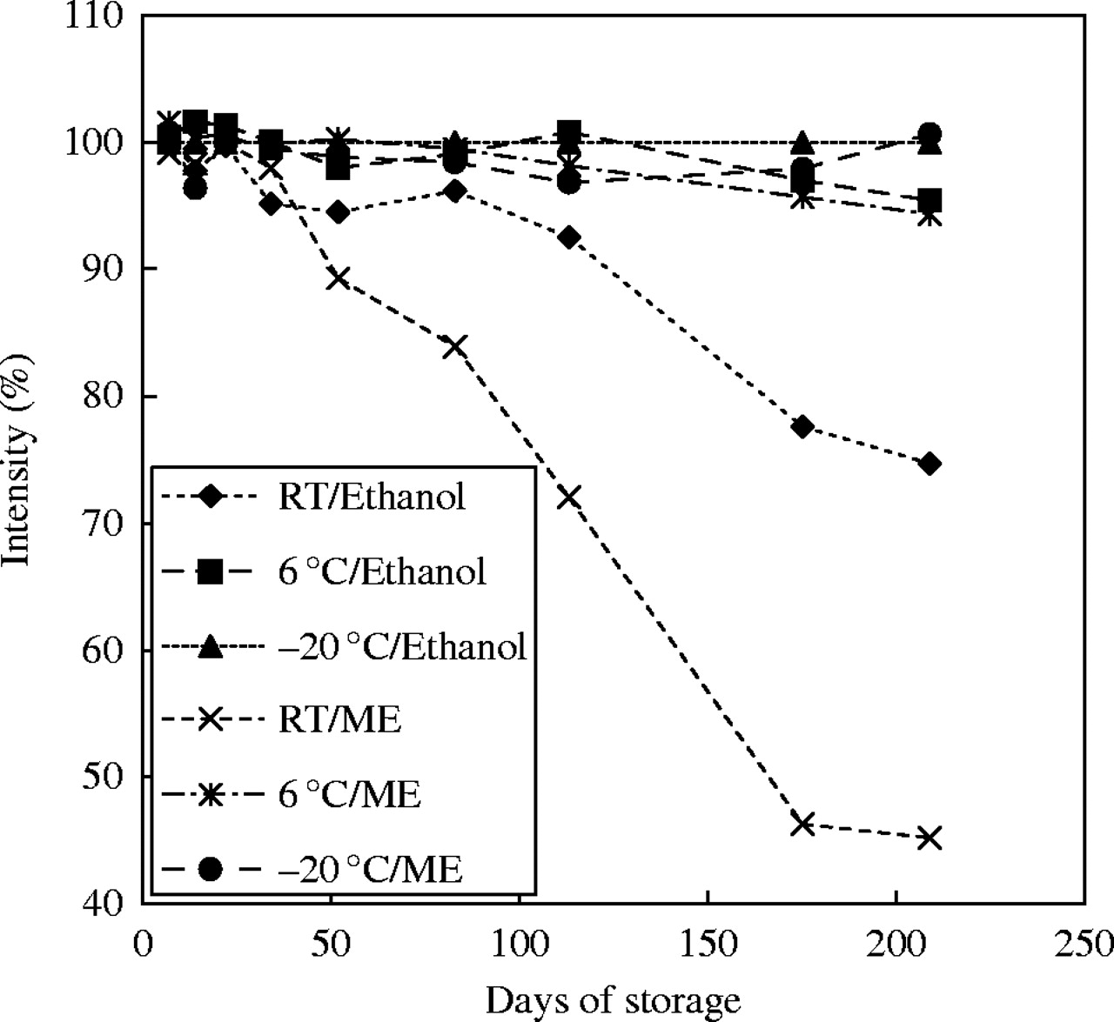
Fig. 5. Quality decay of fixations over time, shown as reduction in Feulgen staining intensity, in Pisum sativum root ...
Notes:
Fig. 5. Quality decay of fixations over time, shown as reduction in Feulgen staining intensity, in Pisum sativum root tip meristems, stored in acetic methanol or 96 % ethanol, at room temperature, in the refrigerator (approx. 6 °C), and at −20 °C. At any point of time the telophase DNA content of deep-frozen ethanol stored root tips served as reference (100 %) (20 telophase nuclei were measured in each of two or three slides).
Unless provided in the caption above, the following copyright applies to the content of this slide: Annals of Botany 95/1 © Annals of Botany Company 2005; all rights reserved

Slide 6
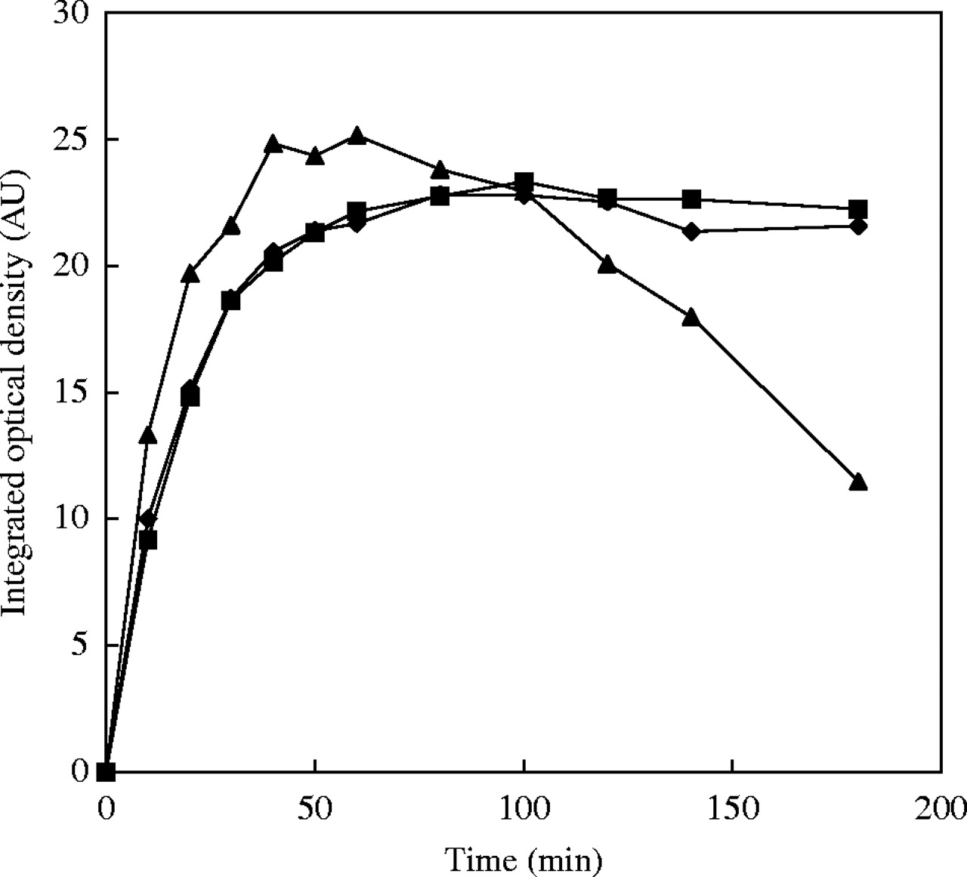
Fig. 6. Hydrolysis curves of Pisum sativum root tip meristems, fixed either in acetic methanol (triangles) or 4 % ...
Notes:
Fig. 6. Hydrolysis curves of Pisum sativum root tip meristems, fixed either in acetic methanol (triangles) or 4 % buffered formaldehyde for 1·5 h, stored at −20 °C overnight (squares) or for 69 weeks (diamonds). From Greilhuber and Temsch (2001).
Unless provided in the caption above, the following copyright applies to the content of this slide: Annals of Botany 95/1 © Annals of Botany Company 2005; all rights reserved

Slide 7
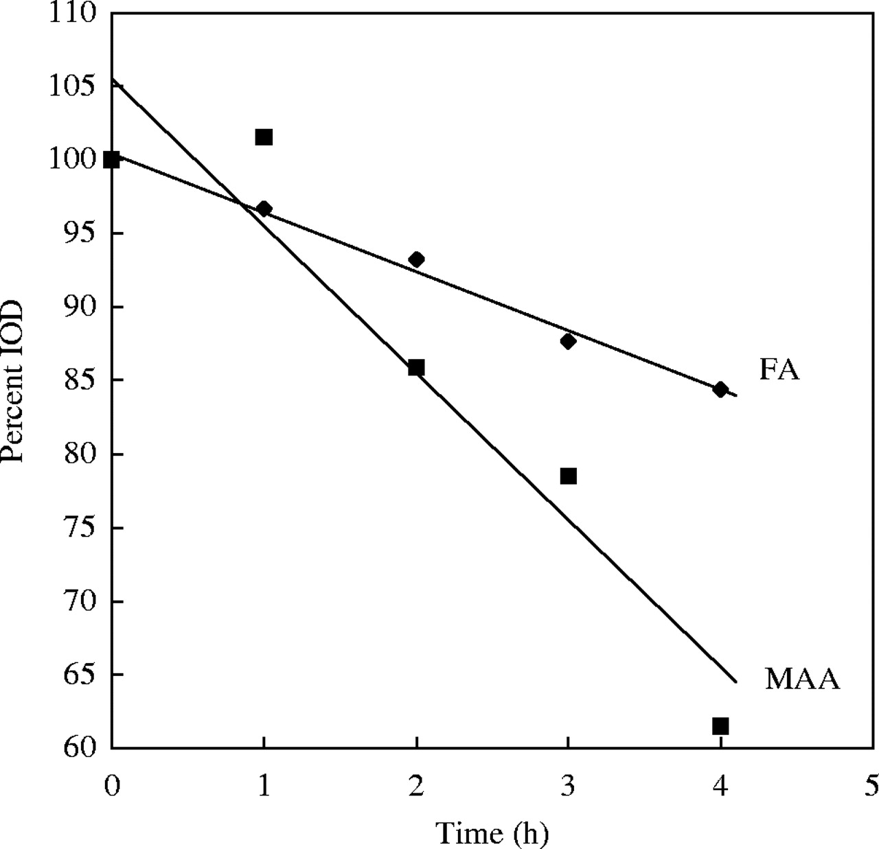
Fig. 7. Influence of post-hydrolysis washes in distilled water at room temperature on Feulgen stainability of Pisum ...
Notes:
Fig. 7. Influence of post-hydrolysis washes in distilled water at room temperature on Feulgen stainability of Pisum sativum meristems, fixed either with acetic methanol (MAA) or 4 % buffered formaldehyde (FA). Integrated optical density (IOD) at any point of time is expressed in percentage of IOD as found after a 5-min wash. From Greilhuber and Temsch (2001).
Unless provided in the caption above, the following copyright applies to the content of this slide: Annals of Botany 95/1 © Annals of Botany Company 2005; all rights reserved

