Slide 1
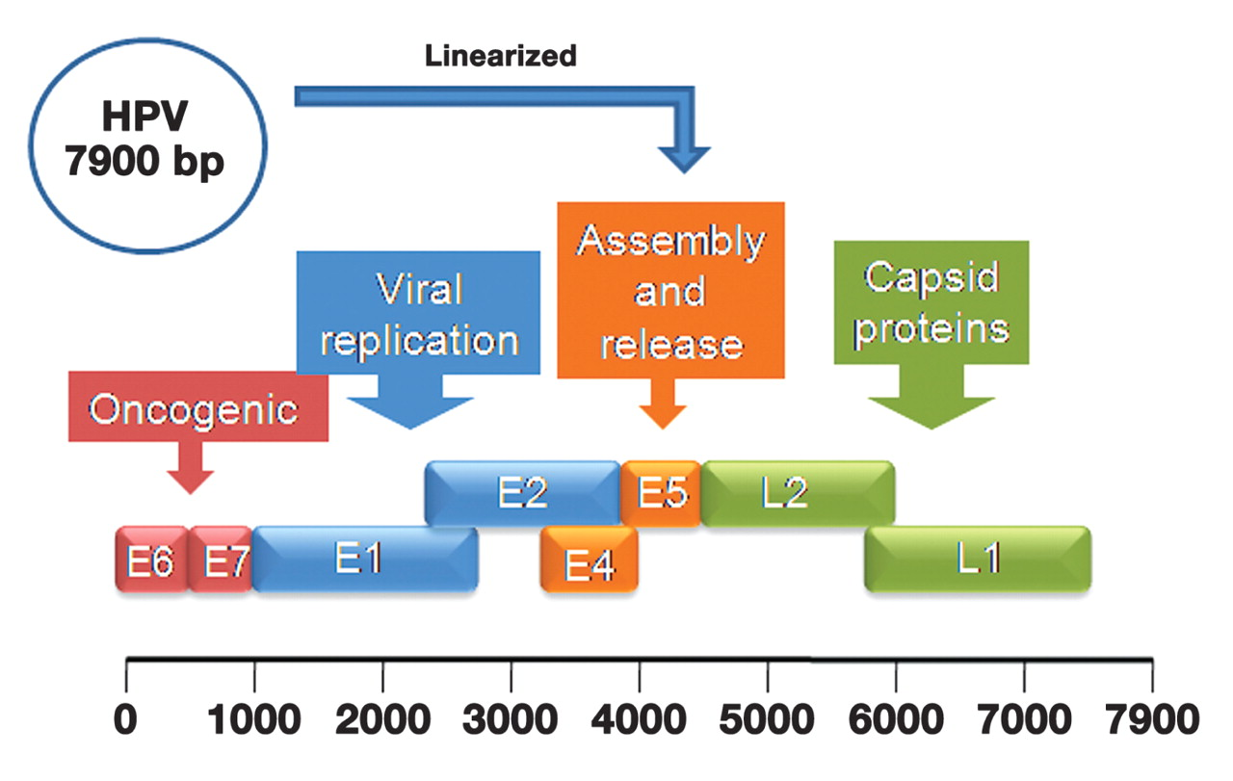
Figure 1 HPV Genome. The HPV genome is a circular molecule of approximately 7900 base pairs. The schematic shows the ...
Notes:
Figure 1 HPV Genome. The HPV genome is a circular molecule of approximately 7900 base pairs. The schematic shows the approximate location of the 8 overlapping reading frames in a linear orientation. The L1 gene, which codes for viral capsid protein, is the primary target for amplification and detection of HPV DNA. The E6 and E7 genes are responsible for the role of HPV in cervical cancer.
Unless provided in the caption above, the following copyright applies to the content of this slide: © American Society of Clinical Pathologists

Slide 2
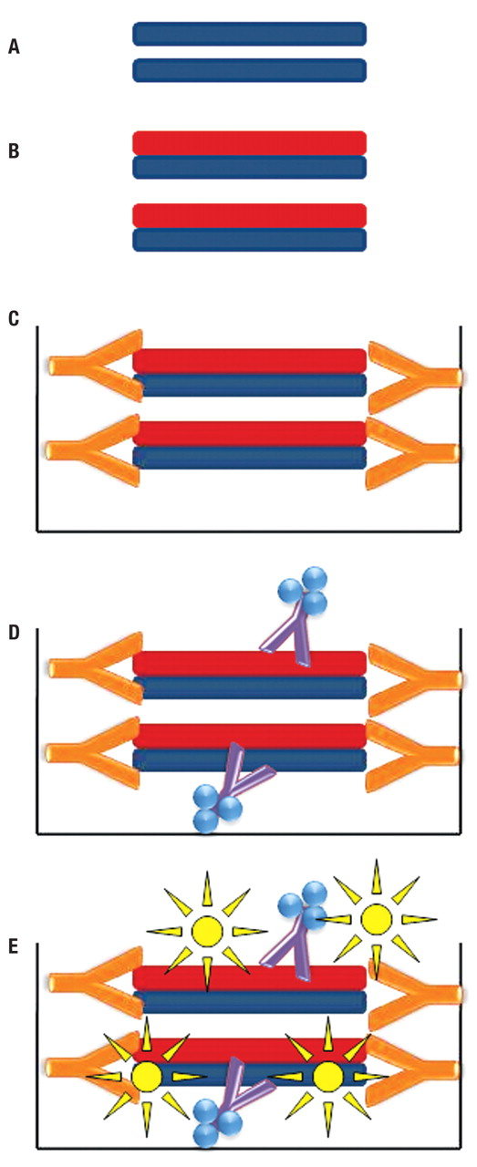
Figure 2 Hybrid Capture Schematic. The schematic shows the basic steps of a hybrid capture assay. (A) The ...
Notes:
Figure 2 Hybrid Capture Schematic. The schematic shows the basic steps of a hybrid capture assay. (A) The double-stranded DNA of the target is denatured, (B) followed by hybridization of a target-specific RNA probe, forming a DNA:RNA hybrid. (C) The hybrid is applied to a microwell plate coated with antibody binding DNA:RNA complexes, thus capturing the hybrid. (D) Alkaline phosphatase conjugated antibodies bind the captured hybrids. (E) A chemiluminescent substrate is added, which results in a detectable signal proportionate to the amount of target DNA.
Unless provided in the caption above, the following copyright applies to the content of this slide: © American Society of Clinical Pathologists

Slide 3
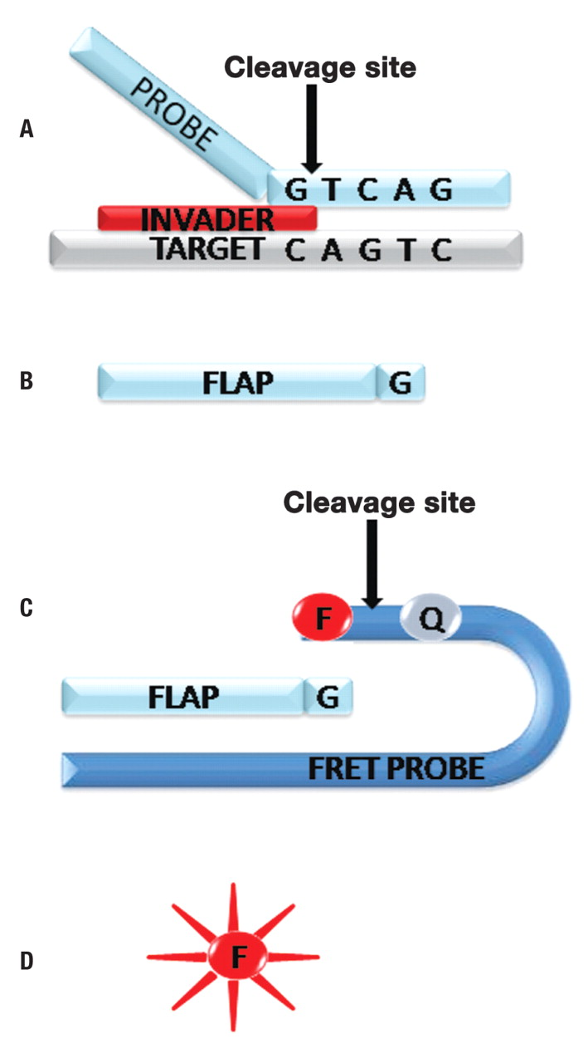
Figure 3 Invader Technology Schematic. The schematic shows the major steps of a signal amplification assay using ...
Notes:
Figure 3 Invader Technology Schematic. The schematic shows the major steps of a signal amplification assay using Invader technology. The target DNA is denatured, and a sequence-specific probe binds in conjunction with an Invader oligo. (A) The formation of this complex results in cleavage at the indicated site. (B) Cleavage releases a free flap of the probe molecule. Multiple flaps are generated from each target DNA molecule. (C) The flap then associates with a FRET probe, resulting in cleavage at the indicated site. (D) The fluorophore, F, is released from the quencher, Q, causing a fluorescent signal proportionate to the amount of target DNA.
Unless provided in the caption above, the following copyright applies to the content of this slide: © American Society of Clinical Pathologists

