Slide 1
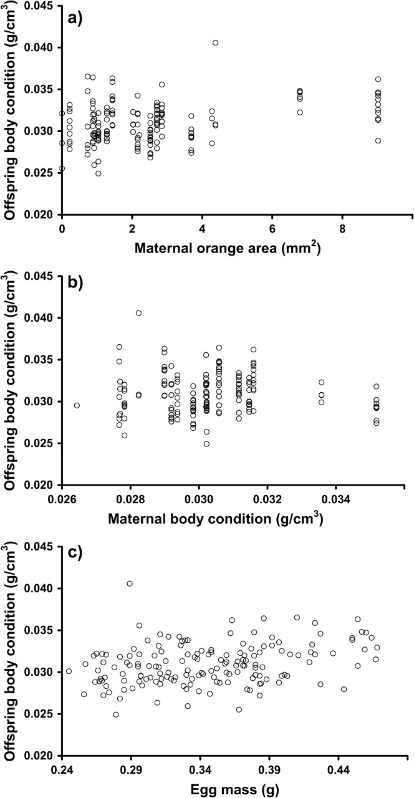
Figure 1 The bivariate relationship between offspring body condition and maternal (a) orange area and (b) body ...
Notes:
Figure 1 The bivariate relationship between offspring body condition and maternal (a) orange area and (b) body condition at the time of peak ornament expression and (c) egg mass. Offspring body condition measurements from days 1, 5, 10, 20, 30, 45, 60, 75, 90, and 180 posthatch were averaged for each individual. Vertical groupings in (a) and (b) indicate offspring from one or a few females.
Unless provided in the caption above, the following copyright applies to the content of this slide: © The Author 2009. Published by Oxford University Press on behalf of the International Society for Behavioral Ecology. All rights reserved. For permissions, please e-mail: journals.permissions@oxfordjournals.org

Slide 2
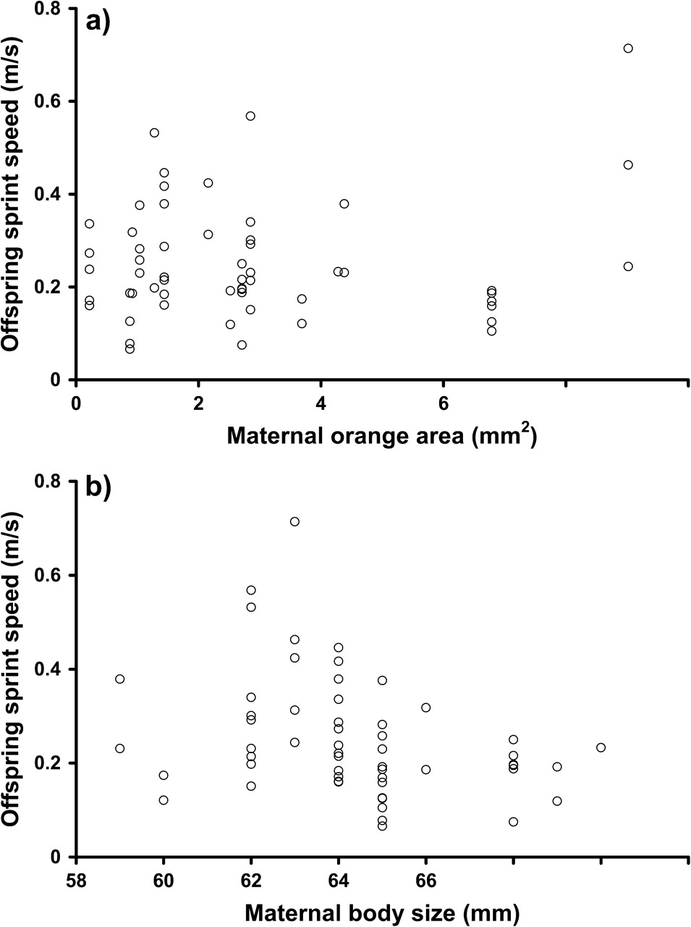
Figure 2 The relationship between offspring sprint speed at day 180 and maternal (a) orange area and (b) body size at ...
Notes:
Figure 2 The relationship between offspring sprint speed at day 180 and maternal (a) orange area and (b) body size at the time of peak ornament expression. Vertical groupings indicate offspring from one or a few females.
Unless provided in the caption above, the following copyright applies to the content of this slide: © The Author 2009. Published by Oxford University Press on behalf of the International Society for Behavioral Ecology. All rights reserved. For permissions, please e-mail: journals.permissions@oxfordjournals.org

