Slide 1
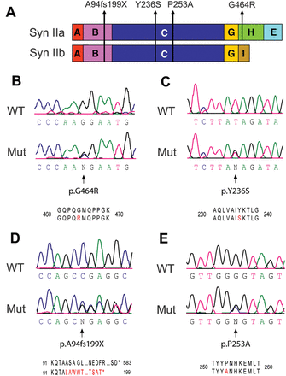
Figure 1. Nonsense and missense mutations identified in SYN2 and associated with ASD. (A) Modular structure of the a ...
Notes:
Figure 1. Nonsense and missense mutations identified in SYN2 and associated with ASD. (A) Modular structure of the a and b splicing isoforms of Syn II and location of the four mutations linked to ASD/epilepsy identified in this study. While the p.A94fs199X mutation [domain (B)] and the p.Y236S/p.P253A mutations [domain (C)] involve NH2-terminal domains shared by the two isoforms, the p.G464R mutation is localized to the proline-rich H domain that is specific for Syn IIa. (B–E) Sequence analysis showing the identification of the p.G464R (B), p.Y236S (C), p.A94fs199X (D) and p.P253A (E) mutations in SYN2.
Unless provided in the caption above, the following copyright applies to the content of this slide: © The Author 2013. Published by Oxford University Press.This is an Open Access article distributed under the terms of the Creative Commons Attribution License (http://creativecommons.org/licenses/by/3.0/), which permits unrestricted reuse, distribution, and reproduction in any medium, provided the original work is properly cited.

Slide 2
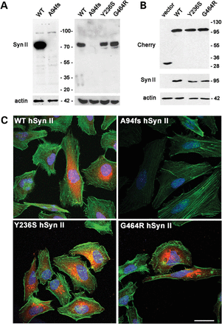
Figure 2. The nonsense hSyn II mutant is not expressed, while the missense mutants are expressed at normal levels in ...
Notes:
Figure 2. The nonsense hSyn II mutant is not expressed, while the missense mutants are expressed at normal levels in both HeLa cells and SYN2 KO neurons. (A) Expression of the A94fs199X-hSyn II mutant in HeLa cells (left) and hippocampal neurons (right). Hela cells were transfected with either WT-hSyn II or A94fs199X-hSyn II in a pCAGGS-ires-Tomato vector and harvested 48 h later. SYN2 KO hippocampal neurons were nucleofected at 0 DIV with pCAGSS-ires-Tomato vector encoding for either WT-hSyn II, A94fs199X-hSyn II, Y236S-hSyn II or G464R-hSyn II and lysed at 3 DIV. The expression of the A94fs199X-hSyn II isoform was undetectable in both Hela cells and neurons. (B) Expression of mCherry-tagged missense hSyn II mutants in HeLa cells. mCherry-tagged variants of either WT-hSyn II, Y236S-hSyn II or G464R-hSyn II were transiently transfected in HeLa cells, with the empty vector (−) used as control. Cells were harvested 48 h after transfection. The expression of recombinant hSyn II variants was analyzed by SDS page and immunoblotting (A and B) using a monoclonal antibody (Mab19.21) directed to the hSyn IIa/IIb sequence S12SFIAN located NH2 terminal to the frameshift (72). In B, the expression of the mCherry fusion proteins was double checked using anti-Cherry antibodies. Mutant hSyn II isoforms were expressed at levels similar to those of the WT protein in both cell systems. In all immunoblots, actin staining was used as a control of equal loading. (C) Confocal images of Hela cells transfected with mCherry-tagged variants of WT-hSyn II, A94fs199X-hSyn II, Y236S-hSyn II or G464R-hSyn II and counterstained with AlexaFluor-488 phalloidin to visualize the F-actin cytoskeleton. WT-hSyn II and missense variants were expressed in the cytoplasm of transfected cells, whereas the expression of A94fs199X-hSyn II was totally absent. Scale bar, 30 μm.
Unless provided in the caption above, the following copyright applies to the content of this slide: © The Author 2013. Published by Oxford University Press.This is an Open Access article distributed under the terms of the Creative Commons Attribution License (http://creativecommons.org/licenses/by/3.0/), which permits unrestricted reuse, distribution, and reproduction in any medium, provided the original work is properly cited.

Slide 3
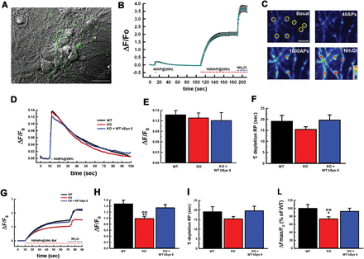
Figure 3. Expression of WT hSyn II rescues the impairment in the RP of SVs in SYN2 KO neurons. (A) Representative image ...
Notes:
Figure 3. Expression of WT hSyn II rescues the impairment in the RP of SVs in SYN2 KO neurons. (A) Representative image of WT hippocampal primary neurons transfected with Syphy to evaluate the size and dynamics of SV pools. The image shows the fluorescent processes of a neuron transfected with SypHy (green) together with other non-transfected neurons visualized in phase contrast. Scale bar, 50 µm. (B) Changes in SypHy fluorescence intensity (means ± SEM) as a function of time recorded from a WT neuron. Electrical field stimulation with 40 AP at 20 Hz, followed by 1600 AP at 20 Hz in the presence of 1 µM bafilomycin and a final perfusion with 50 mm of NH4Cl were used to evaluate the RRP, the RP and the total SV content, respectively. (C) Representative intensity profile images of SypHy-expressing WT neurons at 17 DIV, showing SypHy fluorescence in axonal branches at rest (Basal) and in response to stimulations. Scale bar, 5 µm; look-up table rainbow. (D–F) Evaluation of the RRP. Ensemble averages of individual time courses of SypHy fluorescence in response to 40 AP at 20 Hz field stimulation (D) in WT (n = 20, black trace), SYN2 KO (n = 21, red trace) and SYN2 KO neurons reconstituted with WT-hSyn II (n = 10, blue trace). Mean (± SEM) RRP size calculated as the peak level of fractional fluorescence increase over resting levels (ΔF/F0; E) and mean (± SEM) time constant of endocytosis (τ; E) evaluated by fitting the fluorescence decay after stimulation by a single exponential function. (G–L) Evaluation of the RP and total SV content. Ensemble averages of individual time courses of SypHy fluorescence in response to stimulation with 1600 AP at 20 Hz in the presence of 1 μM bafilomycin (G) in WT (n = 20, black trace), SYN2 KO (n = 21, red trace) and SYN2 KO neurons re-expressing WT-hSyn II (n = 10, blue trace). Mean (± SEM) RP size evaluated as ΔF/F0 (H) and mean (± SEM) time constant of RP depletion (τ; I) evaluated by fitting the fluorescence increase during stimulation by a single exponential rise. The total SypHy fluorescence was calculated as the fractional fluorescence plateau reached after NH4Cl over basal fluorescence (ΔFMAX/F0; L). Data (means±SEM) are expressed in percent of the WT mean value. **P < 0.01 versus WT cells; **P < 0.01 versus SYN2 KO-expressing WT-hSyn II; one-way ANOVA on Ranks (Kruskal–Wallis test) followed by the Dunn's test. Experiments were performed from n = 3 independent preparations, with 12–20 boutons analyzed for each experiment.
Unless provided in the caption above, the following copyright applies to the content of this slide: © The Author 2013. Published by Oxford University Press.This is an Open Access article distributed under the terms of the Creative Commons Attribution License (http://creativecommons.org/licenses/by/3.0/), which permits unrestricted reuse, distribution, and reproduction in any medium, provided the original work is properly cited.

Slide 4
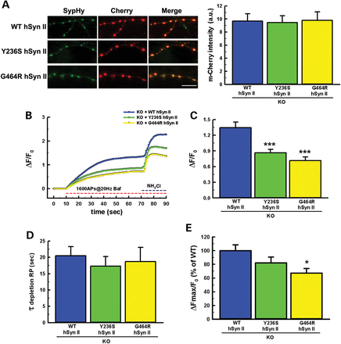
Figure 4. hSyn II missense mutants target to nerve terminals, but are unable to rescue the SYN2 KO phenotype. (A) ...
Notes:
Figure 4. hSyn II missense mutants target to nerve terminals, but are unable to rescue the SYN2 KO phenotype. (A) Synaptic expression of mCherry-tagged hSyn II variants. Left: representative images of SypHy (green) and either WT-hSyn II, Y236S-hSyn II or G464R-hSyn II tagged with mCherry (red) in SYN2 KO hippocampal neurons transfected at 14 DIV and analyzed at 17 DIV. Merge panels show that all hSyn II variants display a virtually complete colocalization at SypHy-positive synaptic puncta. Scale bar, 20 µm. Right: Quantification of the presynaptic expression of mCherry-tagged WT-hSyn II, Y236S-hSyn II and G464R-hSyn II in SYN2 KO neurons. The expression of WT and mutant mCherry-labeled hSyn II was analyzed by quantifying the mCherry fluorescence intensity at stimulation-responsive SypHy-positive puncta. Data are means ± SEM of n = 10 for WT-hSyn II, n = 10 for Y236S-hSyn II and n = 6 for G464R-hSyn II. The point mutations in hSyn II did not affect the targeting of the exogenous protein to nerve terminals. (B) Averaged ensembles of individual time courses of SypHy fluorescence dequenching in response to field stimulation (1600 APs at 20 Hz, 1 µM bafilomycin) followed by 50 mm NH4Cl in SYN2 KO neurons co-transfected with SypHy and either WT-hSyn II (blue trace; n = 10), Y236S-hSyn II (green trace; n = 10) or G464R-hSyn II (yellow trace; n = 6). ROIs of 1.7 µm diameter corresponding to responsive synaptic boutons were manually selected in a pretrial round and analyzed for fluorescence intensity changes versus time. 15–20 ROIs were analyzed per experiment. SypHy dequenching was calculated as fractional fluorescence increase over resting levels (ΔF/F0; means ± SEM). (C–E) Quantitative analysis of RP and total SV content. RP size evaluated as ΔF/F0 plateau values (C), time constant of RP depletion (τ; D) and total SypHy fluorescence calculated as ΔFMAX/F0 and expressed in percentage of WT-hSyn II (E). Data are means ± SEM from the same experiments shown in (B). For further details, see legend to Figure 3 and the section Materials and Methods. *P < 0.05; ***P < 0.001 versus WT-hSyn II, ANOVA on ranks (Kruskal–Wallis test) followed by Dunn's method.
Unless provided in the caption above, the following copyright applies to the content of this slide: © The Author 2013. Published by Oxford University Press.This is an Open Access article distributed under the terms of the Creative Commons Attribution License (http://creativecommons.org/licenses/by/3.0/), which permits unrestricted reuse, distribution, and reproduction in any medium, provided the original work is properly cited.

Slide 5
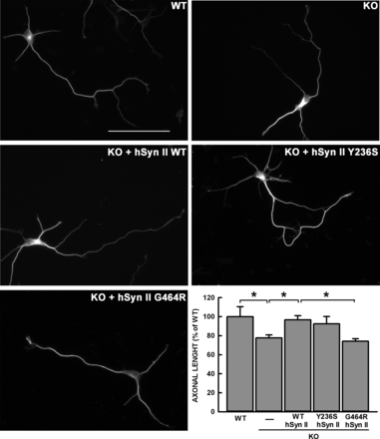
Figure 5. The G464R-hSyn II mutant impairs early stages of axon outgrowth. Representative images of WT and SYN2 KO ...
Notes:
Figure 5. The G464R-hSyn II mutant impairs early stages of axon outgrowth. Representative images of WT and SYN2 KO hippocampal neurons transfected at 0 DIV with either pCAGGS-ires-Tomato vector alternatively encoding for WT-hSyn II, G464R-hSyn II, Y236S-Syn II isoforms or with the vector alone (KO). β-tubulin staining of Tomato-positive neurons is shown. Scale bar, 50 μm. Identified axons at 3 DIV were measured by ImageJ tracing. Within each experimental session, the length of the axons measured in Syn II-transfected neurons was normalized to the average length of the axons measured in WT neurons. The plot shows the mean length values (± SEM) of axons calculated from n = 62 WT neurons, n = 76 SYN2 KO neurons, n = 98 SYN2 KO neurons expressing WT-hSyn II, n = 42 SYN2 KO neurons expressing Y236S-hSyn II and n = 59 SYN2 KO neurons expressing G464R-hSyn II, from n = 6 independent experiments. Statistical analysis was performed by one-way ANOVA followed by the Bonferroni's multiple comparisons test. *P < 0.05 as indicated.
Unless provided in the caption above, the following copyright applies to the content of this slide: © The Author 2013. Published by Oxford University Press.This is an Open Access article distributed under the terms of the Creative Commons Attribution License (http://creativecommons.org/licenses/by/3.0/), which permits unrestricted reuse, distribution, and reproduction in any medium, provided the original work is properly cited.

Slide 6
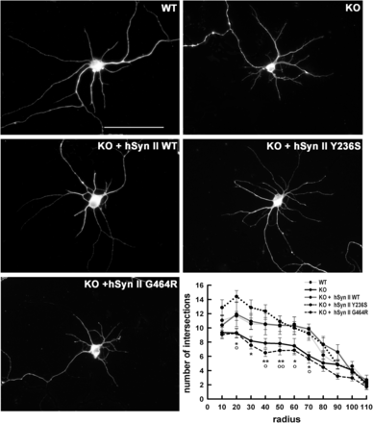
Figure 6. The G464R-hSyn II mutant impairs dendritic branching in SYN2 KO hippocampal neurons at early stages of in ...
Notes:
Figure 6. The G464R-hSyn II mutant impairs dendritic branching in SYN2 KO hippocampal neurons at early stages of in vitro development. Representative images of WT and SYN2 KO hippocampal neurons transfected at 4 DIV with either pCAGGS-ires-Tomato vector alternatively encoding for WT-hSyn II, Y236S-hSyn II and G464R-hSyn II or with Tomato vector alone (KO). β-tubulin staining of Tomato-positive neurons is shown. Scale bar, 50 μm. Dendritic arborization at 7 DIV was measured by Sholl analysis, counting the number of intersections of dendrites with concentric circles centered to the cell body and whose radius was increased at regular steps of 10 μm. Quantitative analysis of dendritic arborization was calculated from n = 31 WT neurons (light gray line), n = 58 SYN2 KO neurons (black line) and n = 67, 31 and 34 SYN2 KO neurons expressing WT-hSyn II (dark gray line), Y236S-hSyn II (dotted line) or G464R-hSyn II (broken line), respectively, from n = 3 independent experiments. Data, expressed as means ± SEM, were analyzed using one-way ANOVA followed by the Bonferroni's multiple comparison test. *P < 0.05; **P < 0.01 G464R-hSyn II versus WT-hSyn II; °P < 0.05; °°P < 0.01 SYN2 KO neurons versus WT neurons or SYN2 KO neurons reconstituted with WT-hSyn II.
Unless provided in the caption above, the following copyright applies to the content of this slide: © The Author 2013. Published by Oxford University Press.This is an Open Access article distributed under the terms of the Creative Commons Attribution License (http://creativecommons.org/licenses/by/3.0/), which permits unrestricted reuse, distribution, and reproduction in any medium, provided the original work is properly cited.

