Slide 1
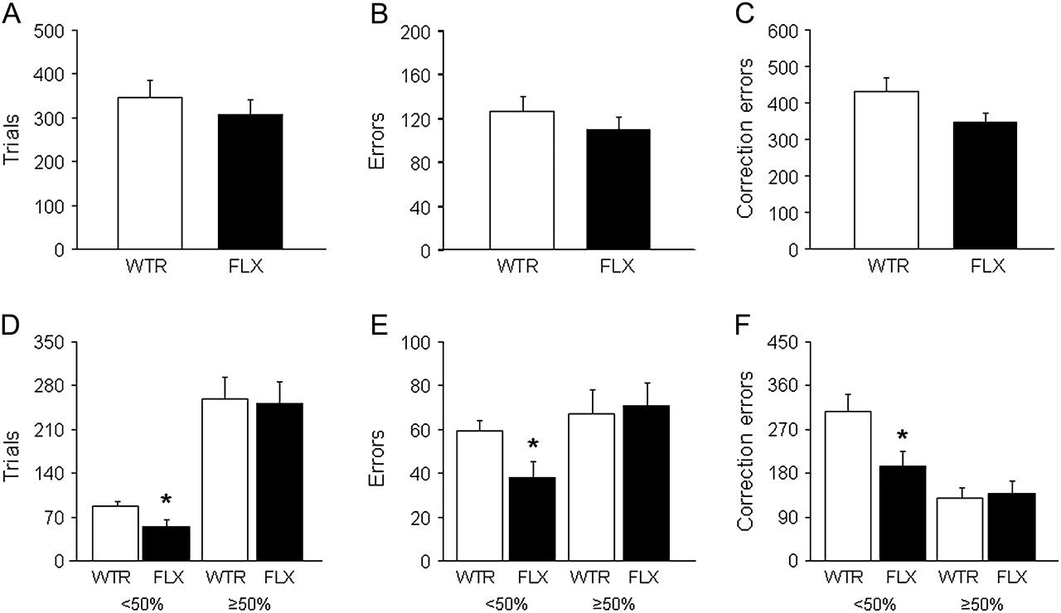
Figure 1. Effects of chronic fluoxetine in C57BL/6J mice. Fluoxetine- and water-treated mice did not significantly ...
Notes:
Figure 1. Effects of chronic fluoxetine in C57BL/6J mice. Fluoxetine- and water-treated mice did not significantly differ in trials (A), errors (B), or correction errors (C) to reversal criterion. Fluoxetine-treated mice made significant fewer trials (D), errors (E), and correction errors (F) during the <50% correct reversal phase, but not ≥50% correct phase, relative to water-treated controls. WTR, water; FLX, fluoxetine. Data are mean ± standard error of the mean. n = 10 per treatment. *P < 0.05 versus water treated.
Unless provided in the caption above, the following copyright applies to the content of this slide: Published by Oxford University Press 2009.

Slide 2
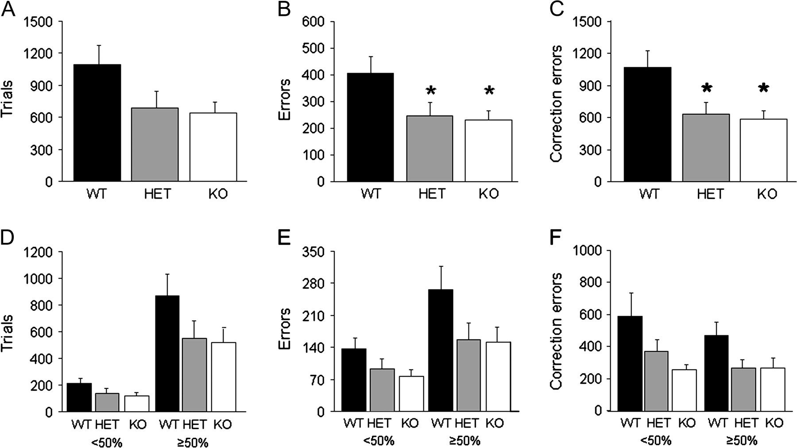
Figure 2. Phenotype of 5-HTT null mutant mice. 5-HTT KO and HET showed a trend for fewer trials (A) and made ...
Notes:
Figure 2. Phenotype of 5-HTT null mutant mice. 5-HTT KO and HET showed a trend for fewer trials (A) and made significantly fewer errors (B) and correction errors (C) to reversal criterion, as compared with WT controls. Genotypes did not significantly differ in trials (D), errors (E), or correction errors (F) when separately examining the <50% correct and ≥50% correct reversal phases. Data are mean ± standard error of the mean. n = 8–10 per genotype. *P < 0.05 versus WT.
Unless provided in the caption above, the following copyright applies to the content of this slide: Published by Oxford University Press 2009.

Slide 3
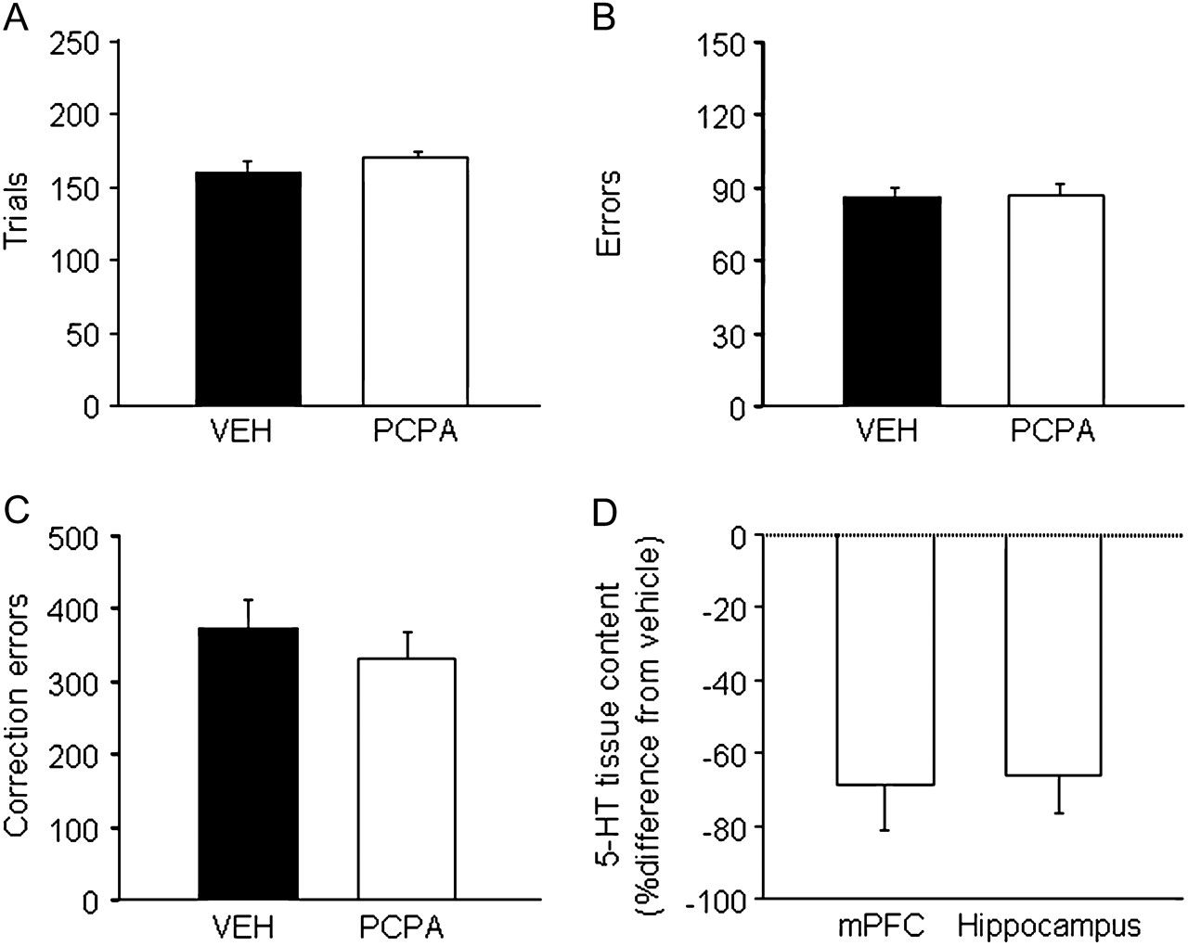
Figure 3. Effects of PCPA treatment in C57BL/6J mice. PCPA- and vehicle-treated mice did not significantly differ in ...
Notes:
Figure 3. Effects of PCPA treatment in C57BL/6J mice. PCPA- and vehicle-treated mice did not significantly differ in trials (A), errors (B), or correction errors (C) during 6 reversal sessions (approximating to <50% correct phase). 5-HT tissue content in the mPFC and hippocampus (D) was significantly lower after the sixth reversal session in PCPA-treated mice relative to and vehicle-treated controls. VEH, vehicle. Data are mean ± standard error of the mean. n = 10 per treatment. *P < 0.05 versus vehicle treated.
Unless provided in the caption above, the following copyright applies to the content of this slide: Published by Oxford University Press 2009.

Slide 4
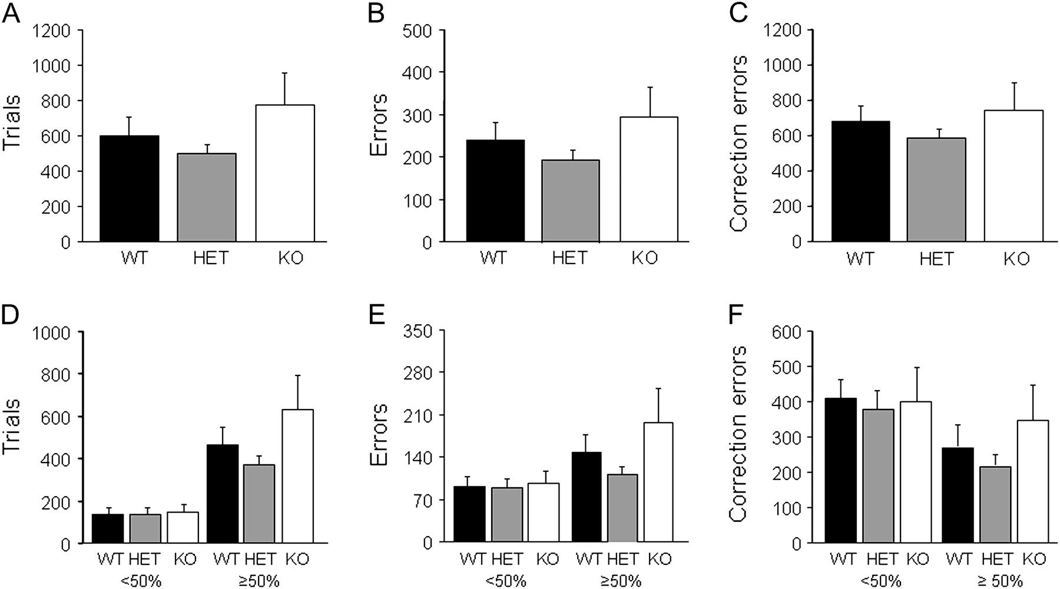
Figure 4. Phenotype of Pet-1 null mutant mice. Genotypes did not significantly differ in trials (A), errors (B), or ...
Notes:
Figure 4. Phenotype of Pet-1 null mutant mice. Genotypes did not significantly differ in trials (A), errors (B), or correction errors (C) to reversal criterion. Genotypes did not significantly differ in trials (D), errors (E), or correction errors (F) when separately examining the <50% correct and ≥50% correct reversal phases. Data are mean ± standard error of the mean. n = 8–12 per genotype.
Unless provided in the caption above, the following copyright applies to the content of this slide: Published by Oxford University Press 2009.

