Slide 1
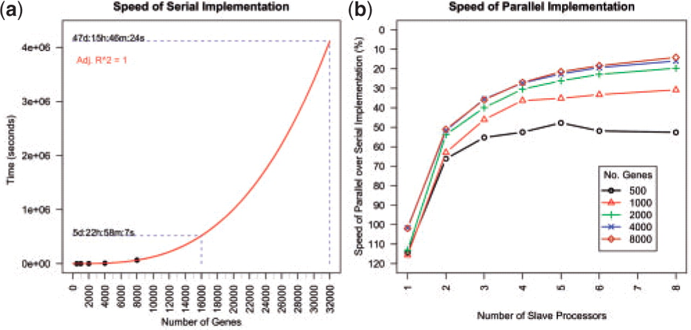
Fig. 2. PCIT performance. (a) graph showing the speed of the serial implementation together with project times for ...
Notes:
Fig. 2. PCIT performance. (a) graph showing the speed of the serial implementation together with project times for data sets containing 16 000 and 32 000 genes. (b) the speed of the parallel implementation of PCIT as a percentage of the time taken for the serial implementation.
Unless provided in the caption above, the following copyright applies to the content of this slide: © The Author 2009. Published by Oxford University Press. All rights reserved. For Permissions, please email: journals.permissions@oxfordjournals.org

Slide 2
Fig. 1. Correlations between a trio of genes A, B and C. Strength of correlation between pairs of genes indicated by ...
Notes:
Fig. 1. Correlations between a trio of genes A, B and C. Strength of correlation between pairs of genes indicated by line width. (a) Is the correlation between AB independent of the strong correlations between AC and BC? Is the correlation between AB meaningful? (b) PCIT determines the AB correlation is meaningful. (c) PCIT determines the AB correlation is not meaningful.
Unless provided in the caption above, the following copyright applies to the content of this slide: © The Author 2009. Published by Oxford University Press. All rights reserved. For Permissions, please email: journals.permissions@oxfordjournals.org

