Slide 1
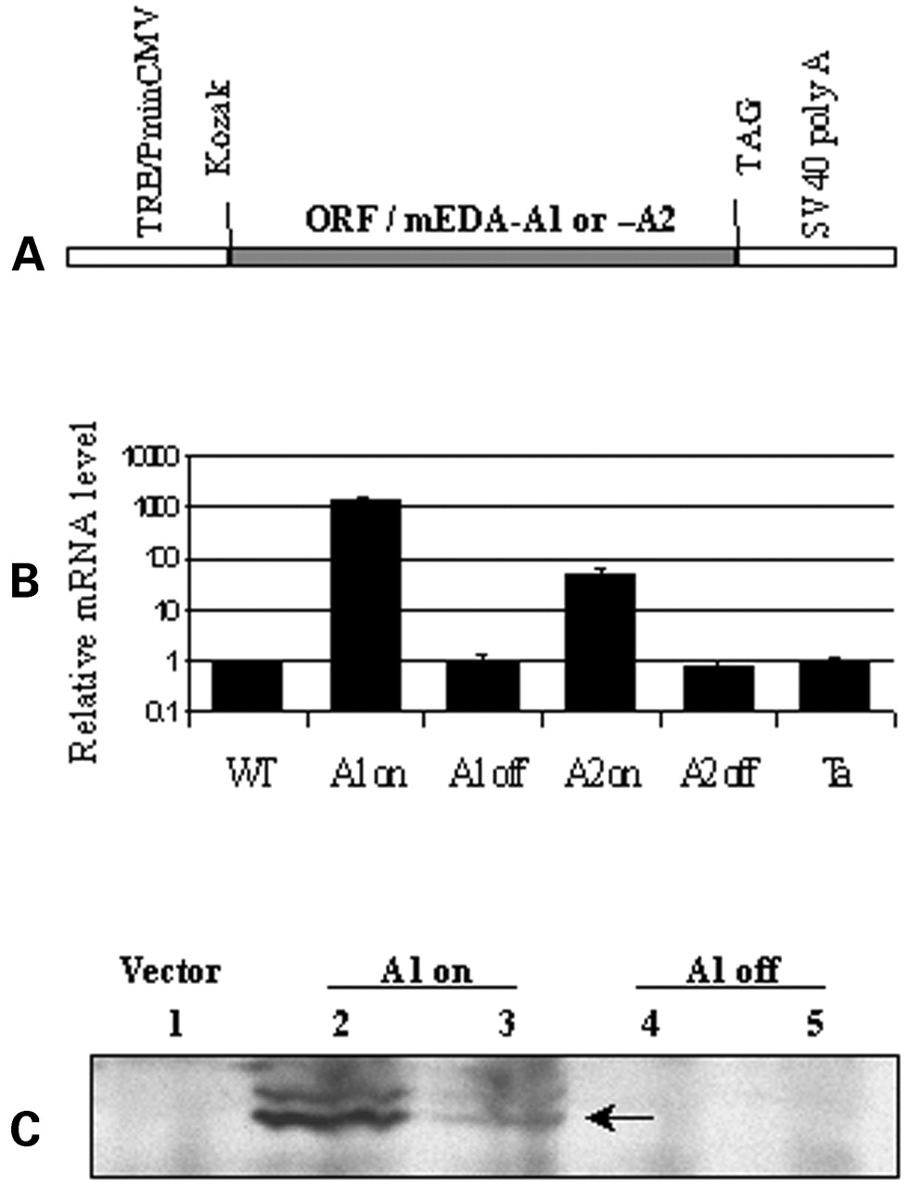
Figure 1. Constructs, expression, and regulation of transgenic mEDA-A1 and mEDA-A2. (A) The coding regions of ...
Notes:
Figure 1. Constructs, expression, and regulation of transgenic mEDA-A1 and mEDA-A2. (A) The coding regions of mEDA-A1 and mEDA-A2 cDNAs were inserted between TRE/PminCMV promoter and SV40 poly A region (see Materials and Methods). The tetracycline-controlled transactivator (tTA) binds to TRE region of mEDA transgenes and activates transcription. (B) Quantitative RT–PCR shows elevated expression of mEDA-A1 and mEDA-A2 in transgenic mouse skin, and shut-down of transgene expression by doxicycline chow administration. Note exponential scale of expression; the Tabby mutation is a single base change, so that Ta and WT mRNA levels are equal. (C) EDA protein expression from transient transfection of mEDA-A1 into MCF-7 Tet-off cell line. Tet- condition (lanes 2 and 3) and shut-down in Tet+ condition (lanes 4 and 5). Lane 1, transfected with pTRE vector only and cultured under Tet− condition. Two bands about 46 kDa are glycosylated EDA protein (40).
Unless provided in the caption above, the following copyright applies to the content of this slide:

Slide 2
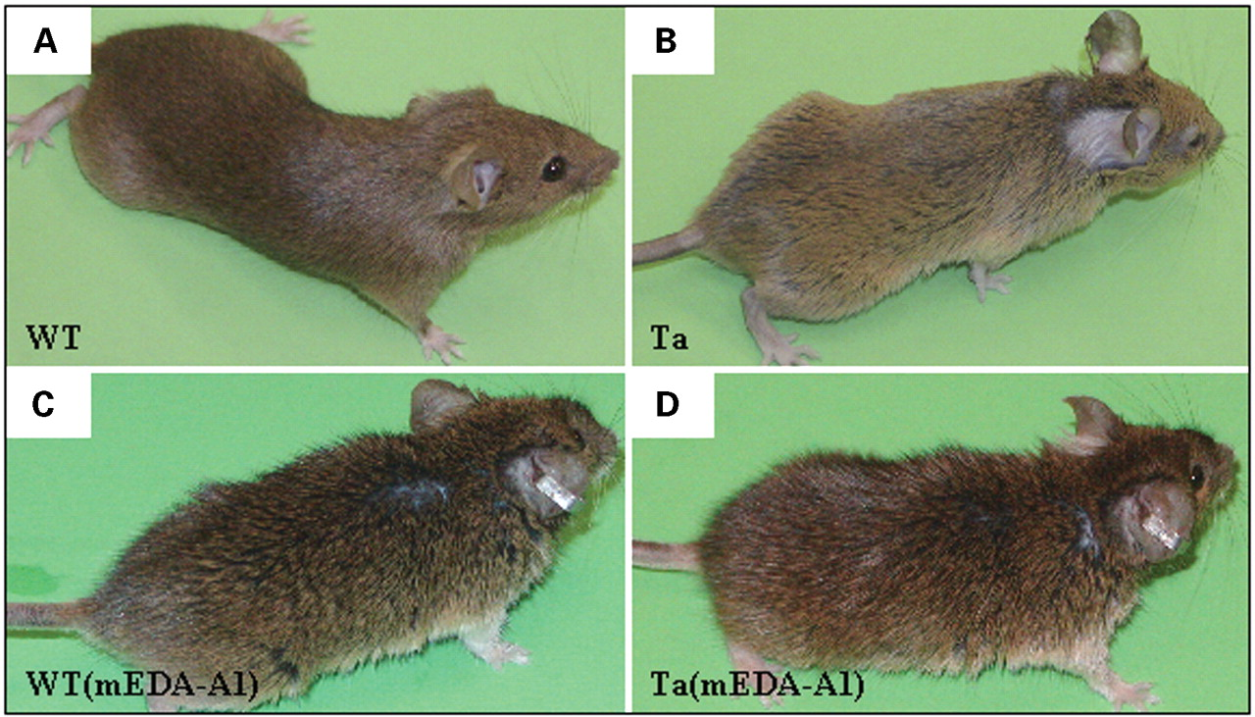
Figure 2. Appearance of mEDA-A1 transgenic mice. A1 transgenic mice in Tabby background [Ta(mEDA-A1)] showed ...
Notes:
Figure 2. Appearance of mEDA-A1 transgenic mice. A1 transgenic mice in Tabby background [Ta(mEDA-A1)] showed darker, longer, disoriented hair and restored hair patches behind ears. Transgenic mice in wild-type background were similar. Photographs by Olympus C-700 digital camera.
Unless provided in the caption above, the following copyright applies to the content of this slide:

Slide 3
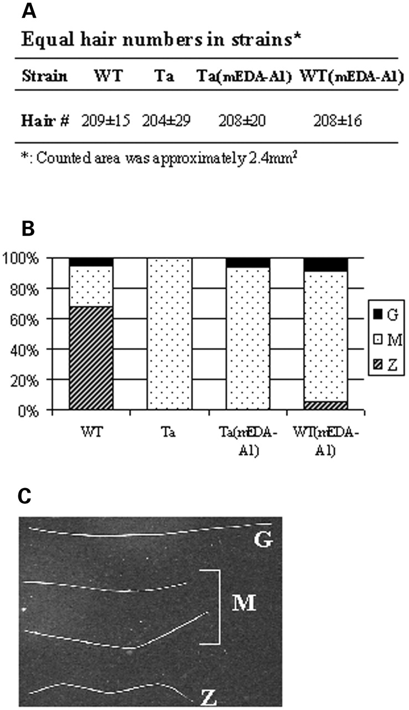
Figure 3. Total hair number and ratio of hair subtypes in mEDA-A1 transgenic mice. (A) Hair number in ...
Notes:
Figure 3. Total hair number and ratio of hair subtypes in mEDA-A1 transgenic mice. (A) Hair number in equivalent areas of back skin. Three independent mice for each strain, and three independent areas for each mouse, were counted. (B) Relative proportions of G, M and Z hair. (C) Three major hair subtypes from wild-type mice. Tabby male mice lack G and Z hairs.
Unless provided in the caption above, the following copyright applies to the content of this slide:

Slide 4
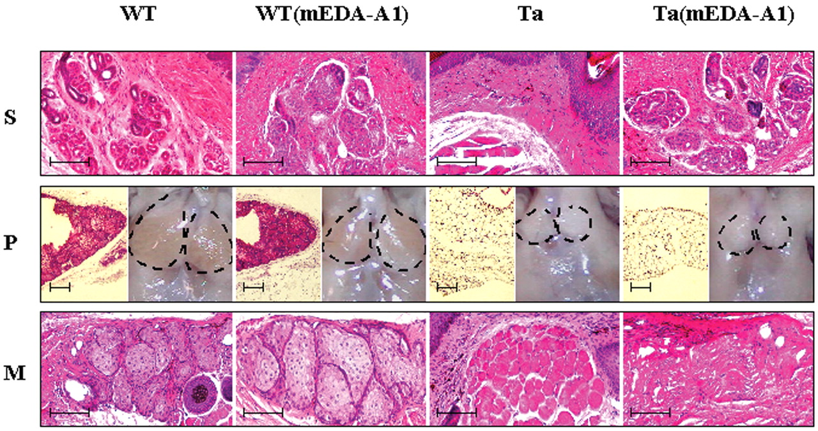
Figure 4. Differential effects of mEDA-A1 on three types of gland. (S) Determinative effect restoring sweat ...
Notes:
Figure 4. Differential effects of mEDA-A1 on three types of gland. (S) Determinative effect restoring sweat glands to Tabby [Ta(mEDA-A1)] mice with no additional effect in a wild-type [WT(mEDA-A1)] background. Hematoxylin-eosin staining. (P) Lack of restoration of preputial gland to Tabby mice, with no additional effect in wild-type. Paired subpanels show hematoxylin-eosin stained sections (left) and digital photographs of the surface of the gland region (right). The dashed black line outlines the overlying fat pad. (M) Lack of restoration of Meibomian gland to Ta, but trophic effect on gland in wild-type mice. Scale bars, 0.1 mm.
Unless provided in the caption above, the following copyright applies to the content of this slide:

Slide 5
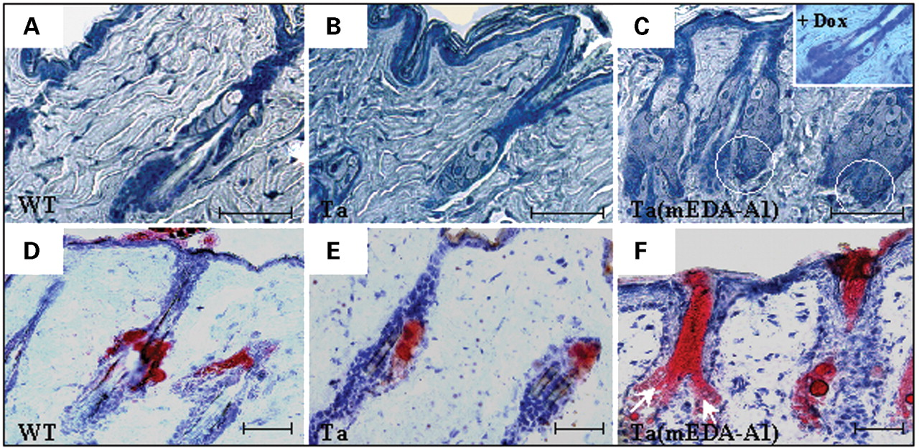
Figure 5. Hyperplasia of sebaceous glands in mEDA-A1 transgenic mice. Panels represent hematoxylin staining, ...
Notes:
Figure 5. Hyperplasia of sebaceous glands in mEDA-A1 transgenic mice. Panels represent hematoxylin staining, with Oil Red O staining added for (D–F), for wild-type, Tabby, and transgenic Tabby skin. Sebaceous gland hyperplasia and follicle angle in de novo guard hair follicle were reversed by doxicycline food application in transgenic Tabby mice (C, insert). Accumulation of young sebocytes in the bottom of transgenic sebaceous glands (C, circled). Oil-Red O staining for sebum. Scale bars, 0.05 mm.
Unless provided in the caption above, the following copyright applies to the content of this slide:

Slide 6
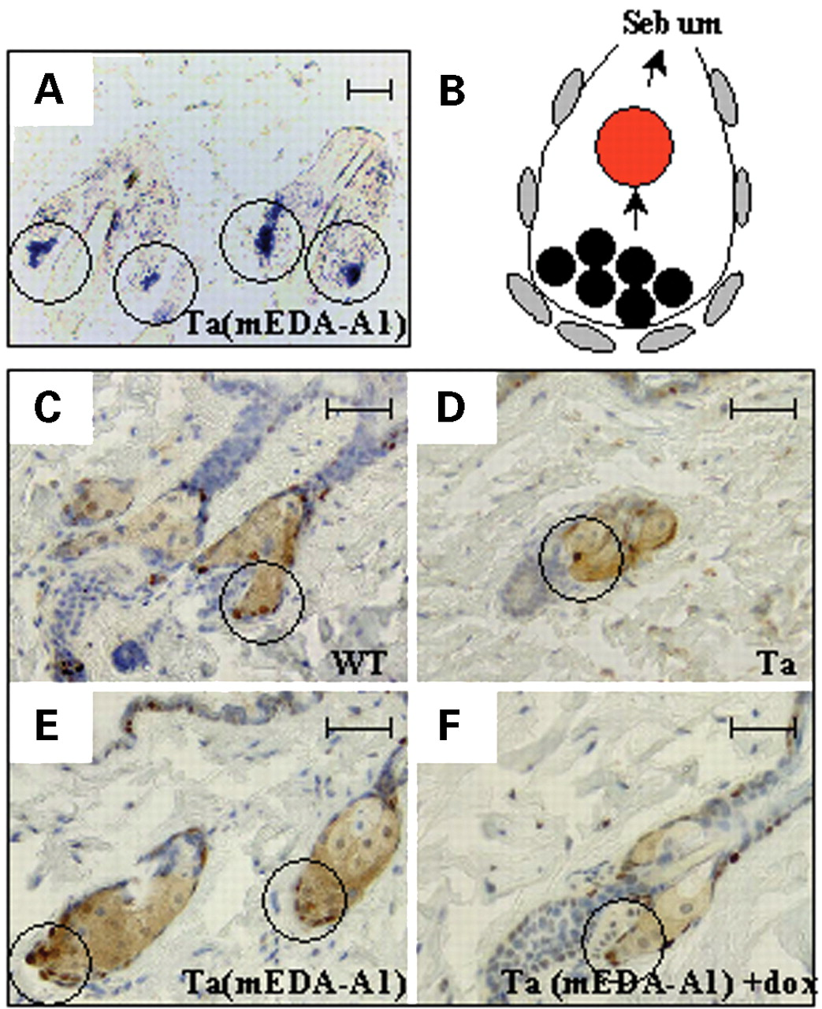
Figure 6. EDA expression and higher replication in sebocytes of transgenic mice. (A) In situ hybridization ...
Notes:
Figure 6. EDA expression and higher replication in sebocytes of transgenic mice. (A) In situ hybridization shows high expression of mEDA-A1 transgene in the lower portion of sebaceous glands [Ta(mEDA-A1)]. (B) Schematic of sebaceous gland proliferation and differentiation in transgenic mice. (C, D) Control PCNA staining of wild-type (C) and Tabby (D) sebaceous glands. PCNA is elevated in sebaceous glands of Ta(mEDA-A1) mice (E), and down-regulated when transgene is off (F). Immunostaining as in Materials and Methods. Scale bars, 0.05 mm.
Unless provided in the caption above, the following copyright applies to the content of this slide:

