Slide 1
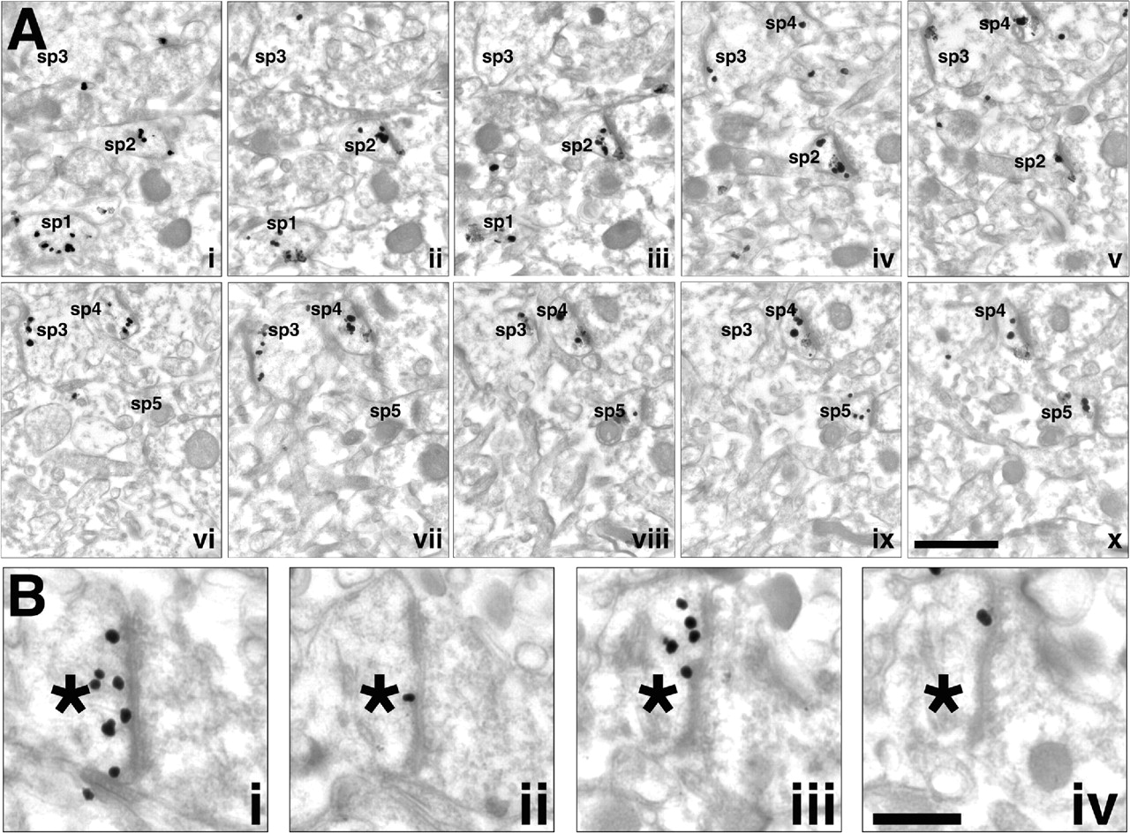
Figure 1. Pre-embedding silver-intensified EM demonstrating spinophilin label in monkey area 46 (layer 1). ...
Notes:
Figure 1. Pre-embedding silver-intensified EM demonstrating spinophilin label in monkey area 46 (layer 1). (Ai–x) Serially sectioned images demonstrate that the majority of axospinous synapses are spinophilin immunopositive. A two-dimensional (single section) analysis suggested that while the majority of spines (70%) were immunopositive (i.e. sp2 and sp4), a subpopulation were unlabeled (sp5). However, a subpopulation of spines would have been inaccurately scored as spinophilin immunonegative in such an analysis. A quantitative analysis of serially sectioned axospinous synapses demonstrated that the overall percentage of immunoreactive synapses exceeds 90% (see results). Additionally, note the low level of non-specific background label. (Bi–iv) High-magnification serially sectioned images demonstrating spinophilin distribution within and throughout an axospinous synapse. Multiple silver-intensified particles are seen throughout the cytoplasm, as well as in close apposition with the postsynaptic density (PSD). Asterisk (*) denotes spine. Note the high level of immunoreactive puncta seen in Bi and Biii, as compared to the lack of label in Bii and Biv. Sp = spine. Scale bars; Ai–x = 0.5 µm, Bi–iv = 0.25 µm.
Unless provided in the caption above, the following copyright applies to the content of this slide:

Slide 2
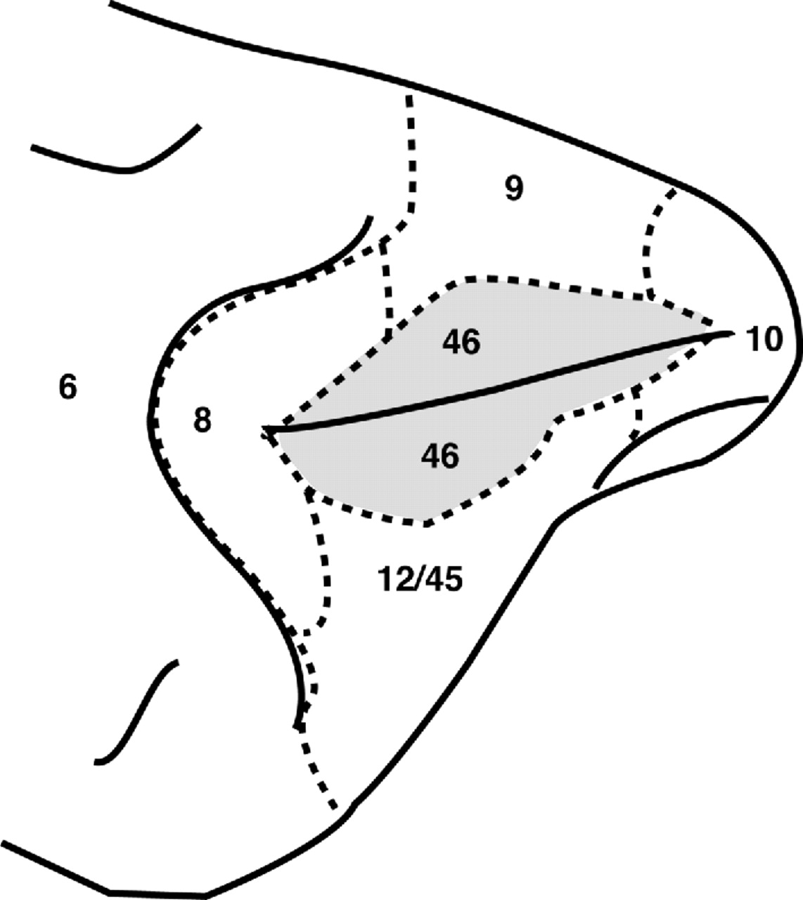
Figure 2. Schematic map of the monkey dorsolateral prefrontal cortex indicating the spatial relationships ...
Notes:
Figure 2. Schematic map of the monkey dorsolateral prefrontal cortex indicating the spatial relationships between area 46 and adjacent cortical regions (adapted from Walker, 1940).
Unless provided in the caption above, the following copyright applies to the content of this slide:

Slide 3
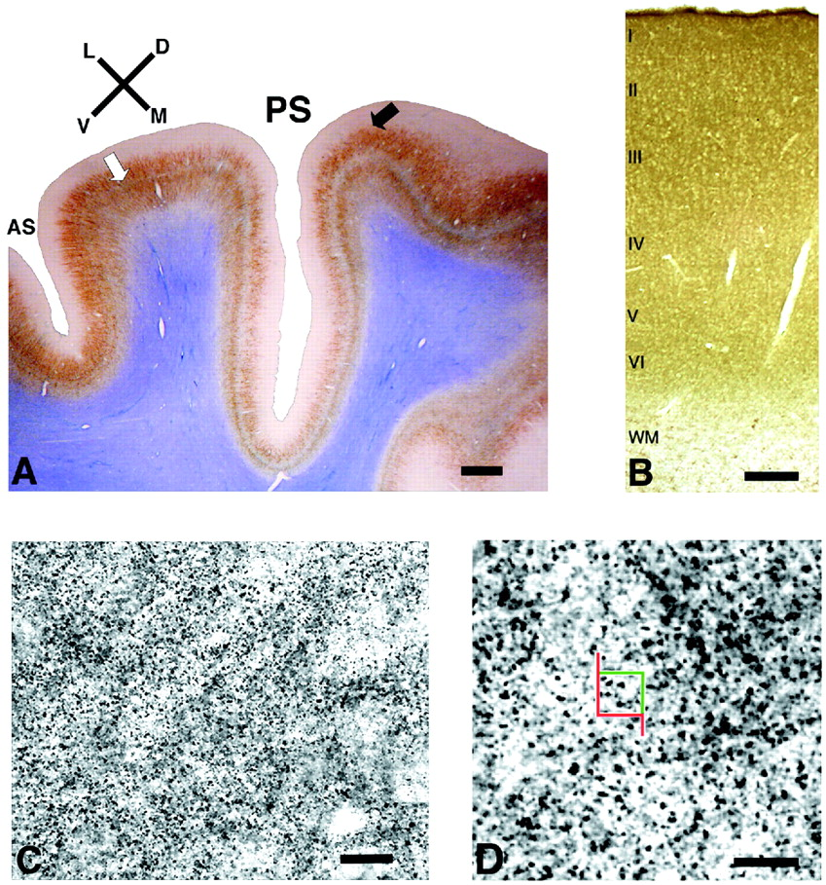
Figure 3. (A) Photomicrograph showing the boundaries of macaque monkey area 46. The boundary between area 46 ...
Notes:
Figure 3. (A) Photomicrograph showing the boundaries of macaque monkey area 46. The boundary between area 46 and area 9 is delineated where layer IV thins out (white arrow). The boundary between area 46 and area 45 is delineated where SMI-32-labeled neurons in layer III become less regularly arranged (black arrow). The tissue was labeled with antibody SMI-32 and counterstained with Giemsa . AS: lower limb of the arcuate sulcus; PS: principal sulcus; L, M, D, V: lateral, medial, dorsal, ventral. The principal sulcus is shown vertically in this picture. Scale bar = 750 µm. (B) Photomicrograph demonstrating spinophilin labeling. There is an intense spinophilin labeling in all of the cortical layers, but none in the white matter (wm). The lack of neuronal somata in layer I permitted the delineation of its boundary with layer II. Scale bar =100 µm. (C, D) Higher-magnification photomicrographs of layer I. (C) Photomicrograph showing Sp-ir profiles at intermediate magnification. Spines not visualized at their optimal focal plane appear blurred. (D) Spinophilin labeling at the magnification used for stereologic analysis. An unbiased counting frame is shown. The red border of the frame and its extensions represent the exclusion line and the green border represents its inclusion line. Spines were counted when they came into focus within the height of the optical disector and within the counting frame when moving the focal plane continuously through the section. A spine was considered to be within the counting frame if it was entirely within the counting frame or partially within it without touching or intersecting the exclusion line when in focus. Scale bar = 10 µm in (C) and 5 µm in (D).
Unless provided in the caption above, the following copyright applies to the content of this slide:

Slide 4
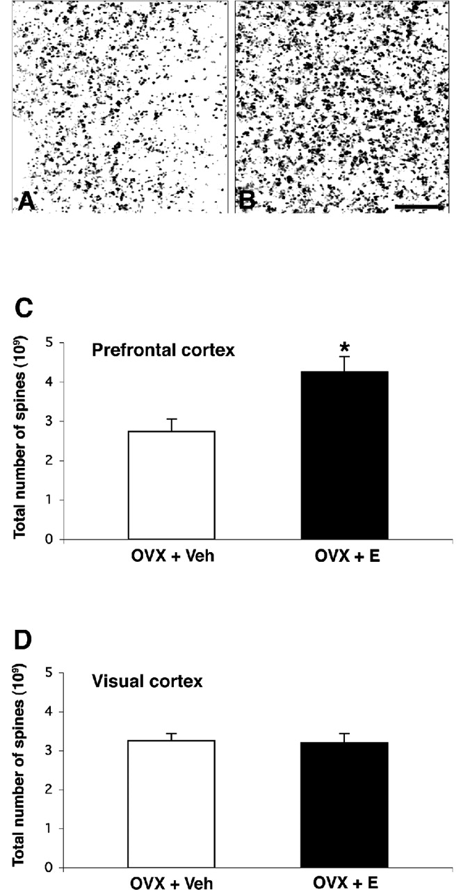
Figure 4. Photomicrograph demonstrating spinophilin-immunoreactive spines in layer I of area 46 in rhesus ...
Notes:
Figure 4. Photomicrograph demonstrating spinophilin-immunoreactive spines in layer I of area 46 in rhesus monkey. OVX+Veh group (A) has a lower spine density than OVX+E group (B). Scale bar = 5 µm. Histograms depicting the total number of spines in layer I of area 46 (C) and the total number of spines in layer I of the opercular portion of area V1 (V1o) (D). Values represent means ± SEM. Four monkeys were ovariectomized and received vehicle (OVX+Veh) and five monkeys were ovariectomized and received estradiol (OVX+E). Estradiol protects against an OVX-induced decrease in the mean total number of spines in the layer I of area 46. The asterisk indicates a statistically significant difference (p = 0.0215), unpaired, two-tailed Student’s t test. There is no difference in the mean total number of the spines in layer I of area V1o between OVX+Veh and OVX+E monkeys (see text).
Unless provided in the caption above, the following copyright applies to the content of this slide:

