Slide 1
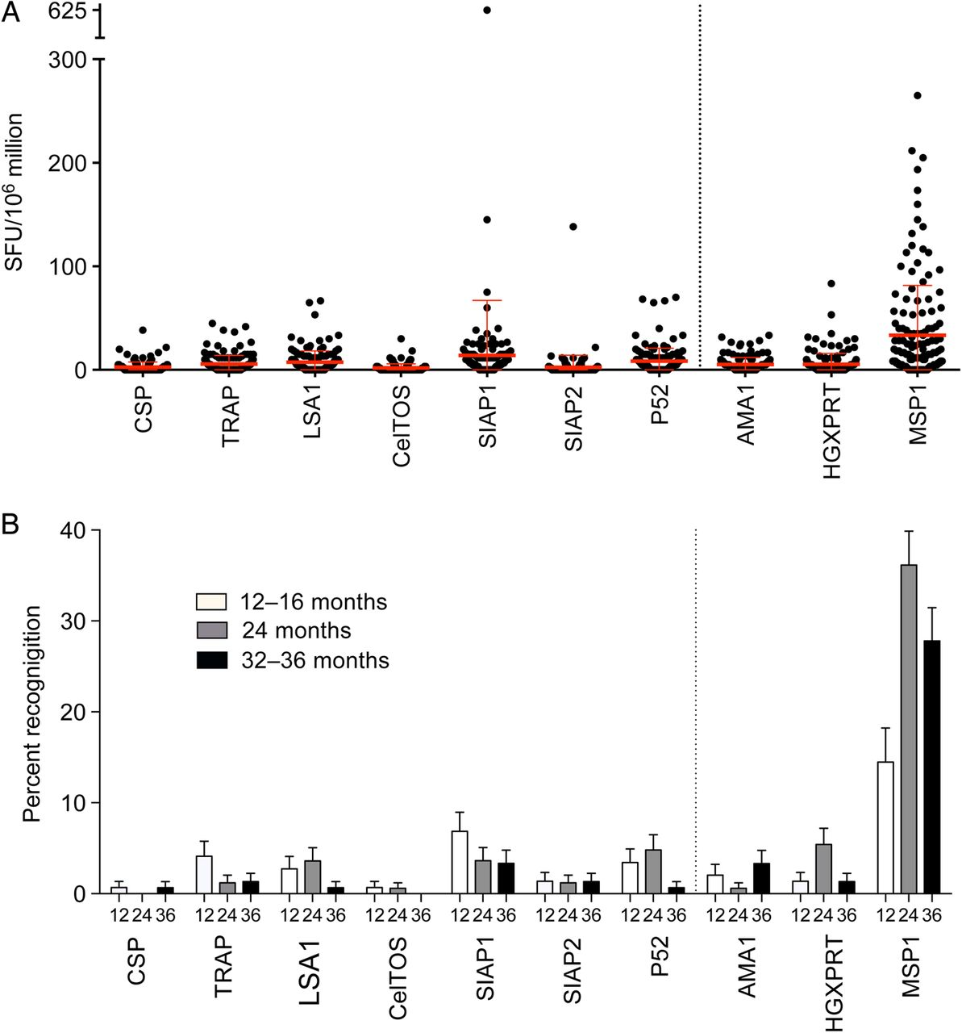
Figure 1. IFNγ ELISpot responses to pre-erythrocytic and blood-stage antigens. A, Magnitude of IFNγ ELISpot responses ...
Notes:
Figure 1. IFNγ ELISpot responses to pre-erythrocytic and blood-stage antigens. A, Magnitude of IFNγ ELISpot responses to 7 pre-erythrocytic (antigens on left of dotted line) and 3 blood-stage malaria proteins (antigens on right of dotted line) at 24 months of age, expressed as spot-forming cells (SFC) per million PBMC. B, Percent of subjects recognizing each protein at 12–16, 24, and 32–36 months of age. Abbreviations: IFNγ, interferon γ; PBMC, peripheral blood mononuclear cells.
Unless provided in the caption above, the following copyright applies to the content of this slide: © The Author 2014. Published by Oxford University Press on behalf of the Infectious Diseases Society of America. All rights reserved. For Permissions, please e-mail: journals.permissions@oup.com.

Slide 2
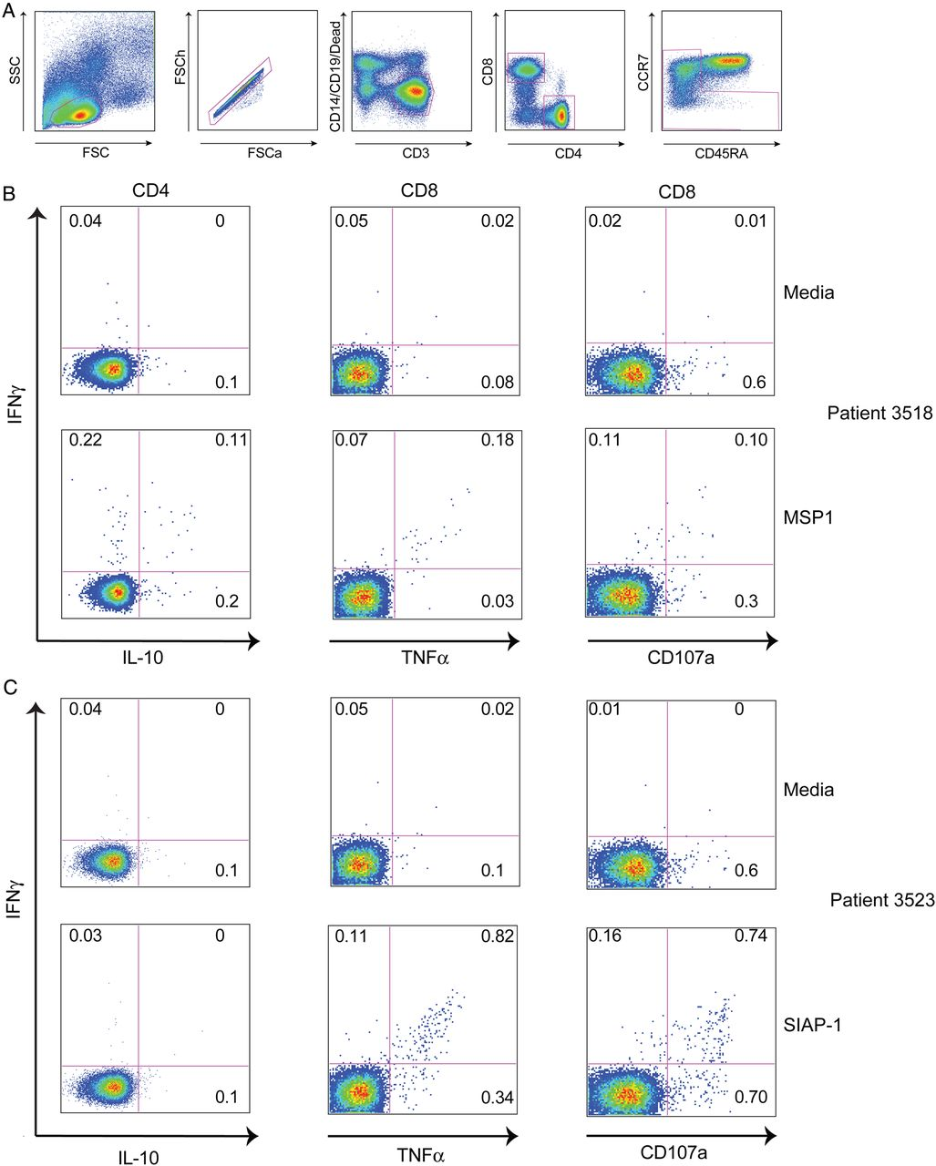
Figure 2. T-cell responses to malaria antigens characterized by multiparameter flow cytometry. A, Gating strategy to ...
Notes:
Figure 2. T-cell responses to malaria antigens characterized by multiparameter flow cytometry. A, Gating strategy to identify live, CD4+ and CD8+ memory T-cell populations. B, Intracellular cytokine assay demonstrating the T-cell response of one representative malaria-exposed child to MSP1 (bottom row), with media control shown in row above. C, Intracellular cytokine assay demonstrating the T-cell response of one malaria-exposed child to SIAP1 (bottom row), with media control shown in row above. Shown are CD4 (first column) and CD8 (right 2 columns) production of IFNγ (y-axis), IL-10 (x-axis, column 1), TNFa (x-axis, columns 2) and mobilization of the degranulation marker CD107a (y-axis, column 3). Abbreviations: IFNγ, interferon γ; IL, interleukin; TNF, tumor necrosis factor.
Unless provided in the caption above, the following copyright applies to the content of this slide: © The Author 2014. Published by Oxford University Press on behalf of the Infectious Diseases Society of America. All rights reserved. For Permissions, please e-mail: journals.permissions@oup.com.

Slide 3
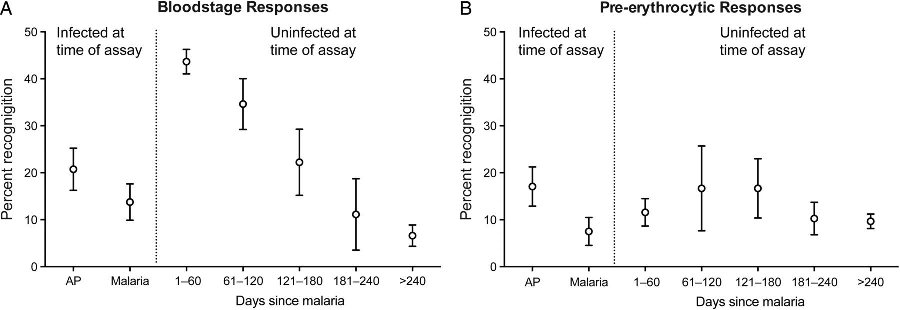
Figure 3. Recent malaria associated with IFNγ responses to blood-stage but not pre-erythrocytic antigens. A, ...
Notes:
Figure 3. Recent malaria associated with IFNγ responses to blood-stage but not pre-erythrocytic antigens. A, Recognition frequencies to any blood-stage antigen in children stratified by prior or current malaria exposure. B, Recognition frequencies to any pre-erythrocytic antigen in children stratified by prior or current malaria exposure. Abbreviation: IFNγ, interferon γ.
Unless provided in the caption above, the following copyright applies to the content of this slide: © The Author 2014. Published by Oxford University Press on behalf of the Infectious Diseases Society of America. All rights reserved. For Permissions, please e-mail: journals.permissions@oup.com.

Slide 4
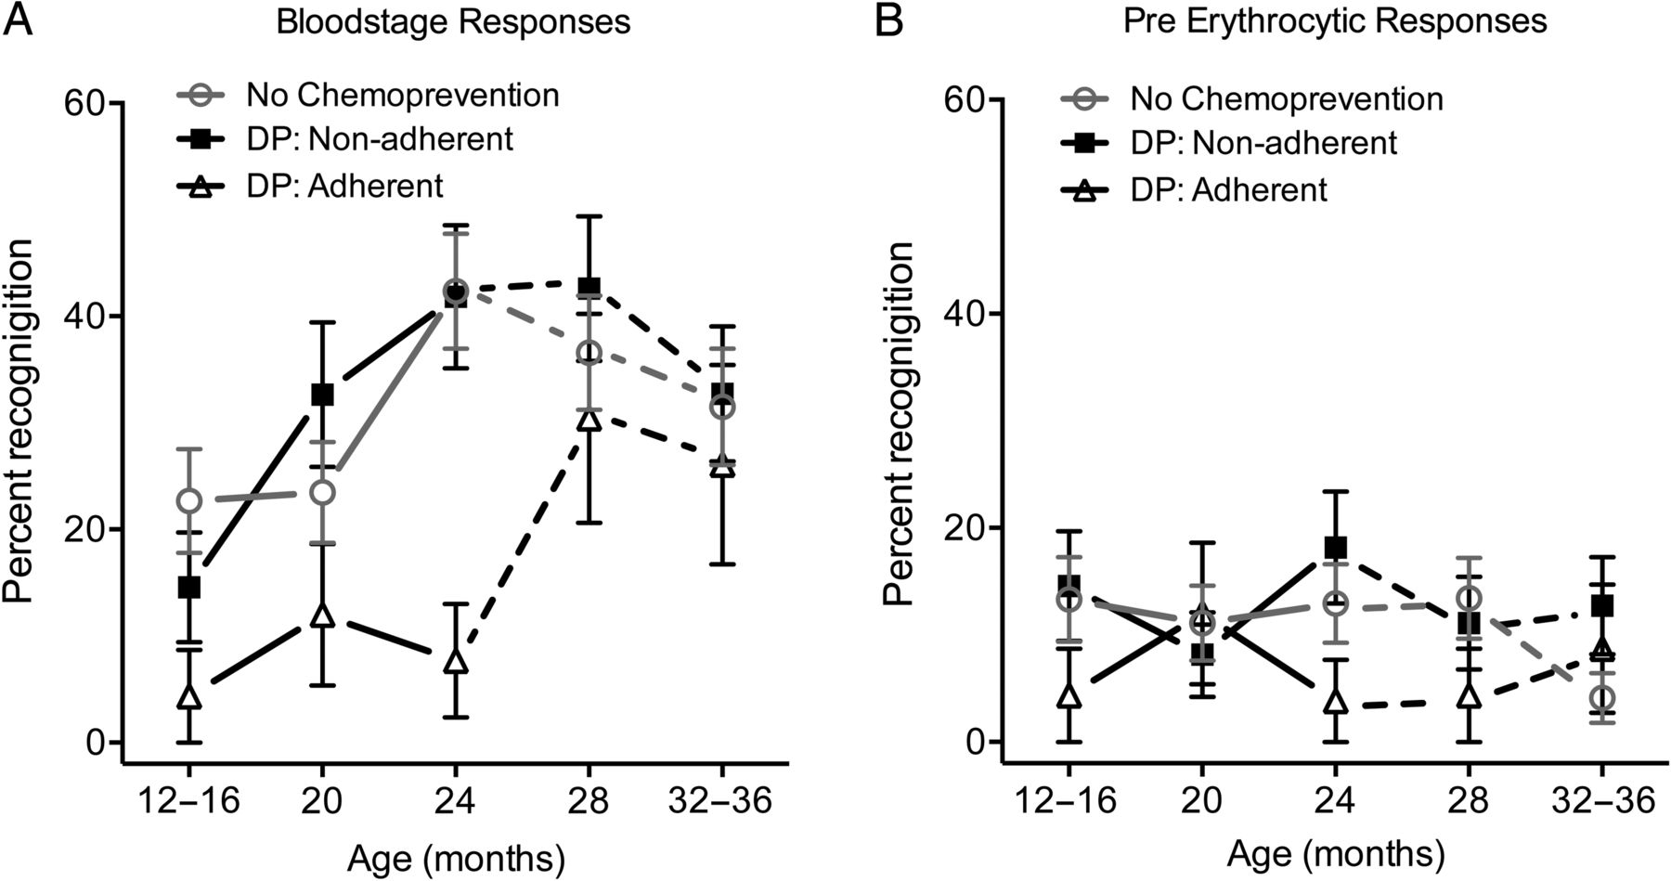
Figure 4. Impact of chemoprevention on ELISpot responses to blood-stage and pre-erythrocytic antigens. A, Recognition ...
Notes:
Figure 4. Impact of chemoprevention on ELISpot responses to blood-stage and pre-erythrocytic antigens. A, Recognition frequencies to any blood-stage antigen at 12–16, 20, 24, 28, and 32–36 months of age in children stratified by antimalarial chemoprevention group (no chemoprevention, DP: Non-adherent, and DP: Adherent. Solid lines represent ELISpot responses during the intervention; dotted lines represent ELISpot responses post-intervention. B, Recognition frequencies to any pre-erythrocytic antigens in children stratified by antimalarial chemoprevention group. Abbreviation: DP, dihydroartemisinin-piperaquine.
Unless provided in the caption above, the following copyright applies to the content of this slide: © The Author 2014. Published by Oxford University Press on behalf of the Infectious Diseases Society of America. All rights reserved. For Permissions, please e-mail: journals.permissions@oup.com.

Slide 5
Figure 5. ELISpot responses and protection from symptomatic malaria. A, Survival curves for IFNγ ELISpot responses to ...
Notes:
Figure 5. ELISpot responses and protection from symptomatic malaria. A, Survival curves for IFNγ ELISpot responses to blood-stage antigens at 24 months of age after adjusting for prior or current malaria exposure (with categories as defined in Table 1) and chemoprevention randomization assignment. The solid black line represents responders to any blood-stage antigen and the dashed line represents nonresponders. B, Survival curves for ELISpot responses to pre-erythrocytic antigens at 24 months of age after adjusting for prior or current malaria. Abbreviation: IFNγ, interferon γ.
Unless provided in the caption above, the following copyright applies to the content of this slide: © The Author 2014. Published by Oxford University Press on behalf of the Infectious Diseases Society of America. All rights reserved. For Permissions, please e-mail: journals.permissions@oup.com.

