Slide 1
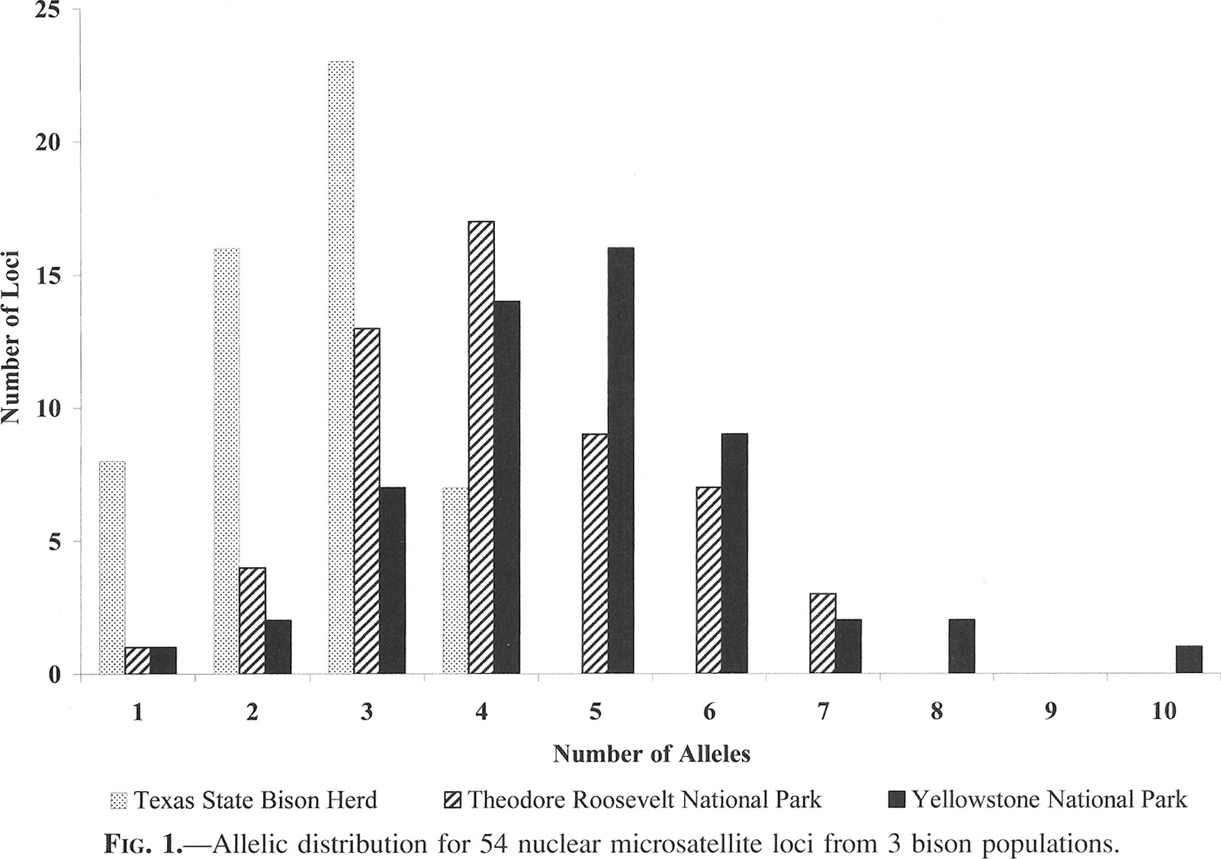
Fig. 1 Allelic distribution for 54 nuclear microsatellite loci from 3 bison populations.
Notes:
Fig. 1 Allelic distribution for 54 nuclear microsatellite loci from 3 bison populations.
Unless provided in the caption above, the following copyright applies to the content of this slide: © 2004 American Society of Mammalogists

