Slide 1
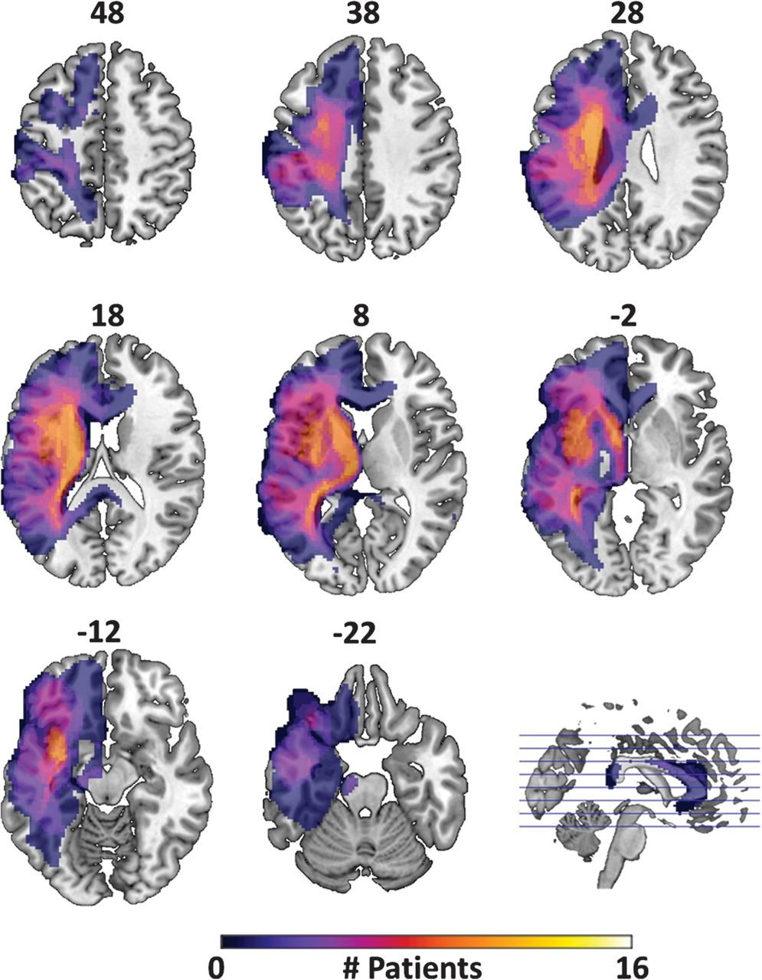
Figure 1. Lesion frequency map. Axial slices showing extent and variability of lesion location within the patient ...
Notes:
Figure 1. Lesion frequency map. Axial slices showing extent and variability of lesion location within the patient group, as defined by the automated lesion detection method of Stamatakis and Tyler (2005). Numbers above each slice give its z coordinate in MNI space. Color bar indicates number of patients whose lesions fell within that region.
Unless provided in the caption above, the following copyright applies to the content of this slide: © The Author 2012. Published by Oxford University Press. All rights reserved. For permissions, please e-mail: journals.permissions@oup.com

Slide 2
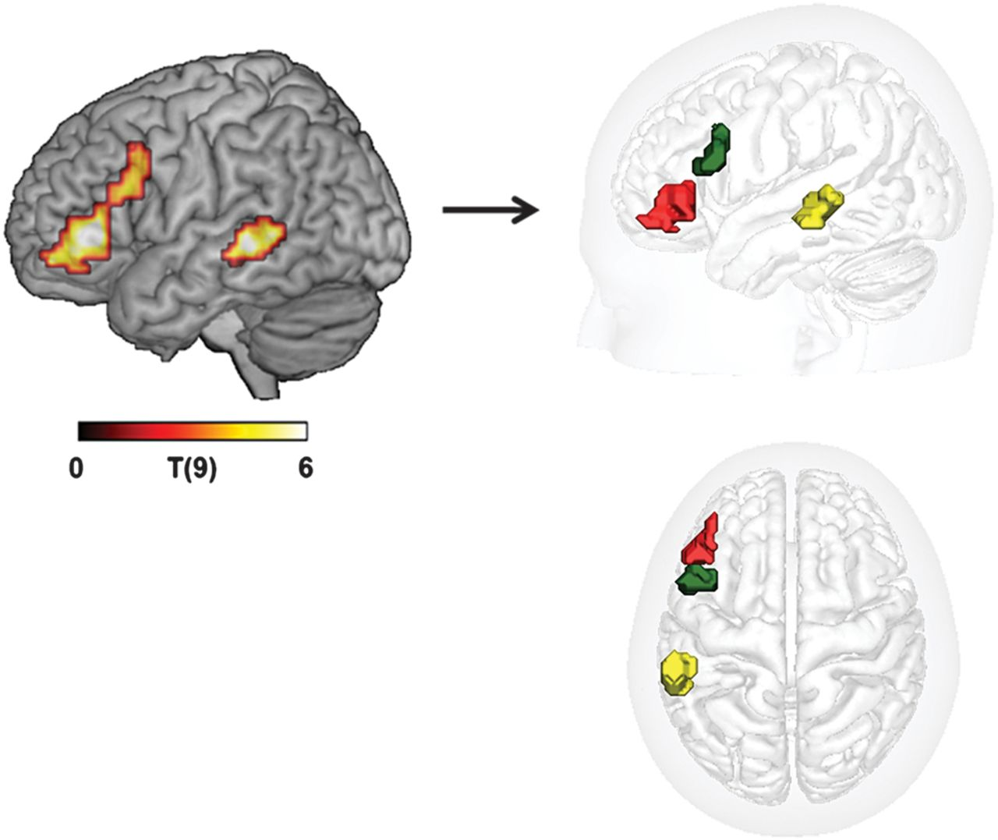
Figure 2. Left posterior middle temporal and 2 left inferior frontal clusters activated in the AP-RWO contrast in the ...
Notes:
Figure 2. Left posterior middle temporal and 2 left inferior frontal clusters activated in the AP-RWO contrast in the fMRI study. These 3 regions were used as seeds for tractography. Left: color map showing T-score activation values for AP-RWO contrast. Right: binary masks of the 3 separated clusters: BA45 (red), BA44 (green), and pMTG (yellow).
Unless provided in the caption above, the following copyright applies to the content of this slide: © The Author 2012. Published by Oxford University Press. All rights reserved. For permissions, please e-mail: journals.permissions@oup.com

Slide 3
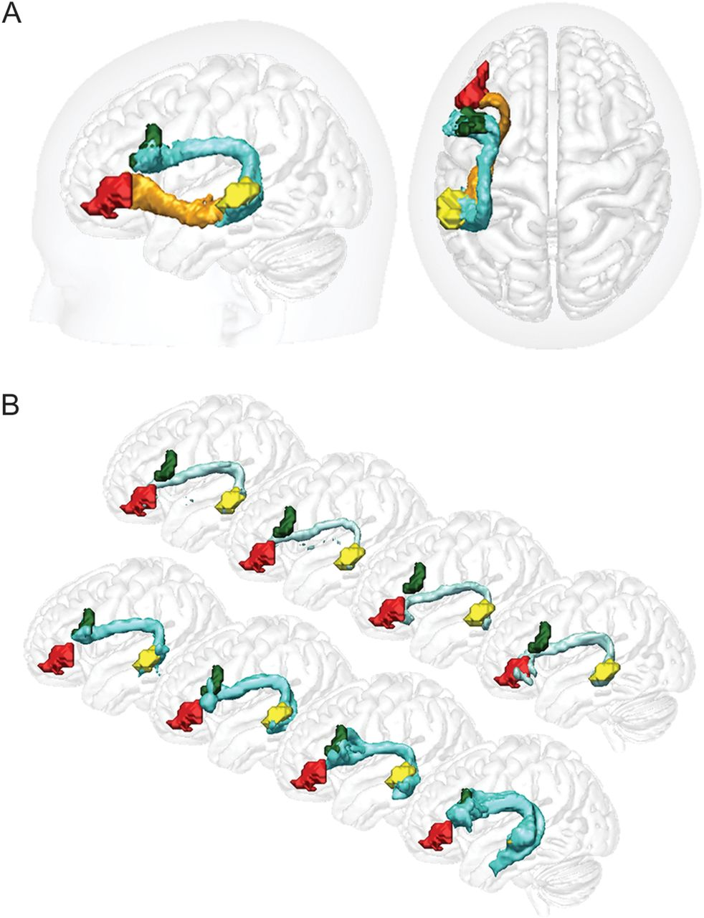
Figure 3. Control group tracts. Surface renderings of dorsal (AF, light blue) and ventral (EmC, orange) pathways. (A) ...
Notes:
Figure 3. Control group tracts. Surface renderings of dorsal (AF, light blue) and ventral (EmC, orange) pathways. (A) Group average pMTG↔BA44 dorsal and pMTG↔BA45 ventral pathways. (B) Renderings of the 2 dorsal pathways (pMTG↔BA44, A and pMTG↔BA45) in 4 example subjects.
Unless provided in the caption above, the following copyright applies to the content of this slide: © The Author 2012. Published by Oxford University Press. All rights reserved. For permissions, please e-mail: journals.permissions@oup.com

Slide 4
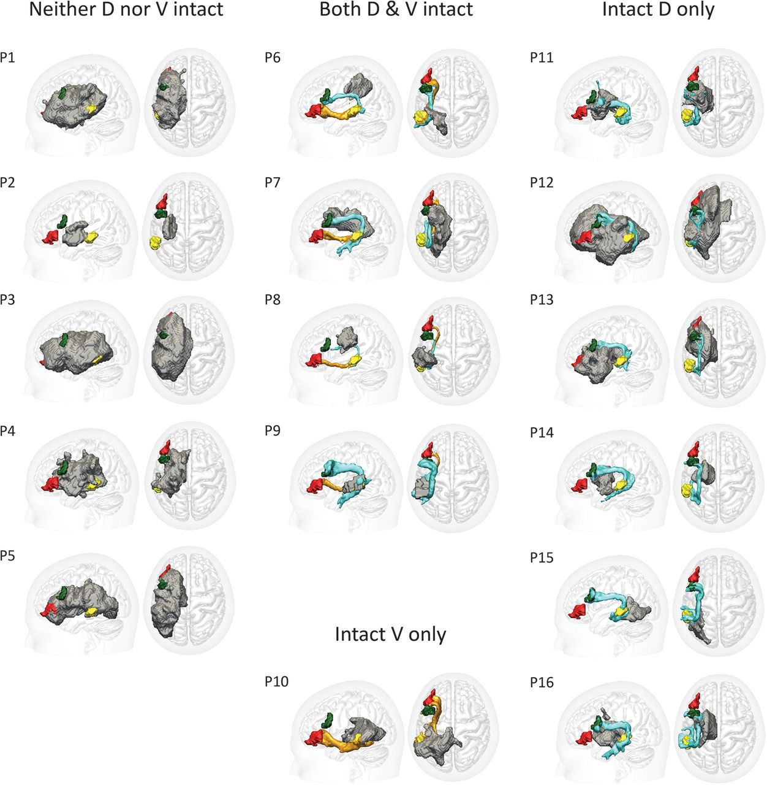
Figure 4. Patients' tracts. Surface renderings of individual tractography reconstructions for each of the 16 patients. ...
Notes:
Figure 4. Patients' tracts. Surface renderings of individual tractography reconstructions for each of the 16 patients. Gray regions indicate the outer surface of the lesioned tissue, as defined by the automated lesion detection method of Stamatakis and Tyler (2005).
Unless provided in the caption above, the following copyright applies to the content of this slide: © The Author 2012. Published by Oxford University Press. All rights reserved. For permissions, please e-mail: journals.permissions@oup.com

Slide 5
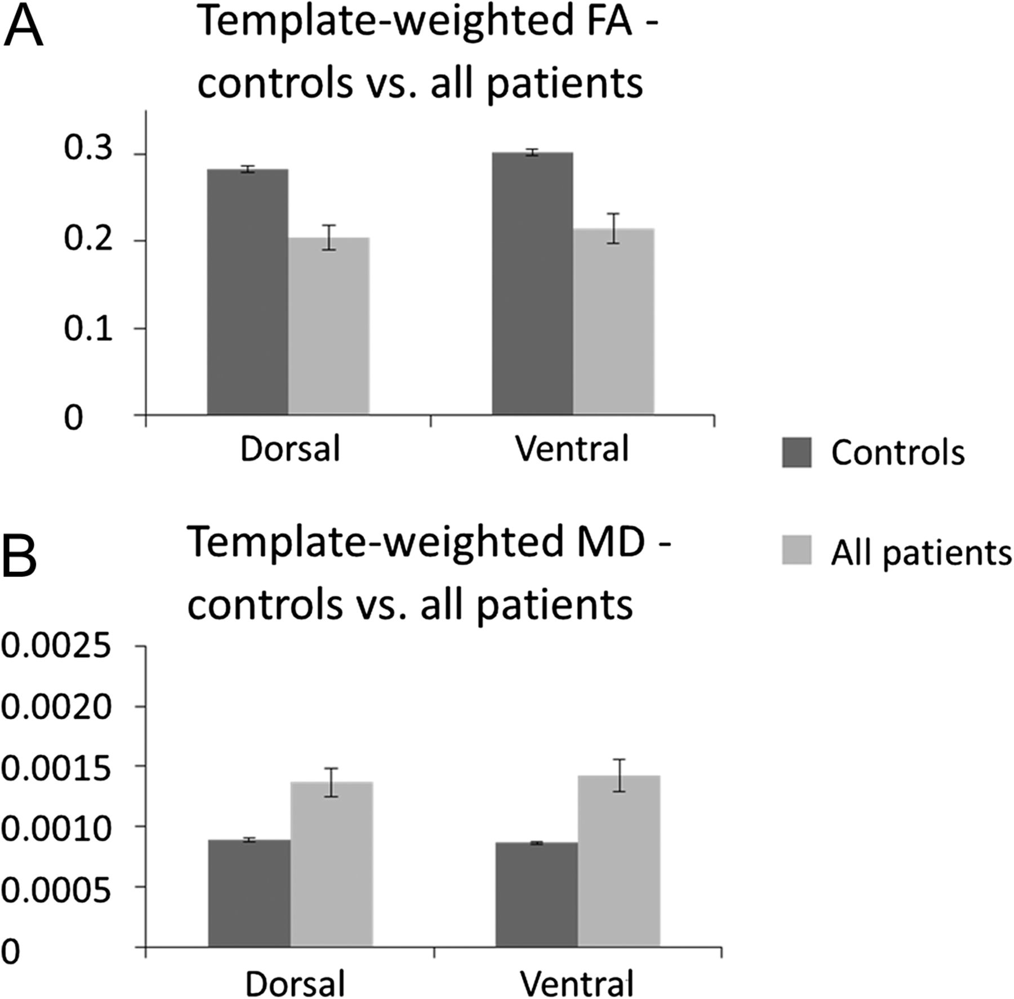
Figure 5. Tract template analyses—controls versus all patients. Mean FA (A) and MD (B) values weighted by tract ...
Notes:
Figure 5. Tract template analyses—controls versus all patients. Mean FA (A) and MD (B) values weighted by tract probability, extracted from dorsal pMTG↔BA44 (AF) and ventral pMTG↔BA45 (EmC) pathway templates following the method of Hua et al. (2008). Controls show significantly higher FA and lower MD than patients within both the AF and EmC templates.
Unless provided in the caption above, the following copyright applies to the content of this slide: © The Author 2012. Published by Oxford University Press. All rights reserved. For permissions, please e-mail: journals.permissions@oup.com

Slide 6
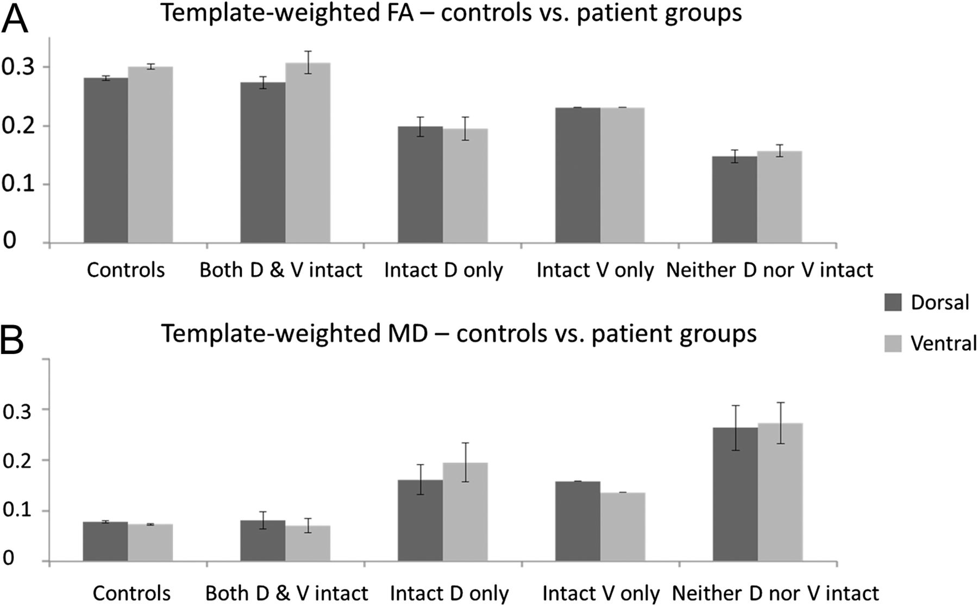
Figure 6. Tract template analyses—controls versus patient groups. Mean FA (A) and MD (B) values weighted by tract ...
Notes:
Figure 6. Tract template analyses—controls versus patient groups. Mean FA (A) and MD (B) values weighted by tract probability, extracted from dorsal pMTG↔BA44 (AF) and ventral pMTG↔BA45 (EmC) pathway templates, for the control and each of the 4 patient groups. As predicted by the individual tractography results, patients with an intact dorsal but no ventral connection showed higher MD in the EmC than the AF, whereas patients with intact ventral but no dorsal connections showed higher MD in the AF than the EmC.
Unless provided in the caption above, the following copyright applies to the content of this slide: © The Author 2012. Published by Oxford University Press. All rights reserved. For permissions, please e-mail: journals.permissions@oup.com

Slide 7
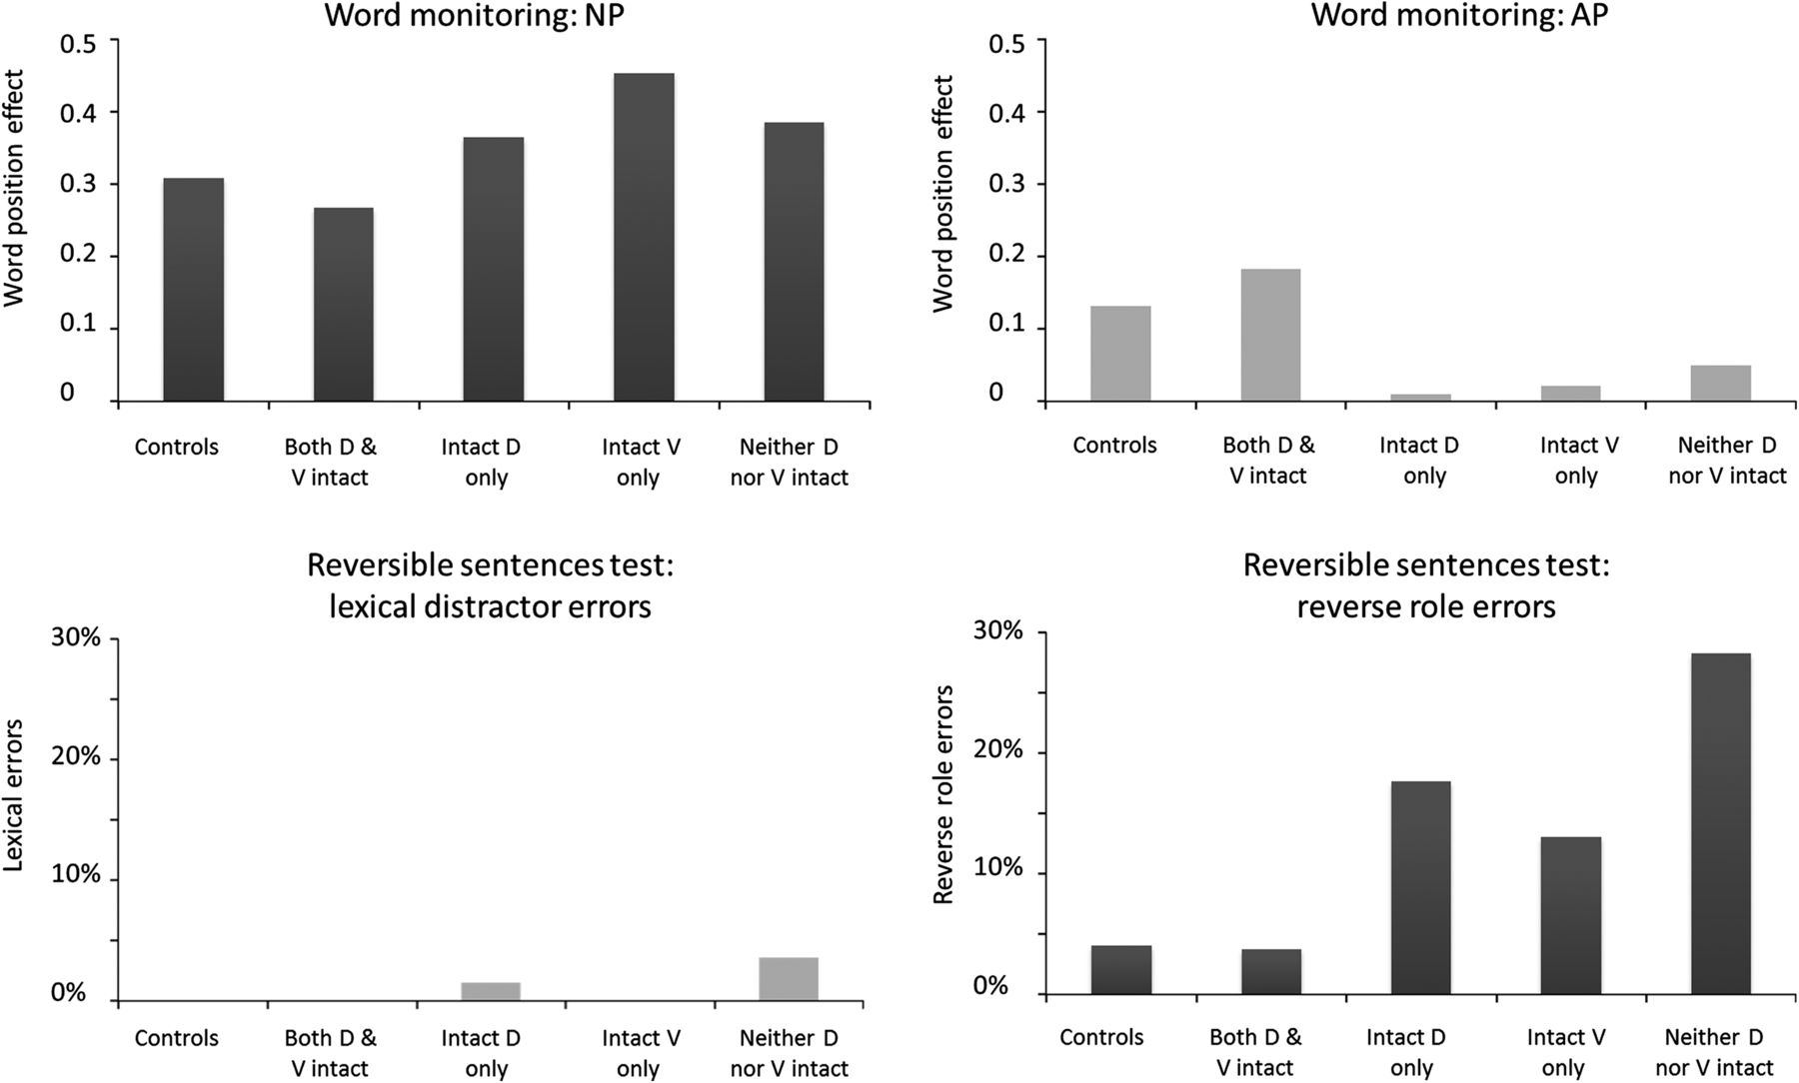
Figure 7. Behavioral data. Top row: Averaged WPE on normal prose (top left) and anomalous prose (top right) conditions ...
Notes:
Figure 7. Behavioral data. Top row: Averaged WPE on normal prose (top left) and anomalous prose (top right) conditions in the word-monitoring study, shown for the controls and each of the tract status-based patient groups. Bottom row: average percent semantic (lexical distracter, bottom left) and syntactic (reverse role, bottom right) errors in the sentence–picture matching task. The controls and patients with both tracts show a large AP WPE in the word-monitoring study and make few syntactic errors in the sentence–picture matching task, both indicating good syntactic comprehension. D = dorsal (pMTG↔BA44) tract, V = ventral (pMTG↔BA45) tract.
Unless provided in the caption above, the following copyright applies to the content of this slide: © The Author 2012. Published by Oxford University Press. All rights reserved. For permissions, please e-mail: journals.permissions@oup.com

