Slide 1
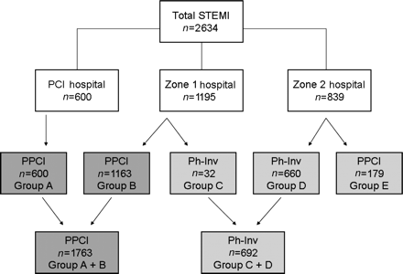
Figure 1 Distribution of ST-elevation myocardial infarction patients by initial hospital presentation and reperfusion ...
Notes:
Figure 1 Distribution of ST-elevation myocardial infarction patients by initial hospital presentation and reperfusion strategy. Percutaneous coronary intervention Hosp: (Minneapolis Heart Institute at Abbott Northwestern Hospital). Zone 1 Hosp (referral hospitals located <60 miles from percutaneous coronary intervention hospital). Zone 2 Hosp (referral hospitals located ≥60 miles from the percutaneous coronary intervention hospital). PPCI, primary percutaneous coronary intervention. Ph-Inv, pharmaco-invasive.
Unless provided in the caption above, the following copyright applies to the content of this slide: Published on behalf of the European Society of Cardiology. All rights reserved. © The Author 2011. For permissions please email: journals.permissions@oup.com

Slide 2
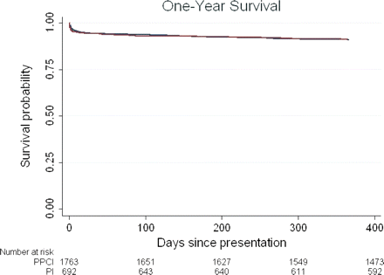
Figure 2 Kaplan–Meier survival curves comparing primary percutaneous coronary intervention treated ST-elevation ...
Notes:
Figure 2 Kaplan–Meier survival curves comparing primary percutaneous coronary intervention treated ST-elevation myocardial infarction patients to pharmaco-invasive-treated ST-elevation myocardial infarction patients.
Unless provided in the caption above, the following copyright applies to the content of this slide: Published on behalf of the European Society of Cardiology. All rights reserved. © The Author 2011. For permissions please email: journals.permissions@oup.com

