Slide 1
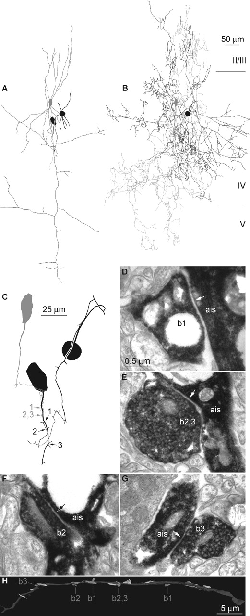
Figure 2. Anatomical correlates of the summation of axo-axonic inputs shown in Figure 1. (A) Dendritic trees ...
Notes:
Figure 2. Anatomical correlates of the summation of axo-axonic inputs shown in Figure 1. (A) Dendritic trees of AAC 1 and 2 (gray and black, only proximal dendrites were recovered from the black cell) and local axonal arborization of the postsynaptic pyramidal cell. (B) Axonal arborization of the presynaptic AACs. (C) The route of presynaptic axons to the axon initial segment of the pyramidal cell. Both presynaptic AACs established three synaptic junctions on the initial segment; one of the presynaptic terminals of AAC 1 formed two synapses (gray 2, 3). (D–G) Electron microscopic verification of synaptic junctions between presynaptic boutons (b1–b3) of AAC 1 (D, E) and AAC 2 (F, G) and the axon initial segment (ais) of the pyramidal cell. (H) Three-dimensional reconstruction based on serial electron microscopic sections of the postsynaptic AIS (dark grey) and all presynaptic terminals targeting it (light gray). Terminals formed by the identified AACs are numbered according to panels C–G.
Unless provided in the caption above, the following copyright applies to the content of this slide:

Slide 2
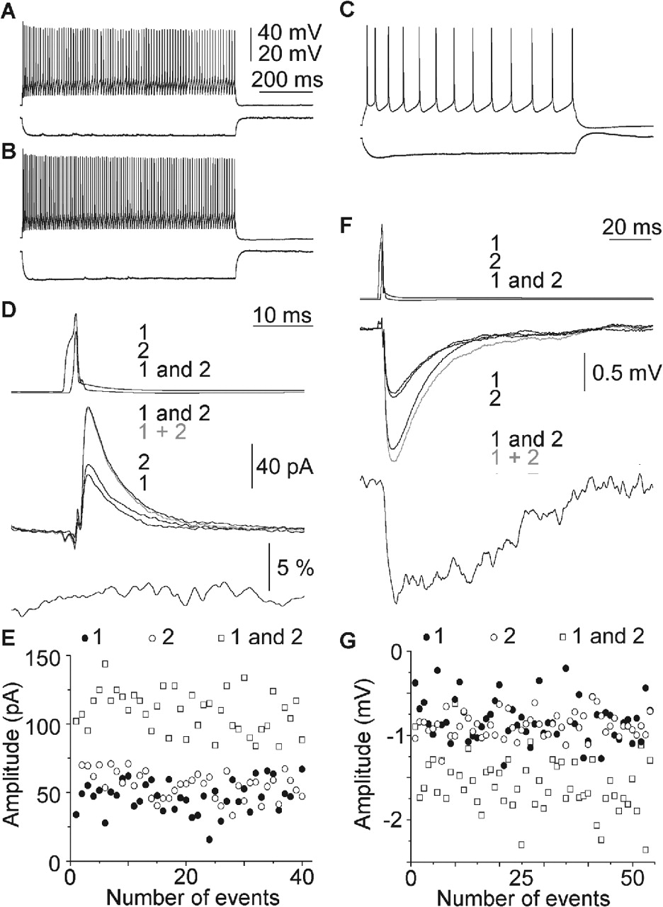
Figure 1. Summation of unitary inputs elicited by AACs in a pyramidal cell. (A–C) Firing pattern and response ...
Notes:
Figure 1. Summation of unitary inputs elicited by AACs in a pyramidal cell. (A–C) Firing pattern and response to a hyperpolarizing current injection (–100 pA) of the presynaptic AACs (A, B) and the postsynaptic pyramidal cell (C). (D) Voltage clamp recordings of summation. Repeated and cyclic activation of the presynaptic cells (top: 1, first AAC alone; 2, second AAC alone; ‘1 and 2’, both cells together) resulted in unitary IPSCs (middle: black, 1; black, 2) and compound responses (middle: black, ‘1 and 2’) in the postsynaptic pyramid held at –50 mV membrane potential. The calculated algebraic sum of IPSC 1 alone and IPSC 2 alone (gray 1 + 2) follows the experimental compound response. The time course of linearity is shown on the bottom panel. (E) Amplitude of recorded IPSCs during recording. (F) Repeating the experiment shown in D, while holding the postsynaptic cell in current clamp at –50 mV, resulted in sublinear summation of IPSPs. The decay of the time course of linearity is slower than that of IPSPs. (G) Stability of recorded IPSPs during the experiment.
Unless provided in the caption above, the following copyright applies to the content of this slide:

