Slide 1
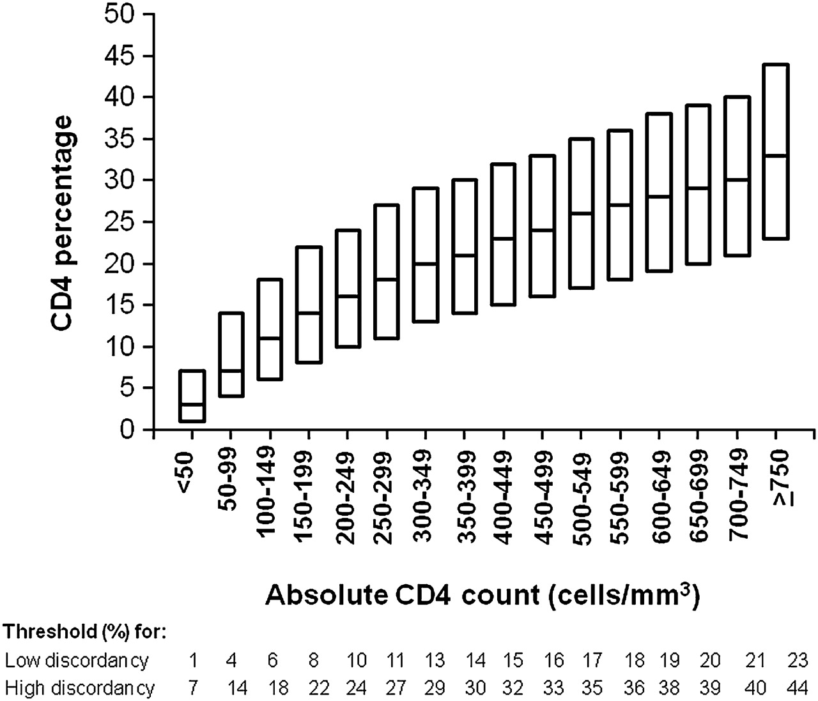
Figure 1. Distribution of CD4 percentage value in individuals with absolute CD4 counts in specified ranges; values ...
Notes:
Figure 1. Distribution of CD4 percentage value in individuals with absolute CD4 counts in specified ranges; values shown are median, 10th, and 90th percentiles.
Unless provided in the caption above, the following copyright applies to the content of this slide: © The Author 2012. Published by Oxford University Press on behalf of the Infectious Diseases Society of America. All rights reserved. For Permissions, please e-mail: journals.permissions@oup.com

