Slide 1
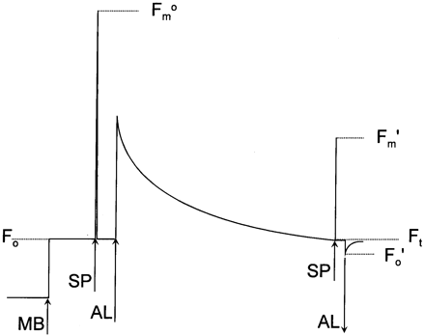
Fig. 1. Sequence of a typical fluorescence trace. A measuring light is switched on (↑MB) and the zero fluorescence ...
Notes:
Fig. 1. Sequence of a typical fluorescence trace. A measuring light is switched on (↑MB) and the zero fluorescence level is measured (Fo). Application of a saturating flash of light (↑SP) allows measurement of the maximum fluorescence level \batchmode \documentclass[fleqn,10pt,legalpaper]{article} \usepackage{amssymb} \usepackage{amsfonts} \usepackage{amsmath} \pagestyle{empty} \begin{document} \(F_{m}^{o}\) \end{document}. A light to drive photosynthesis (↑AL) is then applied. After a period of time, another saturating light flash (↑SP) allows the maximum fluorescence in the light (\batchmode \documentclass[fleqn,10pt,legalpaper]{article} \usepackage{amssymb} \usepackage{amsfonts} \usepackage{amsmath} \pagestyle{empty} \begin{document} \(F_{m}^{{^\prime}}\) \end{document}) to be measured. The level of fluorescence immediately before the saturating flash is termed Ft. Turning off the actinic light (AL), typically in the presence of far‐red light, allows the zero level fluorescence ‘in the light’ to be estimated.
Unless provided in the caption above, the following copyright applies to the content of this slide: © Oxford University Press

