Slide 1
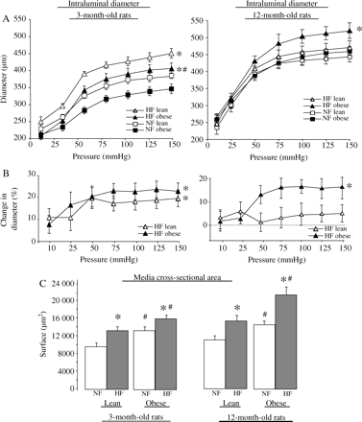
Figure 1 (A) Changes in arterial diameter in response to stepwise increases in pressure in HF and NF mesenteric RAs ...
Notes:
Figure 1 (A) Changes in arterial diameter in response to stepwise increases in pressure in HF and NF mesenteric RAs isolated from 3- and 12-month-old obese and lean Zucker rats. (B) Changes in diameter in HF arteries compared with NF vessels in 3- and 12-month-old lean and obese Zucker rats. (C) Media cross-sectional area. Values are mean ± SEM (n = 12 per group). *P < 0.01, HF vs. NF in each group. #P < 0.01, obese vs. lean.
Unless provided in the caption above, the following copyright applies to the content of this slide: Published on behalf of the European Society of Cardiology. All rights reserved. © The Author 2009. For permissions please email: journals.permissions@oxfordjournals.org.

Slide 2
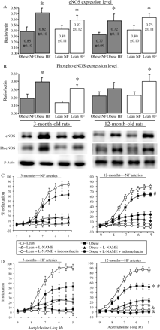
Figure 2 (A) Endothelial NO-synthase (eNOS, A) and phosphorylated-eNOS (B) expression levels were measured using ...
Notes:
Figure 2 (A) Endothelial NO-synthase (eNOS, A) and phosphorylated-eNOS (B) expression levels were measured using western blot analysis in HF and NF mesenteric RAs isolated from 3- and 12-month-old obese and lean Zucker rats. Data are shown as ratio eNOS/beta-actin (values for the intensity of the beta-actin bands are given on each bar). Concentration–response curves to acetylcholine performed in the presence of L-NAME or L-NAME plus indomethacin in NF (C) and HF (D) arteries taken from 3- and 12-month-old lean and obese Zucker rats. Values are mean ± SEM (n = 12 per group). *P < 0.01, HF vs. NF in each group. #P < 0.01, obese vs. lean. &P < 0.01, L-NAME plus indomethacin vs. L-NAME.
Unless provided in the caption above, the following copyright applies to the content of this slide: Published on behalf of the European Society of Cardiology. All rights reserved. © The Author 2009. For permissions please email: journals.permissions@oxfordjournals.org.

Slide 3
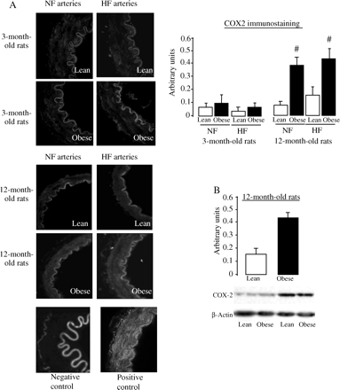
Figure 3 Representative pictures (A) and quantification of COX2 immunostaining performed in HF and NF arteries ...
Notes:
Figure 3 Representative pictures (A) and quantification of COX2 immunostaining performed in HF and NF arteries isolated from 3- and 12-month-old lean and obese Zucker rats. (B) Representative blots and quantification of COX2 expression in arteries isolated from 12-month-old lean and obese Zucker rats. Values are mean ± SEM (n = 12 per group). #P < 0.01, obese vs. lean.
Unless provided in the caption above, the following copyright applies to the content of this slide: Published on behalf of the European Society of Cardiology. All rights reserved. © The Author 2009. For permissions please email: journals.permissions@oxfordjournals.org.

Slide 4
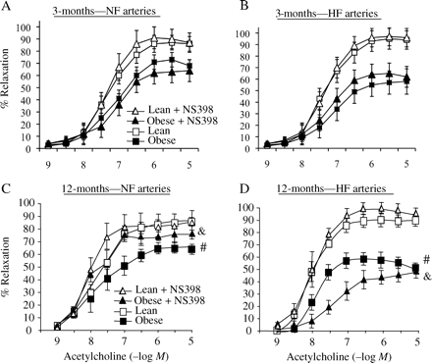
Figure 4 Concentration–response curves to acetylcholine performed in the absence and in the presence of NS398 (10 ...
Notes:
Figure 4 Concentration–response curves to acetylcholine performed in the absence and in the presence of NS398 (10 μmol/L, 20 min) in NF (A and C) and HF (B and D) arteries isolated from 3- (A and B) and 12-month-old (C and D) obese and lean Zucker rats. Values are mean ± SEM (n = 12 per group). #P < 0.01, obese vs. lean. &P < 0.01, NS398 vs. vehicle.
Unless provided in the caption above, the following copyright applies to the content of this slide: Published on behalf of the European Society of Cardiology. All rights reserved. © The Author 2009. For permissions please email: journals.permissions@oxfordjournals.org.

Slide 5
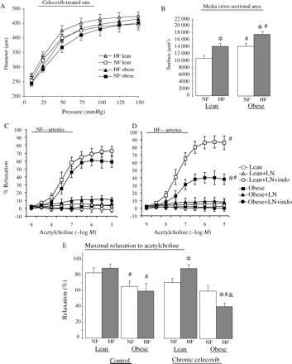
Figure 5 Internal diameter (A) and cross-sectional area (B) in HF and NF mesenteric arteries isolated from ...
Notes:
Figure 5 Internal diameter (A) and cross-sectional area (B) in HF and NF mesenteric arteries isolated from 12-month-old obese and lean Zucker rats treated chronically with the COX2 inhibitor celecoxib. Acetylcholine-dependent relaxation was measured in NF (C) and HF arteries (D) in the presence of L-NAME and in the presence of L-NAME plus indomethacin. Maximal relaxation (E) obtained in response to acetylcholine (calculated from Figure 4A and 5C–D). Values are mean ± SEM (n = 12 per group). *P < 0.01, HF vs. NF in each group. #P < 0.01, obese vs. lean. &P < 0.01, celecoxib vs. vehicle.
Unless provided in the caption above, the following copyright applies to the content of this slide: Published on behalf of the European Society of Cardiology. All rights reserved. © The Author 2009. For permissions please email: journals.permissions@oxfordjournals.org.

