Slide 1
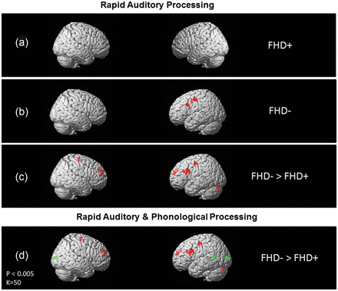
Figure 1. Statistical parametric maps showing brain activation for rapid versus slow acoustic stimuli (FT>ST) in ...
Notes:
Figure 1. Statistical parametric maps showing brain activation for rapid versus slow acoustic stimuli (FT>ST) in children with (FHD+(a)) and without (FHD− (b)) a familial risk for DD. Group differences reveal that FHD+ children show a disruption in neural response to rapid compared with slow acoustic information in left frontal brain regions when compared with FHD− children (c). (d) incorporates group differences (FHD−>FHD+) during rapid auditory (in red) and phonological processing (in green).
Unless provided in the caption above, the following copyright applies to the content of this slide: © The Author 2013. Published by Oxford University Press. All rights reserved. For Permissions, please e-mail: journals.permissions@oup.com

