Slide 1
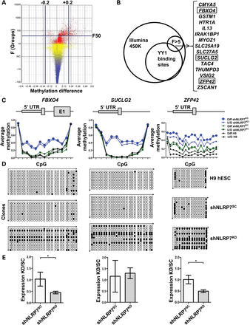
Figure 5. NLRP7 knockdown in hES cells alters DNA methylation at multiple loci. (A) Volcano plot of methylation data ...
Notes:
Figure 5. NLRP7 knockdown in hES cells alters DNA methylation at multiple loci. (A) Volcano plot of methylation data shows methylation difference (X-axis) by F-value (Y-axis). (B) Overlap of 11 608 sites bound by YY1 in reported H1 hESC ChIP-seq data with the significantly altered probes from the F > 5 list of loci yielded 15 significant loci; loci that were verified are boxed. (C) DNA methylation levels at the CpG islands of the FBXO4 gene (left), SUCGL2 gene (middle) and ZFP42 gene (right) are increased in shNLRP7KD hESCs. Each is shown as a graph, with methylation levels on the Y-axis and the individual probes in the region on the X-axis. The partial gene structure is aligned above each graph relative to the distribution of the probes on the graphs. (D) Bisulfite sequencing at each of these CpG islands in differentiated untransduced (top), shNLRP7SC-transduced (middle) and shNLRP7KD-transduced (lower) H9 hESCs confirms the methylation gain upon shNLRP7KD. Each horizontal line represents a sequenced clone, open circles represent unmethylated CpG sites and closed circles represent methylated CpG sites. (E) Increased methylation correlates with decreased mRNA expression by qRT-PCR in shNLRP7KD H9 hESCs compared with shNLRP7SC H9 hESCs for FBXO4 (left) and ZFP42 (right), but not in SUCLG2.
Unless provided in the caption above, the following copyright applies to the content of this slide: © The Author 2013. Published by Oxford University Press. All rights reserved. For Permissions, please email: journals.permissions@oup.com

Slide 2
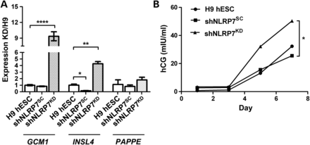
Figure 4. NLRP7 knockdown promotes trophoblast differentiation in hES cells. (A) qRT-PCR of trophoblast lineage markers ...
Notes:
Figure 4. NLRP7 knockdown promotes trophoblast differentiation in hES cells. (A) qRT-PCR of trophoblast lineage markers after 7 days of BMP4-induced differentiation in shNLRP7KD cells, compared with untransduced cells (H9 hESCs), and cells expressing the scrambled shRNA (shNLRP7SC) showed high expression of GCM1 (****P ≤ 0.0001) and INSL4 (**P ≤ 0.01), but no change in PAPPE expression. (B) Quantification by ELISA at 1, 3, 5 and 7 days of BMP4-induced differentiation of hCG secreted in the culture medium: levels increase by day 5 in all three lines, but are higher at both day 5 and day 7 in shNLRP7KD cells, compared with shNLRP7SC cells and untransduced H9 ESCs.
Unless provided in the caption above, the following copyright applies to the content of this slide: © The Author 2013. Published by Oxford University Press. All rights reserved. For Permissions, please email: journals.permissions@oup.com

Slide 3
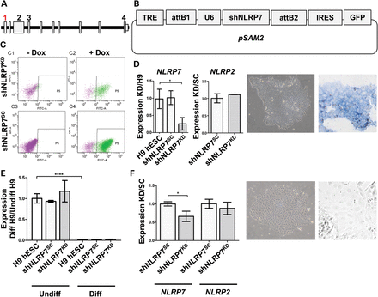
Figure 3. NLRP7 knockdown in H9 cells. (A) Genomic region with exons of NLRP7. Position of shRNA sequences is indicated ...
Notes:
Figure 3. NLRP7 knockdown in H9 cells. (A) Genomic region with exons of NLRP7. Position of shRNA sequences is indicated by numbers 1–4; number 1 (in red) was used for knockdown in hES cells. (B) Map of the pSAM2 vector containing the NLRP7 shRNA sequence (shNLRP7). Constitutive expression of the NLRP7 knockdown cassette is controlled by a U6 RNA promoter. The GFP cassette is separated from the shNLRP7 cassette by an IRES sequence and controlled by a doxycycline-inducible promoter (TRE, tetracycline response element; GFP, green fluorescent protein; IRES, internal ribosomal entry site; attB1 and attB2, cloning sites for Gateway® cloning; U6, U6 promoter sequence for constitutive shRNA expression). (C) FACS results of hES cells transduced with the pSAM2 vector containing the shNRLP7 (upper panels; shNLRP7KD) and the vector containing the scrambled shRNA (lower panels; shNLRP7SC). C1 and C3 show the absence of GFP-labeled cells without doxycycline induction, and C2 and C4 show the presence of GFP-positive cells in gate P5 after doxycycline induction. GFP-positive cells were triple-sorted for purification. (D) NLRP7 mRNA expression (left graph) is reduced by 80% in shNLRP7KD hESCs that express shNLRP7KD compared with untransduced cells (H9 hESCs) and cells containing the scrambled shNLRP7SC(*P ≤ 0.05), but NLRP2 expression (right graph) is unaffected. shNLRP7KD hESCs exhibit characteristic pluripotent colony morphology within 24 h of culture and high alkaline phosphatase (blue stain) activity prior to differentiation. (E) qRT-PCR results show significant reduction of POU5F1 mRNA expression to undetectable levels after 7 days of BMP4-induction of differentiation (****P ≤ 0.0001). (F) NLRP7 mRNA expression remains reduced by ∼50% after differentiation in NLRP7KD hESCs (left graph) that express shNLRP7KD compared with cells expressing scrambled shNLRP7SC (shNLRP7SC) (*P ≤ 0.05), but NLRP2 expression (right graph) remains unaffected. Morphological changes after 24 h of BMP4-induced differentiation: hESCs adopt a more cuboidal shape. Alkaline phosphatase activity (blue stain) disappears after 7 days of differentiation with BMP4 when cells also adopt the larger, flatter more trophoblast-cell-like shape.
Unless provided in the caption above, the following copyright applies to the content of this slide: © The Author 2013. Published by Oxford University Press. All rights reserved. For Permissions, please email: journals.permissions@oup.com

Slide 4
Figure 2. NLRP7 levels do not alter YY1 levels. (A–C) Expression levels of YY1 mRNA by RT-qPCR in HEK293T (A), BeWo (B) ...
Notes:
Figure 2. NLRP7 levels do not alter YY1 levels. (A–C) Expression levels of YY1 mRNA by RT-qPCR in HEK293T (A), BeWo (B) and H9 hESCs (C) and of protein levels in HEK293T cells (A) with NLRP7 overexpression (A) or knockdown (B and C) are unchanged, except for a marginally significant increased expression in undifferentiated hESCs (*P ≤ 0.05).
Unless provided in the caption above, the following copyright applies to the content of this slide: © The Author 2013. Published by Oxford University Press. All rights reserved. For Permissions, please email: journals.permissions@oup.com

Slide 5
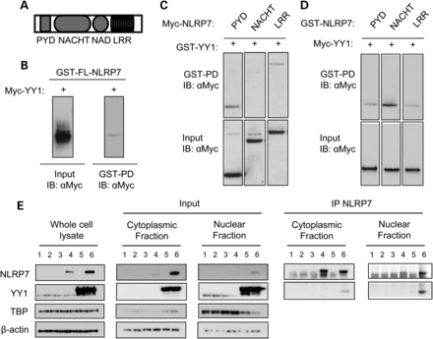
Figure 1. NLRP7 binds to YY1 in both nuclear and cytoplasmic fractions. (A) Map of the NLRP7 protein with different ...
Notes:
Figure 1. NLRP7 binds to YY1 in both nuclear and cytoplasmic fractions. (A) Map of the NLRP7 protein with different domains (PYD: pyrin domain; NACHT: nucleoside-triphosphatase domain named after proteins NAIP, CIITA, HET-E and TP1; NAD: NACHT-associated domain; LRR: leucine-rich repeat). (B) GST-tagged full-length NLRP7 (GST-FL-NLRP7) was co-expressed with Myc-tagged YY1. Immunoblotting was performed with an anti-myc antibody (αMyc) on the cell lysate (WB) on input and after pull-down on glutathione-sepharose (GST-PD). (C) Myc-tagged NLRP7 PYD, NACHT domain (NACHT) and LRR domain (LRR) were co-expressed with GST-tagged YY1 (GST-YY1 ‘+’ lanes) in HEK293T cells and pulled down with GST-PD. Precipitated material (top panel) or cell lysate (bottom panel; input) was immunoblotted with anti-Myc; the bottom panel shows the western analysis of unprecipitated cell lysates to confirm protein expression in each lane. (D) Same experiment as (C) but with tags reversed: NLRP7 domains are GST-tagged and YY1 is Myc-tagged. YY1 binds to the LRR, NACHT and PYD domain. (E) HEK293 cells were transfected with transfection agent alone (1), pDESTV5 (2), pDESTmyc (3), NLRP7-V5 (4), myc-YY1 (5) and NLRP7-V5 together with myc-YY1 (6). Whole-cell lysates show appropriate expression in all experimental groups (left panel). Endogenous YY1 (lanes 1–4) is at a lower molecular weight than myc-tagged YY1 (lanes 5 and 6). Subcellular fractionation followed by loading of 10% input from the IP experiment reveals presence of NLRP7 in cytoplasmic (lane 4) as well as nuclear fraction (lane 6). Additionally, there is no endogenous YY1 in the cytoplasmic fraction (lanes 1–4) suggesting an entirely nuclear localization of YY1 (middle panel). IP of NLRP7 followed by blotting with YY1 reveals an interaction of the two proteins in the cytoplasmic and nuclear fractions (right panels).
Unless provided in the caption above, the following copyright applies to the content of this slide: © The Author 2013. Published by Oxford University Press. All rights reserved. For Permissions, please email: journals.permissions@oup.com

