Slide 1
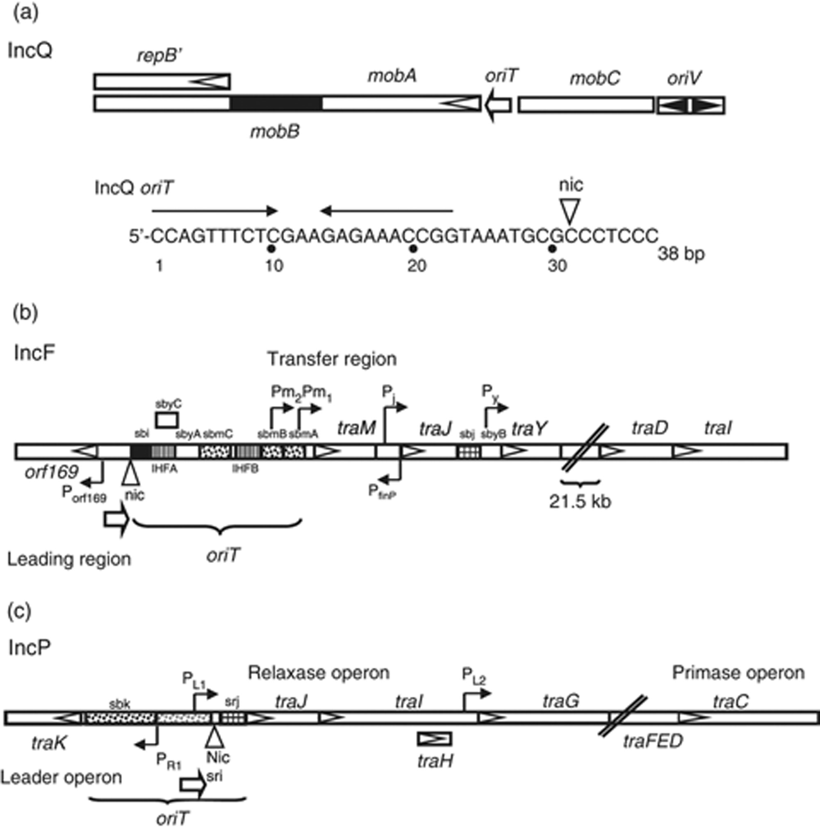
Figure 1 Overview of the organization of IncQ (R1162), IncF (F), and IncP (RP4) oriT regions. ORFs (italicized) are ...
Notes:
Figure 1 Overview of the organization of IncQ (R1162), IncF (F), and IncP (RP4) oriT regions. ORFs (italicized) are indicated by open arrowheads within boxes. Large arrows indicate the direction of transfer. Vertical wedges indicate the nic site. (a) Organization of the R1162 mobilization and replication regions (Scholz et al., 1989). The region encoding mobB that overlaps mobA is indicated by a black box. The origin of vegetative replication (oriV) has two arrowheads indicating bidirectional replication. Below is the sequence of the 38-bp (only the nicked strand is shown) oriT region. The inverted arrows indicate the site of MobA recognition, binding and termination. (b) An abbreviated F transfer region illustrating the positioning of the members of the relaxosome based on Frost et al. (1994). The site of binding for TraI (sbi, black box), TraY (sbyA, -B, -C, clear boxes), TraM (sbmA, -B, -C; speckled boxes) and TraJ (sbj, checked box) are indicated. The major promoters are indicated by hooked arrows that represent the transcriptional start sites. The slanted lines indicate an interruption in the sequence of 21.5 kb (traA to traT). The trbH gene between traD and traI, and traX and finO after traI are not shown. A detailed view of the oriT region (bracket) is given in Fig. 2. (c) A depiction of the oriT region of RP4 based on Pansegrau et al. (1994). The binding sites for TraK are shown as speckled boxes with black indicating strong binding and grey indicating binding at high TraK concentrations. The three promoters associated with expression of the relaxosome components of RP4 are shown as hooked arrows. A detailed view of the oriT region (bracket) is given in Fig. 3.
Unless provided in the caption above, the following copyright applies to the content of this slide: © 2009 Federation of European Microbiological Societies.

Slide 2
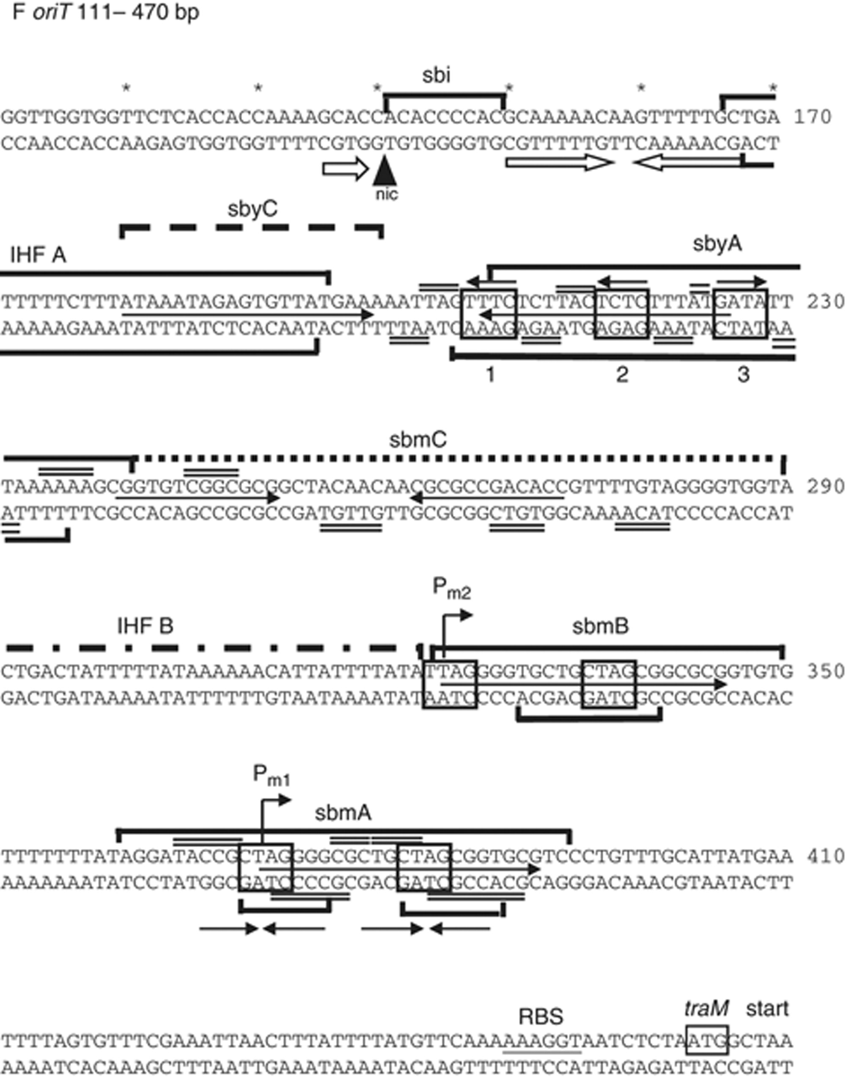
Figure 2 A detailed view of the F oriT region (Fig. 1b) based on results from Tsai et al. (1990); Stern & Schildbach ...
Notes:
Figure 2 A detailed view of the F oriT region (Fig. 1b) based on results from Tsai et al. (1990); Stern & Schildbach (2001); Di Laurenzio et al. (1992); Lum et al. (2002); and Fekete & Frost (2002). The numbering is according to Frost et al. (1994). Solid and dashed brackets indicate DNAse I protection footprints on the top and bottom strand for primary and secondary binding sites, respectively. Boxes containing sequences on both strands indicate recognition sequences whereas double lines above and below the sequence indicate protected residues identified by hydroxy radical footprinting (sbyA and sbmA). Boxes within a single line of sequence indicate protection from hydroxyl radicals in sbmC or the start codon for traM. Hooked arrows indicate the start site for the two traM transcripts. Direct and inverted repeats within sby and sbm sites are indicated with arrows between the lines or below the line for sbmA. See text for details.
Unless provided in the caption above, the following copyright applies to the content of this slide: © 2009 Federation of European Microbiological Societies.

Slide 3
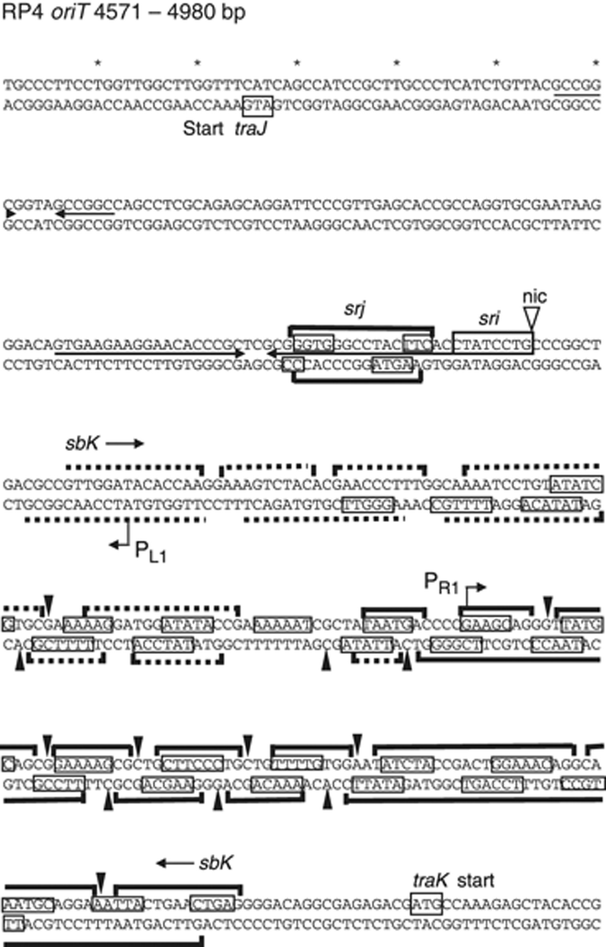
Figure 3 A detailed view of the RP4 oriT region (Fig. 1c) based on Fürste et al. (1989) and Ziegelin et al. (1992). ...
Notes:
Figure 3 A detailed view of the RP4 oriT region (Fig. 1c) based on Fürste et al. (1989) and Ziegelin et al. (1992). Numbering is according to Pansegrau et al. (1994). sri and srj refer to the sites for recognition by TraI (T-strand) and TraJ, respectively. The extensive DNAse I protection footprint is bracketed by arrows above the line and marked by sbK. Solid and dashed brackets indicate DNAse I protection footprints on the top and bottom strand for primary and secondary binding sites, respectively. Filled vertical arrowheads indicate positions of hypersensitivity to DNAse I. Bases that are protected from hydroxyl radicals are boxed on each line of sequence. Hooked arrows indicate the approximate start site for the transcripts from the PL1 and PR1 promoters. The inverted repeats, thought to be associated with TraJ recognition and binding, are indicated between the lines. The start codons for traJ and traK are boxed. See text for details.
Unless provided in the caption above, the following copyright applies to the content of this slide: © 2009 Federation of European Microbiological Societies.

Slide 4
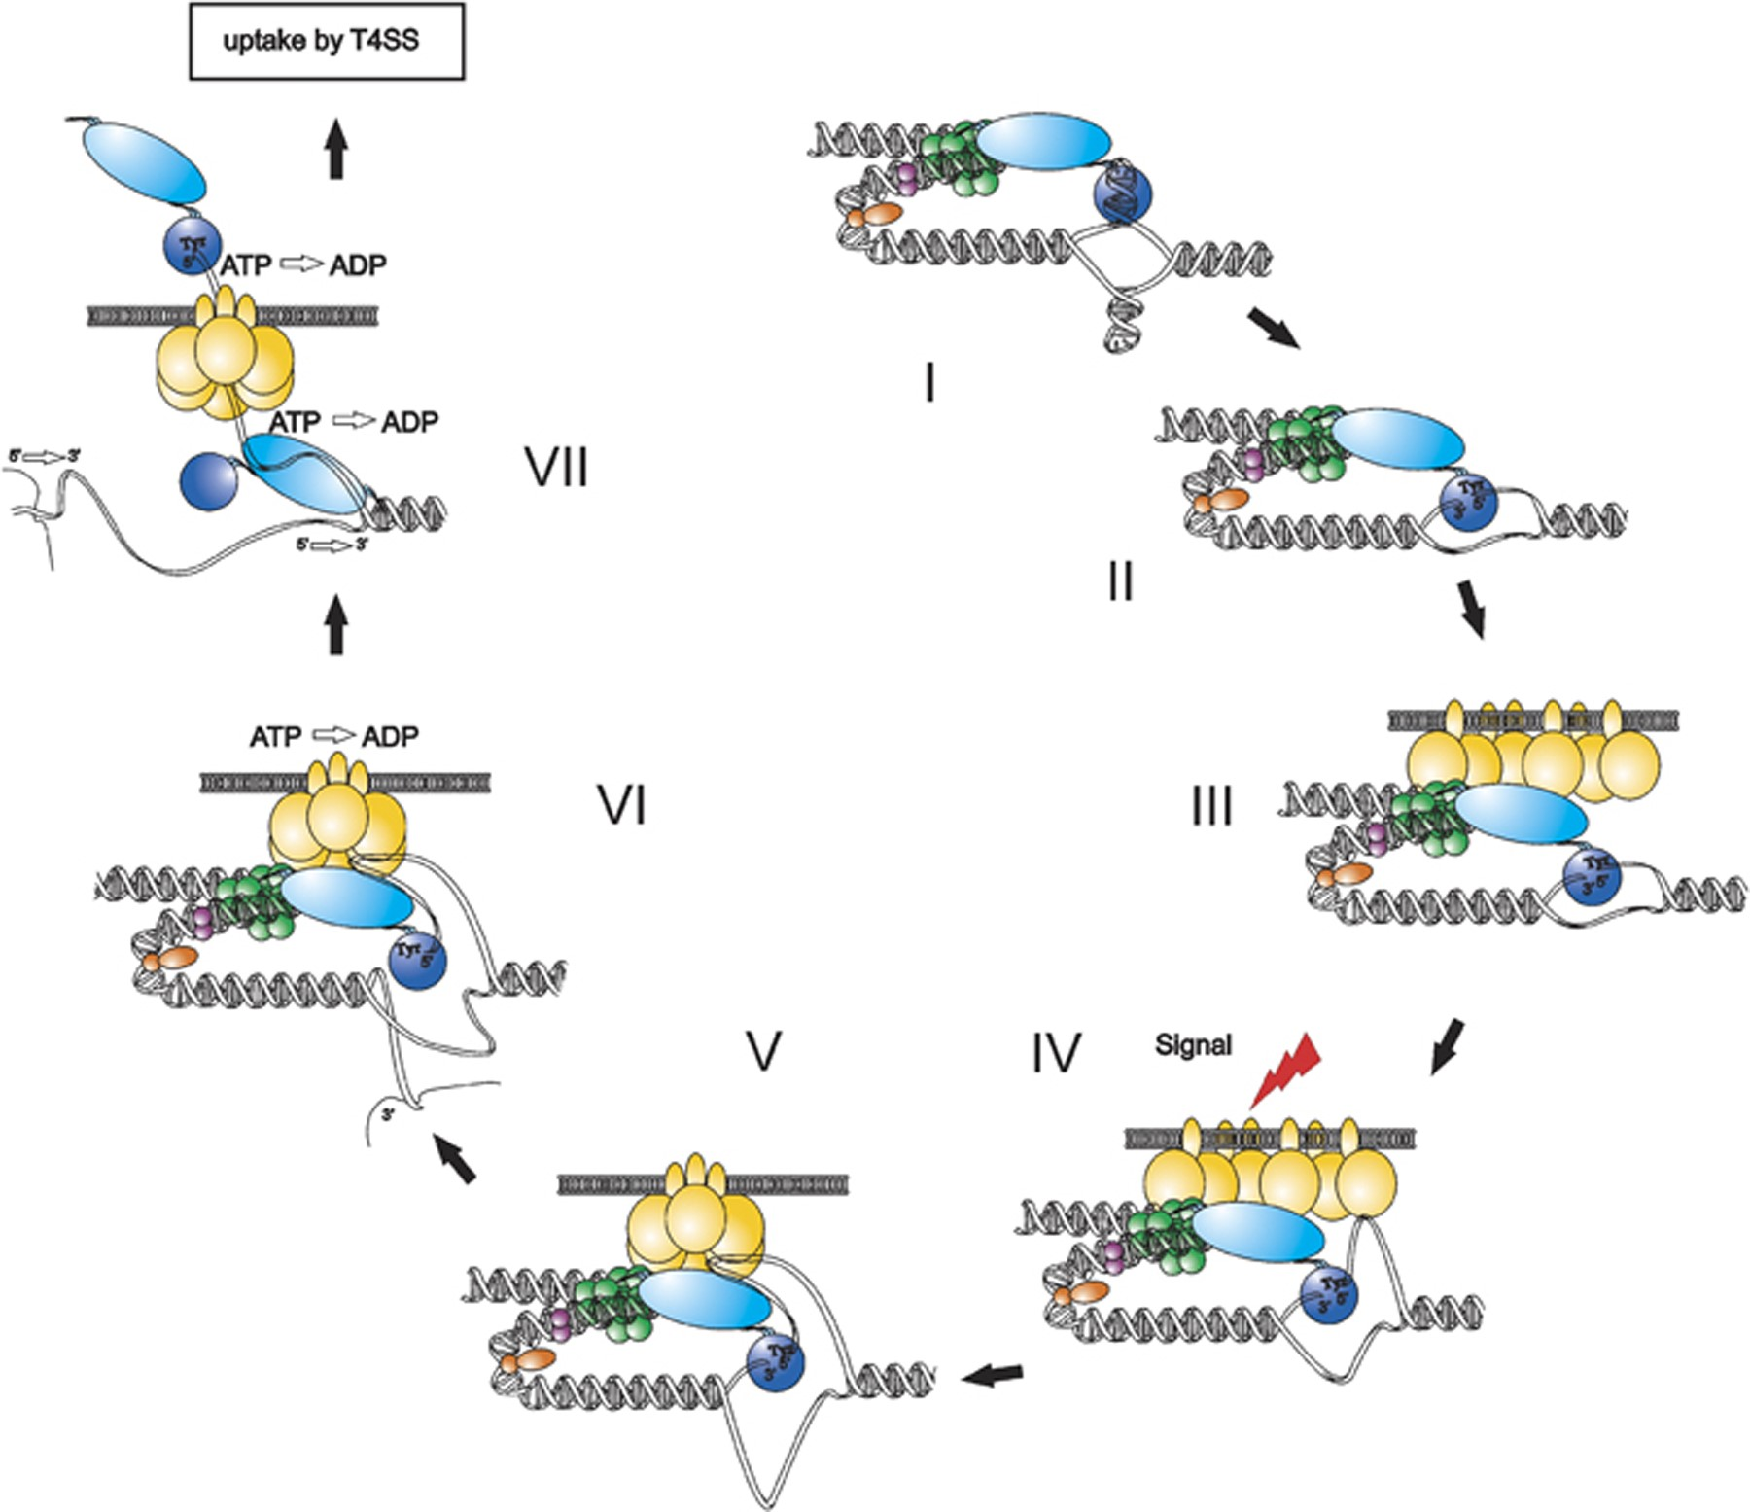
Figure 4 Model for regulation of T-strand production and delivery to the translocation machinery of the ...
Notes:
Figure 4 Model for regulation of T-strand production and delivery to the translocation machinery of the MOBF T4SS (indicated by ‘uptake of DNA’ in a box). Steps in the initiation reaction cascade (I–VII) are described in DNA processing of MOB relaxosomes. Protein components are illustrated as follows: the bifunctional TraI phosphodiesterase (blue) with active site tyrosine (Tyr) and TraI helicase domains (light blue), IHF (orange), TraY (purple), TraM (green) and the T4CP TraD (yellow). See DNA processing of MOB relaxosomes for details. © Journal of Bacteriology 19: 6888-6899, doi:10.1128/JB. 00920-09, reproduced with permission from the American Society for Microbiology.
Unless provided in the caption above, the following copyright applies to the content of this slide: © 2009 Federation of European Microbiological Societies.

