Slide 1
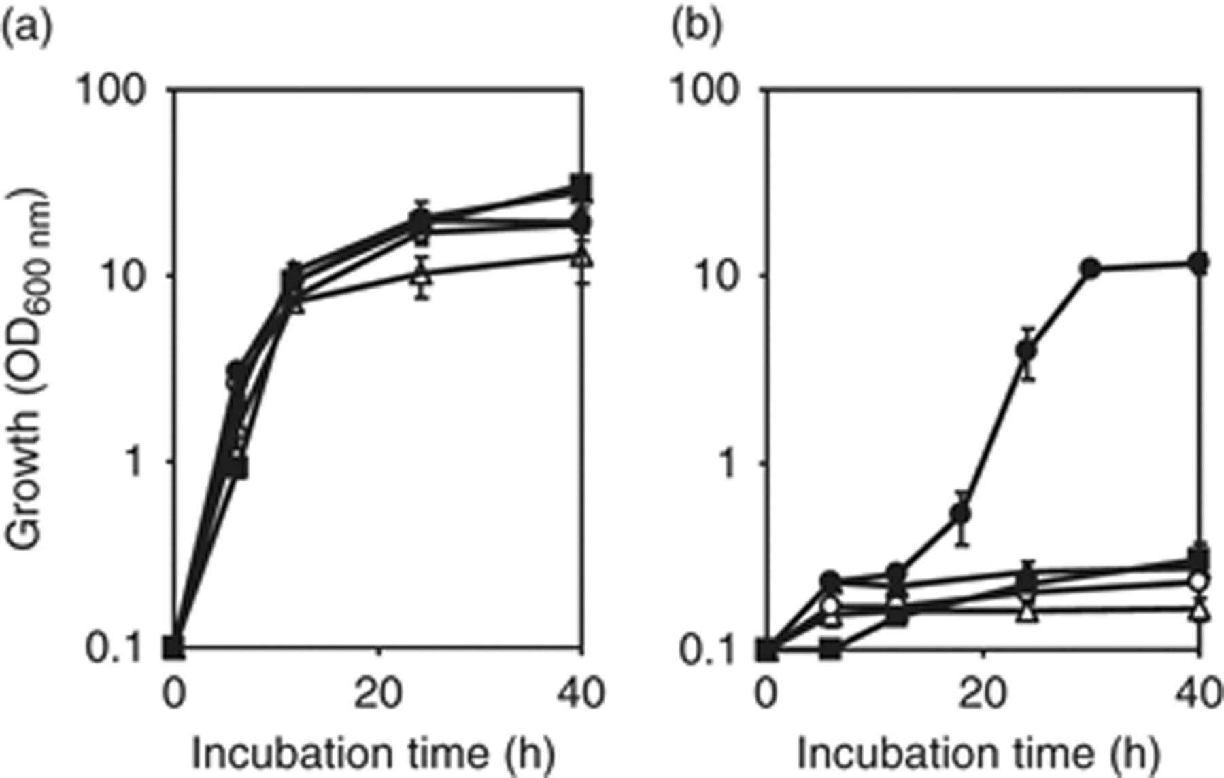
1 Growth of vanillin-tolerant (NBRC 1950) and laboratory strains (X2180, S288C, W303, and HX) of Saccharomyces ...
Notes:
1 Growth of vanillin-tolerant (NBRC 1950) and laboratory strains (X2180, S288C, W303, and HX) of Saccharomyces cerevisiae. NBRC 1950 (closed circles), X2180 (open circles), S288C (closed triangles), W303 (open triangles), and HX (closed squares) strains were cultivated by shaking YPD media containing 0 mM (a) or 15 mM (b) of vanillin. All values are means±SDs of three independent experiments.
Unless provided in the caption above, the following copyright applies to the content of this slide: © 2009 Federation of European Microbiological Societies. Published by Blackwell Publishing Ltd. All rights reserved

Slide 2
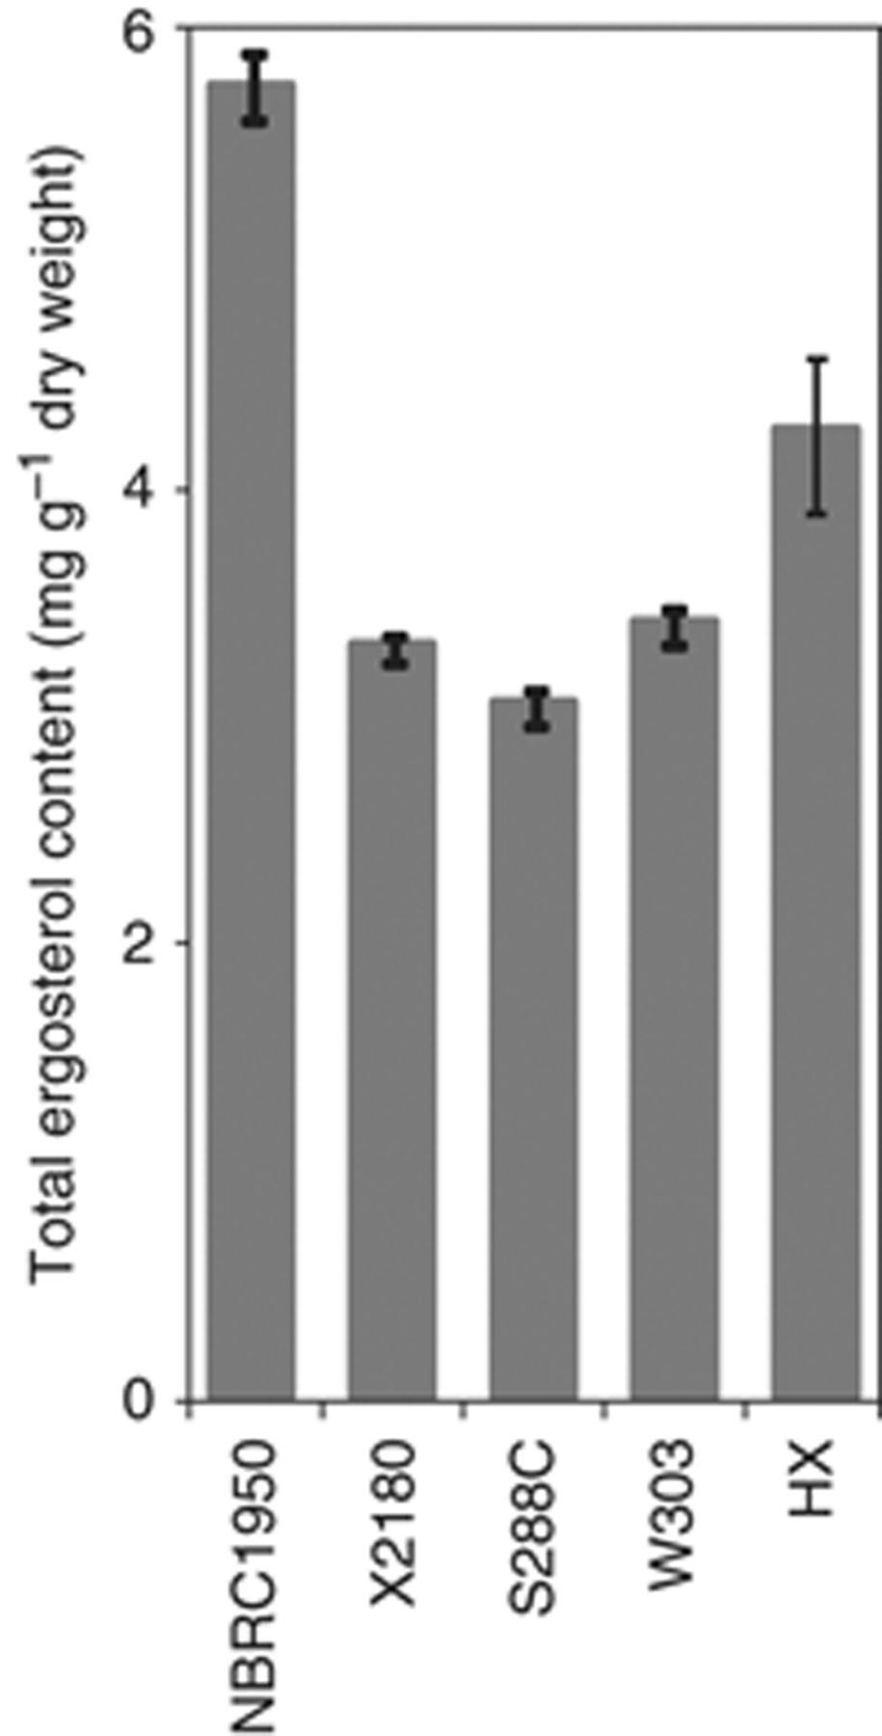
2 Ergosterol contents of vanillin-tolerant (NBRC 1950) and laboratory strains (X2180, S288C, W303, and HX) of ...
Notes:
2 Ergosterol contents of vanillin-tolerant (NBRC 1950) and laboratory strains (X2180, S288C, W303, and HX) of Saccharomyces cerevisiae. All values are means±SDs of three independent experiments.
Unless provided in the caption above, the following copyright applies to the content of this slide: © 2009 Federation of European Microbiological Societies. Published by Blackwell Publishing Ltd. All rights reserved

Slide 3
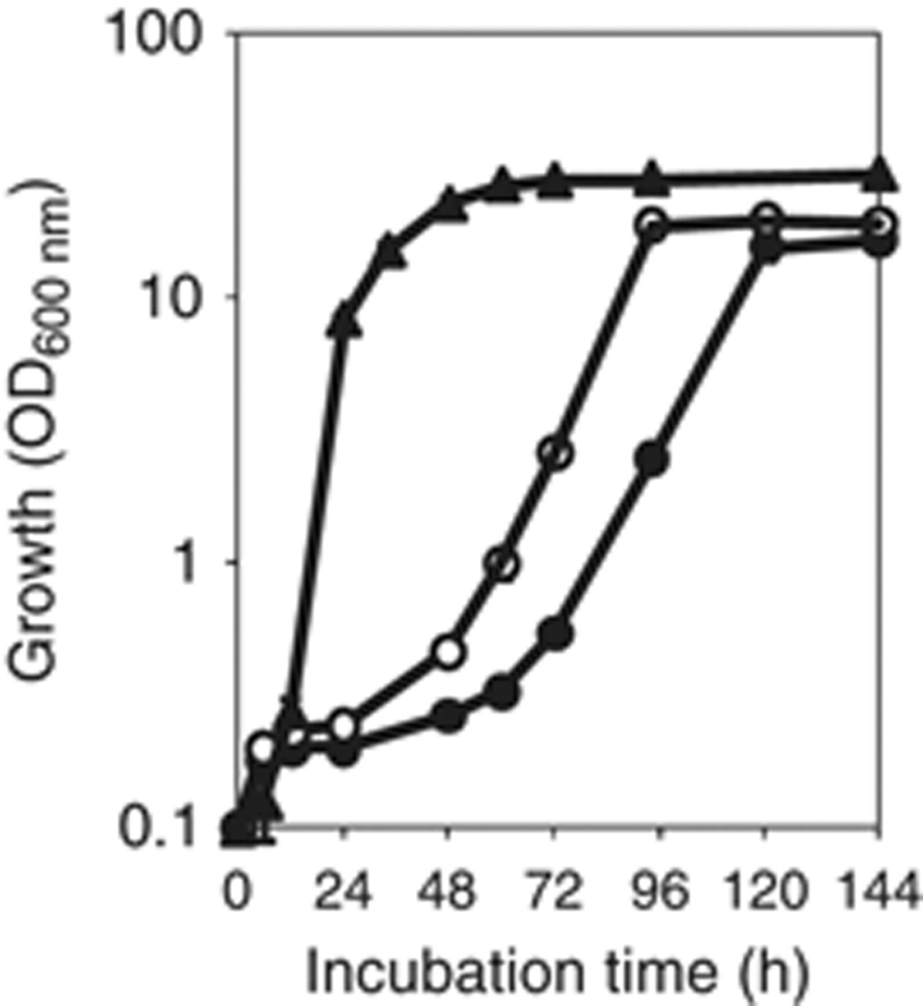
3 Comparison of growth of X2180 with that of HX in a vanillin-containing medium. X2180 (closed circles), HX ...
Notes:
3 Comparison of growth of X2180 with that of HX in a vanillin-containing medium. X2180 (closed circles), HX (open circles), and NBRC 1950 (closed triangles) were cultivated by shaking YPD media containing 12 mM vanillin. All values are means±SDs of three independent experiments.
Unless provided in the caption above, the following copyright applies to the content of this slide: © 2009 Federation of European Microbiological Societies. Published by Blackwell Publishing Ltd. All rights reserved

