Slide 1
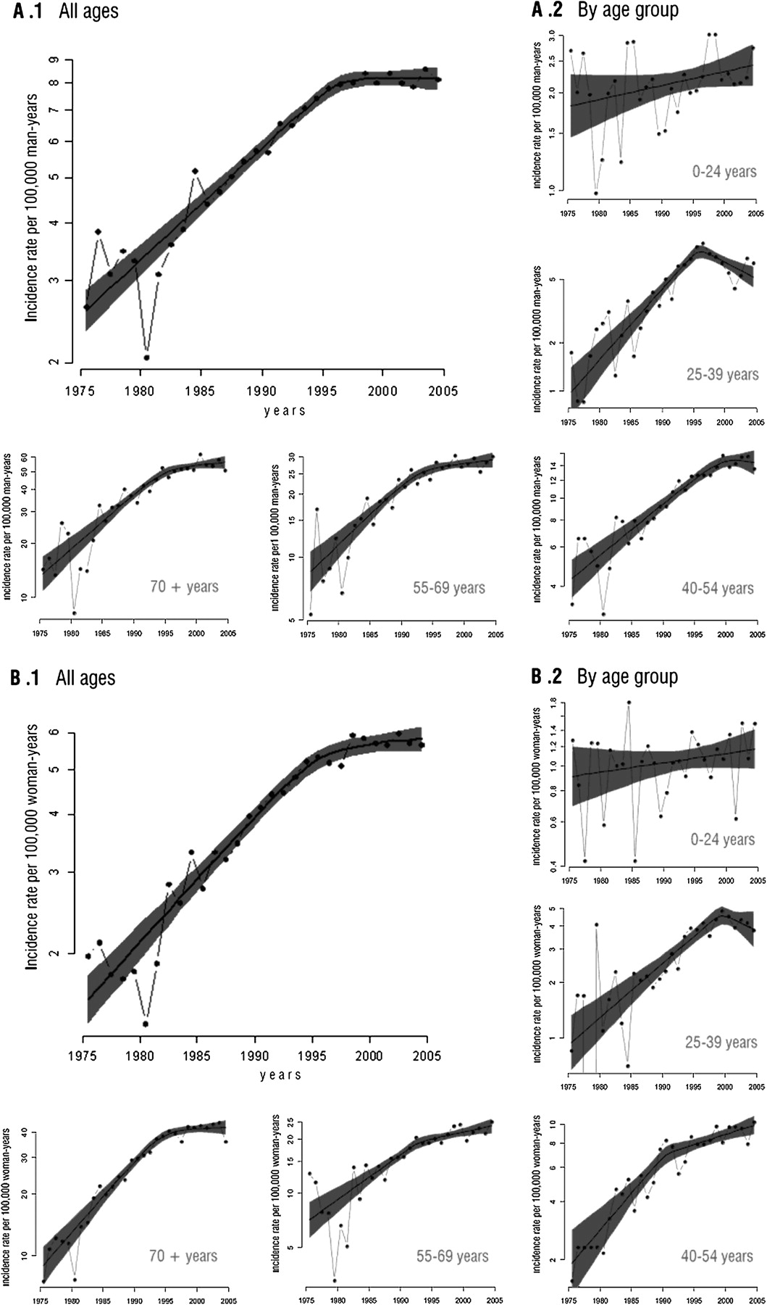
Figure 1. Age- and registry-adjusted incidence rates of non-Hodgkin's lymphoma over the period 1975–2004 among men (A1, ...
Notes:
Figure 1. Age- and registry-adjusted incidence rates of non-Hodgkin's lymphoma over the period 1975–2004 among men (A1, all ages; and A2, by age group) and women (B1, all ages; and B2, by age group) at all Spanish registries. The observed rates (dotted line) were obtained by using nominal categories for each year of diagnosis, and the estimated time trend (solid line) and its 95% confidence interval (CI) (dashed line) were obtained from fitting a change-point model (see Methods section).
Unless provided in the caption above, the following copyright applies to the content of this slide: © The Author 2010. Published by Oxford University Press on behalf of the European Society for Medical Oncology. All rights reserved. For permissions, please email: journals.permissions@oxfordjournals.org

