Slide 1
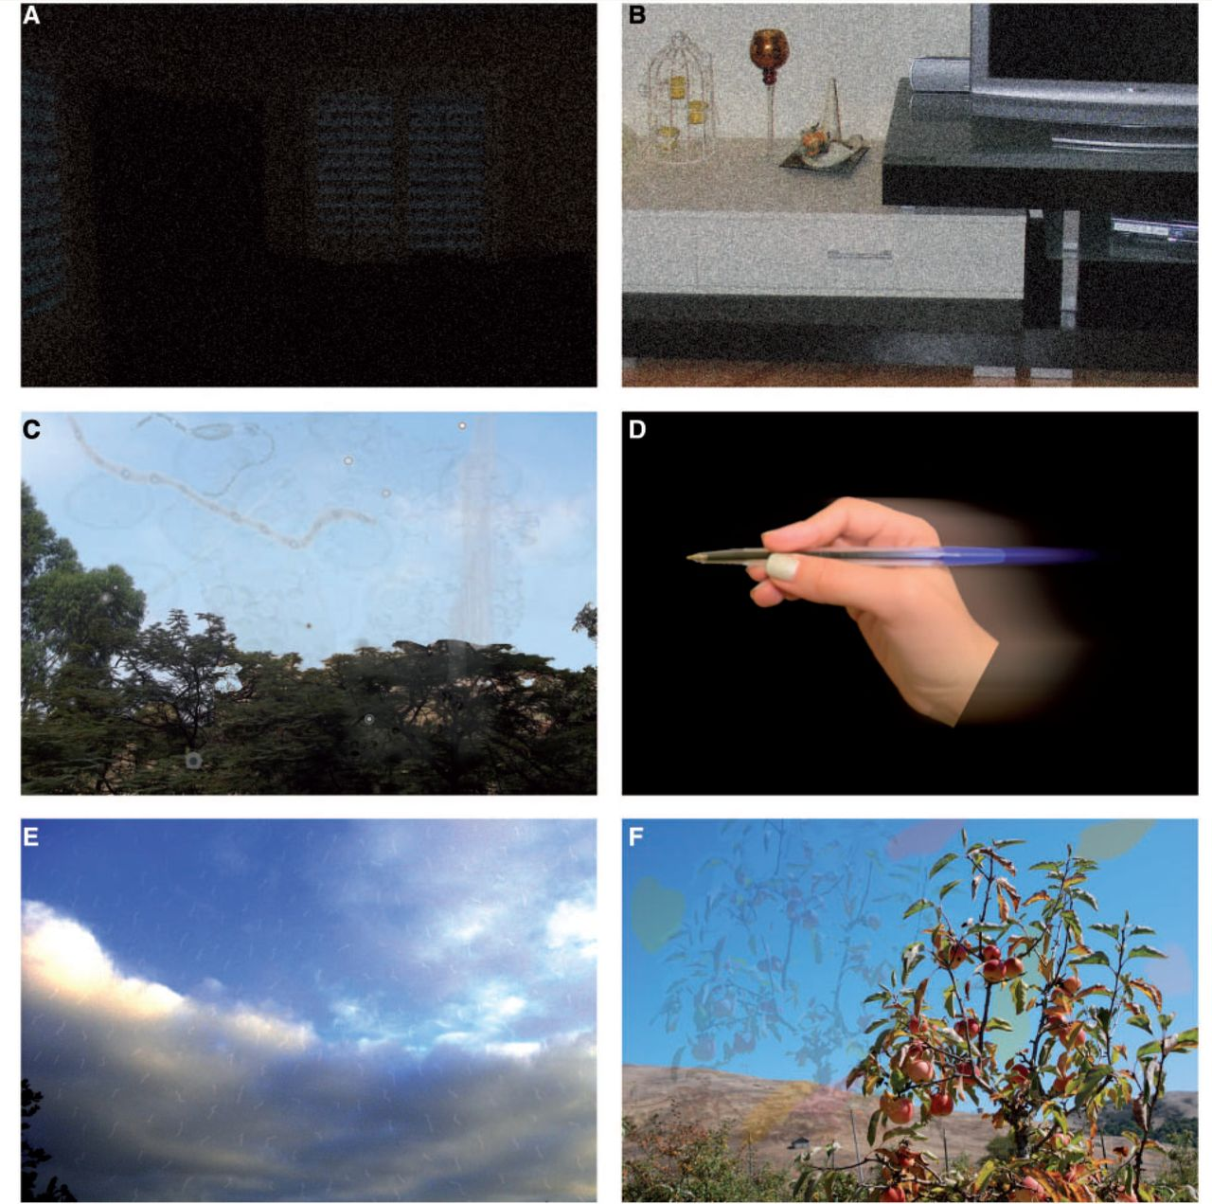
Figure 1 Illustrations done by three patients to demonstrate ‘visual snow’ (tiny dynamic flickering dots in the entire ...
Notes:
Figure 1 Illustrations done by three patients to demonstrate ‘visual snow’ (tiny dynamic flickering dots in the entire visual field) in the dark (A), during the day (B), floaters (C), palinopsia (‘trailing’) in (D), blue field entoptic phenomenon (E), and palinopsia (positive after images) in (F).
Unless provided in the caption above, the following copyright applies to the content of this slide: © The Author (2014). Published by Oxford University Press on behalf of the Guarantors of Brain. All rights reserved. For Permissions, please email: journals.permissions@oup.com

