Slide 1
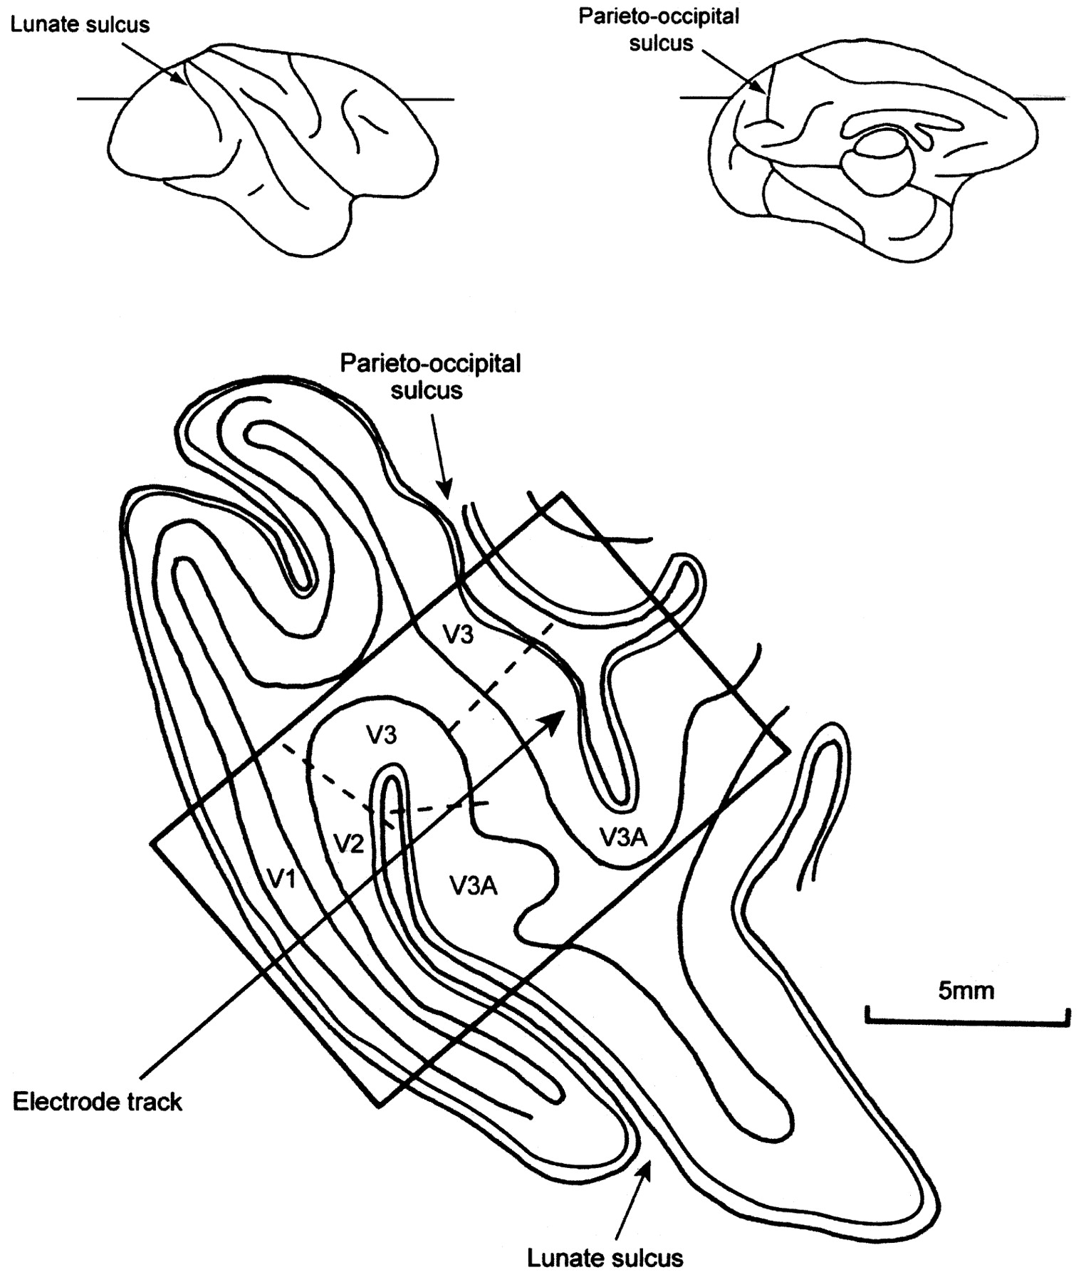
Figure 2. Diagrammatic reconstruction of a horizontal section taken through the brain of the macaque monkey, at the ...
Notes:
Figure 2. Diagrammatic reconstruction of a horizontal section taken through the brain of the macaque monkey, at the level indicated on the surface drawings, to show the electrode trajectories used in this study. Only the posterior part of the section is shown. For further details, see text.
Unless provided in the caption above, the following copyright applies to the content of this slide: © Oxford University Press

Slide 2
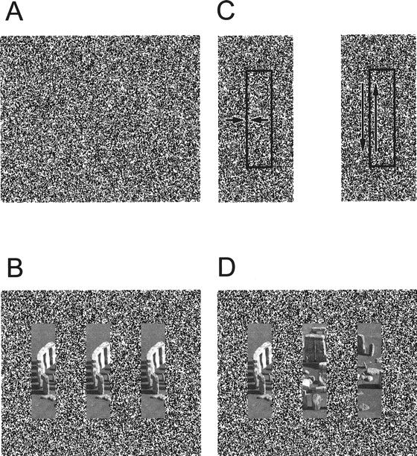
Figure 3. The kinetic contour display used to stimulate the orientation selective cells of the V3 complex in the ...
Notes:
Figure 3. The kinetic contour display used to stimulate the orientation selective cells of the V3 complex in the monkey. A shows the grain of the texture, which consisted of a 320 × 240 pixel image containing a random dot matrix of 50% black and 50% white texture of grain one pixel, with each each pixel subtending 3 arcminutes at a distance of 114 cm. (B) illustrates the stimulus in ‘frame mode’ when the contents of the stimulus bar moved with the stimulus bar. The ‘Stonehenge’ image shown here and in (D) is for illustrative purposes only, and was replaced with a random texture in the actual experiment. (C) Texture motion could either be orthogonal to (left) or parallel to (right), the long edge of the stimulus bar. In some cases the textures were stationary and then the display would appear as in (A) above. (D) In ‘slot mode’ the contents of the stimulus bar did not move with the stimulus bar. In both the ‘slot’ and the ‘frame’ mode, the pixels at the borders changed dynamically as the stimulus bar moved, some changing from black to white or vice versa and some remaining black and some white.
Unless provided in the caption above, the following copyright applies to the content of this slide: © Oxford University Press

Slide 3
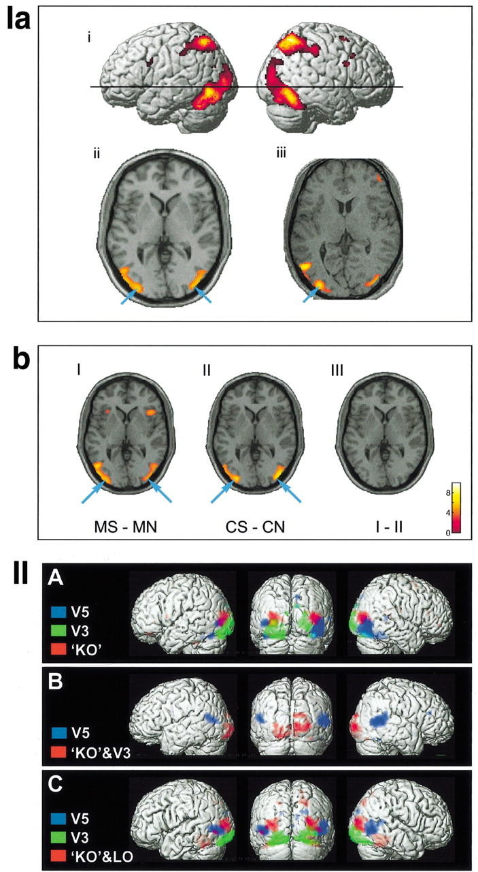
Figure 4. fMRI results from the epoch study (Ia,b) and the ICA analysis of free viewing data (II). (Ia) Epoch study. ...
Notes:
Figure 4. fMRI results from the epoch study (Ia,b) and the ICA analysis of free viewing data (II). (Ia) Epoch study. Main effect of all shapes (color and motion) versus all non-shapes. (i) Group data rendered onto surface of standard ‘template’ brain supplied with SPM99. Black line shows the level of the horizontal section shown in (ii). (ii) Same data shown in a horizontal section at a level of +2 in the Talairach coordinate system with the right side of the brain shown on the right. Arrows indicate the positions of ‘area KO’ in each hemisphere. (iii) Same contrast shown in a single subject, superimposed onto subject’s own structural scan. Arrow indicates left ‘KO’. Statistical thresholds: P < 0.05 corrected in (i) and (ii); P < 0.001 uncorrected in (iii). Colors represent arbitrary scales of significance above this threshold, with lower significance shown in red, through orange, to highest levels of significance in bright yellow. (Ib) Epoch study. Modality-specific effects of shapes. (I) Contrast of motion shapes versus motion non-shapes (MS – MN). (II) Contrast of color shapes versus color non-shapes (CS – CN). (III) Direct comparison of contrast shown in (I) with contrast shown in (II) (i.e. interaction contrast [MS – MN] – [CS – CN]). Talairach coordinate z = +2 (as in a.ii). Arrows indicate position of area ‘KO’ in each hemisphere, as identified in (a.ii). Statistical threshold P < 0.05 corrected. The interaction contrast in (III) did not show any clusters even when the statistical threshold was dropped to P < 0.001 uncorrected. Scale shows relationship between color and Z-statistic. (II) ICA on free viewing data. In the free viewing experiment, ICA isolated area ‘KO’ either on its own, with visual area V3, or with LO, but never with V5. (A–C) show independent components of three separate subjects, which are representative of the three ways in which ICA isolated ‘KO’ in the eight subjects. For each subject the components that contain ‘KO’ (red), V3 (green) and V5 (blue) are shown superimposed on the individuals’ anatomical scans. (A) One of the two subjects in whom ‘KO’, V3 and V5 were each isolated as separate components. (B) A single subject representative of the five subjects in whom ICA grouped area ‘KO’ together with V3 in a single component. (C) The subject in whom ‘KO’ was grouped together with LO. In none of the eight subjects was ‘KO’ grouped with V5 in the same component.
Unless provided in the caption above, the following copyright applies to the content of this slide: © Oxford University Press

Slide 4
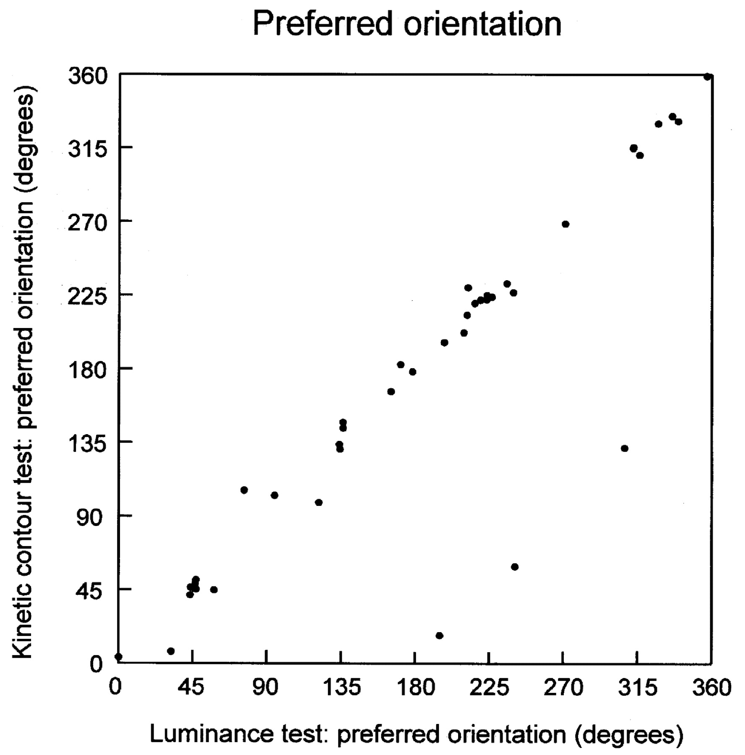
Figure 8. The preferred orientation for each cell, with the preferred orientation to a luminance stimulus plotted along ...
Notes:
Figure 8. The preferred orientation for each cell, with the preferred orientation to a luminance stimulus plotted along the x-axis and the preferred orientation to a kinetic contour stimulus plotted along the y-axis.
Unless provided in the caption above, the following copyright applies to the content of this slide: © Oxford University Press

Slide 5
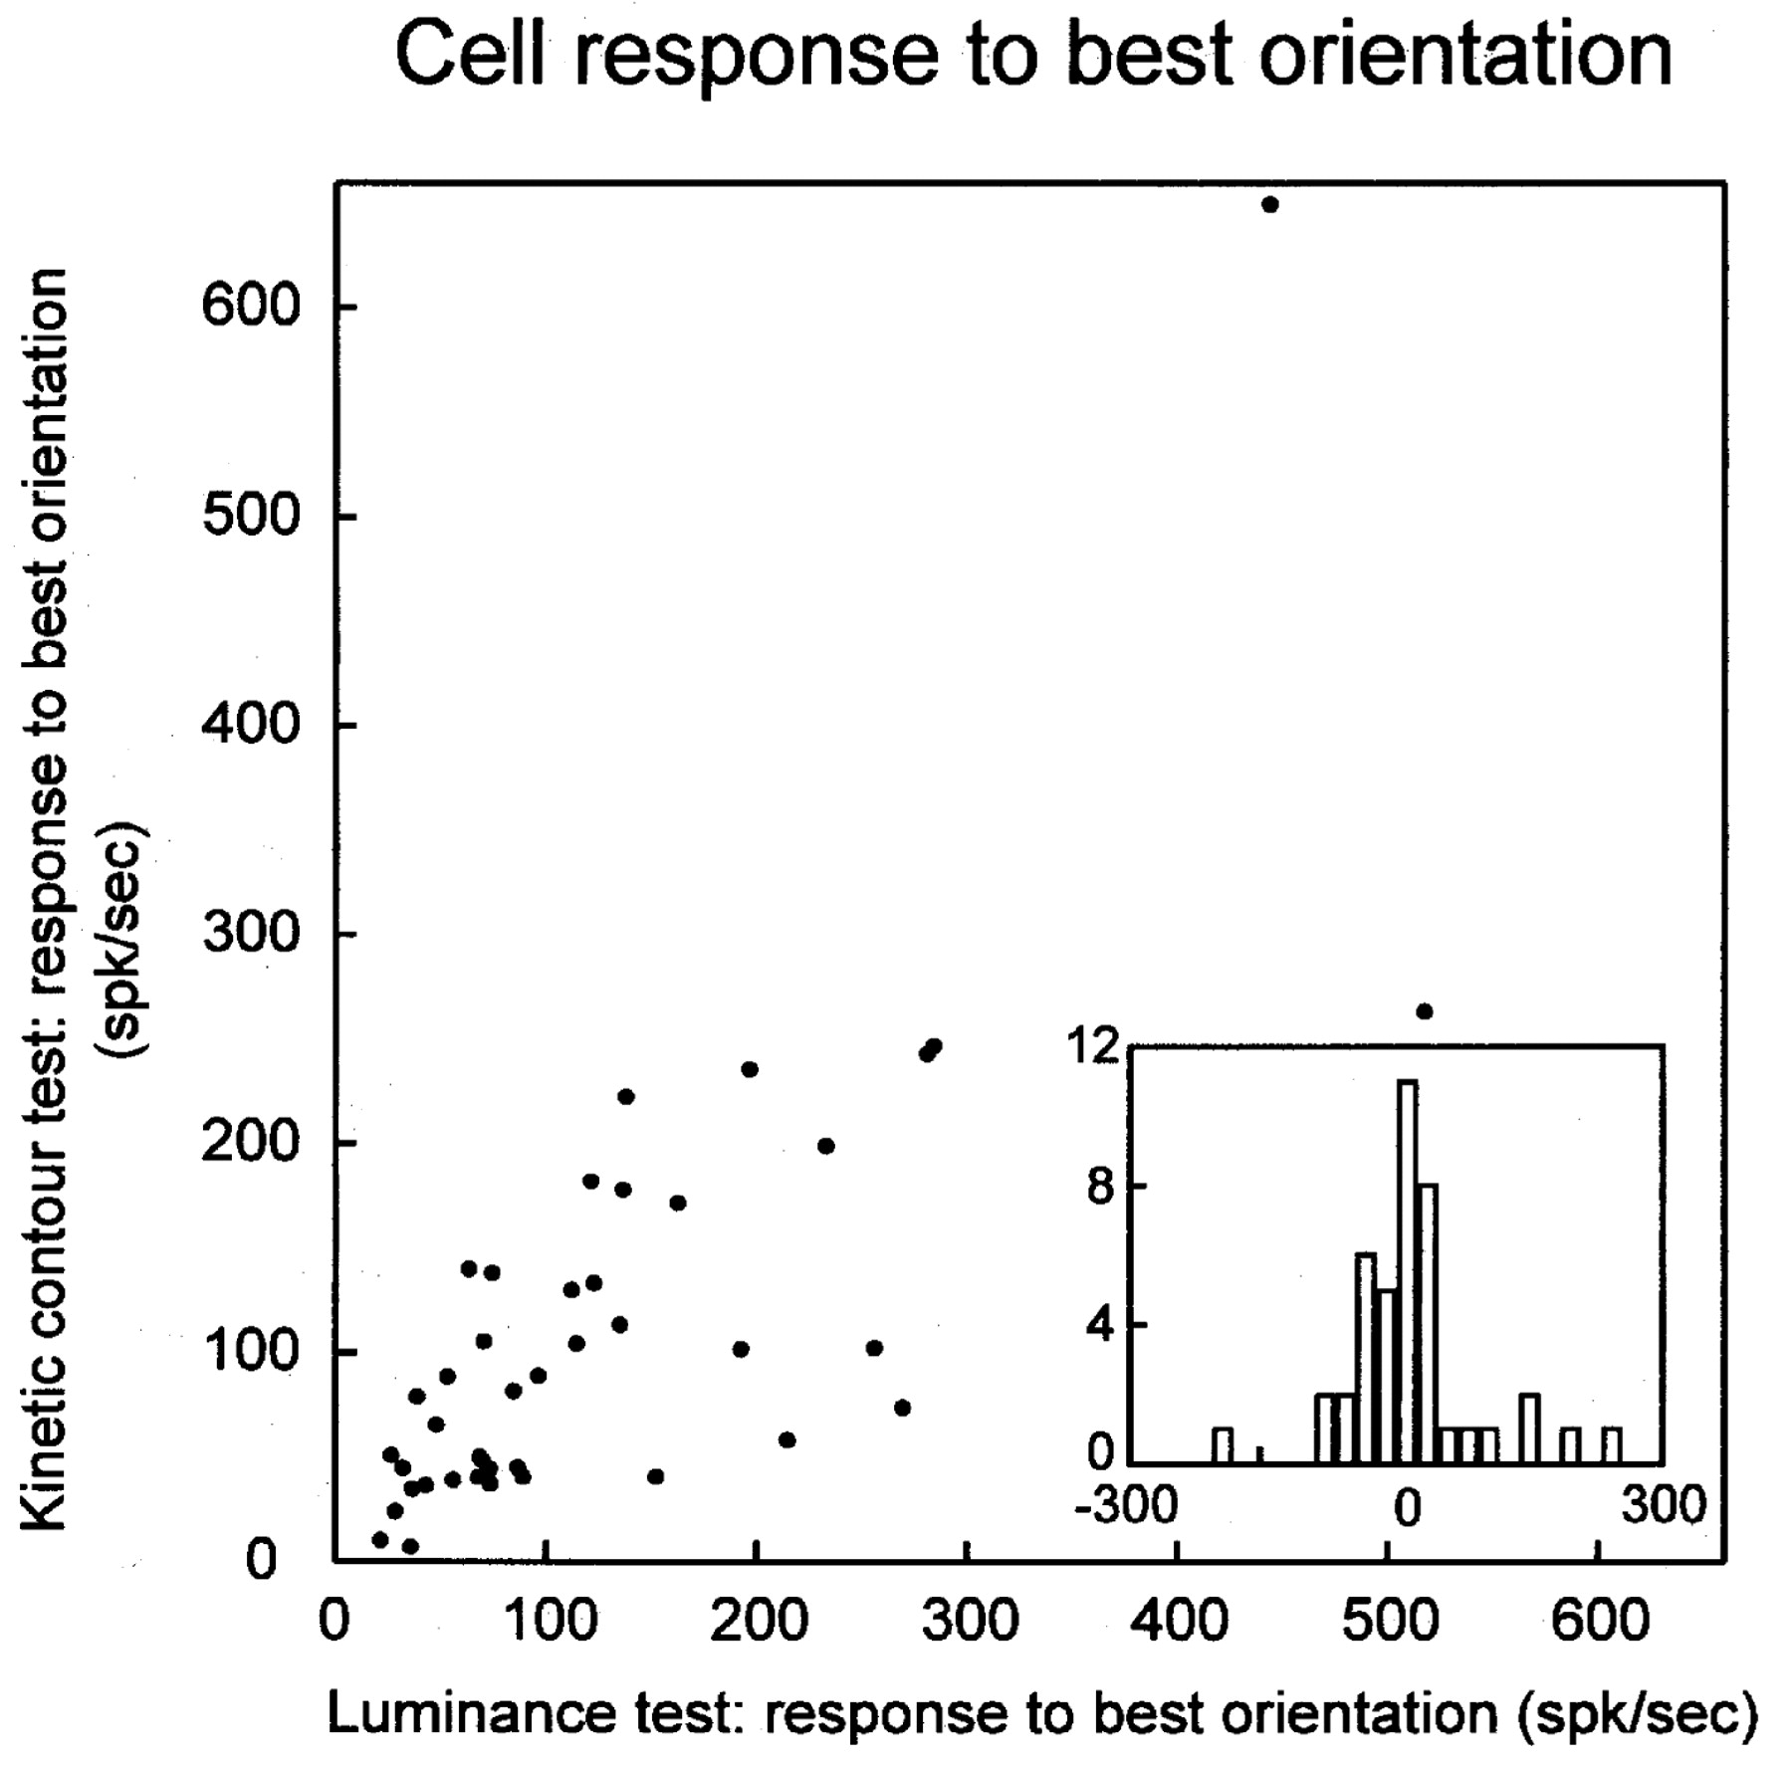
Figure 9. Maximum cell responses for kinetic and luminance contours. The inset graph shows the frequency distribution ...
Notes:
Figure 9. Maximum cell responses for kinetic and luminance contours. The inset graph shows the frequency distribution of the difference between luminance and kinetic responses. In this inset graph, the x-axis shows the difference in response between luminance and kinetic contours (in spikes/s), and the y-axis shows frequency.
Unless provided in the caption above, the following copyright applies to the content of this slide: © Oxford University Press

Slide 6
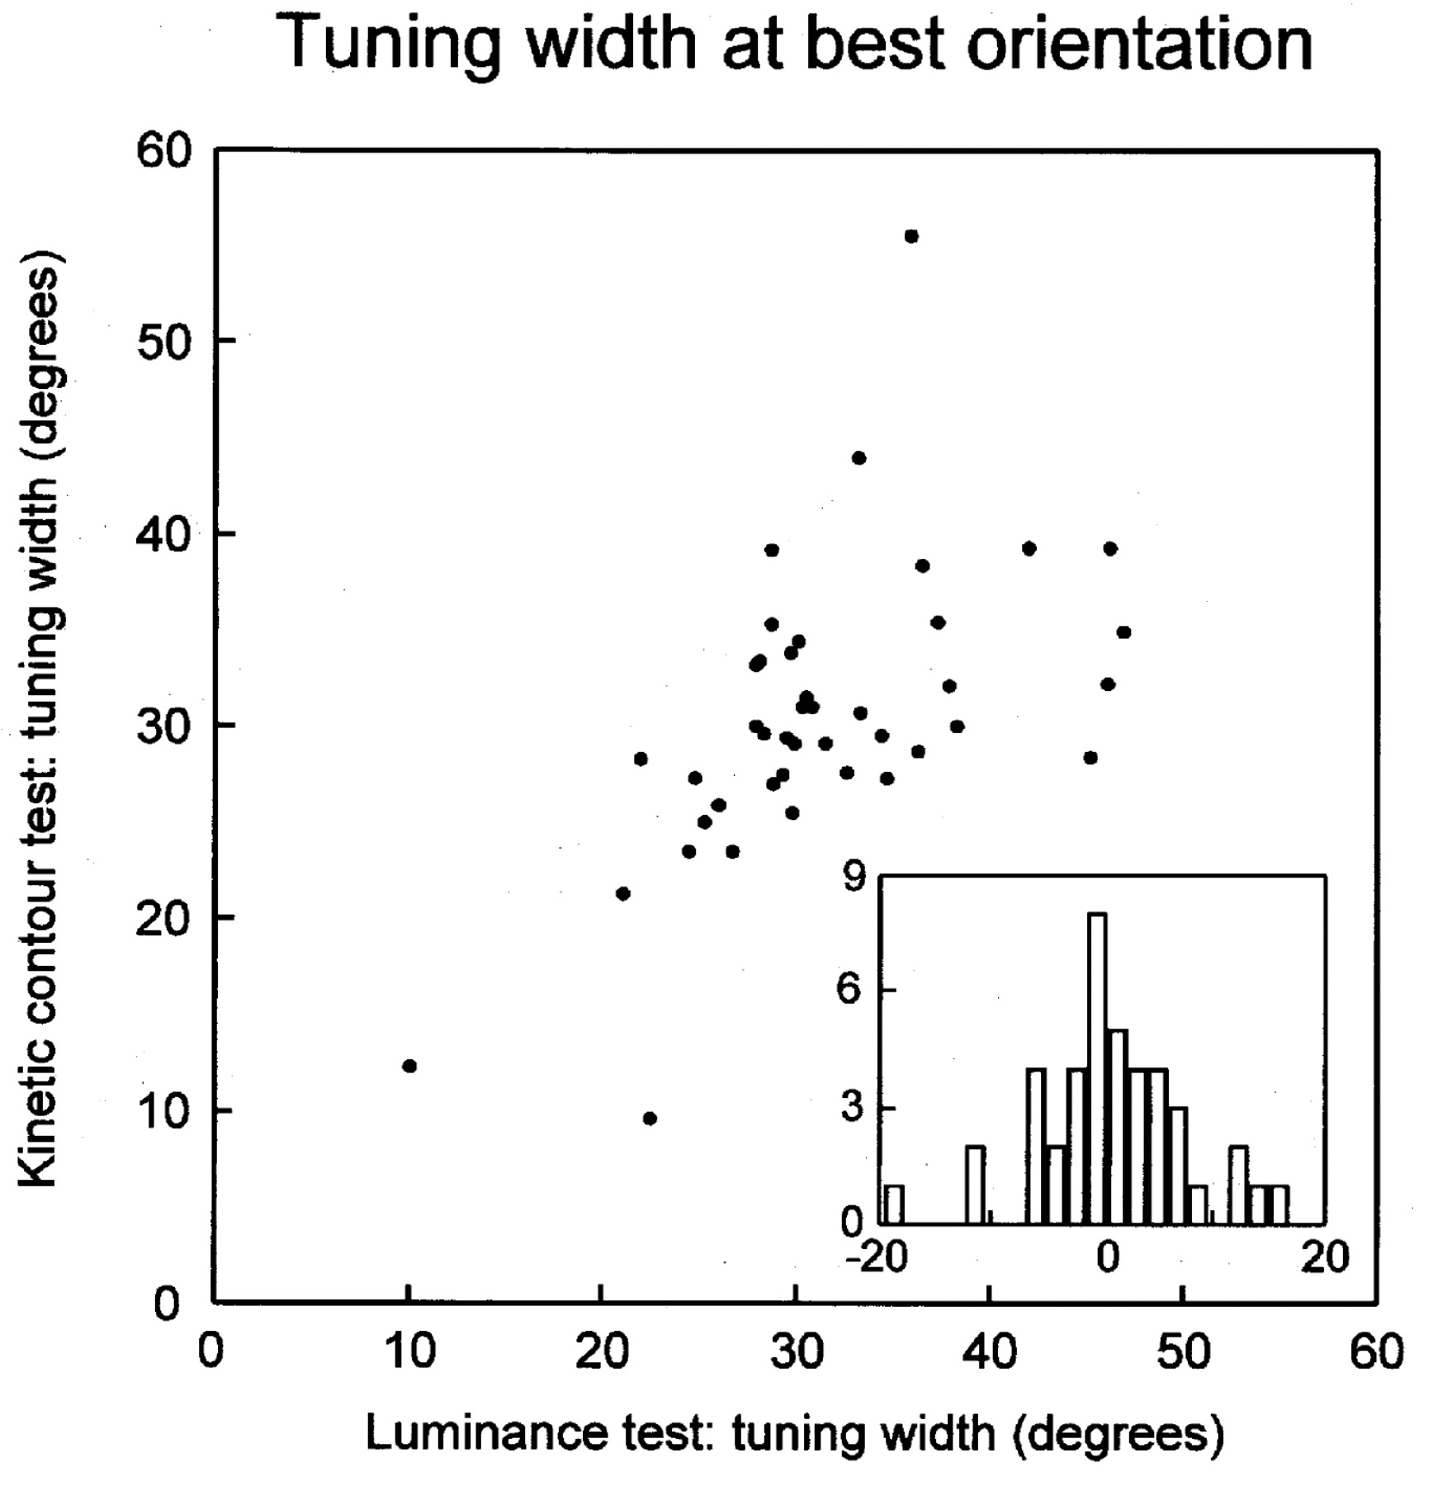
Figure 10. Tuning width of cells at the preferred orientation. The inset graph shows the frequency distribution of the ...
Notes:
Figure 10. Tuning width of cells at the preferred orientation. The inset graph shows the frequency distribution of the difference between luminance and kinetic contour tuning. In this inset graph, the x-axis shows the difference in tuning between luminance and kinetic contours (in degrees), and the y-axis shows frequency.
Unless provided in the caption above, the following copyright applies to the content of this slide: © Oxford University Press

Slide 7
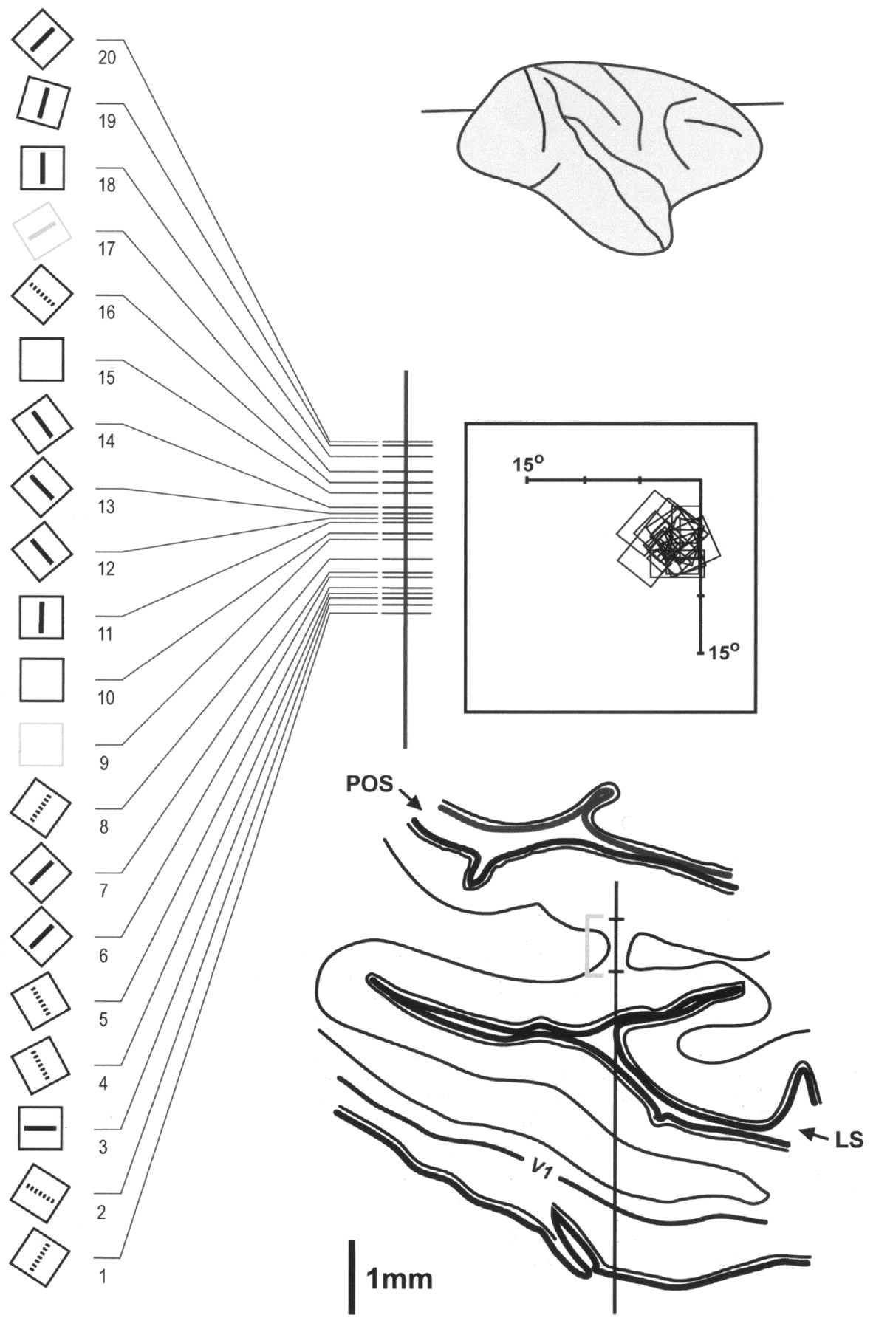
Figure 11. Reconstruction of a long penetration through the annectant gyrus of the lunate sulcus, which houses V3A, ...
Notes:
Figure 11. Reconstruction of a long penetration through the annectant gyrus of the lunate sulcus, which houses V3A, shown on a drawing of a horizontal section taken through the posterior part of the brain at the level indicated above. The receptive fields of the 20 cells recorded from were located within the contralateral inferior quadrant, abutting the vertical meridian (centre right of figure). The penetration is reconstructed in detail on the left, showing the receptive fields and the preferences of the cells. Black bars = cells that preferred lines generated from luminance; gray bars = equal response to the two types of stimulus; dashed bars = better response to lines generated from kinetic contours; empty receptive fields signify that the cell was unselective for orientation, but responded better to luminance (cells 10 and 15) or to kinetic contours (cell 9). Average distance between cells was 100 μm. LS, lunate sulcus, POS, parieto-occipital sulcus; V1, primary visual cortex.
Unless provided in the caption above, the following copyright applies to the content of this slide: © Oxford University Press

Slide 8
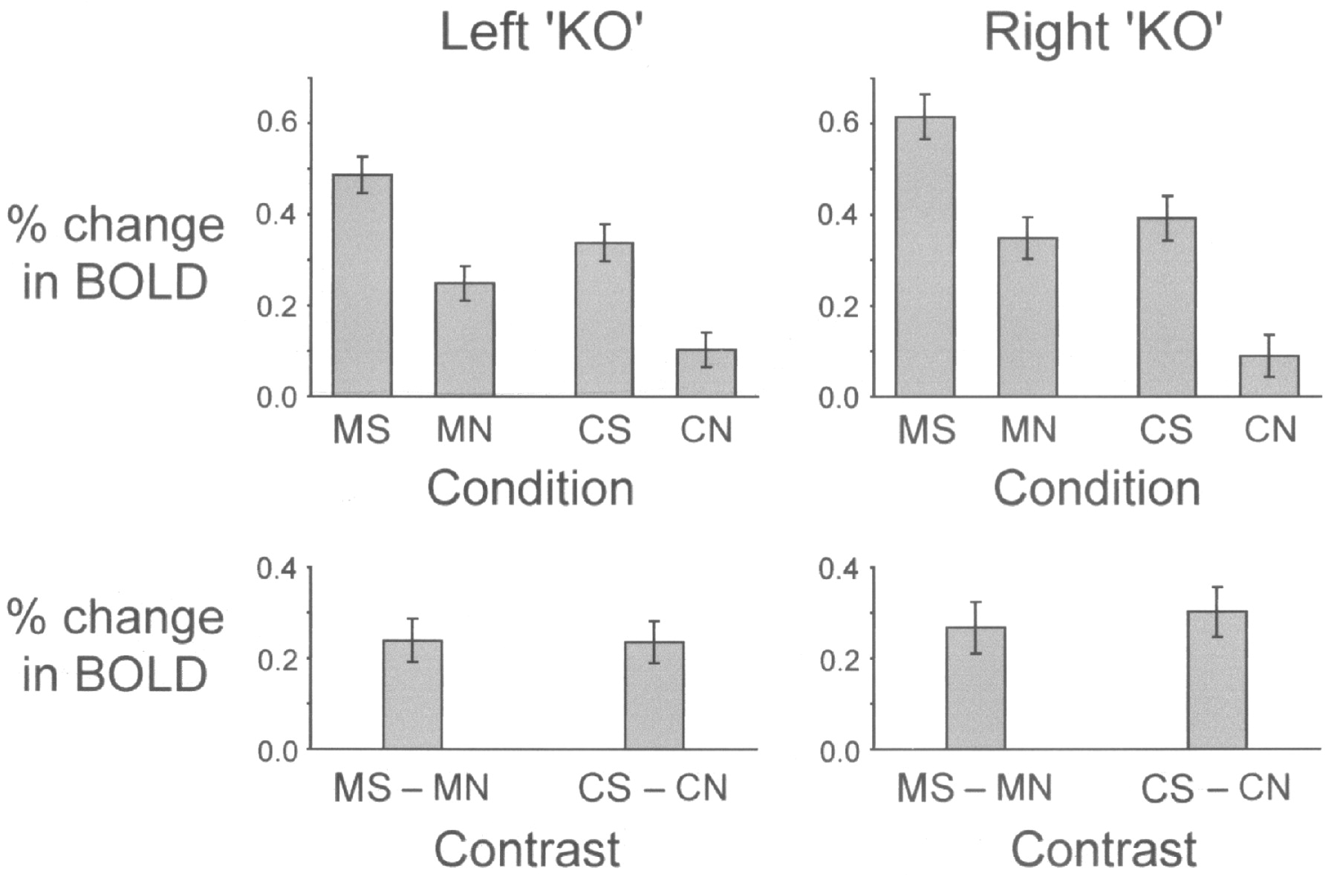
Figure 5. Mean BOLD responses of area KO (left and right) in the four conditions of experiment 1. Bottom row shows ...
Notes:
Figure 5. Mean BOLD responses of area KO (left and right) in the four conditions of experiment 1. Bottom row shows shape-specific responses in the context of motion (MS – MN) and of color (CS – CN). BOLD signal is expressed as a percentage of the global mean, with the response to the ‘gray’ baseline conditions subtracted.
Unless provided in the caption above, the following copyright applies to the content of this slide: © Oxford University Press

Slide 9
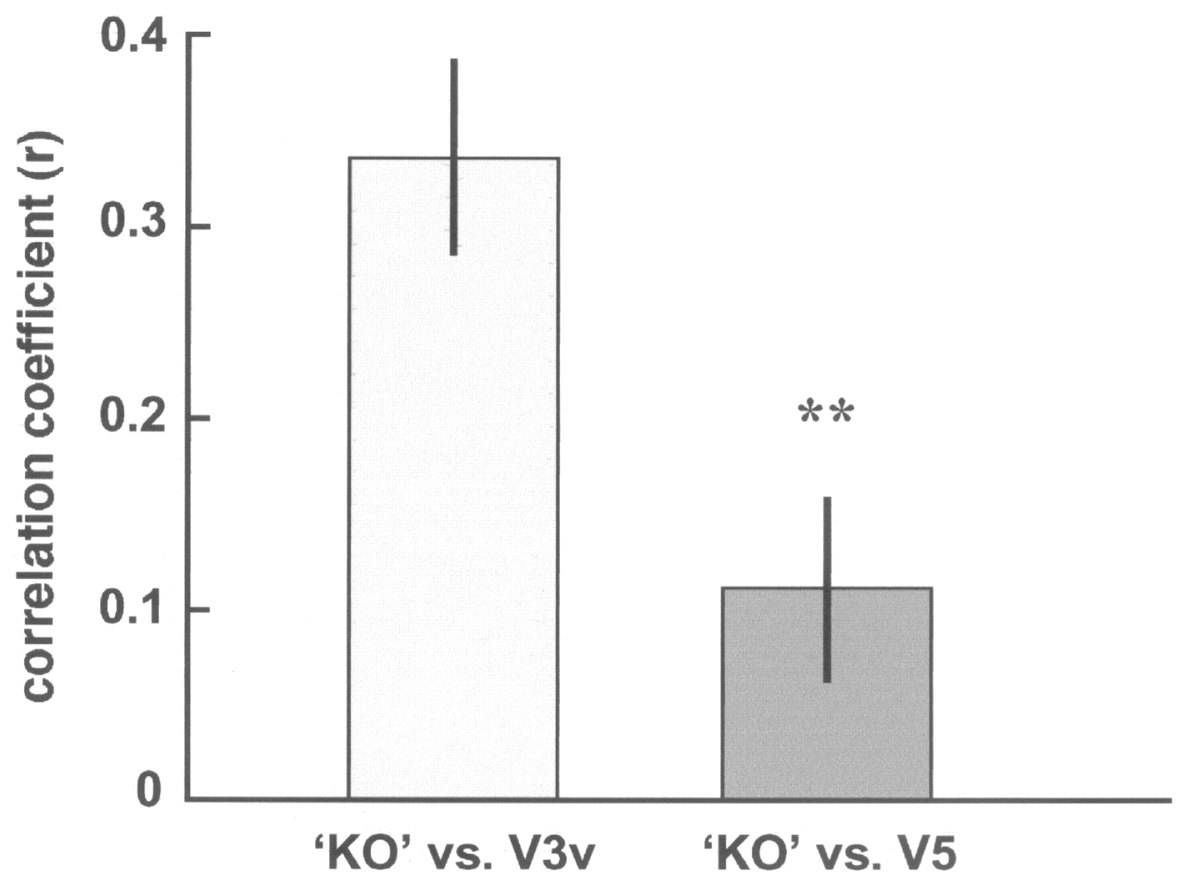
Figure 6. The correlation coefficients of ATCs between areas ‘KO’ and V3 and between ‘KO’ and V5 during free viewing. ...
Notes:
Figure 6. The correlation coefficients of ATCs between areas ‘KO’ and V3 and between ‘KO’ and V5 during free viewing. Lower V3 (V3v) was used in the analysis, as it is spatially further from ‘KO’ than upper V3, and therefore provides a more stringent test. The graph shows the average correlation coefficients r calculated for all pairs of BOLD signal taken from the most significant voxels of areas KO, V5 and V3v within each subject, in the areas identified in all eight subjects. Vertical bars are standard error of the mean (SEM). r of ‘KO’ with V3v (r = 0.34 ± 0.05 SEM) is significantly higher than that of ‘KO’ with V5 (r = 0.11± 0.05 SEM) [paired t-test, P < 0.0001, n = 28 (pairs within and across hemispheres)].
Unless provided in the caption above, the following copyright applies to the content of this slide: © Oxford University Press

Slide 10
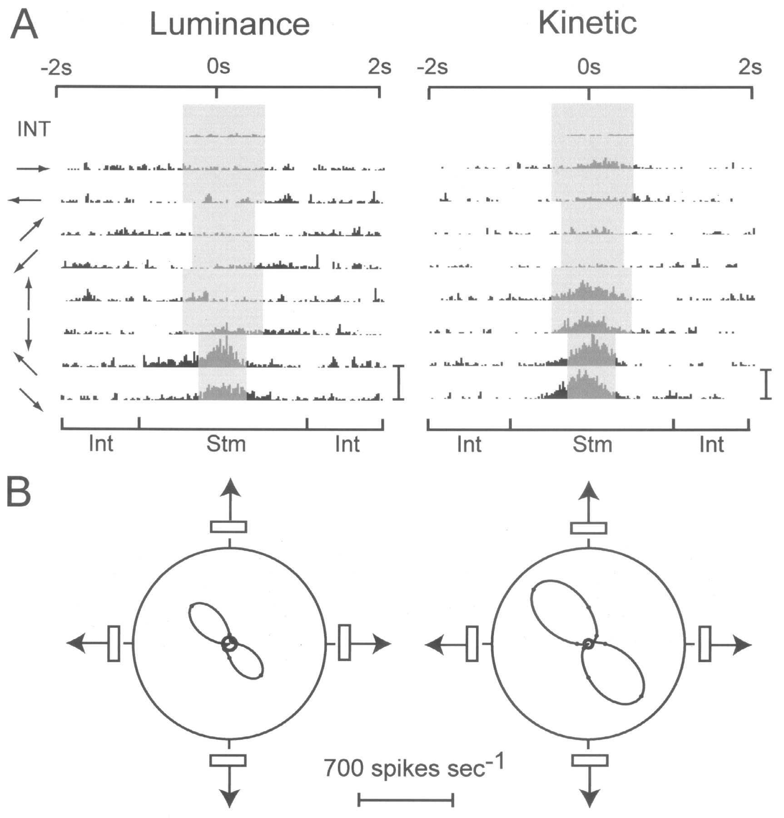
Figure 7. The responses of an orientation-selective cell that favors kinetic contours to motion in different directions ...
Notes:
Figure 7. The responses of an orientation-selective cell that favors kinetic contours to motion in different directions of an appropriately oriented bar, defined by luminance (on left) or kinetic contours (on right). In each case, width of stimulus = 0.31°, length = 5.24°, speed = 5.24°/s. The responses of the cell are shown in the top two panels (A). Gray areas in each row represent ‘response windows’, over which the mean firing rate is measured. Top rows show the averaged histograms for 33 interstimulus intervals (INT); the gray response window here is the whole duration of this interval (1s). Each of the other rows shows the mean response to four oriented bars, moving in the direction indicated by the arrow on the left. The gray response window in this case is the period during which the stimulus was in the cell’s receptive field. Beneath the histograms, a bar indicates the stimulus interval (Stm), flanked by two interstimulus intervals (Int). Bin width for histograms = 40ms. Scale bars to the right of the histograms represent 1000 spikes/s. The directional profiles of the cell for luminance contours (on left) and kinetic contours (on right) are indicated in the lower two polar plots (B). Solid line shows best spline fit of the data points. Three concentric circles at the centre of each polar plot indicate the background firing rate (from the INT row above), and 1 standard error above and below this firing rate.
Unless provided in the caption above, the following copyright applies to the content of this slide: © Oxford University Press

Slide 11
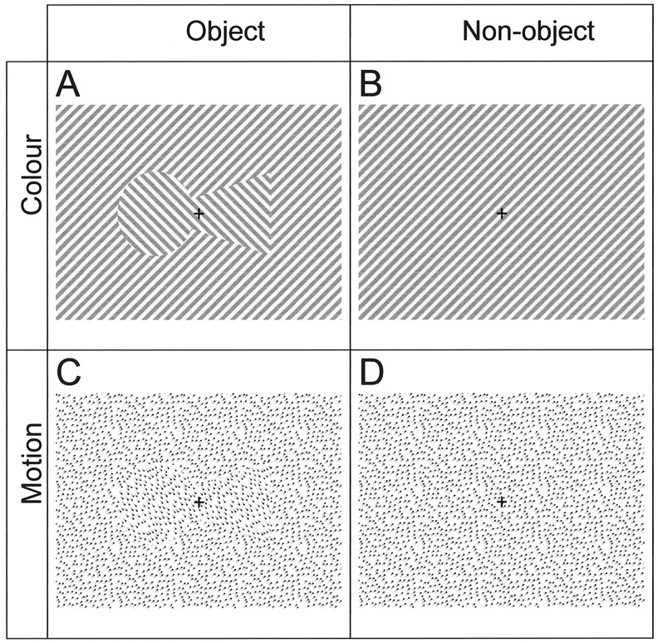
Figure 1. Illustration of stimuli and 2 × 2 factorial design. The shape shown in the left column is the ‘target’ shape ...
Notes:
Figure 1. Illustration of stimuli and 2 × 2 factorial design. The shape shown in the left column is the ‘target’ shape (a keyhole). (A) Color shape (CS). The screen was composed of alternating bars of isoluminant red and green, the orientation of the lines inside the shape lying orthogonally to those outside. (B) Color no-shape (CN). The same background as CS, but without the central shape. (C) Motion shape (MS). The screen was composed of a random field of moving dots, which are represented here by smeared dots. Dots inside the object moved in a direction orthogonal to those outside. The dots had the following properties: dot size 0.05° (= 1 pixel), density 20%, speed 0.5°/s (11pixels/s), dot lifespan ∞, motion coherence 100%. (D) Motion no-shape (MN). The same background as MS, but without the central shape.
Unless provided in the caption above, the following copyright applies to the content of this slide: © Oxford University Press

