Slide 1
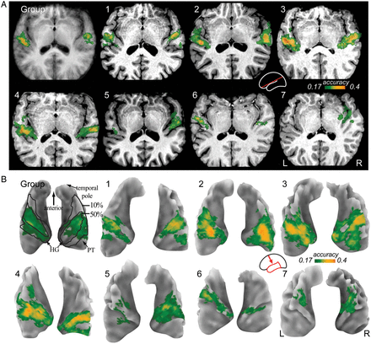
Figure 1. Volume slices (A) and surface renderings (B) showing the spatial distribution of classification accuracy in ...
Notes:
Figure 1. Volume slices (A) and surface renderings (B) showing the spatial distribution of classification accuracy in AC. Both individual (labeled 1–7) and group average data (labeled Group) are shown. The group data are based on a fixed-effects analysis. The volume slices were oriented to run parallel to the lateral sulcus (see Materials and Methods and inset schematic brain). The cortical surfaces were extracted from the structural volumes; only the upper surfaces of the left and right temporal lobes are shown with HG, PT, and the temporal pole marked in the group average surface (upper left corner in B, viewing direction is indicated by the red arrow in the inset schematic brain). The color overlay on each slice or surface shows the performance accuracy of the classification algorithm expressed as proportion of correct classifications and thresholded at P = 0.01 in the chance (binomial) distribution. Black lines in the group average surfaces indicate the extent of the 10% and 50% probability maps of cytoarchitectonically defined core AC reported by Morosan et al. (2001). The slice and surface representations are provided to facilitate comparisons with previously published results. In both representations, maxima of classification accuracy are visible on or near HG in all participants.
Unless provided in the caption above, the following copyright applies to the content of this slide: © The Author 2014. Published by Oxford University PressThis is an Open Access article distributed under the terms of the Creative Commons Attribution License (http://creativecommons.org/licenses/by/3.0/), which permits unrestricted reuse, distribution, and reproduction in any medium, provided the original work is properly cited.

Slide 2
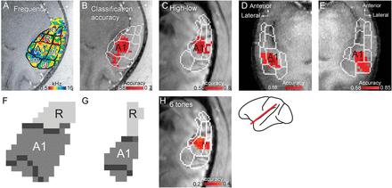
Figure 2. (A) A slice through a macaque brain (Monkey 1) parallel to the STP and covering AC. The color overlay shows ...
Notes:
Figure 2. (A) A slice through a macaque brain (Monkey 1) parallel to the STP and covering AC. The color overlay shows the sound frequency that evoked the strongest response for each voxel. The black lines delineate different functional fields in AC, identified based on the response amplitude to pure tones and tonotopic gradient reversals. The core fields A1 and R as well as belt fields CM, CL, and AL are labeled. Modified, with permission, from Petkov et al. (2006). (B–E) The pattern classification results from 3 macaque monkeys (4 hemispheres; B, C, E: right AC of Monkeys 1, 2, and 3; D: left AC of Monkey 3; C: the classification accuracy when the 6 sound frequency conditions used in Monkey 2 were grouped into high and low frequencies to enable direct comparison with the other monkeys, compare with panel H for results of the 6-frequency classification). The red highlight shows the region where the classification accuracy was significantly above chance (chance levels differed, dependent on the number of frequency conditions). The white lines delineate different AC fields as in A. F and G show automatically determined borders (dark gray) in core fields in the region of interest comprising A1 and R as determined by the manual parcellation shown in B and C, respectively. The automatically identified border between A1 and R coincided exactly with the manual parcellation. The orientation of the slices in A–E and H is depicted in the inset schematic brain.
Unless provided in the caption above, the following copyright applies to the content of this slide: © The Author 2014. Published by Oxford University PressThis is an Open Access article distributed under the terms of the Creative Commons Attribution License (http://creativecommons.org/licenses/by/3.0/), which permits unrestricted reuse, distribution, and reproduction in any medium, provided the original work is properly cited.

Slide 3
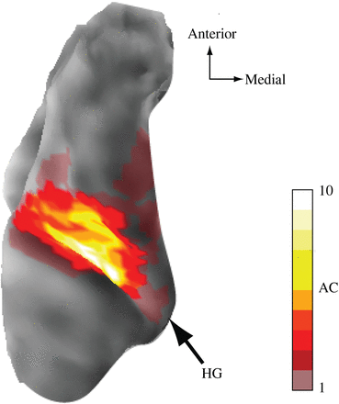
Figure 3. Probability map of estimated core AC. Cortical surfaces of all 14 hemispheres were aligned to the left ...
Notes:
Figure 3. Probability map of estimated core AC. Cortical surfaces of all 14 hemispheres were aligned to the left hemisphere of a target using surface-based alignment of the location of gyri and sulci. The color code indicates the number of hemispheres that contained core AC at a given cortical location. Large overlap of core AC was observed in middle HG.
Unless provided in the caption above, the following copyright applies to the content of this slide: © The Author 2014. Published by Oxford University PressThis is an Open Access article distributed under the terms of the Creative Commons Attribution License (http://creativecommons.org/licenses/by/3.0/), which permits unrestricted reuse, distribution, and reproduction in any medium, provided the original work is properly cited.

Slide 4
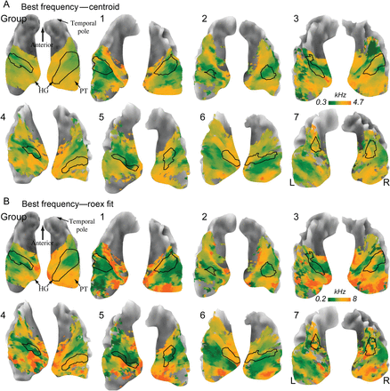
Figure 4. Temporal lobe surfaces with renderings of the voxel best frequencies estimated by calculating the centroids ...
Notes:
Figure 4. Temporal lobe surfaces with renderings of the voxel best frequencies estimated by calculating the centroids of the voxel tuning curves (A), or fitting them with bell-shaped (roex) functions (B). In both panels, the outlines of core AC, estimated by thresholding the classification accuracy maps at the significance threshold (see Data Analysis), are marked with black lines.
Unless provided in the caption above, the following copyright applies to the content of this slide: © The Author 2014. Published by Oxford University PressThis is an Open Access article distributed under the terms of the Creative Commons Attribution License (http://creativecommons.org/licenses/by/3.0/), which permits unrestricted reuse, distribution, and reproduction in any medium, provided the original work is properly cited.

Slide 5
Figure 5. Automatic parcellation of core AC. The extracted individual brain surface (A) is inflated (B) and a segment ...
Notes:
Figure 5. Automatic parcellation of core AC. The extracted individual brain surface (A) is inflated (B) and a segment covering STP is cut out. (C) The best-frequency map is masked with the contiguous region of significant classification performance located closest to HG. This region is taken as estimate of core AC. (D) Gradient reversals are computed for all orientations between 0 and 179°. The reversal maps for different orientations are then summed. The values in the resulting map indicate the angle between the adjoining tonotopic gradients. (E) Stable reversals indicate the location of subfield borders within core AC.
Unless provided in the caption above, the following copyright applies to the content of this slide: © The Author 2014. Published by Oxford University PressThis is an Open Access article distributed under the terms of the Creative Commons Attribution License (http://creativecommons.org/licenses/by/3.0/), which permits unrestricted reuse, distribution, and reproduction in any medium, provided the original work is properly cited.

Slide 6
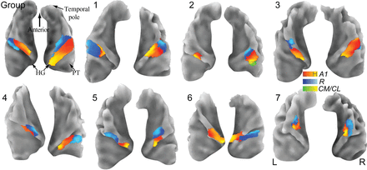
Figure 6. Parcellation results and tonotopic gradients for the human data. All individual hemispheres and the group ...
Notes:
Figure 6. Parcellation results and tonotopic gradients for the human data. All individual hemispheres and the group average data are shown. In most hemispheres (11/14), we found 1 tonotopic gradient reversal with a shared low-frequency border, presumably marking the core fields A1 (red-yellow color gradient, corresponding to low-to-high best frequencies) and R (blue-cyan color gradient). In 1 hemisphere (Participant 2, right hemisphere), we found an additional high-frequency reversal posterior to A1, which probably marks the border between A1 and either of the belt fields CM or CL (green-yellow color gradient). In 2 hemispheres (Participants 2 and 6, left hemispheres), no stable gradient reversals were found in the region of significant classification accuracy.
Unless provided in the caption above, the following copyright applies to the content of this slide: © The Author 2014. Published by Oxford University PressThis is an Open Access article distributed under the terms of the Creative Commons Attribution License (http://creativecommons.org/licenses/by/3.0/), which permits unrestricted reuse, distribution, and reproduction in any medium, provided the original work is properly cited.

Slide 7
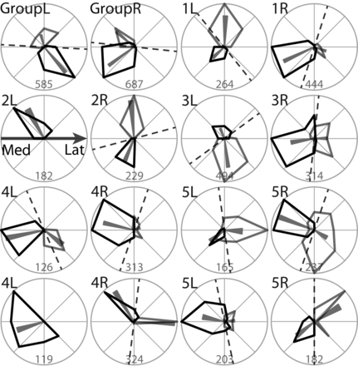
Figure 7. Circular histograms of tonotopic gradient direction in A1 (black polygons) and R (gray polygons) in left (L) ...
Notes:
Figure 7. Circular histograms of tonotopic gradient direction in A1 (black polygons) and R (gray polygons) in left (L) and right (R) hemispheres of the group data and Participants 1–7. Directions are relative to the orientation of HG, whose medial-to-lateral axis corresponds to the horizontal axis in each plot (indicated by the black arrow in plot 2L). Directions were binned every 45° (light-gray circle sections) for plotting. Mean directions and 95% confidence intervals are indicated by small gray triangles. Numbers at the bottom of each graph indicate the upper axis limit of the histogram as number of vertices. Dashed black lines show the orientation of the border between A1 and R, as identified by the gradient reversal analysis.
Unless provided in the caption above, the following copyright applies to the content of this slide: © The Author 2014. Published by Oxford University PressThis is an Open Access article distributed under the terms of the Creative Commons Attribution License (http://creativecommons.org/licenses/by/3.0/), which permits unrestricted reuse, distribution, and reproduction in any medium, provided the original work is properly cited.

