Slide 1
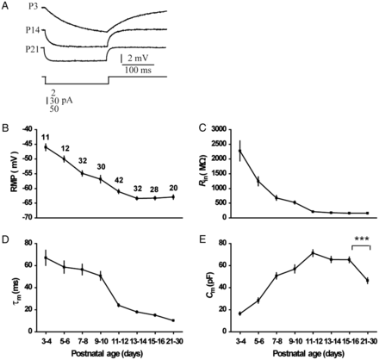
Figure 1. Postnatal development of passive membrane properties of FS interneurons. (A) Voltage deflections induced by ...
Notes:
Figure 1. Postnatal development of passive membrane properties of FS interneurons. (A) Voltage deflections induced by rectangular hyperpolarizing current injections P3 (top), P14 (middle) and P21 (bottom). Traces are the average of 50 responses. (B) Resting membrane potential (RMP) hyperpolarized with age. (C) Input resistance (Rin) decreased more than 12-fold during the first 2 postnatal weeks. (D) Membrane time constant (τm) decreased nearly 7-fold. (E) Membrane capacitance (Cm) increased gradually from P3–4 to P11–12, but showed a steep decrease after P15–16 (t-test). Values in B are the numbers of cells selected for analysis from the respective age group and apply to C–E and Figure 2C–F. *P < 0.05; **P < 0.01; ***P < 0.001 for this and all subsequent figures.
Unless provided in the caption above, the following copyright applies to the content of this slide: © The Author 2012. Published by Oxford University Press. All rights reserved. For Permissions, please e-mail: journals.permissions@oup.com

Slide 2
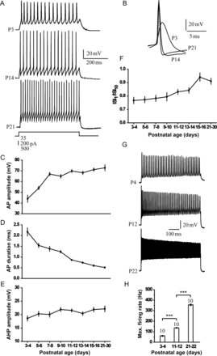
Figure 2. Postnatal development of active membrane properties of FS interneurons. (A) Action potential (AP) firing at ...
Notes:
Figure 2. Postnatal development of active membrane properties of FS interneurons. (A) Action potential (AP) firing at 30–50 Hz at P3 (top), P14 (middle) and P21 (bottom). Holding voltage was maintained at −70 mV through injection of hyperpolarizing current. (B) Single AP at P3, P14, and P21. (C) AP amplitude increased abruptly during the first postnatal week. (D) AP duration became briefer with age. (E) Afterhyperpolarization (AHP) amplitude did not significantly change with age. (F) The ratio of the first to the 10th interspike interval (ISI) (ISI1/ISI10) increased sharply after the second postnatal week. (G) The maximal firing rate at P4 (top), P12 (middle), and P22 (bottom). (H) The maximal firing rate increased throughout adolescence (t-test). Values above bars are the numbers of cells for the respective age group.
Unless provided in the caption above, the following copyright applies to the content of this slide: © The Author 2012. Published by Oxford University Press. All rights reserved. For Permissions, please e-mail: journals.permissions@oup.com

Slide 3
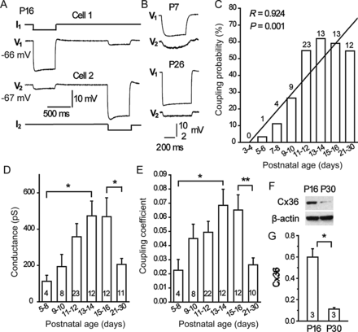
Figure 3. Properties of electrical coupling in developing FS interneurons. (A) Example of electrical coupling between ...
Notes:
Figure 3. Properties of electrical coupling in developing FS interneurons. (A) Example of electrical coupling between FS interneurons in P16 mice. Injection of hyperpolarizing current (−200 pA) into cell 1 (I1) simultaneously affected the noninjected cell 2 (V2, RMP: −67 mV). Injection of current (−200 pA) into cell 2 (I2) similarly affected the membrane potential of cell 1 (V1, RMP: −66 mV). Traces are the average of at least 50 responses. (B) Examples of electrical coupling between FS interneurons in P7 (top) and P26 (bottom) mice. Traces are the average of at least 50 responses. (C) The probability of electrical coupling in FS–FS connections increased during the second postnatal week, and then remained at a constant level (R = 0.924, P = 0.001, linear regression). Values above bars are the numbers of electrically coupled FS–FS pairs recorded from the respective age group. (D and E) The amplitude of electrical conductance (D) and coupling coefficient (E) increased 4- and 3-folds from P5–8 to P13–14, respectively, and then decreased significantly after P15–16 (t-test). Values inside bars represent the numbers of pairs selected for analysis from the respective age group. (F) Western blots of PFC using antibodies against Connexin (Cx) 36 and β-actin revealed decreased protein expression level of Cx36 in P30 mice compared to P16 mice. (G) Relative protein quantification of Cx36 showed significant difference between P16 and P30 mice (t-test). n = 3 brains for each age group.
Unless provided in the caption above, the following copyright applies to the content of this slide: © The Author 2012. Published by Oxford University Press. All rights reserved. For Permissions, please e-mail: journals.permissions@oup.com

Slide 4
Figure 4. Coupled clusters of putative FS interneurons in the developing PFC. (A) Morphology of neurobiotin-stained ...
Notes:
Figure 4. Coupled clusters of putative FS interneurons in the developing PFC. (A) Morphology of neurobiotin-stained putative FS neurons in P4 (left) and P16 (middle) G42 mice. Right: High-magnification view of a cluster of neurons in a coronal slice of P16 cortex. Arrows point to the pial surface. Scale bars, 25 µm. (B) The number of coupled neurons per successful dye injection increased with postnatal ages (t-test). Values above/within bars show the numbers of successful dye injections from the respective age group.
Unless provided in the caption above, the following copyright applies to the content of this slide: © The Author 2012. Published by Oxford University Press. All rights reserved. For Permissions, please e-mail: journals.permissions@oup.com

Slide 5
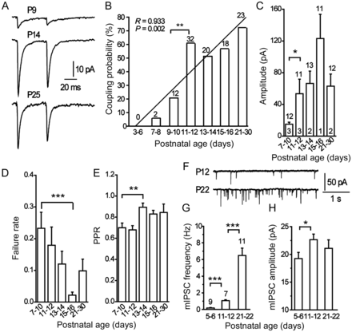
Figure 5. Properties of chemical connections among developing FS interneurons. (A) Examples of chemical connections ...
Notes:
Figure 5. Properties of chemical connections among developing FS interneurons. (A) Examples of chemical connections between FS interneurons at P9 (top), P14 (middle), and P25 (bottom). Each trace is the average of 50–100 responses. (B) The probability of chemical connections between FS interneurons increased significantly from P9–10 to P11–12 (P = 0.004 vs. P9–10, Fisher's Exact test), and then remained at a relatively high level (R = 0.933, P = 0.002, linear regression). Numbers above bars are the numbers of chemically coupled FS–FS pairs recorded from the respective age group. (C) The amplitude of unitary GABAergic postsynaptic currents (uIPSCs) increased more than 3-fold from P7–10 to P11–12 (t-test). Values above and within bars represent the numbers of pairs selected for analysis and the number of pairs expressing only chemical synapses, respectively, from the respective age group and apply to D and E. (D) The failure rate of uIPSCs showed a sharp decrease from P7–10 to P15–16 (t-test). (E) The paired-pulse ratio (PPR) increased significantly during the first 2 postnatal weeks (t-test). (F) Representative traces of mIPSCs recorded from FS interneurons in P12 (top) and P22 (bottom) mice. (G and H) Summary data for mIPSC frequency (G) and amplitude (H) over postnatal development (t-test). Values above bars represent the numbers of recorded neurons from the respective age group and apply to H.
Unless provided in the caption above, the following copyright applies to the content of this slide: © The Author 2012. Published by Oxford University Press. All rights reserved. For Permissions, please e-mail: journals.permissions@oup.com

Slide 6
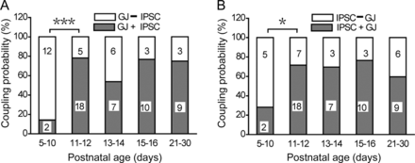
Figure 6. Independent development of electrical and chemical synapses among FS interneurons. (A) Among the gap ...
Notes:
Figure 6. Independent development of electrical and chemical synapses among FS interneurons. (A) Among the gap junction-connected FS–FS pairs, the probability of coexpression of both synaptic types was low at P5–10, but increased markedly at P11–12 (P < 0.0001 vs. P5–10, χ2 test). Values within bars represent the numbers of FS–FS pairs with only electrical synapses (empty bars) or both synaptic types (gray bars) from the respective age group. (B) Only 2 of 7 IPSC-connected FS–FS pairs coexpressed electrical synapses at P5–10; however, at P11–12, 18 of 25 chemically connected FS–FS pairs were also electrically coupled (P5–10 vs. P11–12, P = 0.018, χ2 test). Values within bars represent the numbers of FS–FS pairs with only chemical synapses (empty bars) or both synaptic types (gray bars) from the respective age group.
Unless provided in the caption above, the following copyright applies to the content of this slide: © The Author 2012. Published by Oxford University Press. All rights reserved. For Permissions, please e-mail: journals.permissions@oup.com

Slide 7
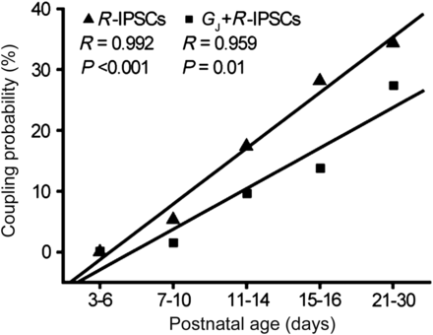
Figure 7. The incidence of reciprocal IPSCs (R-IPSCs) (▴) and the coexpression of gap junctions and R-IPSCs (GJ + ...
Notes:
Figure 7. The incidence of reciprocal IPSCs (R-IPSCs) (▴) and the coexpression of gap junctions and R-IPSCs (GJ + R-IPSCs) (▪) among developing FS interneurons were significantly associated with postnatal age.
Unless provided in the caption above, the following copyright applies to the content of this slide: © The Author 2012. Published by Oxford University Press. All rights reserved. For Permissions, please e-mail: journals.permissions@oup.com

Slide 8
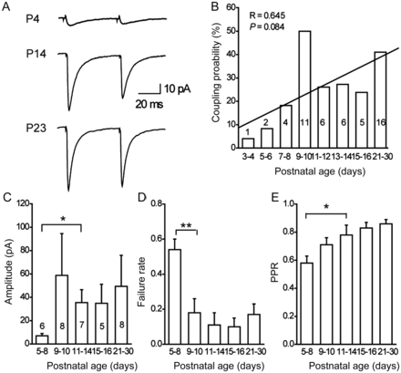
Figure 8. Development of GABAergic synapses between FS interneurons and PNs (FS → PN). (A) Representative responses ...
Notes:
Figure 8. Development of GABAergic synapses between FS interneurons and PNs (FS → PN). (A) Representative responses from P4 (top), P14 (middle), and P23 (bottom) mice. (B) Bar plot showing the connection probability of GABAergic synapses in FS → PN connections (R = 0.645, P = 0.084, linear regression). Values above/within bars are the numbers of chemically coupled FS → PN pairs recorded from the respective age group. (C) The amplitude of uIPSCs exhibited a more than 5-fold increase from P5–8 to P11–14 (t-test). Values above/within bars show the numbers of FS → PN pairs selected for analysis from the respective age group and apply to D and E. (D) The failure rate of uIPSCs demonstrated a 3-fold decrease between P5–8 and P9–10 (t-test). (E) The PPR of uIPSCs increased during the first 2 postnatal weeks (t-test). Note that paired-pulse depression was reduced with age.
Unless provided in the caption above, the following copyright applies to the content of this slide: © The Author 2012. Published by Oxford University Press. All rights reserved. For Permissions, please e-mail: journals.permissions@oup.com

Slide 9
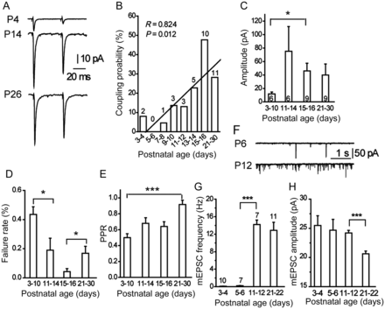
Figure 9. Development of glutamatergic synapses between PNs and FS interneurons (PN → FS). (A) Representative responses ...
Notes:
Figure 9. Development of glutamatergic synapses between PNs and FS interneurons (PN → FS). (A) Representative responses from P4 (top), P14 (middle), and P26 (bottom) mice. (B) Bar plot showing the connection probability of glutamatergic synapses in PN → FS connections (R = 0.824, P = 0.012, linear regression). Values above bars are the numbers of chemically connected PN → FS pairs recorded from the respective age group. (C) The amplitude of unitary excitatory postsynaptic currents (uEPSCs) demonstrated a nearly 4-fold increase from P3–10 to P15–16 (t-test). Values within bars represent the numbers of PN → FS pairs selected for analysis from the respective age group and apply to D and E. (D) The failure rate of uEPSCs showed a 2-fold decrease between P3–10 and P11–14 (t-test), followed by a 4-fold increase from P15–16 to P21–30 (t-test). (E) The PPR of uEPSCs increased nearly 2-fold from P3–10 to P21–30 (t-test). (F) Representative traces of mEPSCs recorded from FS interneurons in P6 (top) and P12 (bottom) mice. (G and H). Summary data for mEPSC frequency (G) and amplitude (H) over postnatal development (t-test). Values above bars represent the numbers of recorded neurons from the respective age group and apply to H.
Unless provided in the caption above, the following copyright applies to the content of this slide: © The Author 2012. Published by Oxford University Press. All rights reserved. For Permissions, please e-mail: journals.permissions@oup.com

Slide 10
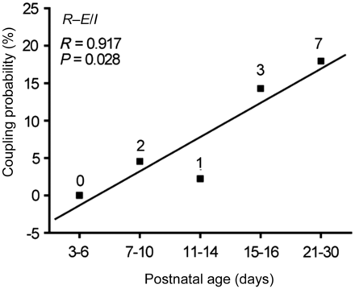
Figure 10. Age-dependent coexpression of reciprocal glutamatergic and GABAergic synapses (R − E/I) in FS–PN connections ...
Notes:
Figure 10. Age-dependent coexpression of reciprocal glutamatergic and GABAergic synapses (R − E/I) in FS–PN connections (R = 0.917; P = 0.028, n = 198 FS–PN pairs, linear regression). Values are the numbers of mutually chemically connected FS–PN pairs from the respective age group.
Unless provided in the caption above, the following copyright applies to the content of this slide: © The Author 2012. Published by Oxford University Press. All rights reserved. For Permissions, please e-mail: journals.permissions@oup.com

