Slide 1
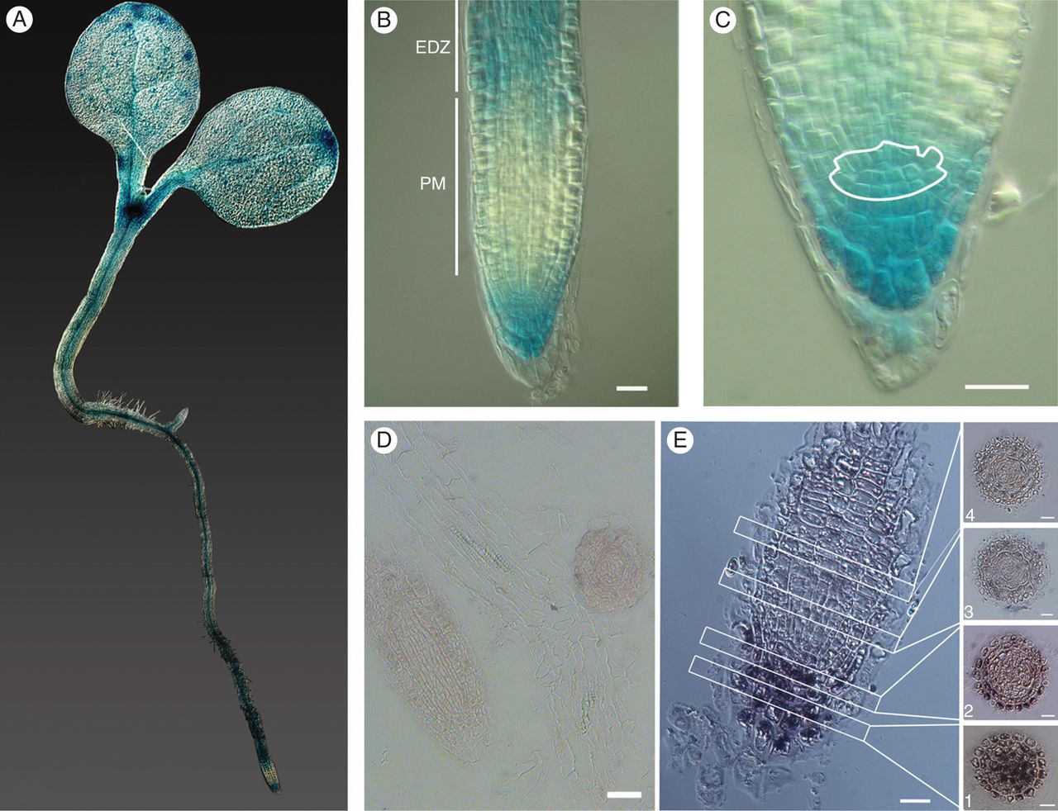
Fig. 1. Spatial expression of Mob1A in arabidopsis seedlings. (A–C) GUS staining of 3- to 4-day-old pMob1A::GUS-Mob1A ...
Notes:
Fig. 1. Spatial expression of Mob1A in arabidopsis seedlings. (A–C) GUS staining of 3- to 4-day-old pMob1A::GUS-Mob1A seedlings. In (B), the root proximal meristem (PM) and the beginning of the elongation–differentiation zone (EDZ) are labelled and indicated by white bars. In (C), the root stem cell niche is outlined in white. (D and E) In situ hybridization of specific sense (D) and antisense (E) Mob1A probes in longitudinal root sections. For (E) every second or every third 7 µm cross-section from the columella tissue up to the meristem is shown: (1) columella cells, (2) stem cell niche and (3 and 4) distal meristem cells. Scale bars are 10 µm in B and C, and 50 µm in D and E.
Unless provided in the caption above, the following copyright applies to the content of this slide: © The Author 2013. Published by Oxford University Press on behalf of the Annals of Botany Company. All rights reserved. For Permissions, please email: journals.permissions@oup.com

Slide 2
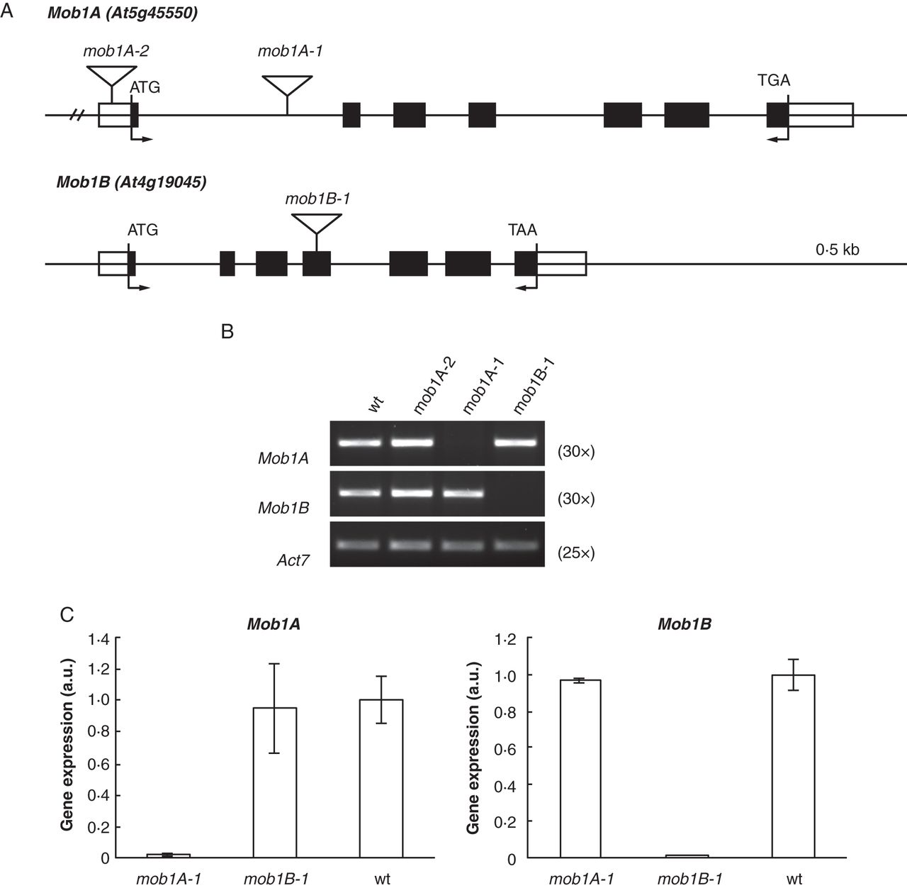
Fig. 2. Expression analysis of Mob1A and Mob1B knock-out mutants. (A) Schematic representation of Mob1A and Mob1B ...
Notes:
Fig. 2. Expression analysis of Mob1A and Mob1B knock-out mutants. (A) Schematic representation of Mob1A and Mob1B intron–exon structure and T-DNA insertion sites of SALK and GABI Kat lines. Black and whitey boxes indicate exons and untranslated regions, respectively. Arrows indicate primers used for RT–PCR analysis of T-DNA mutants. (B) Semi-quantitative and (C) quantitative RT–PCR analysis of Mob1A and Mob1B expression in T-DNA mutants. In (B) the number of RT–PCR cycles is indicated in parentheses. Error bars in C represent the s.d.
Unless provided in the caption above, the following copyright applies to the content of this slide: © The Author 2013. Published by Oxford University Press on behalf of the Annals of Botany Company. All rights reserved. For Permissions, please email: journals.permissions@oup.com

Slide 3
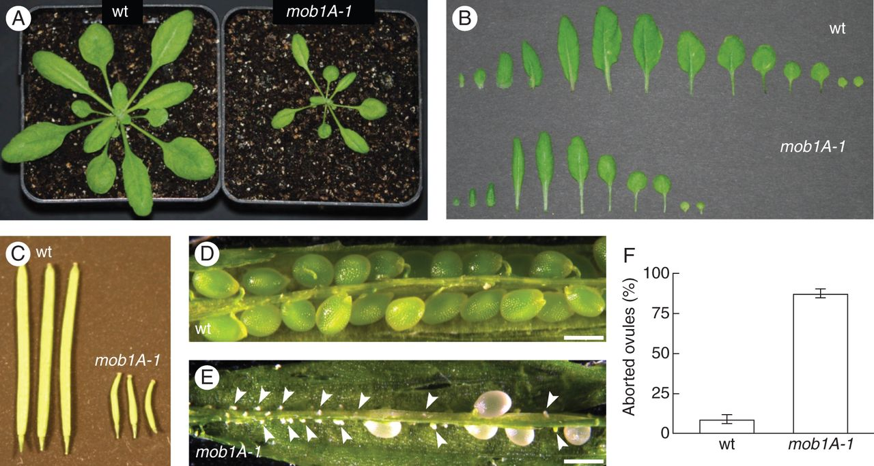
Fig. 3. mob1A-1 displays defects in plant growth and reproduction. (A) Rosette phenotype of 3-week-old wild-type ...
Notes:
Fig. 3. mob1A-1 displays defects in plant growth and reproduction. (A) Rosette phenotype of 3-week-old wild-type Col-0 (wt) and mob1A-1 plants. Note the reduced size of the mob1A-1 mutant. (B) Arrangement of all leaves from 3-week-old wild-type and mob1A-1 plants reveals a reduced number of leaves for mob1A-1. (C) Siliques of wild-type and mob1A-1 plants 10 d after flower opening. mob1A-1 siliques display a clear reduction in size. (D and E) Morphology of seeds from wild-type and mob1A-1 plants. Shown are siliques at 8–10 d after flowering. mob1A-1 siliques contain several aborted (arrowheads) and pale seeds. (F) Proportion of aborted ovules from siliques of wild-type and mob1A-1 plants. Means ± s.d. are reported; n = 3 (ten siliques per plant; >370 total seeds were examined). Scale bars are 500 µm (D, E).
Unless provided in the caption above, the following copyright applies to the content of this slide: © The Author 2013. Published by Oxford University Press on behalf of the Annals of Botany Company. All rights reserved. For Permissions, please email: journals.permissions@oup.com

Slide 4
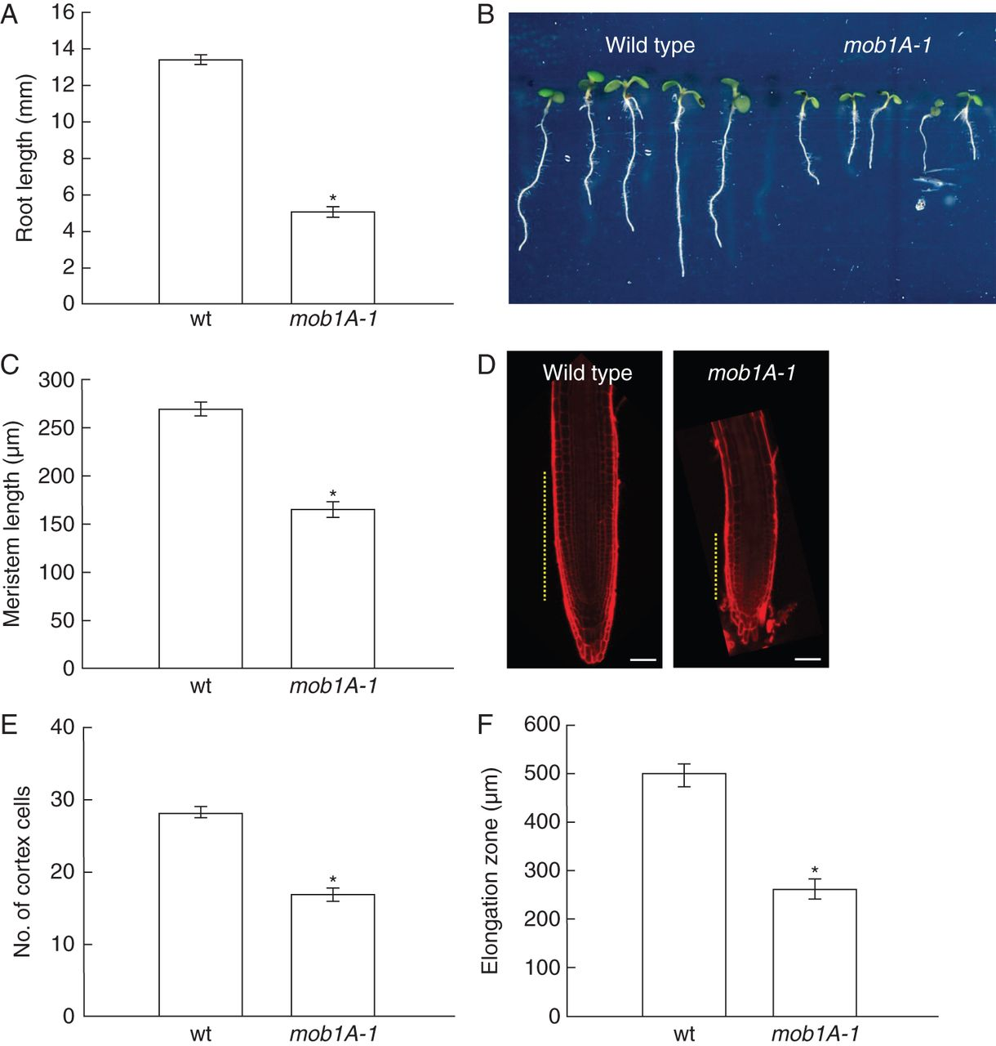
Fig. 4. Mob1A function is required for proper root development. (A and B) Whole root length analysis of wild-type ...
Notes:
Fig. 4. Mob1A function is required for proper root development. (A and B) Whole root length analysis of wild-type (wt) and mob1A-1 plants (n = 42). (C and D) Length measurement (C) (n = 16) and size comparison (D) of wild-type and mob1A-1 root meristem. In D, meristem size is indicated by dashed yellow lines (scale bars are 50 µm). (E) Counting of cortex cell number (n = 16). (F) Length measurement of the root elongation zone (n = 16). All measurements and images were performed on seedlings 5 d after germination. In the graphs, the mean ± s.e. is reported (*P < 0·001, t-test).
Unless provided in the caption above, the following copyright applies to the content of this slide: © The Author 2013. Published by Oxford University Press on behalf of the Annals of Botany Company. All rights reserved. For Permissions, please email: journals.permissions@oup.com

Slide 5
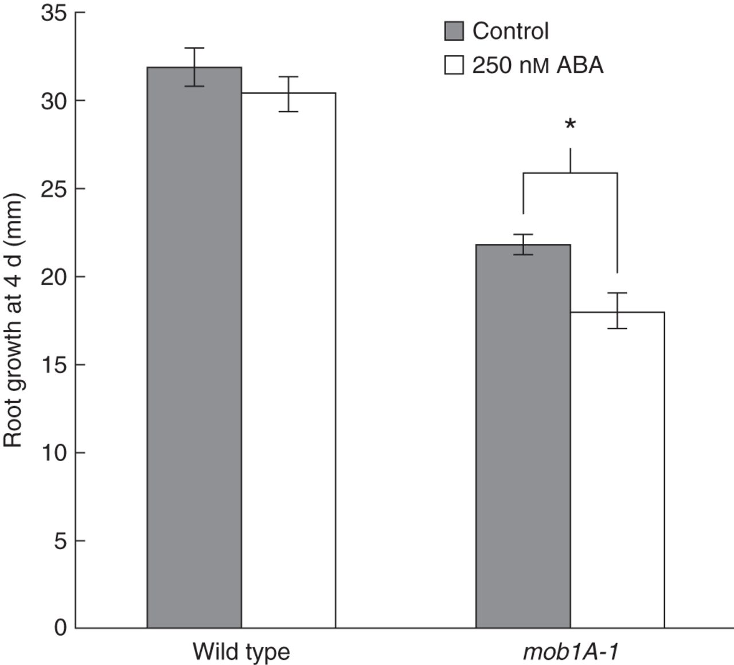
Fig. 5. mob1A-1 roots are more sensitive to abscisic acid (AB). Four days root growth (n >10) of wild-type and ...
Notes:
Fig. 5. mob1A-1 roots are more sensitive to abscisic acid (AB). Four days root growth (n >10) of wild-type and mob1A-1 seedlings on control medium and medium containing 250 nM ABA. Seedlings were transfered in parallel to new plates 3 d after germination. The mean ± s.e. is reported (*P < 0·001, t-test).
Unless provided in the caption above, the following copyright applies to the content of this slide: © The Author 2013. Published by Oxford University Press on behalf of the Annals of Botany Company. All rights reserved. For Permissions, please email: journals.permissions@oup.com

Slide 6
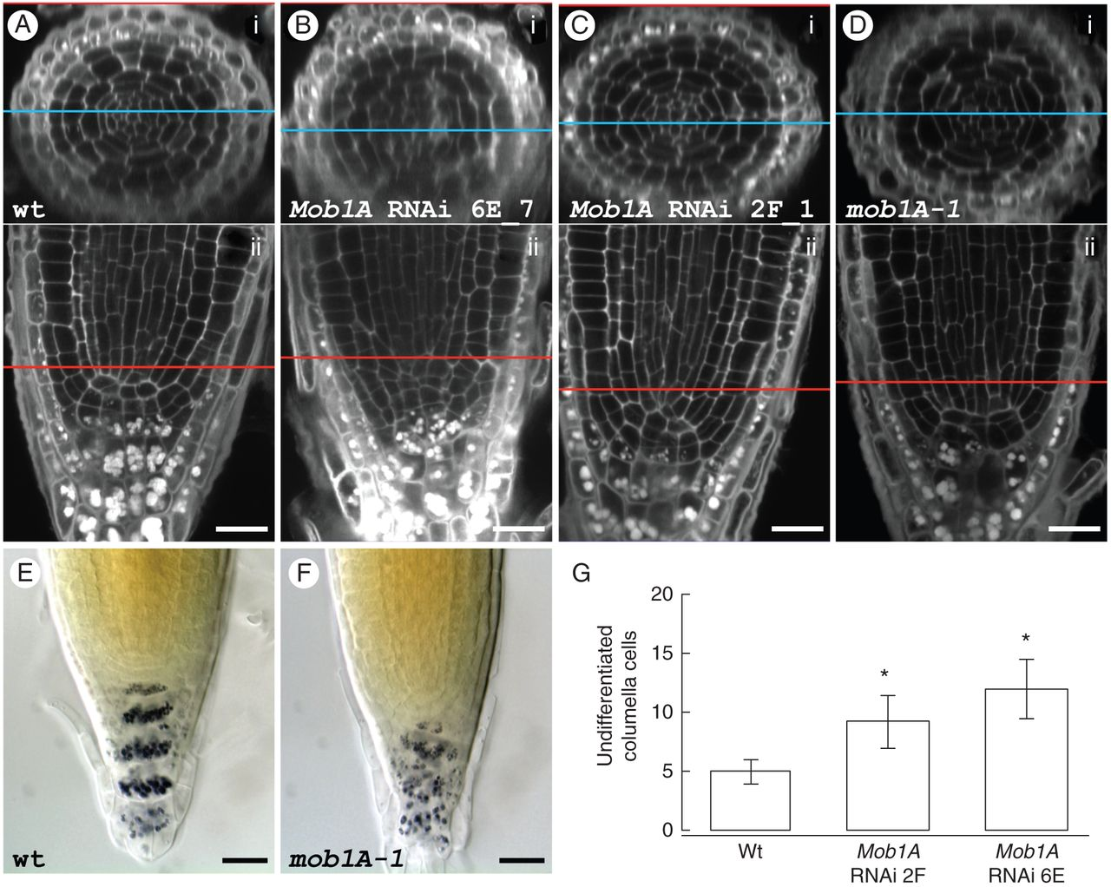
Fig. 6. Reduced levels of Mob1A expression affect root meristem cellular pattern. (A–D) Staining of cell borders and ...
Notes:
Fig. 6. Reduced levels of Mob1A expression affect root meristem cellular pattern. (A–D) Staining of cell borders and starch grains in wild-type (A), Mob1A RNAi lines 6E_4 (B) and 2F_1 (C) and mob1A-1 (D) roots. The upper panel (i) of each figure shows a transversal section of the root, which was electronically reconstructed from a z-stack of longitudinal sections (ii). The blue and the red lines indicate the level in the root tip, to which the two sections correspond. (E and F) Lugol staining of wild-type (E) and mob1A-1 (F) root tips. Scale bars are 20 µm (A–F). (G) Counting of undifferentiated columella cells in wild-type (wt) roots and roots of Mob1A RNAi lines with a distorted cellular pattern (n = 4). Cells were counted throughout the planes of a confocal z-stack. The mean ± s.d. is reported (*P < 0·001, t-test). Scale bars are 20 µm (A–F). Frequency of root tips with a distorted cellular pattern in the wild type, Mob1A RNAi lines and the mob1A-1 mutant line Wild typeMob1A RNAi linesmob1A-14G2F6ERoot tips with disordered cellular pattern3681013Observed root tips3030303030Phenotype penetrance (%)102026·733·343·3
Unless provided in the caption above, the following copyright applies to the content of this slide: © The Author 2013. Published by Oxford University Press on behalf of the Annals of Botany Company. All rights reserved. For Permissions, please email: journals.permissions@oup.com

Slide 7
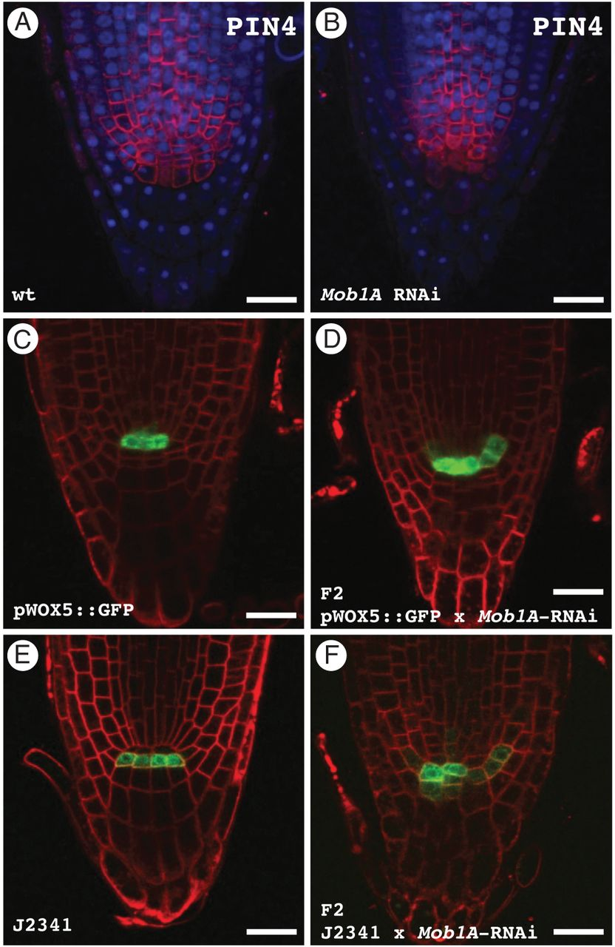
Fig. 7. The expression pattern of different cellular markers is altered in Mob1A RNAi roots. (A and B) ...
Notes:
Fig. 7. The expression pattern of different cellular markers is altered in Mob1A RNAi roots. (A and B) Immunolocalized PIN4 (red) and DAPI staining (blue) in wild-type (A) and Mob1A RNAi (B) root tips. (C and D) Root tip GFP distribution in the pWOX5::GFP reporter line (C) and in an F2 population from a pWOX5::GFP × Mob1A RNAi cross (D). Seedlings were incubated for 10 min in 4 µm FM4-64 prior to microscopy observation to visualize the cell plasma membrane. Note the expanded GFP expression in the sample from the F2 crossing population. (E and F) Root tip GFP distribution in the J2341 columella initials marker line (E) and in an F2 population from a J2341 × Mob1A RNAi cross (F). Plasma membranes were stained with FM4-64 as described above. Cells expressing GFP in the F2 crossing population failed to display the same alignment as in J2341 roots. Scale bars are 20 µm (A–F).
Unless provided in the caption above, the following copyright applies to the content of this slide: © The Author 2013. Published by Oxford University Press on behalf of the Annals of Botany Company. All rights reserved. For Permissions, please email: journals.permissions@oup.com

