Slide 1
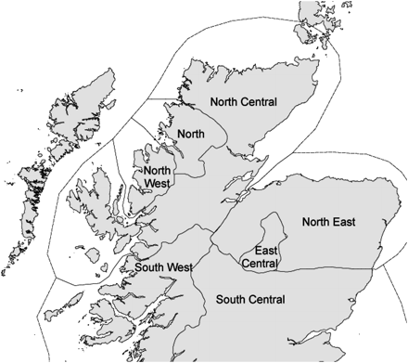
Figure 1. Map of the current Scots pine seed zones in Scotland.
Notes:
Figure 1. Map of the current Scots pine seed zones in Scotland.
Unless provided in the caption above, the following copyright applies to the content of this slide: © Institute of Chartered Foresters, 2010. All rights reserved. For Permissions, please email: journals.permissions@oxfordjournals.org

Slide 2
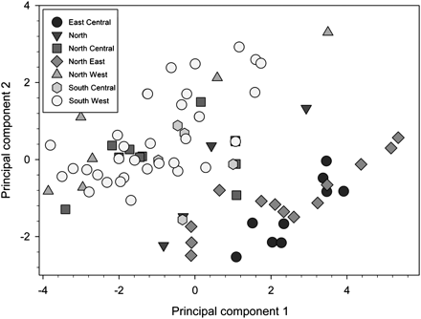
Figure 2. Plot of the first principal components, which account for 69 and 24% of total variation, respectively, of ...
Notes:
Figure 2. Plot of the first principal components, which account for 69 and 24% of total variation, respectively, of climatic variation among 84 native pinewood sites. The seven variables used are shown in Table 1. Current seed zones are represented by different symbols, and the closer the populations are in the graph, the more similar they are climatically. PC1 represents a gradient in annual rainfall and temperature: populations with more negative values are generally located in the west (high rainfall, mild climate); positive values represent more eastern pinewoods with less rainfall and colder winters.
Unless provided in the caption above, the following copyright applies to the content of this slide: © Institute of Chartered Foresters, 2010. All rights reserved. For Permissions, please email: journals.permissions@oxfordjournals.org

