Slide 1
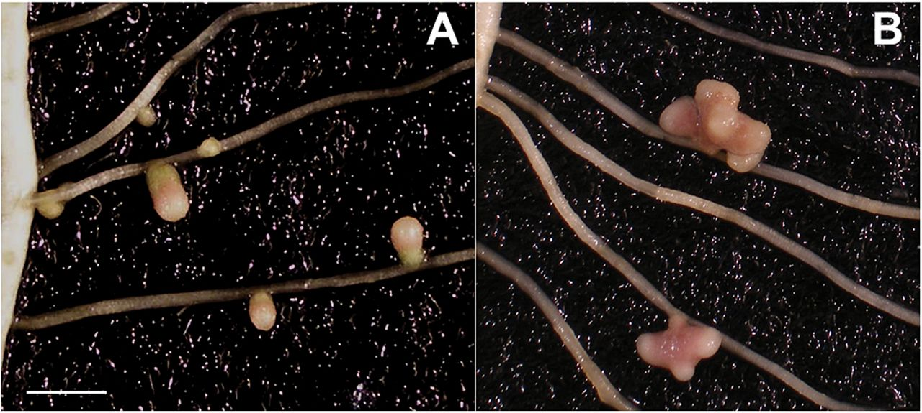
Fig. 1. Nodules from the WT (A) and E151 (B) 28 days after inoculation. Whereas the WT exhibits small cylindrical ...
Notes:
Fig. 1. Nodules from the WT (A) and E151 (B) 28 days after inoculation. Whereas the WT exhibits small cylindrical nodules, E151 displays large, fan-shaped nodules which are multimeristematic. Scale bar=1cm. (This figure is available in colour at JXB online.)
Unless provided in the caption above, the following copyright applies to the content of this slide: © The Author 2015. Published by Oxford University Press on behalf of the Society for Experimental Biology.This is an Open Access article distributed under the terms of the Creative Commons Attribution License (http://creativecommons.org/licenses/by/3.0/), which permits unrestricted reuse, distribution, and reproduction in any medium, provided the original work is properly cited.

Slide 2
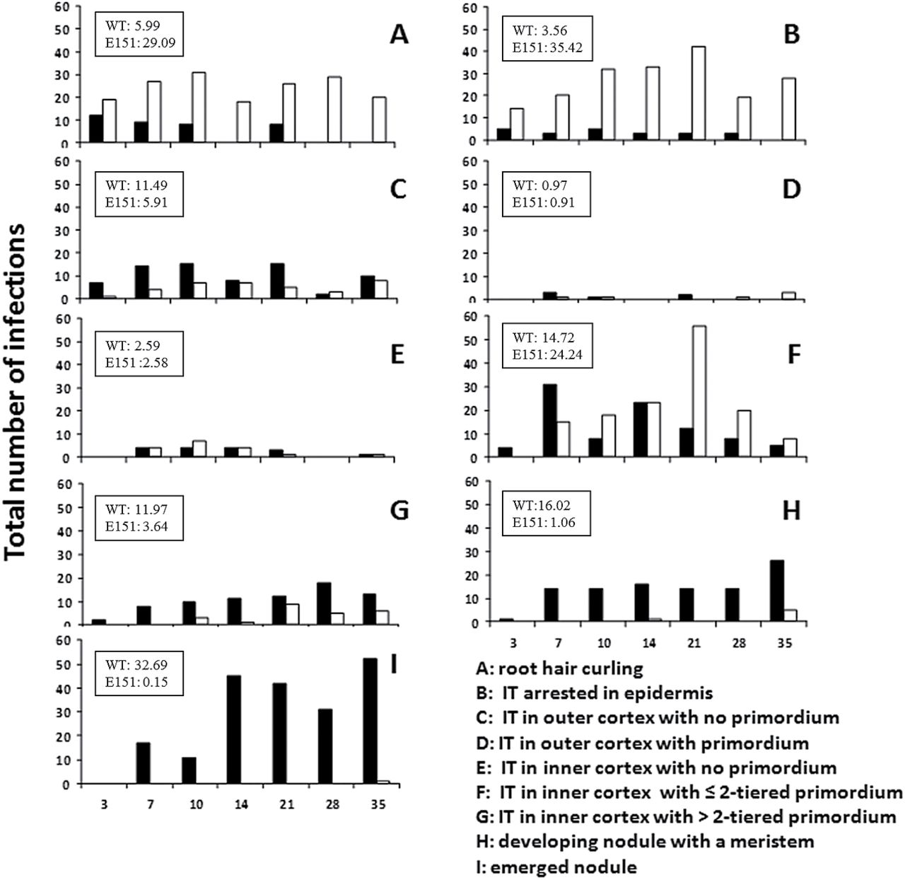
Fig. 2. Total number of nodulation events for each stage of WT (black bars) and E151 (white bars) root segments at 3, ...
Notes:
Fig. 2. Total number of nodulation events for each stage of WT (black bars) and E151 (white bars) root segments at 3, 7, 10, 14, 21, 28, and 35 days after inoculation. Nine stages have been defined as A–I, and insets show percentages of infection events observed on lateral roots at each of those stages. The inset values represent all time points combined in relation to the total number of infections observed for each pea line (618 for the WT and 660 for the mutant E151). The total number of plants was at least 22 for each line and time.
Unless provided in the caption above, the following copyright applies to the content of this slide: © The Author 2015. Published by Oxford University Press on behalf of the Society for Experimental Biology.This is an Open Access article distributed under the terms of the Creative Commons Attribution License (http://creativecommons.org/licenses/by/3.0/), which permits unrestricted reuse, distribution, and reproduction in any medium, provided the original work is properly cited.

Slide 3
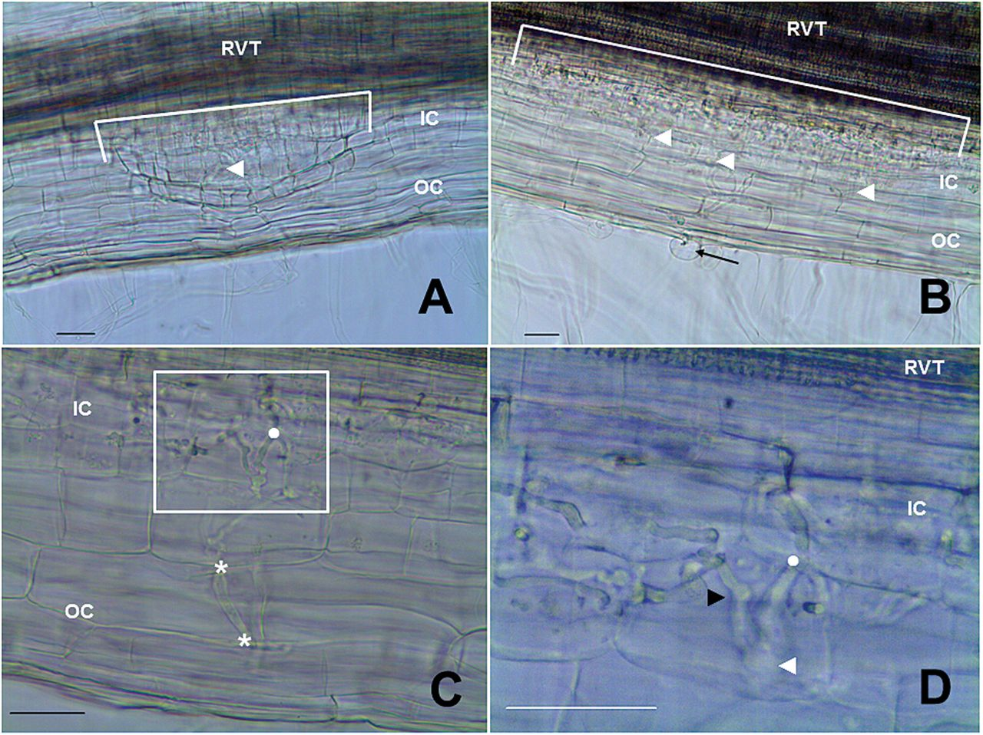
Fig. 3. Nodule development on WT (A) and E151 (B–D) plants grown in pouches and spot-inoculated. Lateral roots were ...
Notes:
Fig. 3. Nodule development on WT (A) and E151 (B–D) plants grown in pouches and spot-inoculated. Lateral roots were cleared but not stained. Nodule stages are those described in Fig. 2. (A) Nodule (stage H) with a meristem forcing its way through the outer cortex (OC). The nodule originates in the inner cortex (IC) from the cortical cells abutting the root vascular tissue (RVT). The nodule base delineated by the white line covers a length of 350 μm. An infection thread (arrowhead) is seen within the developing nodule. (B) Nodule primordium (stage F) comprised only of two cell layers and with a wide base [575 μm (white line)]. The infection thread starts from a curled root hair (arrow) and branches many times (arrowheads). (C) Close-up on an infection thread illustrating its splitting each time it enters into a new cell layer (*) of the OC. In the IC, the branching becomes erratic. The area highlighted by the box is magnified in (D) and the dot is located in the same place in both images. (D) The infection thread exhibits bulges (white arrowhead) and knots (black arrowhead) in the IC. Many branches of the thread enter into a single cell which can no longer divide; consequently, the IC cells become enlarged. Scale bars=50 μm. (This figure is available in colour at JXB online.)
Unless provided in the caption above, the following copyright applies to the content of this slide: © The Author 2015. Published by Oxford University Press on behalf of the Society for Experimental Biology.This is an Open Access article distributed under the terms of the Creative Commons Attribution License (http://creativecommons.org/licenses/by/3.0/), which permits unrestricted reuse, distribution, and reproduction in any medium, provided the original work is properly cited.

Slide 4
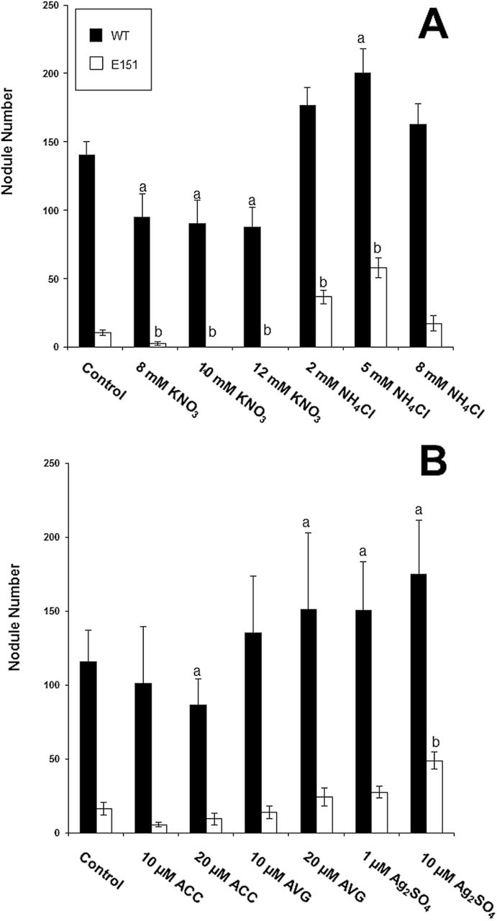
Fig. 4. (A) Nodule number on WT and E151 plants treated with either nitrate or ammonium. (B) Nodule number on WT and ...
Notes:
Fig. 4. (A) Nodule number on WT and E151 plants treated with either nitrate or ammonium. (B) Nodule number on WT and E151 plants treated with either the direct precursor of ethylene (ACC), an inhibitor of the enzyme ACC synthase (AVG), or an antagonist of ethylene action (Ag2SO4). Data (mean ±SE; nitrogen treatments: n=12 per line, three trials; ethylene treatments: n=15 per line, four trials) were subjected to a one-way ANOVA followed by Fischer’s protected LSD post-hoc test to determine significant differences within pea lines between treatments; letters (a for WT and b for E151) indicate significance at a 95% confidence level.
Unless provided in the caption above, the following copyright applies to the content of this slide: © The Author 2015. Published by Oxford University Press on behalf of the Society for Experimental Biology.This is an Open Access article distributed under the terms of the Creative Commons Attribution License (http://creativecommons.org/licenses/by/3.0/), which permits unrestricted reuse, distribution, and reproduction in any medium, provided the original work is properly cited.

Slide 5
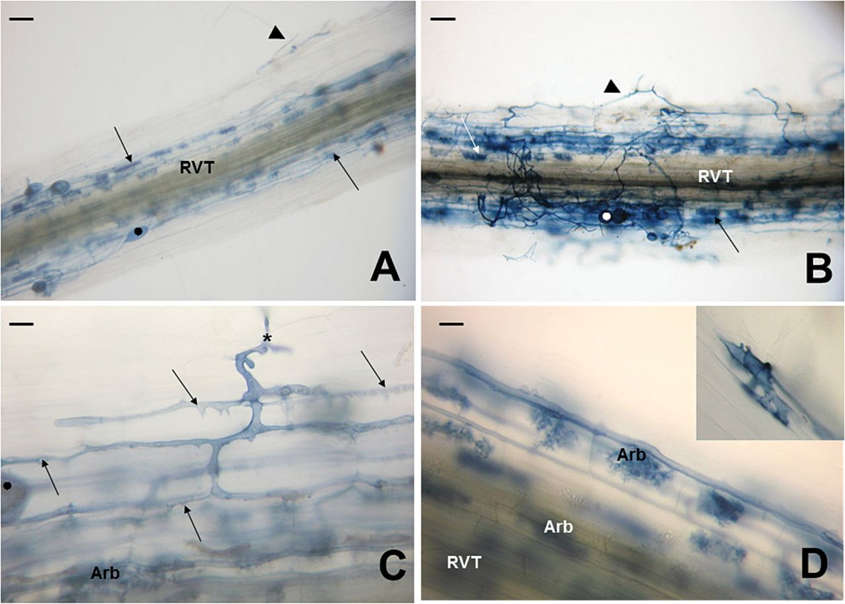
Fig. 5. Mycorrhizae development in roots of WT (A) and E151 (B–D) plants inoculated with the fungus Rhizophagus ...
Notes:
Fig. 5. Mycorrhizae development in roots of WT (A) and E151 (B–D) plants inoculated with the fungus Rhizophagus irregulare and harvested 35 DAI. (A) Colonization unit exhibiting extraradicular hyphae (arrowhead), intraradical hyphae in the cortex running parallel to the root vascular tissue (RVT), many arbuscules (arrows), and vesicles (black dot). (B) Colonization unit comprising an abundance of extraradicular hyphae (arrowhead), arbuscules (arrow), and numerous vesicles. (C) Close-up of a hypha (asterisk) entering an epidermal cell and progressing through the root cortex. The hyphae run in the apoplastic space of the outer cortex, and, in contrast to those in the WT, which are smooth, they have short pointed projections (arrows) along their length. Most of the hyphae reaching the inner cortex develop into arbuscules (Arb). (D) The Arb are numerous as they are present in practically all of the inner cortical cells surrounding the stele (RVT). There are more hyphopodia in E151 than in the WT, and some are aberrant in that they are septate and branched (inset). Bars: (A) and (B)=200 μm; (C) and (D)=20 μm. (This figure is available in colour at JXB online.)
Unless provided in the caption above, the following copyright applies to the content of this slide: © The Author 2015. Published by Oxford University Press on behalf of the Society for Experimental Biology.This is an Open Access article distributed under the terms of the Creative Commons Attribution License (http://creativecommons.org/licenses/by/3.0/), which permits unrestricted reuse, distribution, and reproduction in any medium, provided the original work is properly cited.

