Slide 1
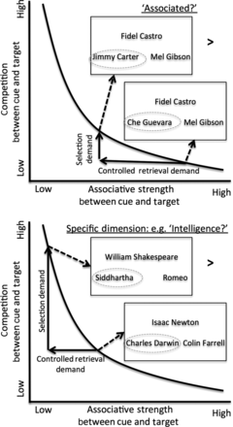
Figure 1. Making social judgments involves accessing goal-relevant information from memory. This access relies on 2 ...
Notes:
Figure 1. Making social judgments involves accessing goal-relevant information from memory. This access relies on 2 processes: Controlled retrieval and selection. The demand for these processes in turn depends on 2 features, the associative strength between the cue and target (depicted along the x-axis) and the competition between the cue and target (depicted along the y-axis). The curvilinear line illustrates that these features are nonindependent: As associative strength between a cue and a target decreases, the competition or interference also increases (e.g. because weakly associated targets of a cue must compete against more strongly associated probes that may be retrieved surreptitiously). Thus, to separate out the contributions of controlled retrieval and selection in making social judgments, participants engaged in 2 conditions. For one condition, which is illustrated in the top portion of the graph, participants made an “Associated?” judgment by matching the cue name (e.g. “Fidel Castro”) with the more associated probe name. The probe was either more strongly associated (e.g. “Che Guevara”) or more weakly associated (e.g. “Jimmy Carter”; gray circles were not shown in the task, but are included here to indicate the correct probe response). Comparing trials with weaker associative strength to trials with stronger associative strength increases demands placed on controlled retrieval. However, it may also increase the demands placed on selection (e.g. because matching Fidel Castro with Jimmy Carter may nevertheless bring information about stronger associates, such as Che Guevara, to mind surreptitiously, and this information must be selected against). Thus, a second condition is involved, which is illustrated in the bottom portion of the graph, in which a matching judgment is made along a specific dimension (e.g. “Intelligence?”). Comparing trials with higher selection demand (e.g. having to match the cue “William Shakespeare” with the probe “Siddhartha” for intelligence involves selecting against the stronger but irrelevant probe “Romeo”) versus those that have low selection demand (i.e. trials in which the more associated probe is also the better match for the given dimension, in this case for “Isaac Newton,” “Charles Darwin” is both more associated and the correct match). With these conditions, the difference between the conditions in the top graph and in the bottom graph reveals whether neural regions are more associated with controlled retrieval or selection.
Unless provided in the caption above, the following copyright applies to the content of this slide: © The Author 2013. Published by Oxford University Press. All rights reserved. For Permissions, please e-mail: journals.permissions@oup.com

Slide 2
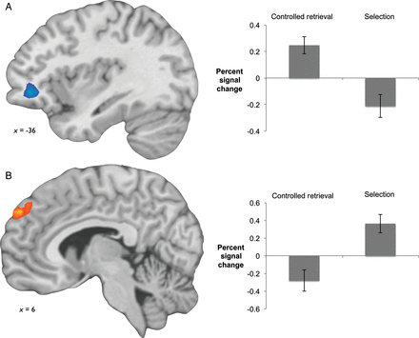
Figure 2. Neural regions specific to controlled retrieval demands (A) and selection demands (B) for social information. ...
Notes:
Figure 2. Neural regions specific to controlled retrieval demands (A) and selection demands (B) for social information. The left anterior vlPFC (A) showed greater activity to controlled retrieval demand than to selection demand for social information, but at an uncorrected threshold. The dorsomedial prefrontal cortex (B) showed greater activity to both selection demand alone and in the comparison of selection demand with controlled retrieval demand (P< 0.05, FWER corrected).
Unless provided in the caption above, the following copyright applies to the content of this slide: © The Author 2013. Published by Oxford University Press. All rights reserved. For Permissions, please e-mail: journals.permissions@oup.com

Slide 3
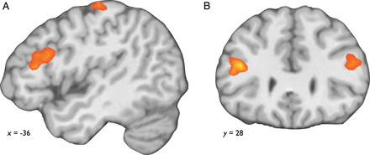
Figure 3. Sagittal (A) and coronal (B) views of lateral prefrontal neural regions that respond to increasing memory ...
Notes:
Figure 3. Sagittal (A) and coronal (B) views of lateral prefrontal neural regions that respond to increasing memory retrieval demands for social information (controlled retrieval and selection demands combined; P < 0.05, FWER corrected).
Unless provided in the caption above, the following copyright applies to the content of this slide: © The Author 2013. Published by Oxford University Press. All rights reserved. For Permissions, please e-mail: journals.permissions@oup.com

