Slide 1
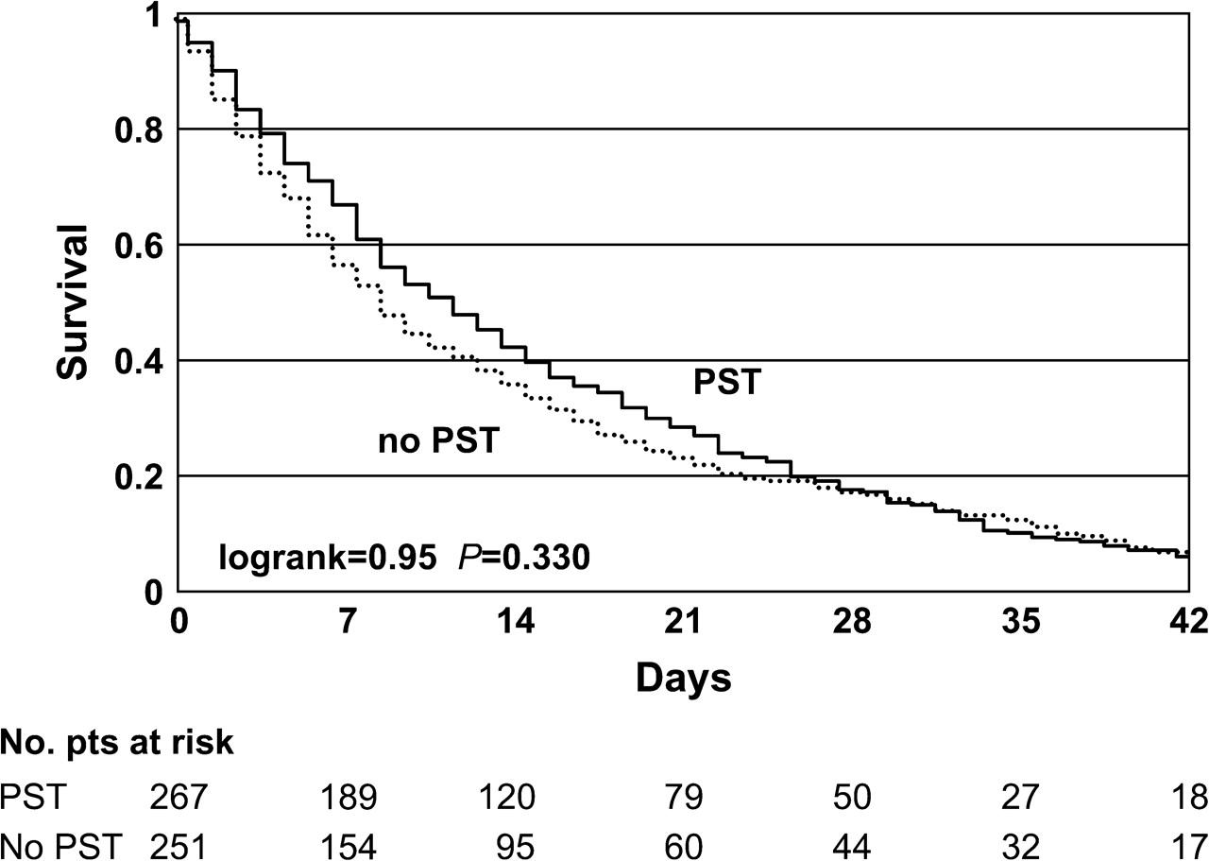
Figure 1. Kaplan–Meier survival curves for cohort A [palliative sedation therapy (PST)] and cohort B (no PST).
Notes:
Figure 1. Kaplan–Meier survival curves for cohort A [palliative sedation therapy (PST)] and cohort B (no PST).
Unless provided in the caption above, the following copyright applies to the content of this slide: © The Author 2009. Published by Oxford University Press on behalf of the European Society for Medical Oncology. All rights reserved. For permissions, please email: journals.permissions@oxfordjournals.org

