Slide 1
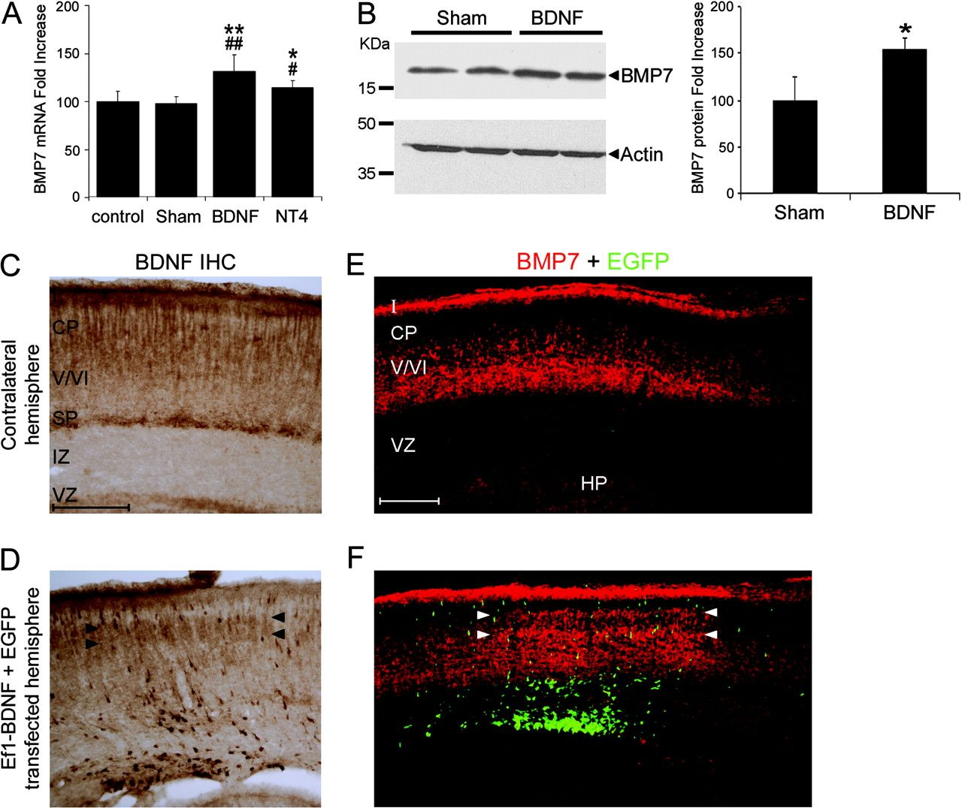
Figure 1. BDNF induces BMP7 expression. (A) Quantification of BMP7 mRNA levels by RT-PCR in E18 cerebral cortices from ...
Notes:
Figure 1. BDNF induces BMP7 expression. (A) Quantification of BMP7 mRNA levels by RT-PCR in E18 cerebral cortices from intact animals (control) or injected at E14 with vehicle (sham), BDNF, or NT4. (B) Representative western blot for BMP7 and actin as loading control in E16 cortical tissue from animals injected at E14 with vehicle (sham) or BDNF. Molecular weight markers are indicated to the left. The graph represents the quantification of BMP7 protein from 3 animals at each condition. (C) BDNF immunostaining in a coronal cortical section of a mouse electroporated with BDNF and GFP vectors (Ef1-BDNF + GFP) showing the normal protein distribution in the contralateral control hemisphere (Ef1-BDNF + GFPcontra) with respect to the transfected hemisphere (Ef1-BDNF + GFP) (D), where intense BDNF-expressing cells are seen through the cortical wall. (E, F) Double immunostaining for BMP7 (red) and EGFP (green) was performed in an adjacent section to that showed in (C, D). Arrowheads indicate BDNF overexpression in the upper CP in D and the area of strong BMP7 induction in (F). Error bars indicates the standard deviation. Scale bars, 200 μm. *Significant difference with respect to sham-operated animals (*P < 0.05, **P < 0.01, LSD test). #Significant differences with respect to control (#P < 0.05, ##P < 0.01, LSD test). I, layer I/MZ; V/VI, layers V/VI; HP, hippocampus.
Unless provided in the caption above, the following copyright applies to the content of this slide: © The Author 2009. Published by Oxford University Press. All rights reserved. For permissions, please e-mail: journals.permissions@oxfordjournals.org

Slide 2
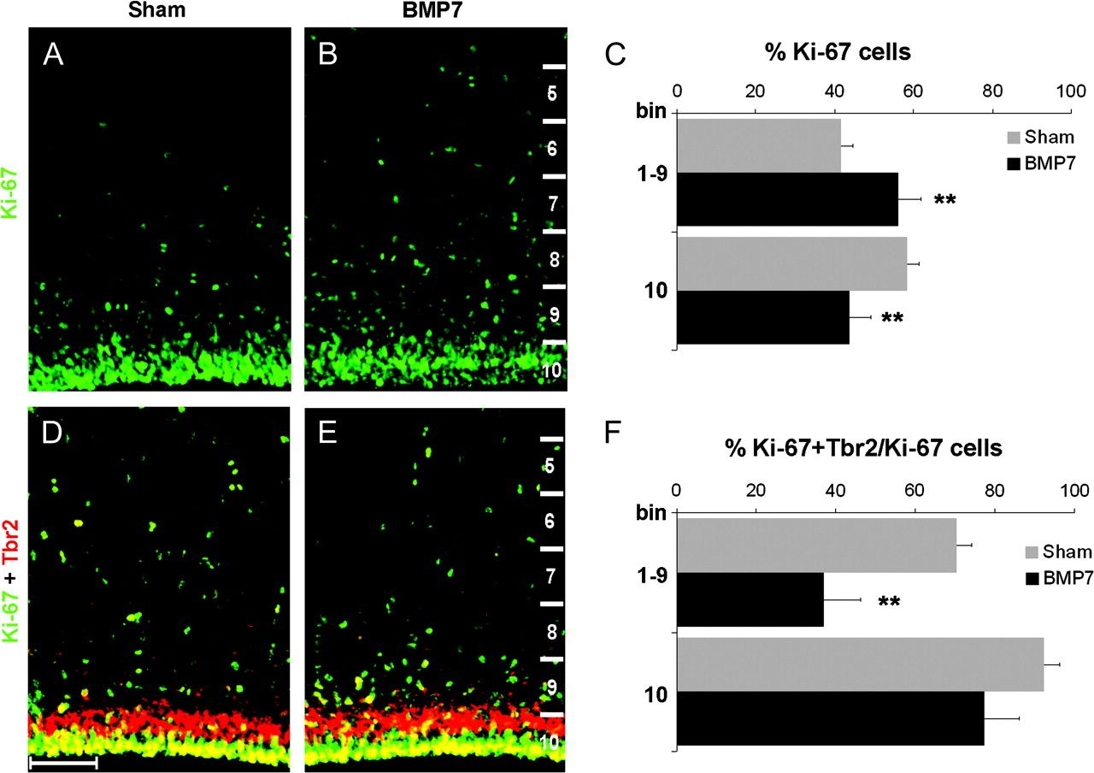
Figure 7. BMP7 effects in VZ and SVZ progenitors Ki-67 immunostaining showing the distribution of the cycling ...
Notes:
Figure 7. BMP7 effects in VZ and SVZ progenitors Ki-67 immunostaining showing the distribution of the cycling progenitor pool in sham-operated (A) and BMP7-injected animals (B). (C) Histogram showing the displacement of Ki-67 progenitors from the VZ (bin 10) to more basal positions (bin 1–9). (D, E) Figures show the distribution of IPCs double-stained with Ki-67 and TBR2 in sham-operated (D) and BMP7-injected (E) animals. (F) Histogram showing different distribution of IPCs between sham-operated and BMP7-injected animals. **Significant difference P < 0.01, LSD test. Error bars reflect the standard deviation. Scale bar, 80 μm.
Unless provided in the caption above, the following copyright applies to the content of this slide: © The Author 2009. Published by Oxford University Press. All rights reserved. For permissions, please e-mail: journals.permissions@oxfordjournals.org

Slide 3
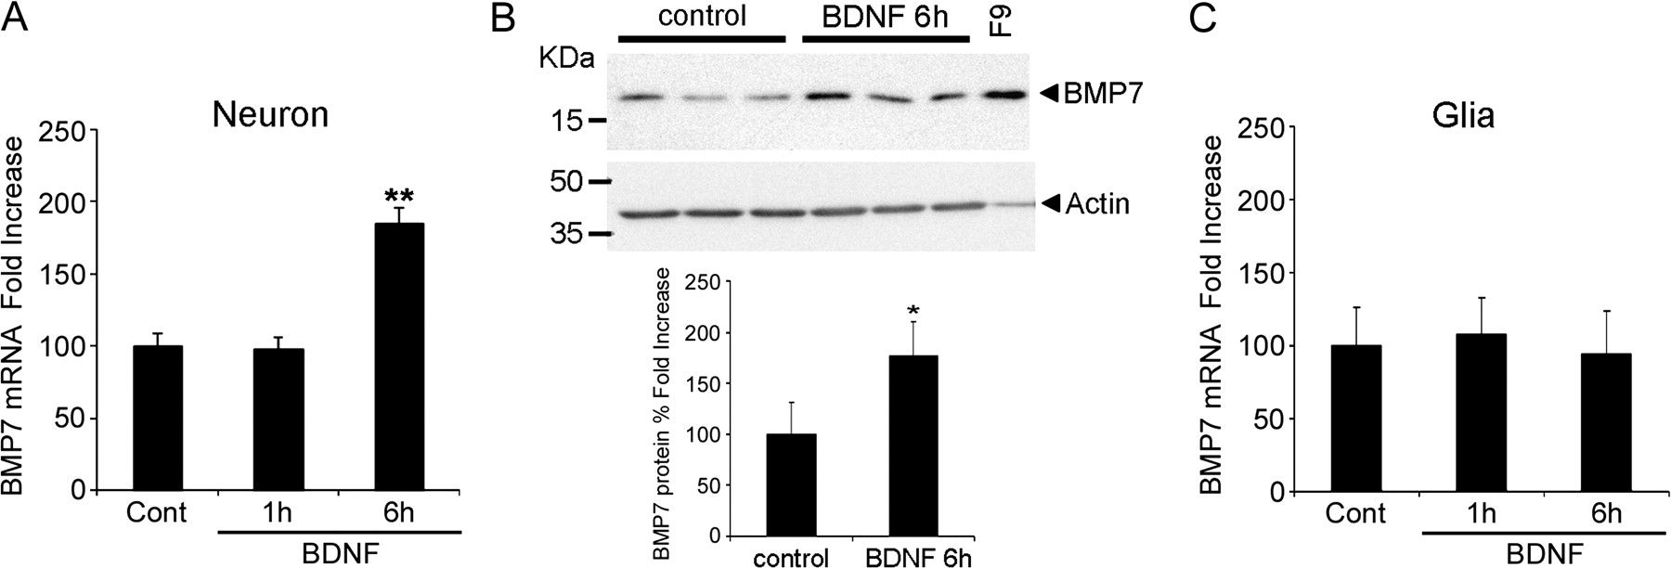
Figure 2. BDNF upregulates BMP7 in vitro. (A) Quantification of BMP7 mRNA levels by RT-PCR in primary neuronal E16 ...
Notes:
Figure 2. BDNF upregulates BMP7 in vitro. (A) Quantification of BMP7 mRNA levels by RT-PCR in primary neuronal E16 cortical cultures treated with BDNF (100 ng/mL) for 1 and 6 h. (B) Western blot for BMP7 and actin as loading control in neuronal cultures treated for 6 h with BNDF (100 ng/mL). F9 cells (embryonic carcinoma cells that overexpress BMP7) were used as a positive control. The graph summarizing quantification of western blots demonstrates that neurons treated with BDNF for 6 h express higher BMP7 protein levels. (C) BMP7 mRNA was quantified in pure neonatal glial cultures treated with BDNF (100 ng/mL) for 1 or 6 h. BMP7 mRNA levels increased after 6 h of BDNF treatment in neuronal cultures (A) but not in glial cultures (C).
Unless provided in the caption above, the following copyright applies to the content of this slide: © The Author 2009. Published by Oxford University Press. All rights reserved. For permissions, please e-mail: journals.permissions@oxfordjournals.org

Slide 4
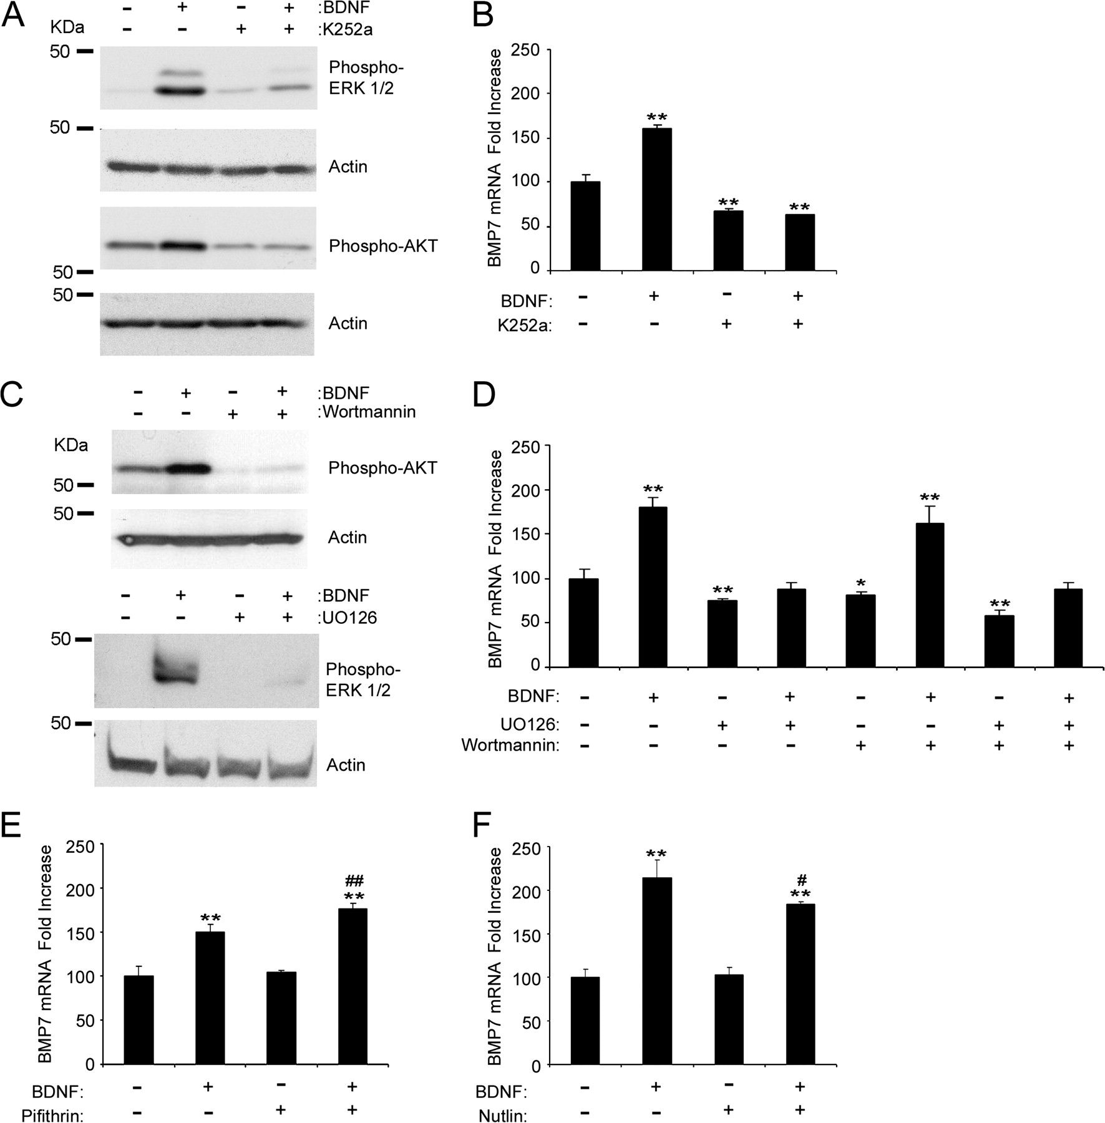
Figure 3. BDNF induces BMP7 expression through TrkB receptor and MAP kinase/ERK pathway. (A) Western blots of E16 ...
Notes:
Figure 3. BDNF induces BMP7 expression through TrkB receptor and MAP kinase/ERK pathway. (A) Western blots of E16 neuronal cultures exposed to the TrkB inhibitor K252a (0.6 μM) or dimethyl sulfoxide (DMSO) as control, 1 h before BDNF treatment for 1h. (B) RT-PCR results showing K252a blockage of the BMP7 mRNA expression induced by 6-h BDNF treatment. (C) Immunoblots showing the effect on BDNF-dependent phosphorylation of ERK1/2 and AKT, respectively, of MEK inhibitor UO126 (10 μM), PI3-kinase inhibitor wortmaninn (0.1 μM), or DMSO as control on E16 neuronal cultures exposed to them 1 h before BDNF treatment for 1 h. (D) Histogram summarizing the effect of the different inhibitors of TrkB downstream pathways on BMP7 mRNA expression analyzed by RT-PCR after 6 h of BDNF treatment. (E) Histogram summarizing the effect of p53 transcriptional activity inhibitor pifithrin-α on BMP7 mRNA expression analyzed by RT-PCR. A 10 μM cyclic pifithrin-α or DMSO as control was administered 1-h before BDNF treatment for 6 h. (F) Real-time results showing the effect of p53 activation through nutlin-3 (10 μM), which inhibits MDM-2, a p53 inhibitor. Error bars reflect the standard deviation. *Significant differences with respect to controls, and #differences between BDNF and BDNF + inhibitor treatments (#/*P < 0.05, ##/**P < 0.01, LSD test).
Unless provided in the caption above, the following copyright applies to the content of this slide: © The Author 2009. Published by Oxford University Press. All rights reserved. For permissions, please e-mail: journals.permissions@oxfordjournals.org

Slide 5
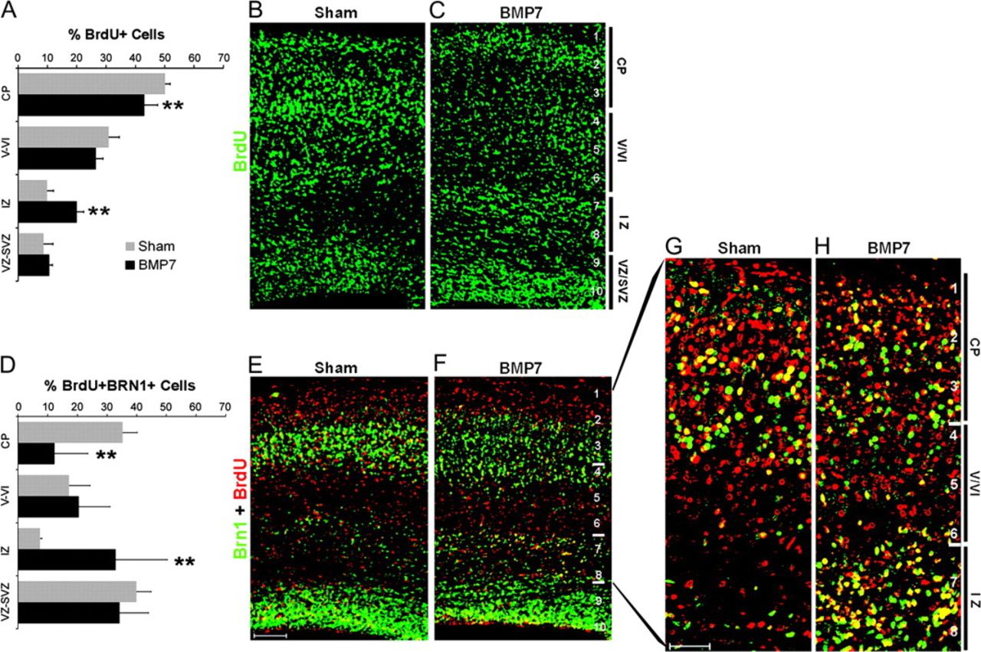
Figure 4. BMP7 treatment in E14 embryos impairs radial migration. (A) Graph of the laminar distribution of ...
Notes:
Figure 4. BMP7 treatment in E14 embryos impairs radial migration. (A) Graph of the laminar distribution of BrdU-positive cells in E18 cerebral cortex of embryos injected with vehicle (sham) (B) or BMP7 (C) at E14. BrdU was injected to the E14 pregnant females 3 h after BMP7 injection. The graph shows significant reduction in the percentage of labeled cells in the upper CP and a parallel increase in the percentage of labeled cells in the SP and IZ in BMP7-treated mice. (D) Laminar distribution of double-labeled neurons for BrdU (red) and Brn1 (green) at E18 in sham-operated (E) and BMP7-treated (F) animals. (G, H) Higher magnifications showing that ectopic BrdU-positive cells in the IZ of BMP7-treated mice (H) expressed Brn1 and had stopped migrating. **Significant difference P < 0.01, LSD test. Error bars reflect the standard deviation. Scale bar, 80 μm.
Unless provided in the caption above, the following copyright applies to the content of this slide: © The Author 2009. Published by Oxford University Press. All rights reserved. For permissions, please e-mail: journals.permissions@oxfordjournals.org

Slide 6
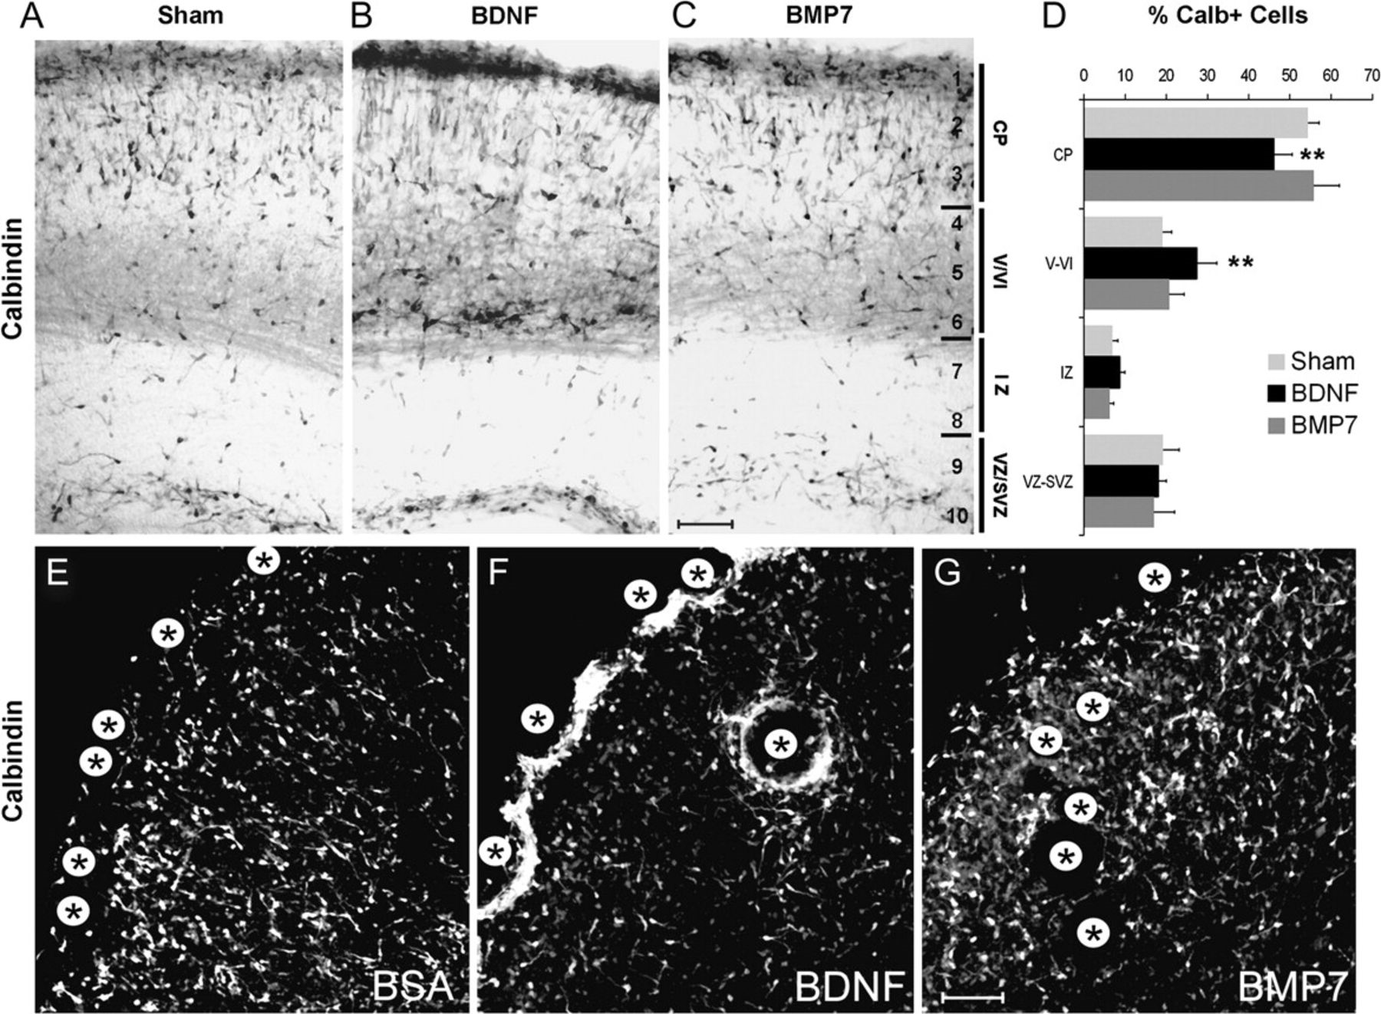
Figure 5. BMP7 do not affect the migration of GABAergic neurons identified by calbindin immunostaining at E18 in ...
Notes:
Figure 5. BMP7 do not affect the migration of GABAergic neurons identified by calbindin immunostaining at E18 in cortical coronal sections of mice injected at E14 with vehicle (sham) (A), BDNF (B), or BMP7 (C). (D) Graph of the laminar distribution of calbindin-positive neurons in control and BDNF- and BMP7-injected animals showing increased percentage of GABAergic neurons in layers V–VI of BDNF-treated animals and normal GABAergic cell distribution in BMP7- and vehicle-treated cortices. Calbindin-positive GABAergic neurons in E17 cortical organotypic cultures exposed to agarose beads (*) preadsorbed with BSA as negative control (E), BDNF as positive control (F), or BMP7 (G) for 48 h. BDNF exerted a dramatic attractive response in GABAergic neurons, while BMP7 had no effect. **Significant difference (P < 0.01, LSD test). Error bars reflect the standard deviation. Scale bar in A–C, 100 μm; E–G, 40 μm.
Unless provided in the caption above, the following copyright applies to the content of this slide: © The Author 2009. Published by Oxford University Press. All rights reserved. For permissions, please e-mail: journals.permissions@oxfordjournals.org

Slide 7
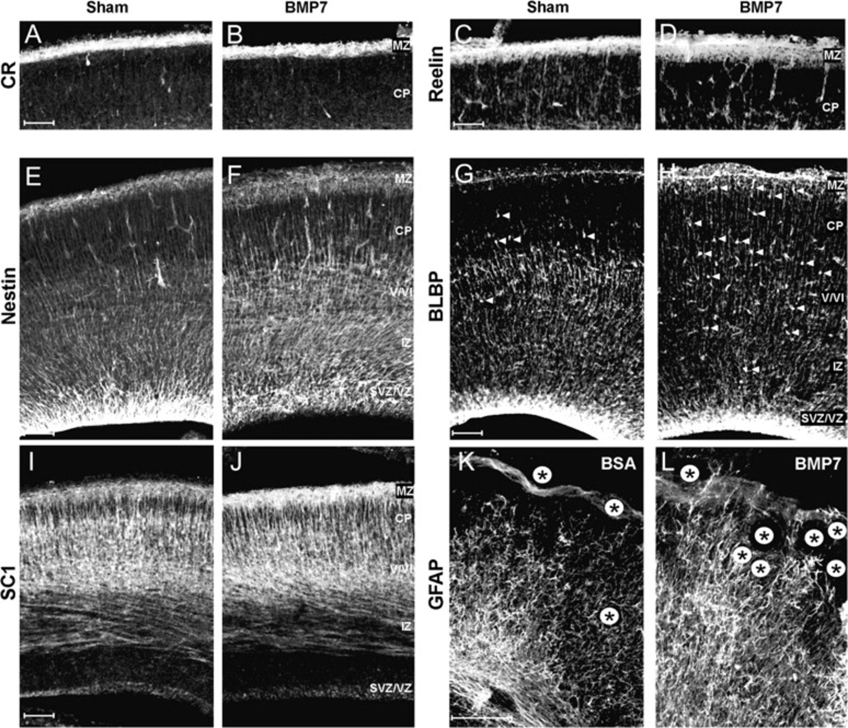
Figure 6. BMP7 effects on radial glia organization in developing mouse cerebral cortex. Cajal–Retzius cells identified ...
Notes:
Figure 6. BMP7 effects on radial glia organization in developing mouse cerebral cortex. Cajal–Retzius cells identified by antibodies for calretinin (A, B) and reelin (C, D) showing their normal distribution in E18 cortical coronal sections from mice sham operated (A, C) or injected with BMP7 (B, D) at E14. (E, F) Staining for the progenitor marker nestin showing less intensity and a marked decrease in the radiality of labeled structures in the VZ of BMP7-treated brains (F) with respect to sham-operated brains (E). (G, H) BLBP protein staining showing reduced expression in deeper layers and more BLBP-positive cells in the CP of BMP7-treated animals (H) with respect to controls (G). (I, J) Staining for the antiadhesive protein SC1 showing a marked increase in BMP7-treated cortex (J) with respect to controls (I). (K, L) Organotypic cortical cultures exposed for 48 h to agarose beads preadsorbed with BSA as negative control (K) or BMP7 (L), showing increased GFAP expression and ramification in glial cells in the vicinity of BMP7 beads. V/VI, cortical layers V and VI. Scale bar, 80 μm.
Unless provided in the caption above, the following copyright applies to the content of this slide: © The Author 2009. Published by Oxford University Press. All rights reserved. For permissions, please e-mail: journals.permissions@oxfordjournals.org

Slide 8
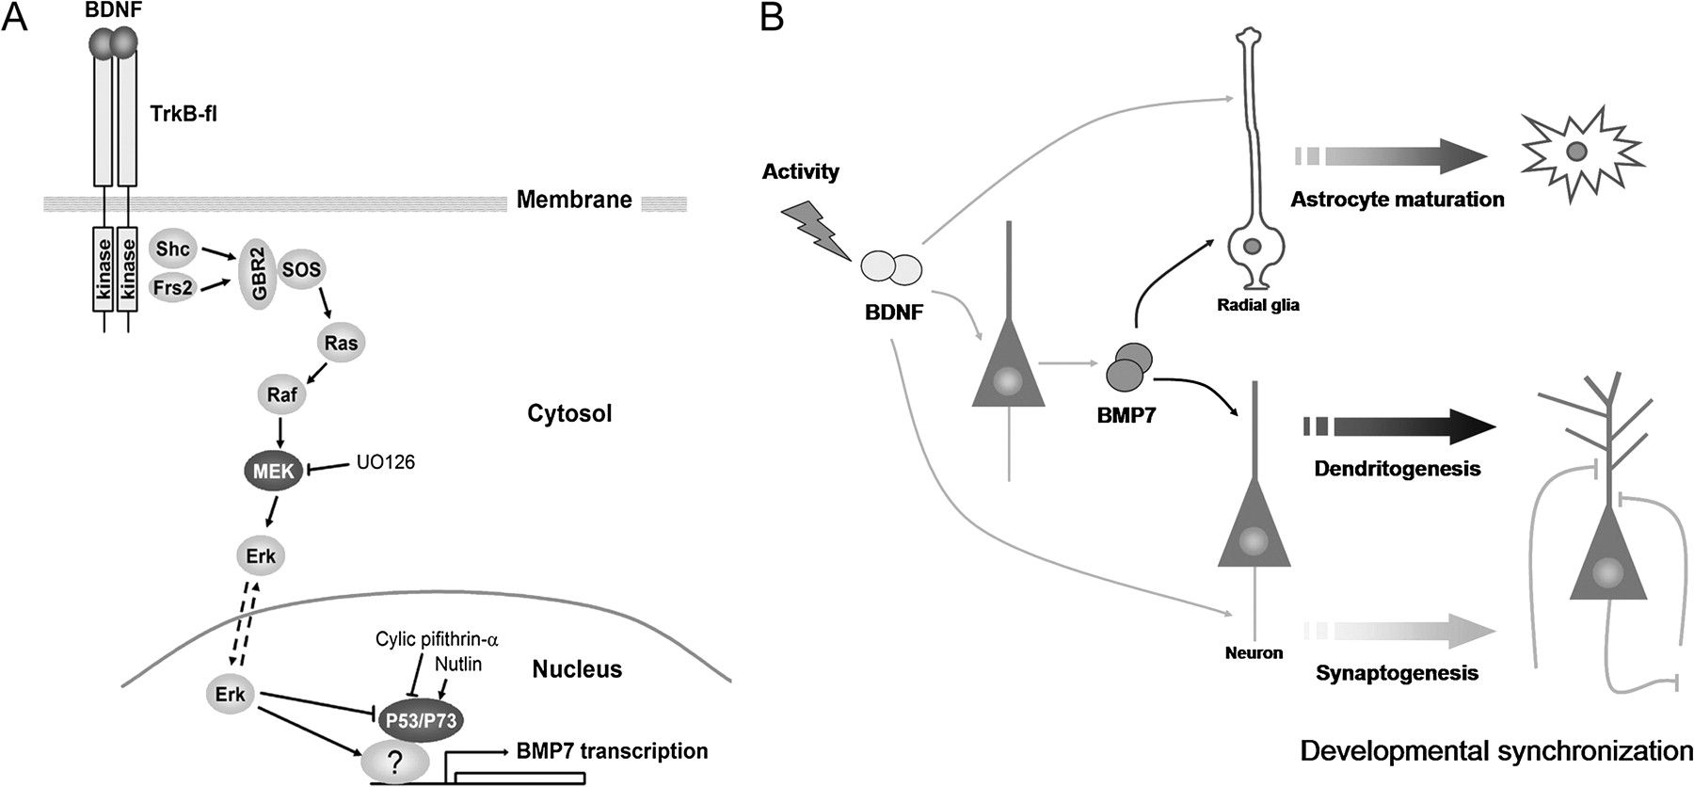
Figure 8. Model of BMP7 activation by BDNF. (A) Pathway of activation. (B) Model of physiological role for ...
Notes:
Figure 8. Model of BMP7 activation by BDNF. (A) Pathway of activation. (B) Model of physiological role for BDNF-dependent BMP7 expression during development.
Unless provided in the caption above, the following copyright applies to the content of this slide: © The Author 2009. Published by Oxford University Press. All rights reserved. For permissions, please e-mail: journals.permissions@oxfordjournals.org

