Slide 1
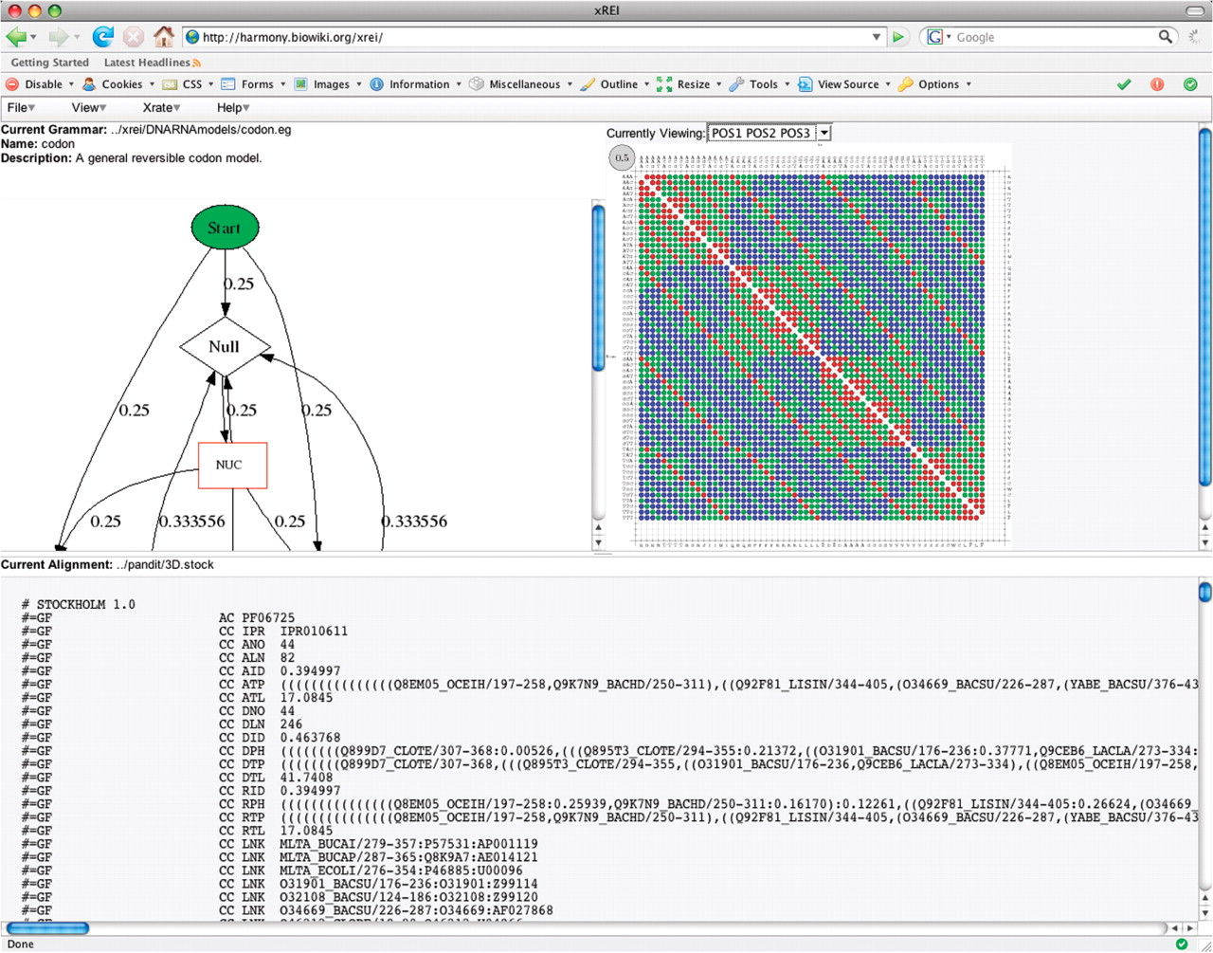
Figure 1. The xREI Interface.
Notes:
Figure 1. The xREI Interface.
Unless provided in the caption above, the following copyright applies to the content of this slide: © 2008 The Author(s)This is an Open Access article distributed under the terms of the Creative Commons Attribution Non-Commercial License (http://creativecommons.org/licenses/by-nc/2.0/uk/) which permits unrestricted non-commercial use, distribution, and reproduction in any medium, provided the original work is properly cited.

Slide 2
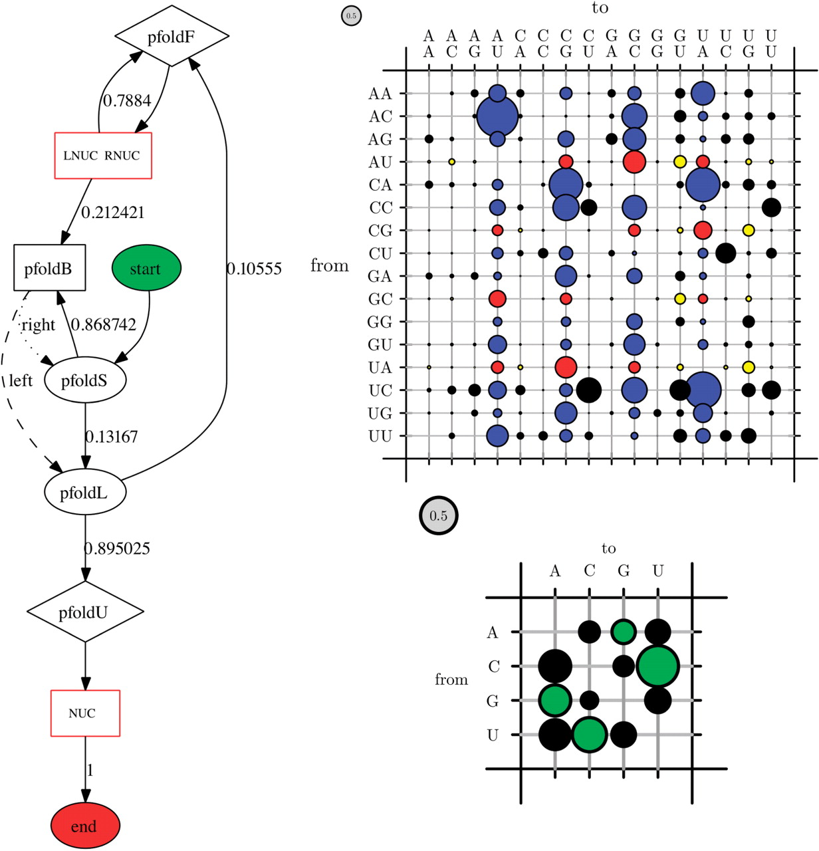
Figure 2. Representative xREI output for a pfold-derived phylo-grammar. On the left is the dot-rendered state ...
Notes:
Figure 2. Representative xREI output for a pfold-derived phylo-grammar. On the left is the dot-rendered state transition diagram. Null states are represented by ovals, bifurcations by rectangles, emission states by diamonds and emission chains by red rectangles. Transition probabilities are shown where applicable. At the top right is the rate matrix for the LNUC RNUC dinucleotide chain colored to highlight mutations to/from canonical pairs, and bottom right is the rate matrix for the NUC nucleotide chain colored to highlight transversions/transitions.
Unless provided in the caption above, the following copyright applies to the content of this slide: © 2008 The Author(s)This is an Open Access article distributed under the terms of the Creative Commons Attribution Non-Commercial License (http://creativecommons.org/licenses/by-nc/2.0/uk/) which permits unrestricted non-commercial use, distribution, and reproduction in any medium, provided the original work is properly cited.

