Slide 1
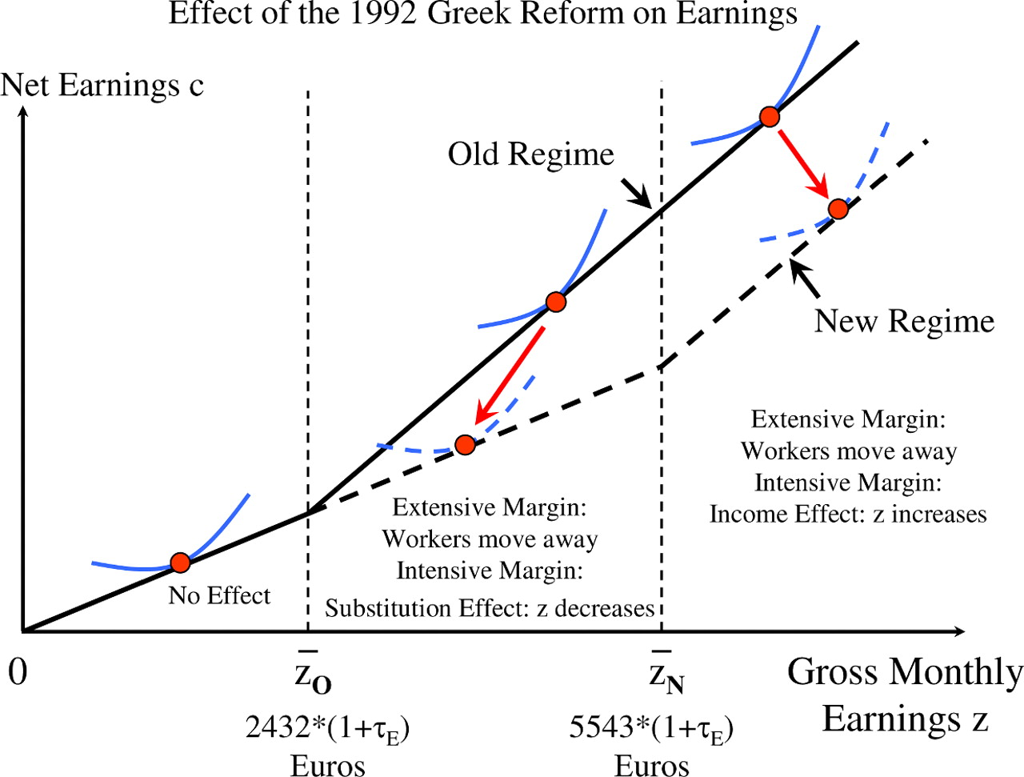
F IGURE I Conceptual Framework The figure displays the effects of the 1992 pension reform in Greece on the monthly ...
Notes:
F IGURE I Conceptual Framework The figure displays the effects of the 1992 pension reform in Greece on the monthly budget constraint of private sector employees (covered by the IKA social insurance system). The x -axis represents monthly gross earnings (including both employer and employee payroll taxes). The y -axis represents monthly net earnings (earnings net of both employer and employee payroll taxes). The solid line is the old regime budget (for those entering the IKA system before 1993) and the dashed line is the new regime budget (for those entering the IKA system on or after 1993). The reform increased the cap in earnings subject to payroll taxes from z O to z N for new regime workers, hence shifting outward the kink point in the budget set where the payroll marginal tax rate ends. Along the extensive margin, workers with earnings above z O are induced by the reform to move away from the IKA sector (either drop out of the labor force, shift to another sector not covered by IKA, or move to a foreign country). Along the intensive margin, workers with monthly earnings below z O are unaffected by the reform. Workers with earnings between z O and z N experience a substitution effect which decreases gross earnings (and also an income effect but small relative to substitution effects). Workers with earnings above z N experience only an income effect which increases gross earnings.I
Unless provided in the caption above, the following copyright applies to the content of this slide: © The Author(s) 2012. Published by Oxford University Press, on behalf of President and Fellows of Harvard College. All rights reserved. For Permissions, please email: journals.permissions@oup.com.

Slide 2
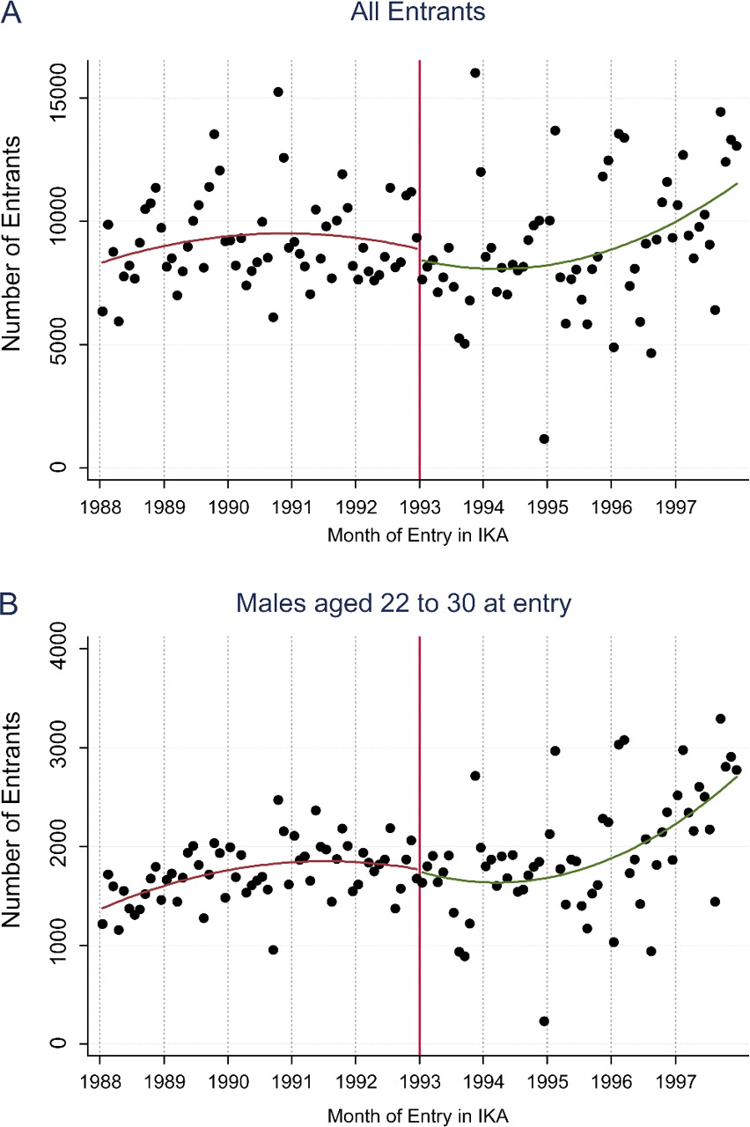
F IGURE II Identification Checks: Number of Entrants by Month of Entry. Panel A displays the number of entrants by month ...
Notes:
F IGURE II Identification Checks: Number of Entrants by Month of Entry. Panel A displays the number of entrants by month of entry in the sample of all entrants (regardless of subsequent IKA earnings). Panel B displays the number of male entrants aged 22 to 30 at entry by month of entry (males aged 22 to 30 at entry have the highest expected earnings and hence are the most likely to be affected by the cap increase in the new regime). In both panels, the curve on each side of the discontinuity is the best quadratic fit. Both graphs display no discontinuity at the cut-off date showing that individuals did not game the system by entering IKA before 1993 after the reform was enacted in October 1992. Source is IKA administrative Social Security earnings data.
Unless provided in the caption above, the following copyright applies to the content of this slide: © The Author(s) 2012. Published by Oxford University Press, on behalf of President and Fellows of Harvard College. All rights reserved. For Permissions, please email: journals.permissions@oup.com.

Slide 3
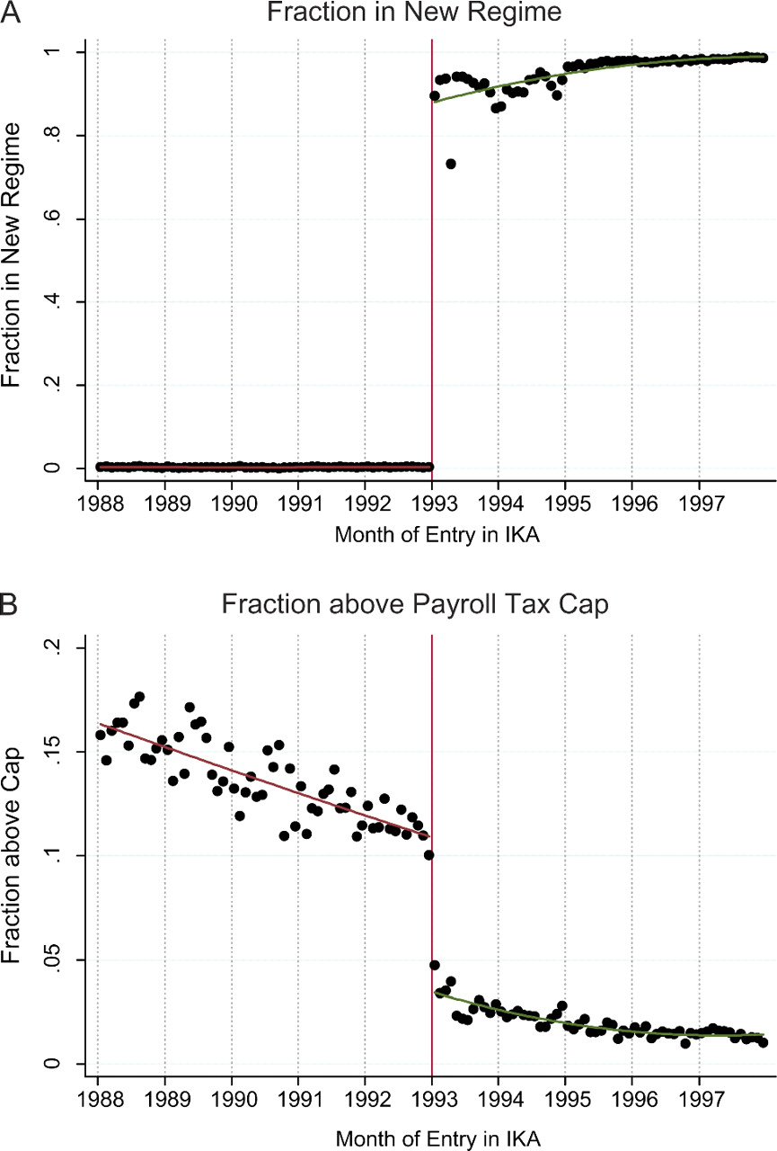
F igure III First Stage: Fraction in New Regime and Above Cap by Month of Entry In both panels, the sample is all workers ...
Notes:
F igure III First Stage: Fraction in New Regime and Above Cap by Month of Entry In both panels, the sample is all workers with positive earnings in the IKA social insurance scheme as of March 2009. Panel A displays the fraction of workers in the new regime by month of entry into the IKA system. Workers entering IKA before 1993 are all in the old regime. The vast majority of workers entering IKA on or after 1993 are in the new regime. Some post-1993 entrants are in old regime because workers who had covered earnings before 1993 in any other social insurance scheme (outside IKA) still qualify for the old regime. Panel B displays the fraction of workers with earnings above the payroll tax cap. There is a sharp drop at the 1/1/1993 cut-off date as the cap for new regime workers is 2.28 times higher than for old regime workers. In both panels, the curve on each side of the discontinuity is the best quadratic fit. Source is IKA administrative Social Security earnings data.
Unless provided in the caption above, the following copyright applies to the content of this slide: © The Author(s) 2012. Published by Oxford University Press, on behalf of President and Fellows of Harvard College. All rights reserved. For Permissions, please email: journals.permissions@oup.com.

Slide 4
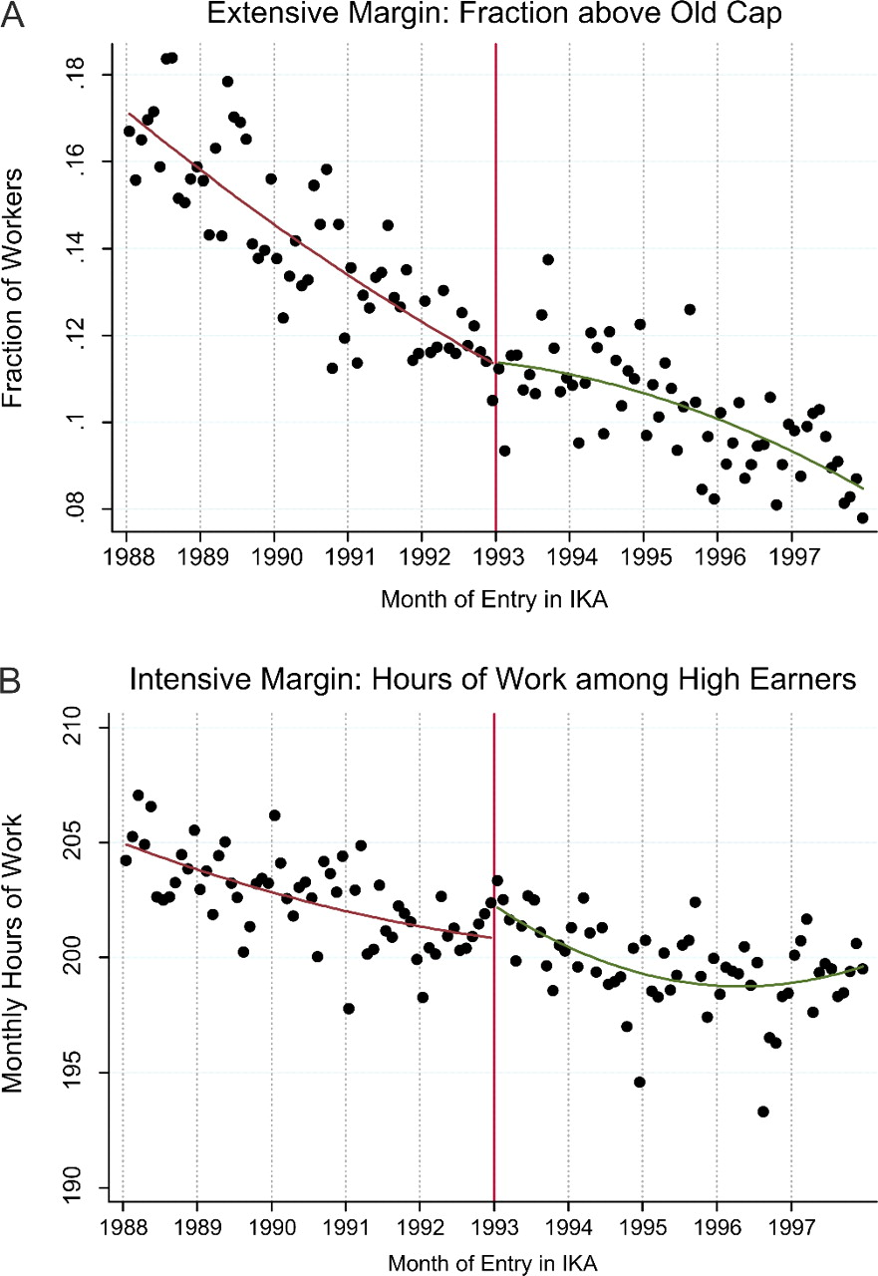
F igure IV Labor Supply Responses Panel A displays the fraction of workers with IKA earnings above the old cap in March ...
Notes:
F igure IV Labor Supply Responses Panel A displays the fraction of workers with IKA earnings above the old cap in March 2009 (among all workers with positive earnings in March 2009) by month of entry. Panel B displays, by month of entry in IKA, the average number of monthly hours of work among high earners in March 2009 (defined as those with regular earnings per day of work above 2500/25 euros, i.e., would reach the old cap by working full month). In both panels, the curve on each side of the discontinuity is the best quadratic fit. Both graphs display no significant discontinuity at the cut-off date. Panel A implies that highly skilled workers in the new regime did not respond to the higher tax along the extensive margin. Panel B implies that there is no intensive labor supply response to the higher marginal payroll tax rate in the new regime.
Unless provided in the caption above, the following copyright applies to the content of this slide: © The Author(s) 2012. Published by Oxford University Press, on behalf of President and Fellows of Harvard College. All rights reserved. For Permissions, please email: journals.permissions@oup.com.

Slide 5
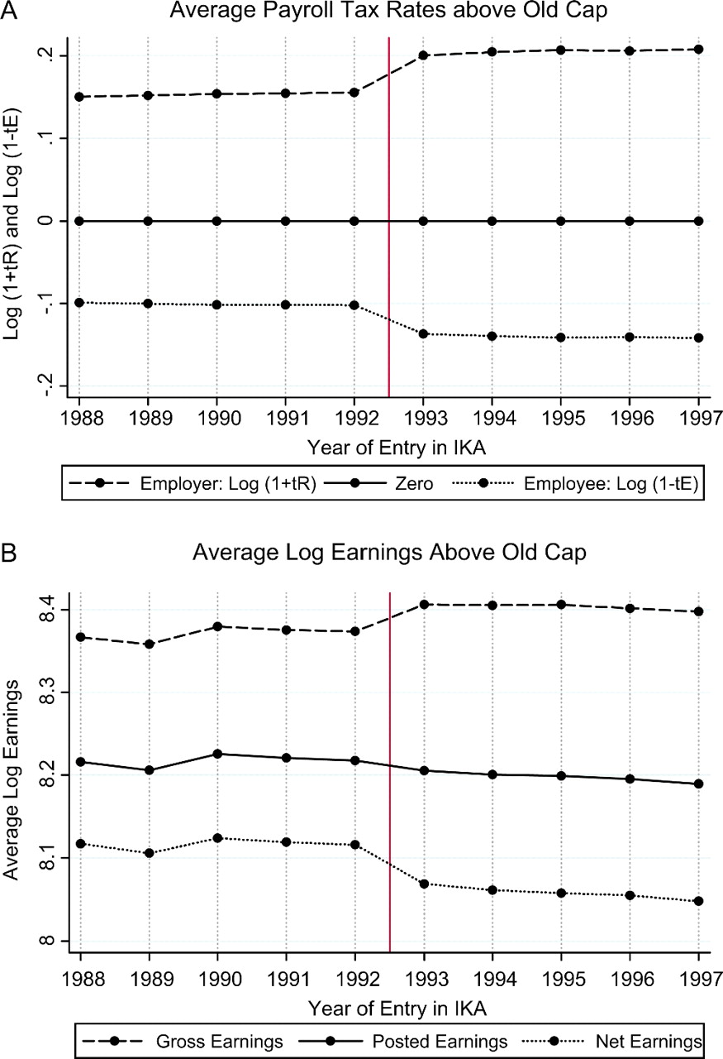
F igure V Tax Incidence Effects: Average Tax Rates and Earnings above Old Cap Panel A displays, by year of entry in ...
Notes:
F igure V Tax Incidence Effects: Average Tax Rates and Earnings above Old Cap Panel A displays, by year of entry in IKA, the average log(1 + t R ) and log(1 – t E ) for workers with posted earnings above the old cap in March 2009. t R is the average employer payroll tax rate (employer taxes/posted earnings) and t E is the average employee payroll tax rate (employee taxes/posted earnings). The zero line is displayed for illustration. As expected, log(1 + t R ) jumps up and log(1 - t E ) jumps down at the reform cut-off entry date. Panel B displays, by year of entry in IKA, the average log gross earnings, log posted earnings, and log net earnings for all workers above the old cap in March 2009. Panel B shows that gross earnings jump up at the cut-off date, posted earnings are flat, and net earnings jump down. The striking similarity between Panel A and Panel B shows that employers bear the incidence of employer taxes while employees bear the incidence of employee taxes.
Unless provided in the caption above, the following copyright applies to the content of this slide: © The Author(s) 2012. Published by Oxford University Press, on behalf of President and Fellows of Harvard College. All rights reserved. For Permissions, please email: journals.permissions@oup.com.

Slide 6
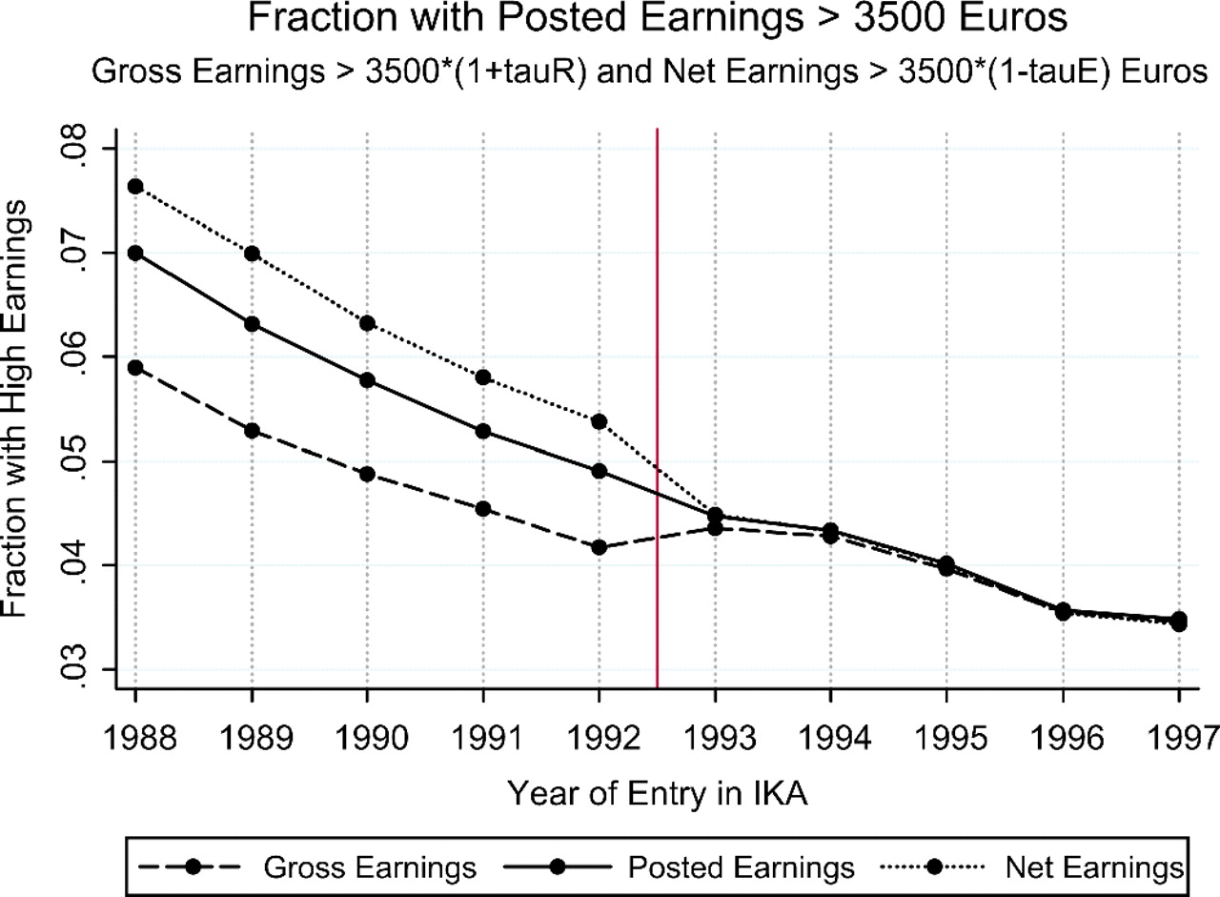
F igure VI Tax Incidence Effect: Fraction with High Earnings The graph displays, by year of entry in IKA, the fraction ...
Notes:
F igure VI Tax Incidence Effect: Fraction with High Earnings The graph displays, by year of entry in IKA, the fraction of workers in March 2009 with monthly gross earnings, posted earnings, and net earnings above 3500*(1 + τR ), 3500, and 3500*(1 - τE ) euros. The graph shows that gross earnings jump up (relative to trend) at the cut-off date, posted earnings are continuous, and net earnings jump down, confirming the results from Figure V.
Unless provided in the caption above, the following copyright applies to the content of this slide: © The Author(s) 2012. Published by Oxford University Press, on behalf of President and Fellows of Harvard College. All rights reserved. For Permissions, please email: journals.permissions@oup.com.

