Slide 1
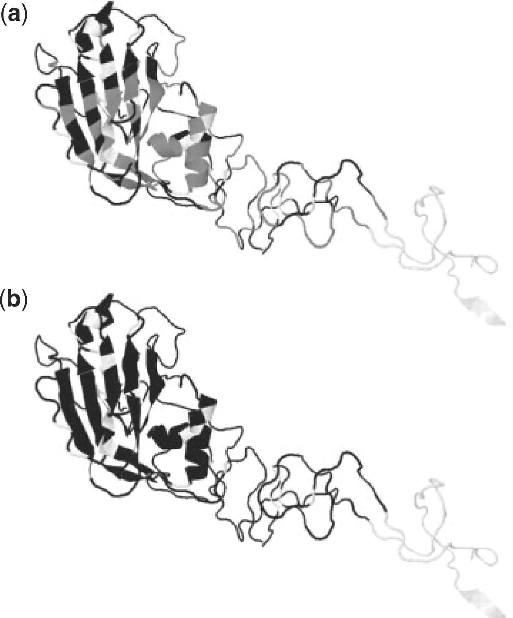
Fig. 1. Original and expanded set of antigenic residues. Antigenic residues shown on a single monomer of A/Aichi/2/68 ...
Notes:
Fig. 1. Original and expanded set of antigenic residues. Antigenic residues shown on a single monomer of A/Aichi/2/68 HA1. (a) Original 131 residues in black, proposed additions in grey, others white. (b) Original and expanded residues in black, others in white.
Unless provided in the caption above, the following copyright applies to the content of this slide: © The Author 2010. Published by Oxford University Press. All rights reserved. For Permissions, please email: journals.permissions@oxfordjournals.org

Slide 2
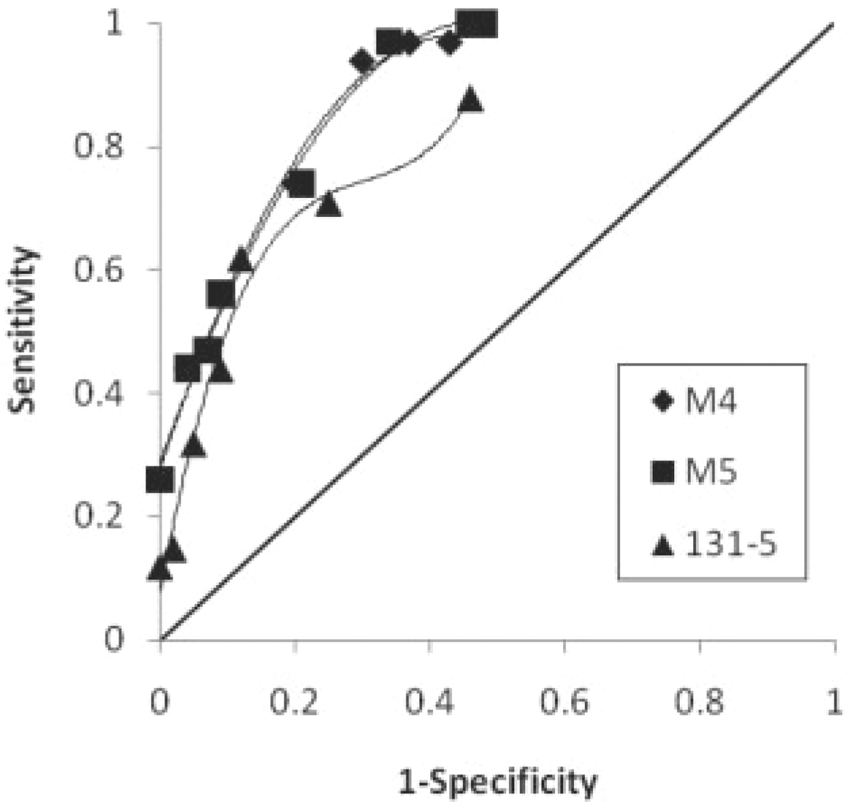
Fig. 2. Receiver operating characteristic (ROC) curves for selected models. ROC curve (Metz, 1978) for models M4, M5 ...
Notes:
Fig. 2. Receiver operating characteristic (ROC) curves for selected models. ROC curve (Metz, 1978) for models M4, M5 and the 131 location 5 site model (131–5), obtained by applying the screening step described in Section 2.5, with cutoff values between 0 and 10.
Unless provided in the caption above, the following copyright applies to the content of this slide: © The Author 2010. Published by Oxford University Press. All rights reserved. For Permissions, please email: journals.permissions@oxfordjournals.org

Slide 3
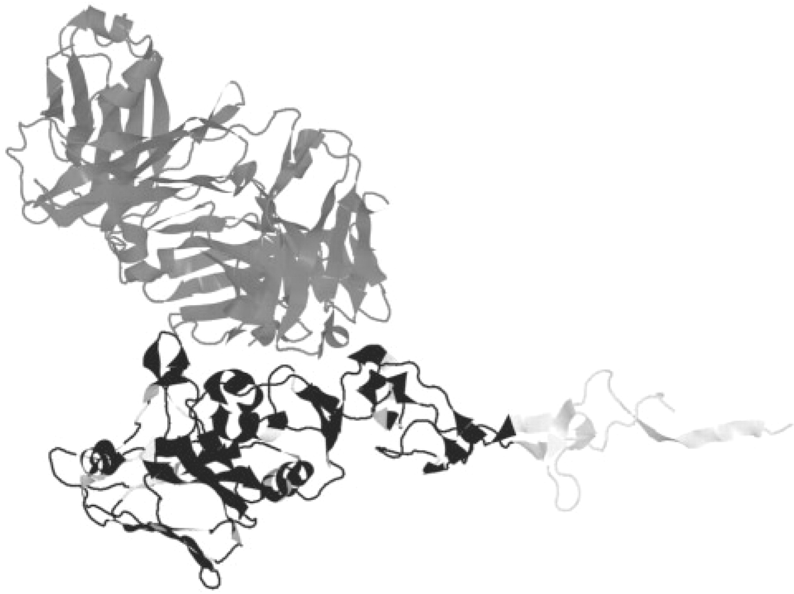
Fig. 3. The HA1/antibody interface for structure PDB 1EO8. The antibody is shown in grey. The 241 residues from our ...
Notes:
Fig. 3. The HA1/antibody interface for structure PDB 1EO8. The antibody is shown in grey. The 241 residues from our extended list are in black, other HA residues in white.
Unless provided in the caption above, the following copyright applies to the content of this slide: © The Author 2010. Published by Oxford University Press. All rights reserved. For Permissions, please email: journals.permissions@oxfordjournals.org

Slide 4
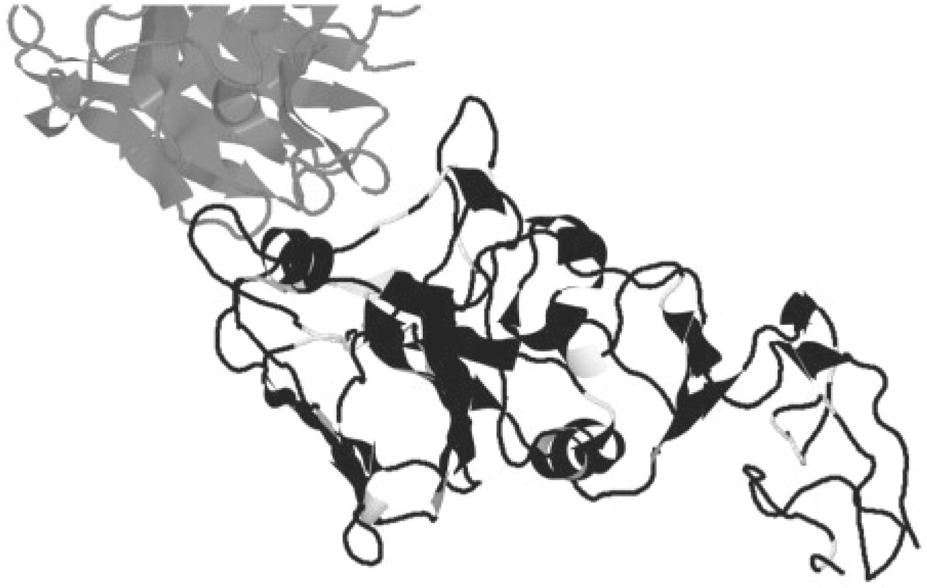
Fig. 4. The HA1/antibody interface for structure PDB 2VIR. The antibody is shown in grey. The 241 residues from our ...
Notes:
Fig. 4. The HA1/antibody interface for structure PDB 2VIR. The antibody is shown in grey. The 241 residues from our extended list are in black, other HA residues in white.
Unless provided in the caption above, the following copyright applies to the content of this slide: © The Author 2010. Published by Oxford University Press. All rights reserved. For Permissions, please email: journals.permissions@oxfordjournals.org

