Slide 1
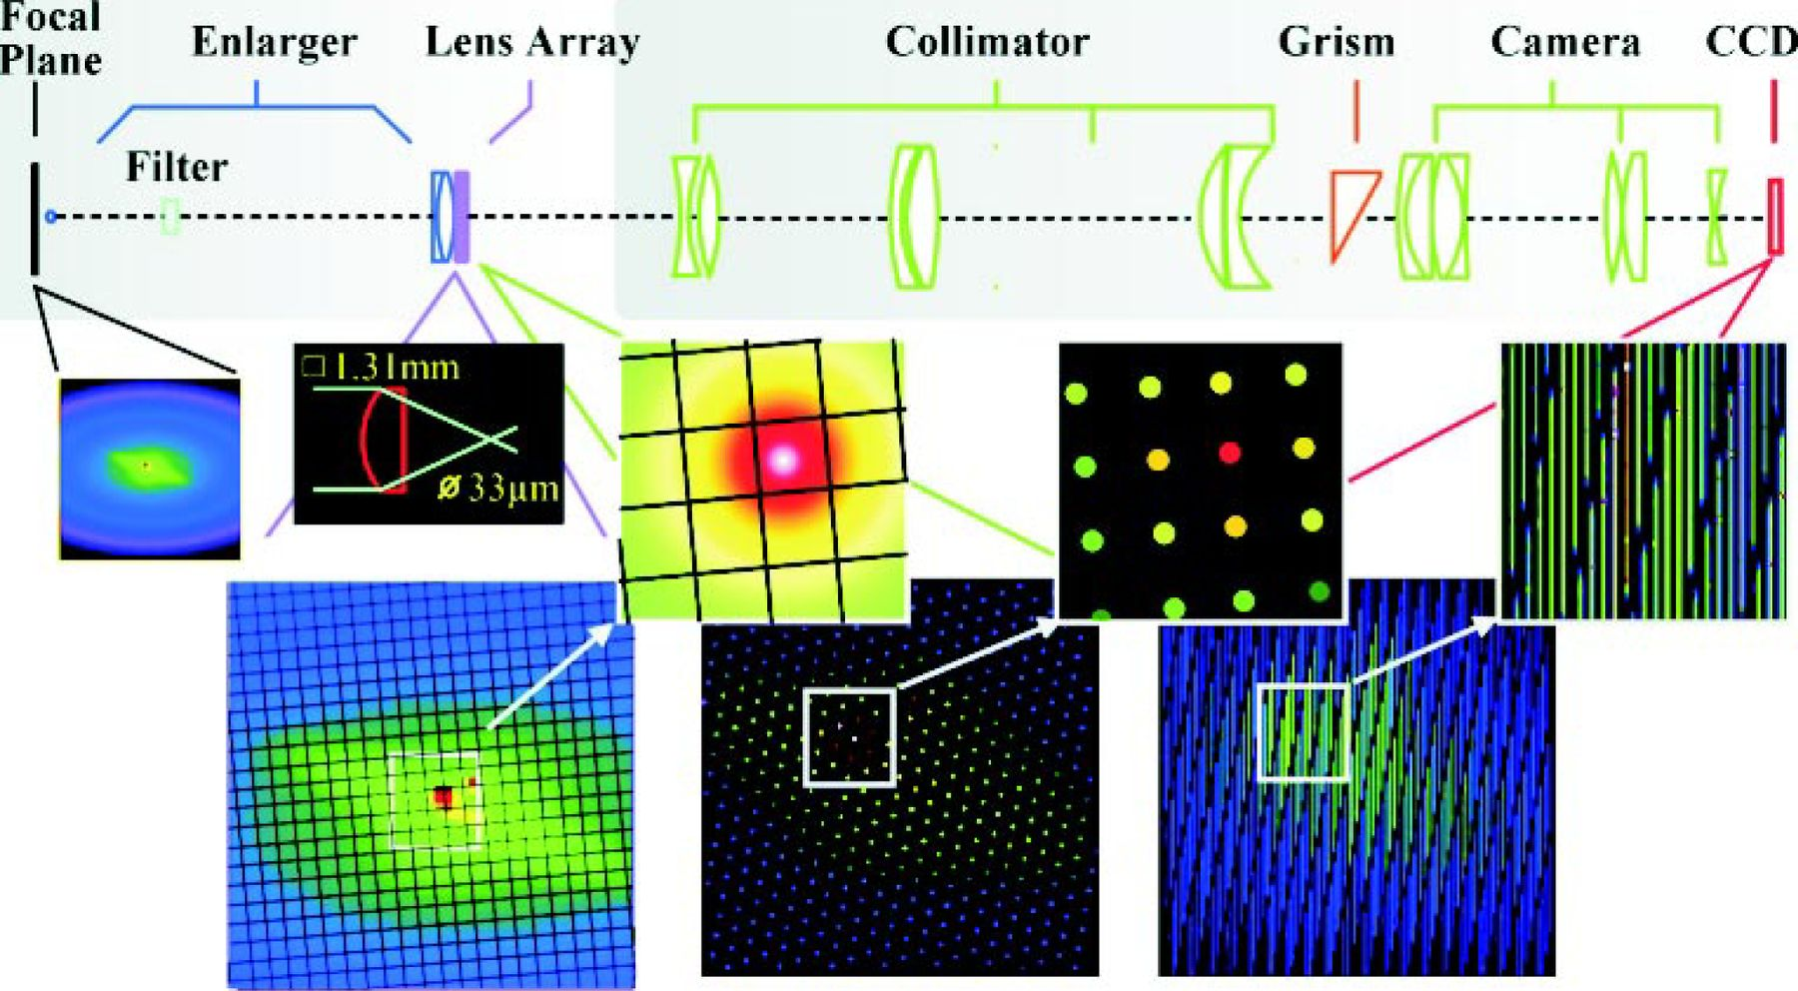
Figure 1. Optical layout of SAURON. The main optical elements are displayed from the telescope focal plane (left) to ...
Notes:
Figure 1. Optical layout of SAURON. The main optical elements are displayed from the telescope focal plane (left) to the detector plane (right). The image of a galaxy is shown successively at the telescope focal plane, at the entrance plane of the lens array, at the exit plane of the lens array and at the detector plane. A zoom-in of a small area of the galaxy is shown for each plane. The insert shows the detailed light path within a microlens.
Unless provided in the caption above, the following copyright applies to the content of this slide: © 2001 RAS

Slide 2
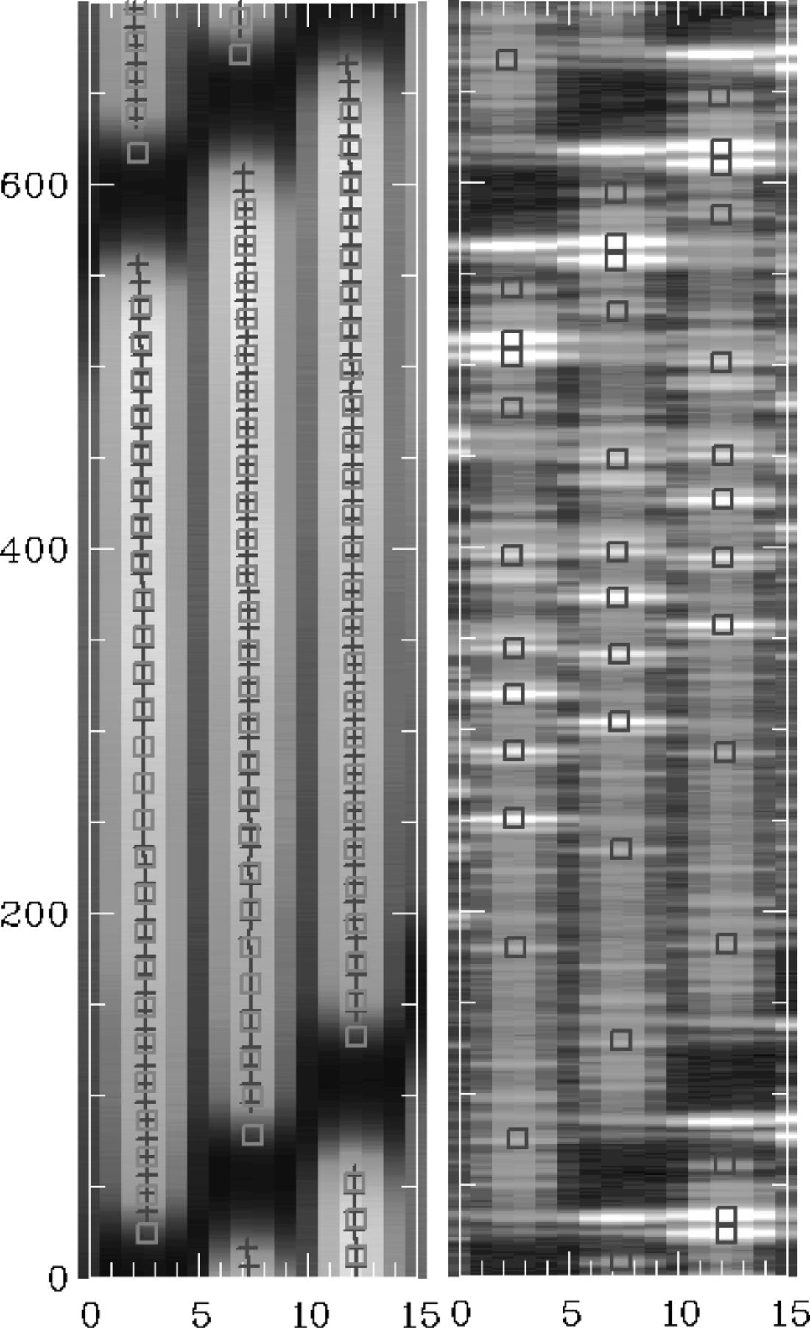
Figure 9. Example of mask-fitting results. Left panel: a small part of a continuum exposure with the derived locations ...
Notes:
Figure 9. Example of mask-fitting results. Left panel: a small part of a continuum exposure with the derived locations of the spectra (crosses) and the corresponding fitted values (squares). Right panel: the corresponding arc (neon) exposure and fitted emission lines (squares). The images have been expanded along the cross-dispersion axis for clarity.
Unless provided in the caption above, the following copyright applies to the content of this slide: © 2001 RAS

Slide 3
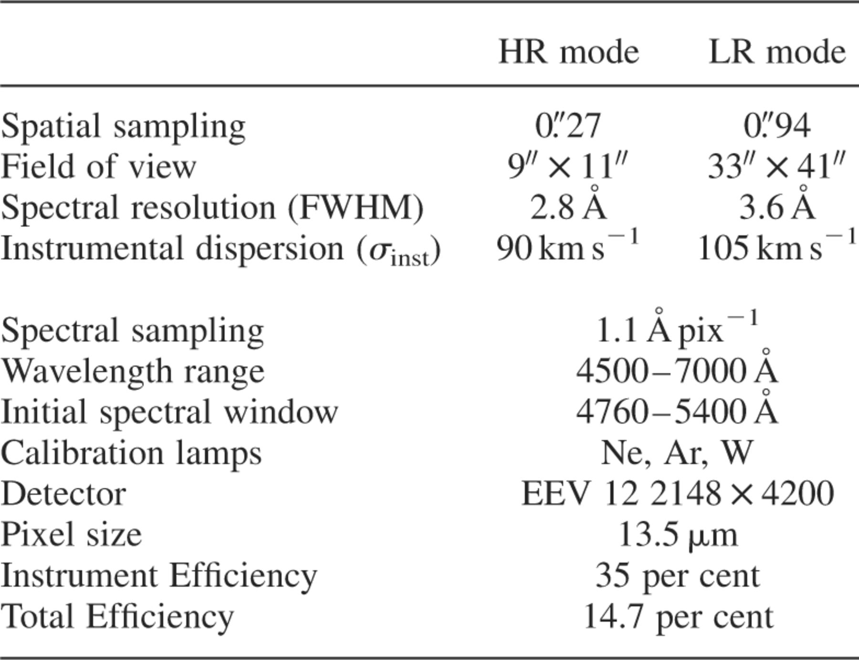
Table 1. Current specification of SAURON on the WHT.
Notes:
Table 1. Current specification of SAURON on the WHT.
Unless provided in the caption above, the following copyright applies to the content of this slide: © 2001 RAS

Slide 4
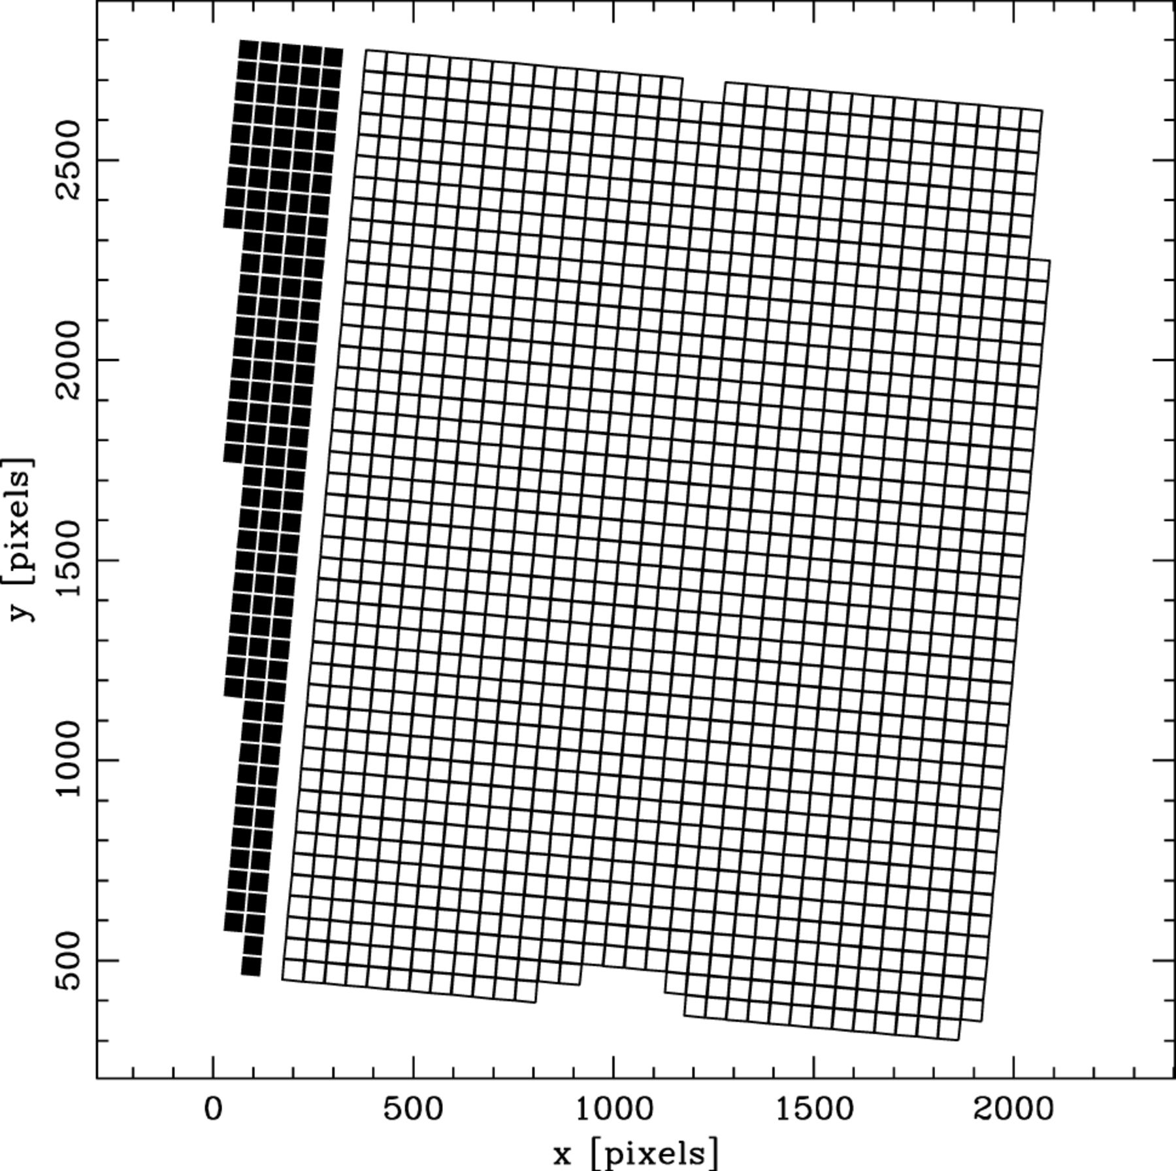
Figure 2. The SAURON lenslet position on the CCD. Open squares: object lenses, solid squares: sky lenses. The scale is ...
Notes:
Figure 2. The SAURON lenslet position on the CCD. Open squares: object lenses, solid squares: sky lenses. The scale is in pixels. The sky lenses have the same shape and size as the object lenses (i.e., 0.94 arcsec in the LR mode and 0.27 arcsec in the HR mode), but are shifted 1.9 arcmin away from the centre of the field.
Unless provided in the caption above, the following copyright applies to the content of this slide: © 2001 RAS

Slide 5
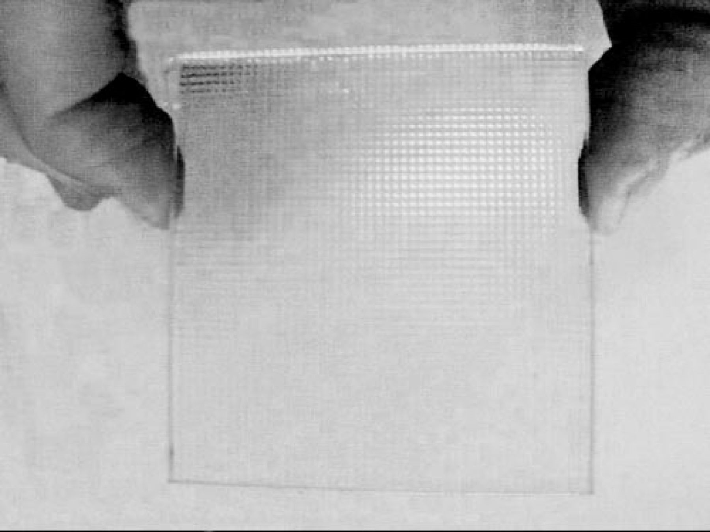
Figure 3. The SAURON lenslet array is made from two sets of cylindrical barrels of in fused silica. It consists of ...
Notes:
Figure 3. The SAURON lenslet array is made from two sets of cylindrical barrels of in fused silica. It consists of over 1600 square lenslets, each of which is 1.31 mm on a side.
Unless provided in the caption above, the following copyright applies to the content of this slide: © 2001 RAS

Slide 6
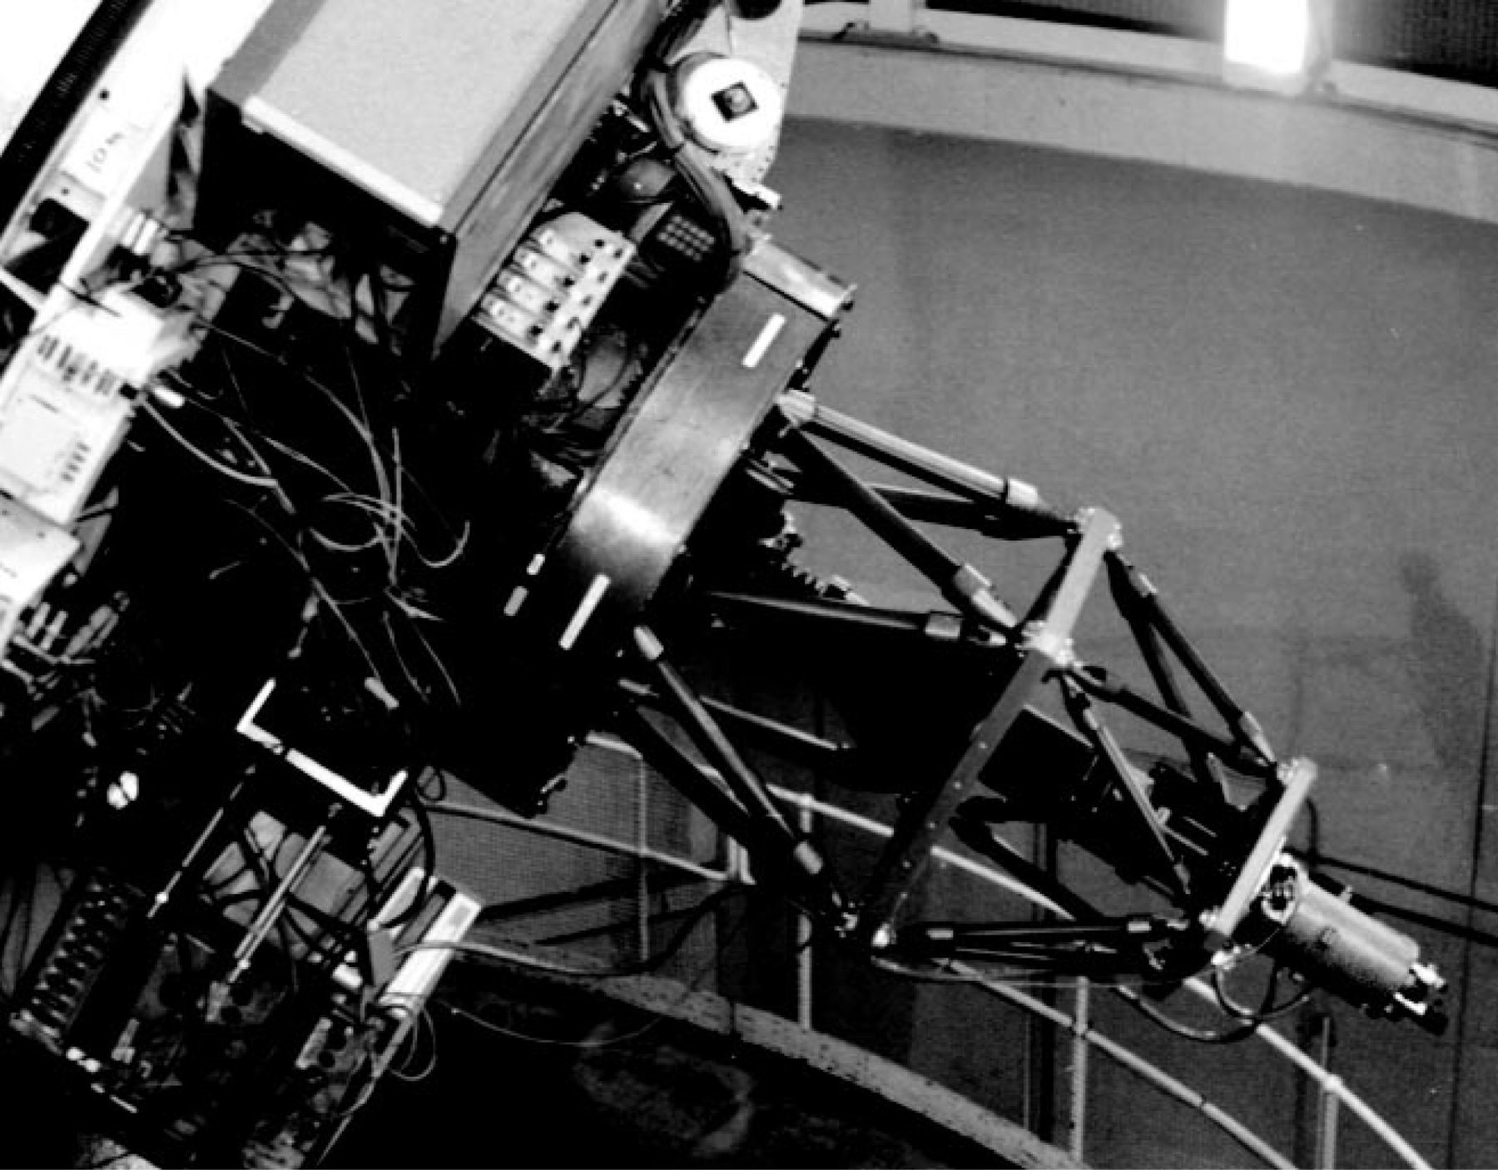
Figure 4. SAURON at the Cassegrain port of the WHT during the commissioning run in 1999 February. This figure is ...
Notes:
Figure 4. SAURON at the Cassegrain port of the WHT during the commissioning run in 1999 February. This figure is available in colour in the electronic version of the article on Synergy.
Unless provided in the caption above, the following copyright applies to the content of this slide: © 2001 RAS

Slide 7
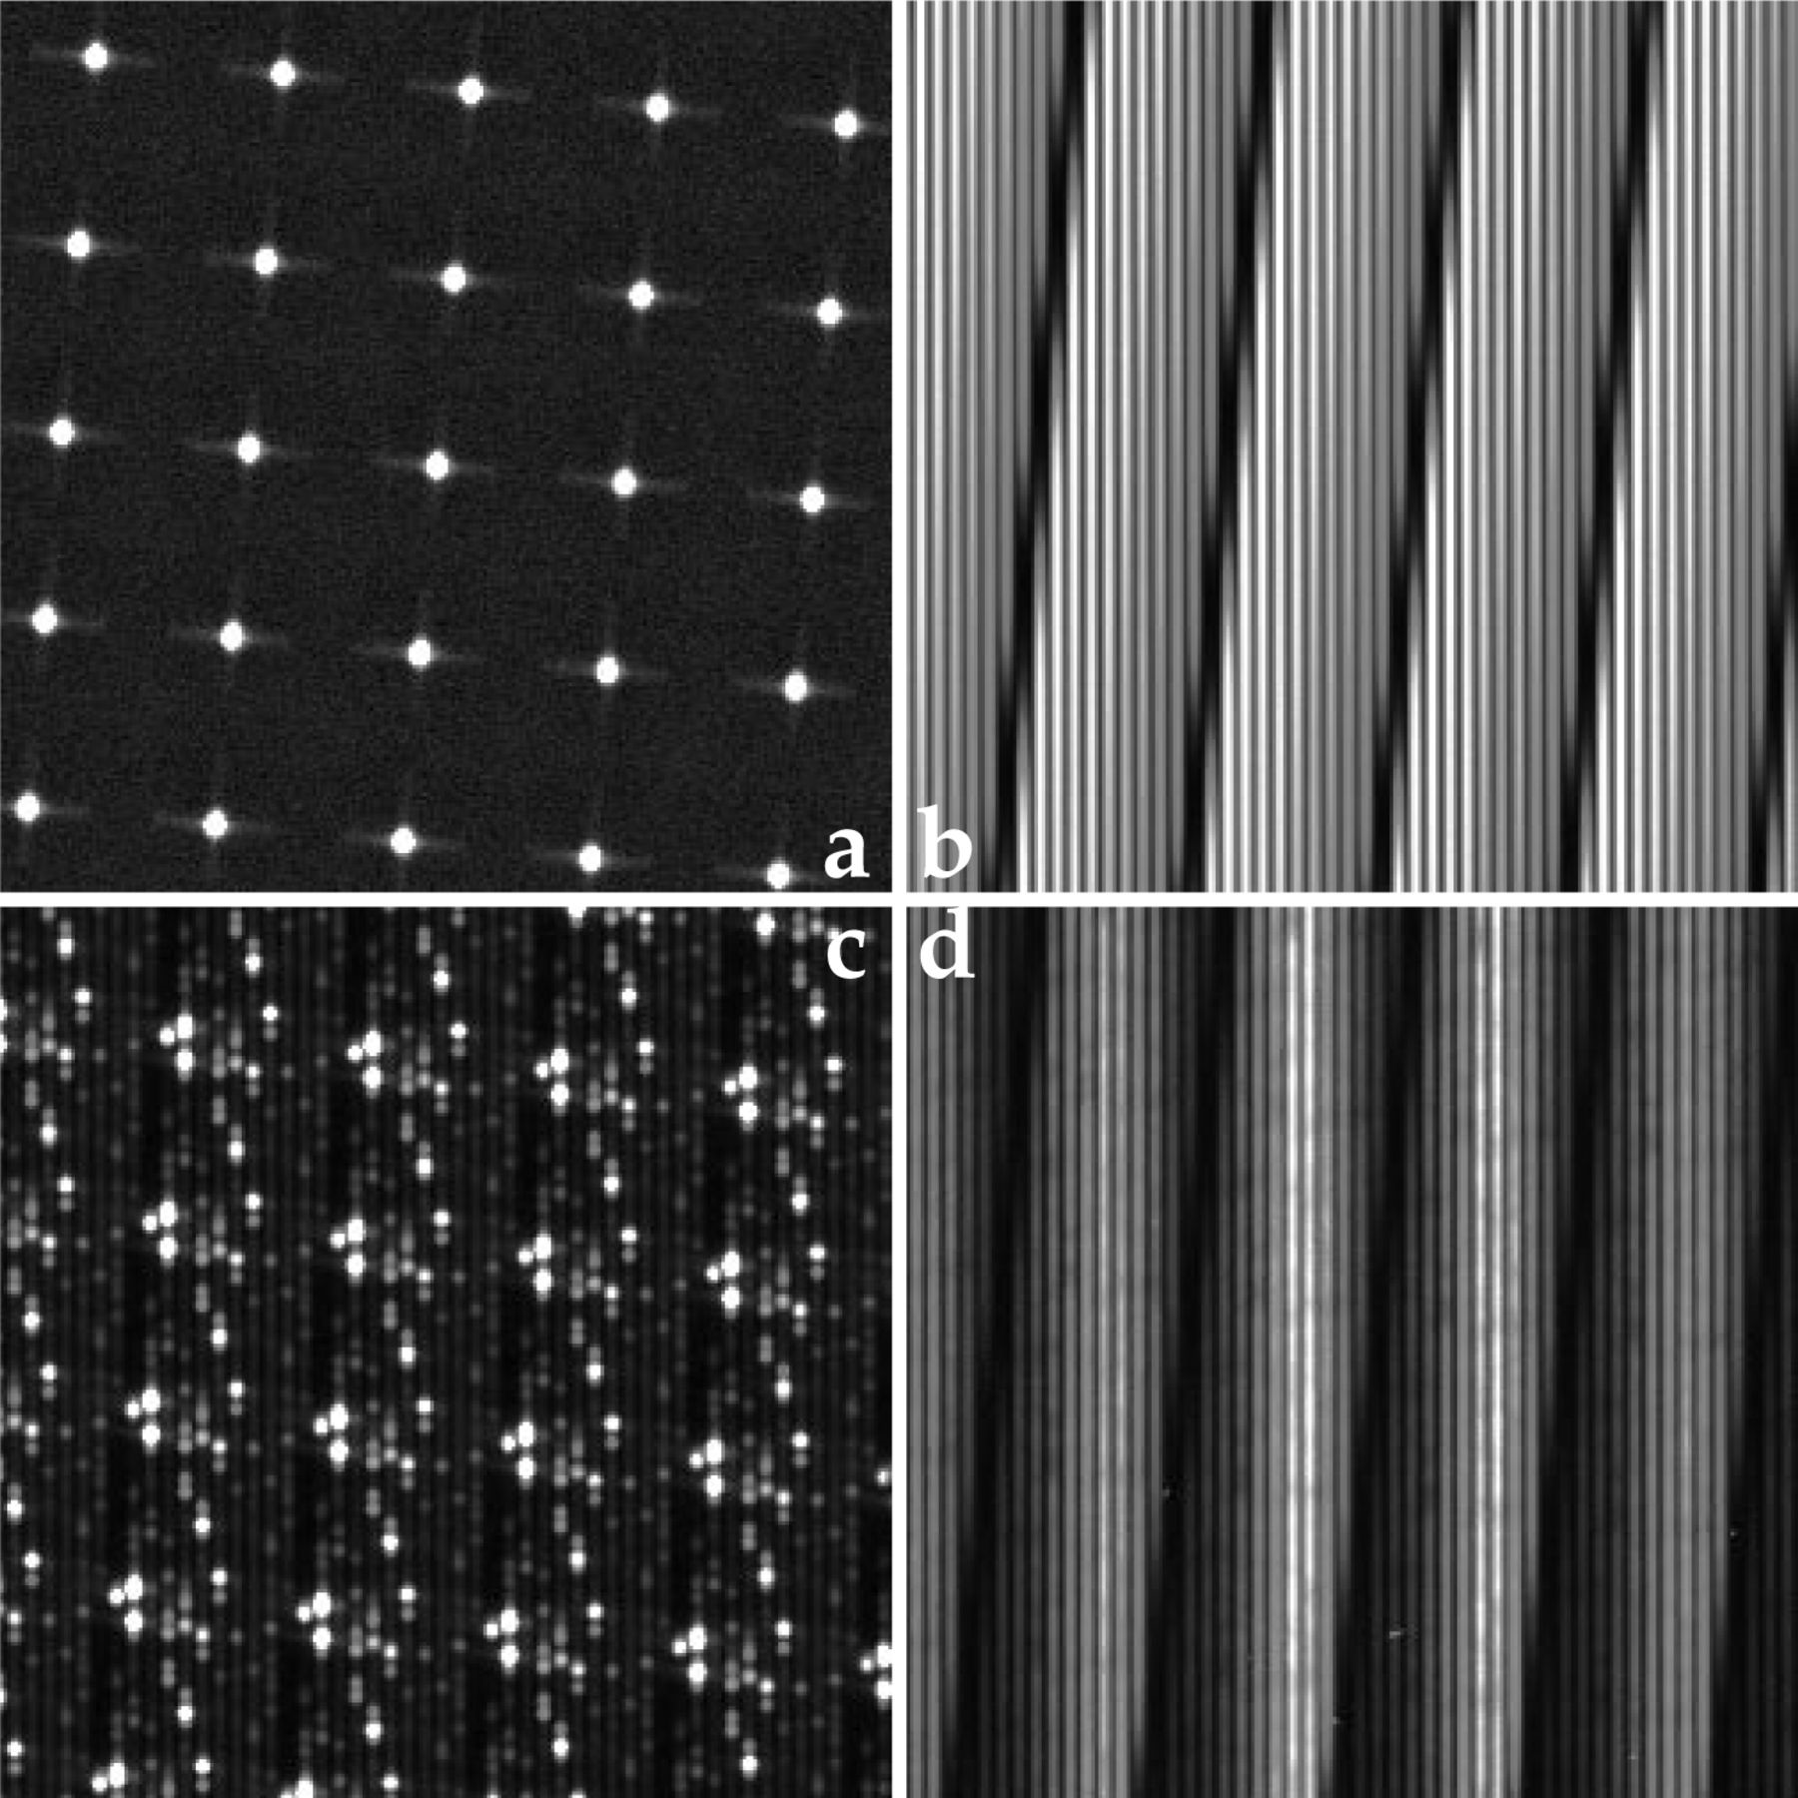
Figure 5. Examples of SAURON exposures taken during commissioning. Each panel shows only a small part of the entire CCD ...
Notes:
Figure 5. Examples of SAURON exposures taken during commissioning. Each panel shows only a small part of the entire CCD frame so that details can be seen. (a) Micropupil image taken with the grism out. Each cross is the diffraction pattern from one square lenslet. (b) Continuum image using the tungsten lamp. (c) Neon arc. (d) Central part of NGC 3377. This figure is available in colour in the electronic version of the article on Synergy.
Unless provided in the caption above, the following copyright applies to the content of this slide: © 2001 RAS

Slide 8
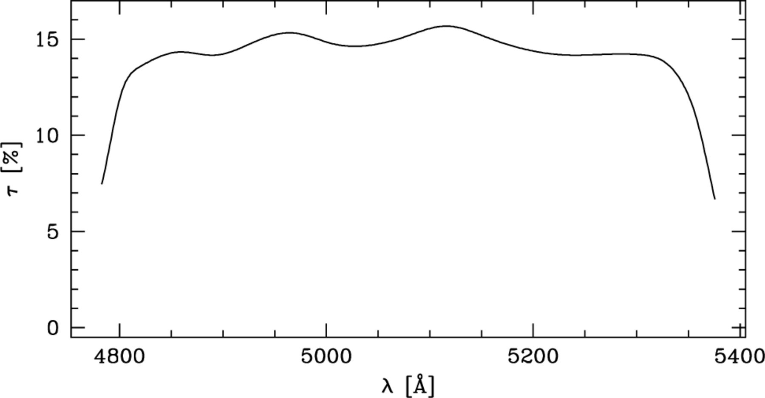
Figure 6. Total measured throughput of SAURON (including telescope, atmosphere and CCD transmission).
Notes:
Figure 6. Total measured throughput of SAURON (including telescope, atmosphere and CCD transmission).
Unless provided in the caption above, the following copyright applies to the content of this slide: © 2001 RAS

Slide 9
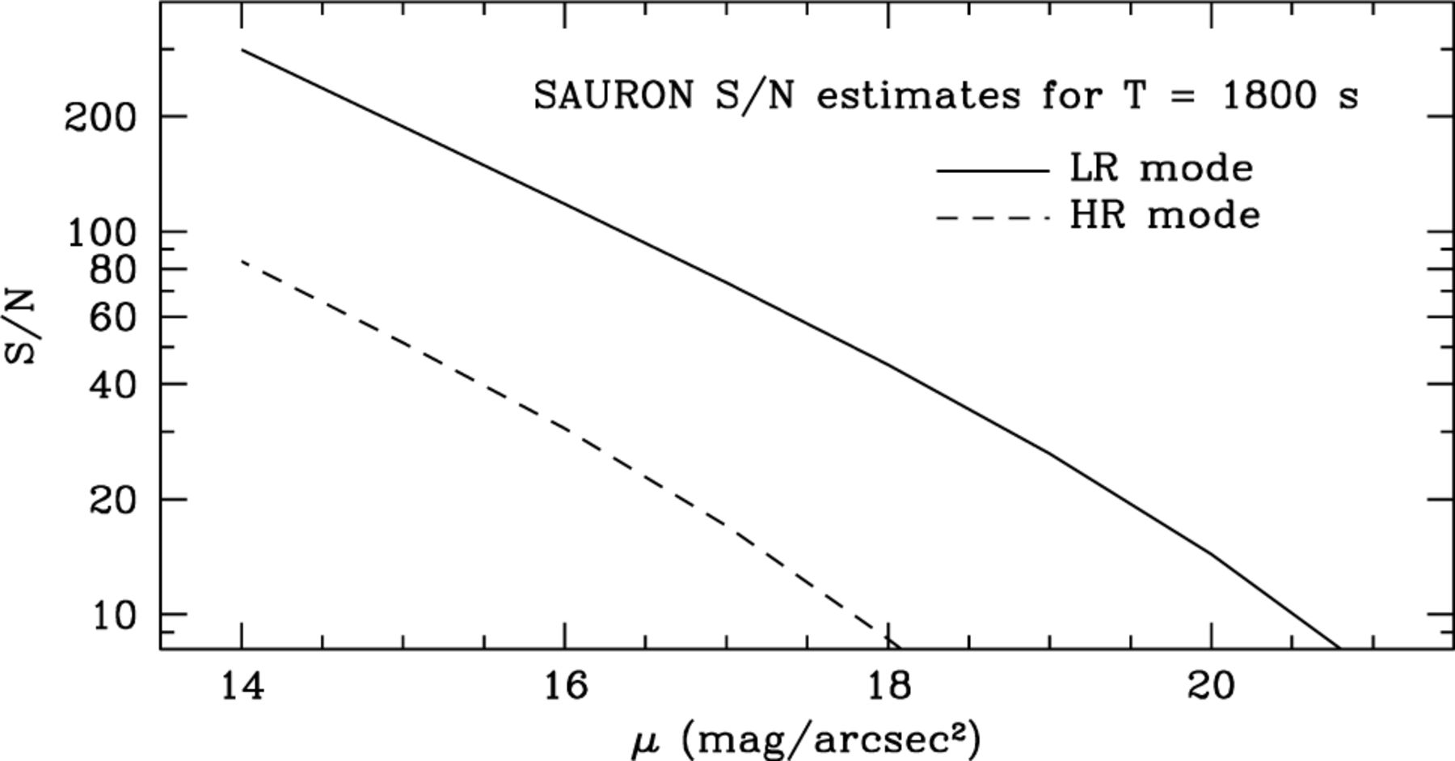
Figure 7. Signal-to-noise ratio S/N (per pixel) of individual SAURON spectra as a function of surface brightness, for ...
Notes:
Figure 7. Signal-to-noise ratio S/N (per pixel) of individual SAURON spectra as a function of surface brightness, for an integration time of 1800 s. The solid line indicates the LR mode and the dashed line is for HR mode.
Unless provided in the caption above, the following copyright applies to the content of this slide: © 2001 RAS

Slide 10
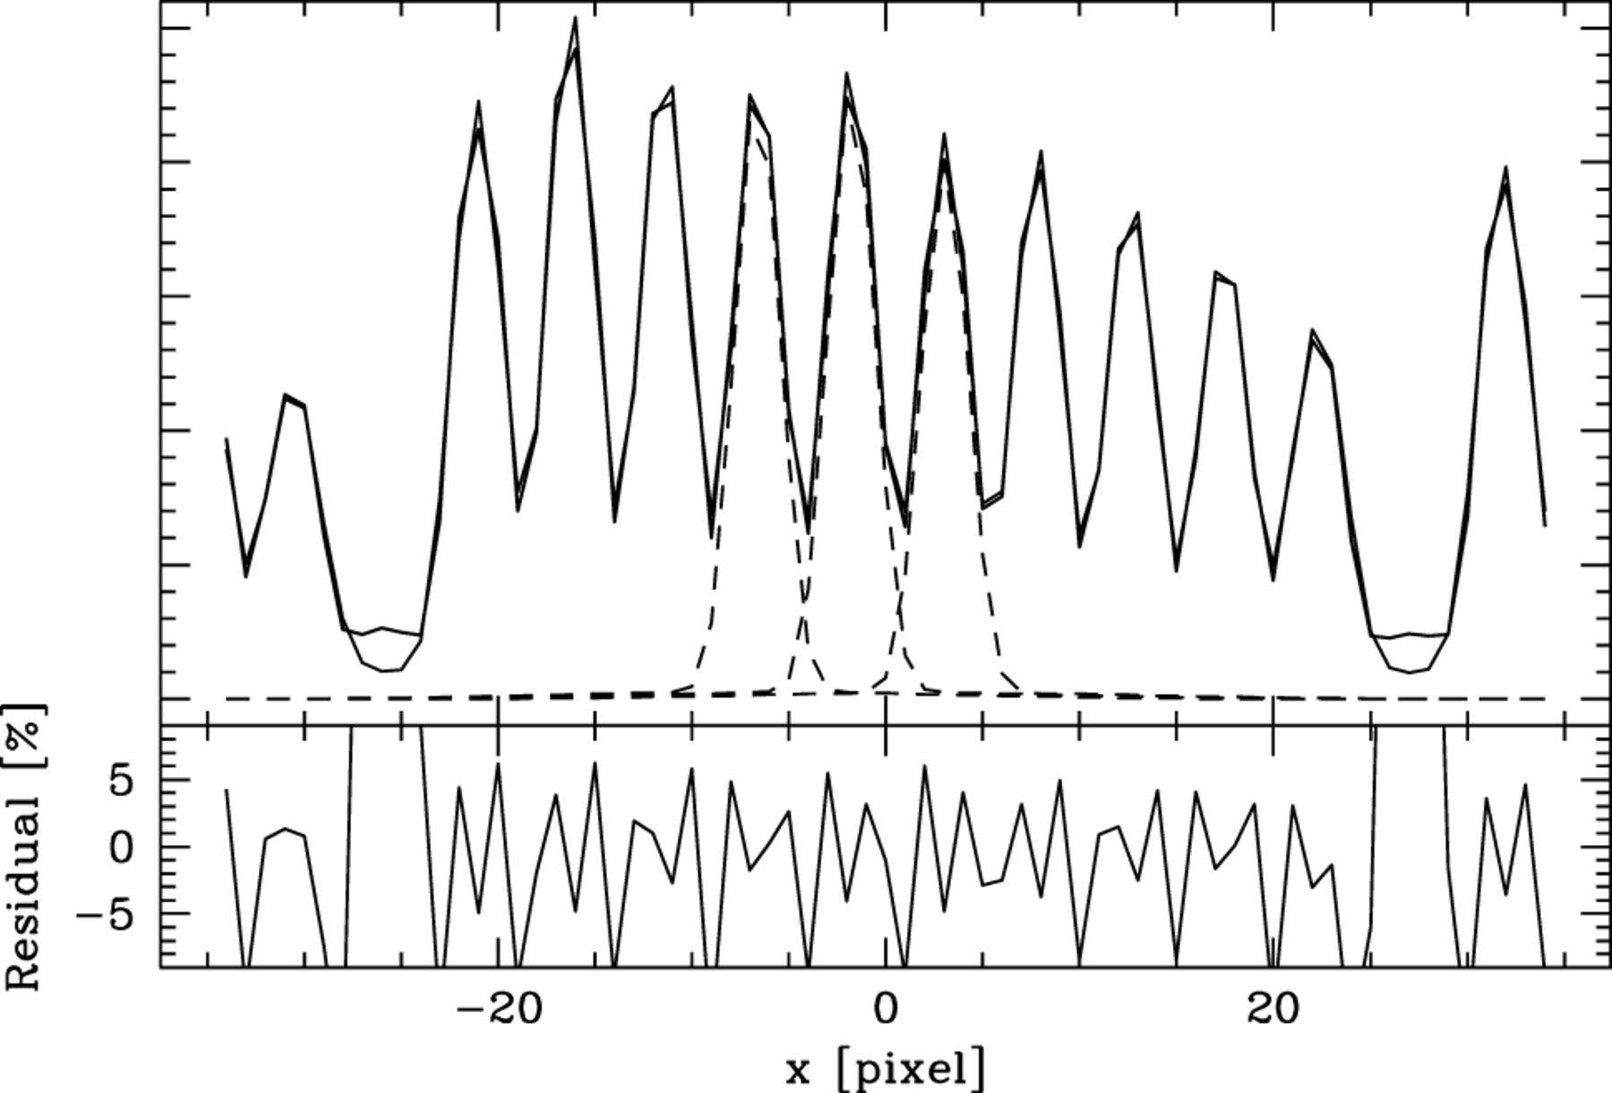
Figure 8. Upper panel: example of a cross-dispersion profile derived from a continuum exposure (thick solid line) and ...
Notes:
Figure 8. Upper panel: example of a cross-dispersion profile derived from a continuum exposure (thick solid line) and its fit by the model described in text (thin solid line). To illustrate the level of overlap, only the central three fitted profiles are shown (dashed lines). Lower panel: relative residual of the fit (in per cent).
Unless provided in the caption above, the following copyright applies to the content of this slide: © 2001 RAS

Slide 11
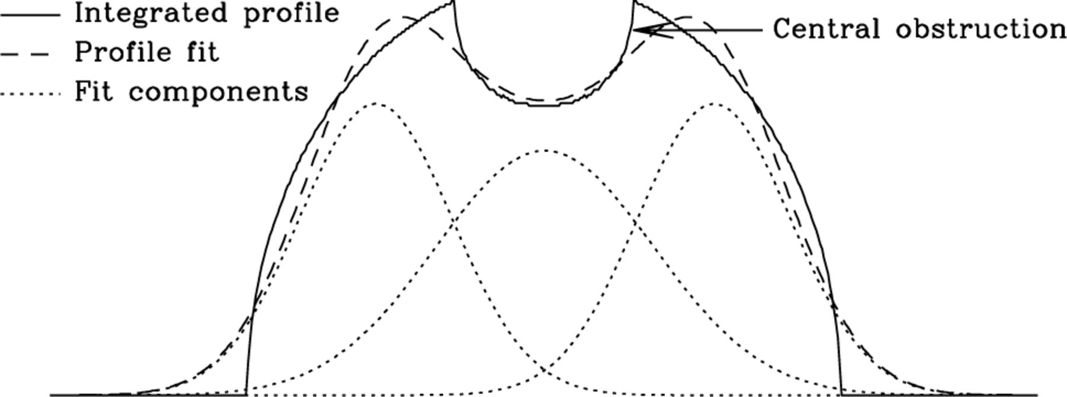
Figure 10. Integrated cross-dispersion profile 풢 of the geometrical micropupil (solid line) and its fit (dashed line) ...
Notes:
Figure 10. Integrated cross-dispersion profile 풢 of the geometrical micropupil (solid line) and its fit (dashed line) with three Gaussian functions (dotted lines).
Unless provided in the caption above, the following copyright applies to the content of this slide: © 2001 RAS

Slide 12
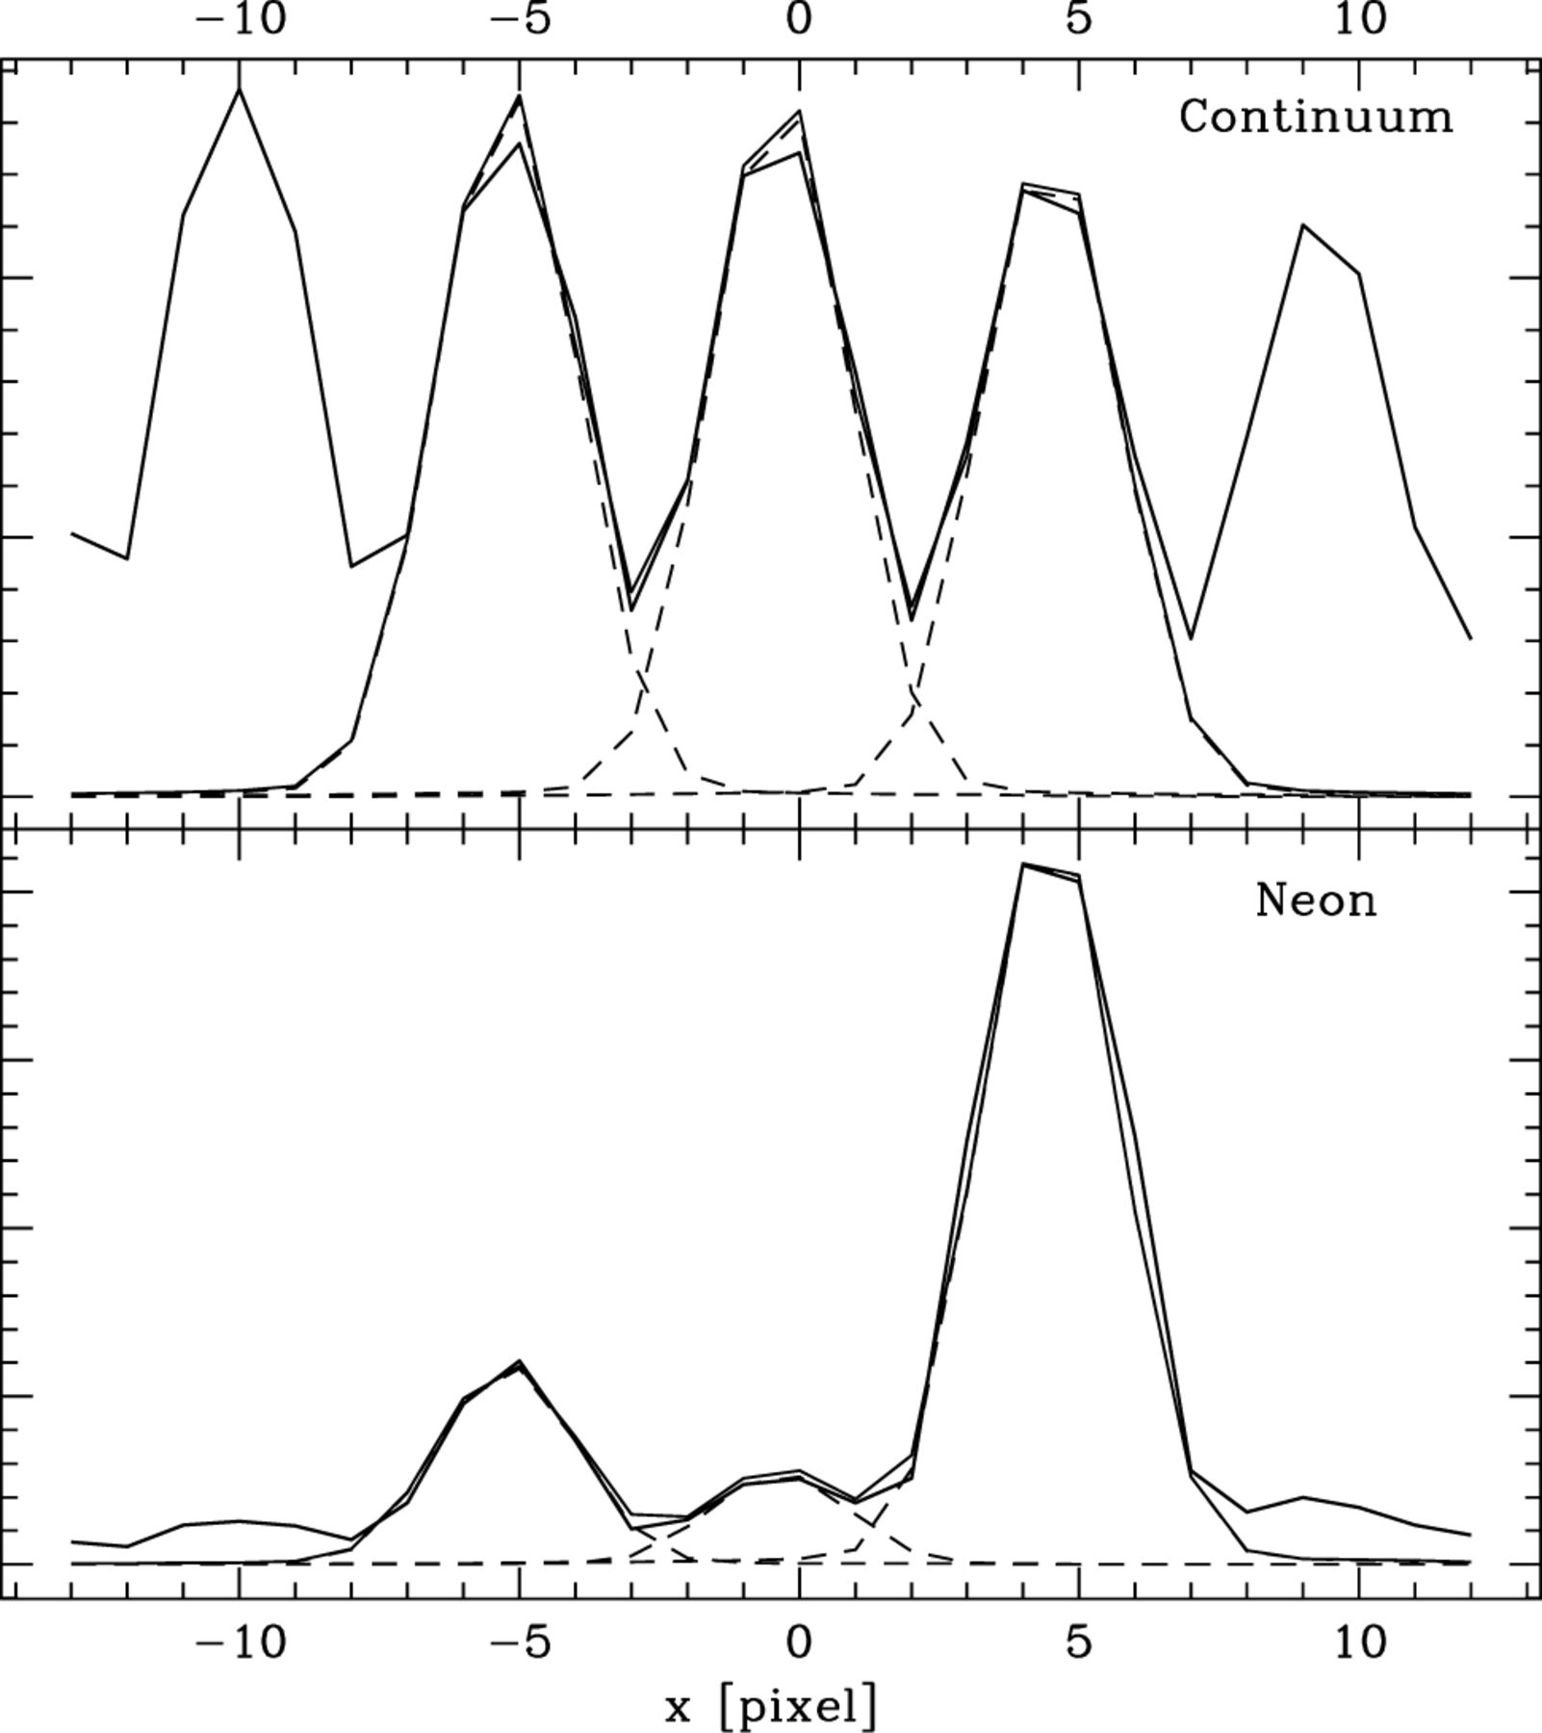
Figure 11. Examples of flux computation in the extraction process on continuum (upper panel) and neon arc (lower panel) ...
Notes:
Figure 11. Examples of flux computation in the extraction process on continuum (upper panel) and neon arc (lower panel) exposures. Thick solid line: data. Thin solid line: sum of the estimated central-plus-neighbours cross-dispersion profiles. Dashed lines: individual cross-dispersion profiles.
Unless provided in the caption above, the following copyright applies to the content of this slide: © 2001 RAS

Slide 13
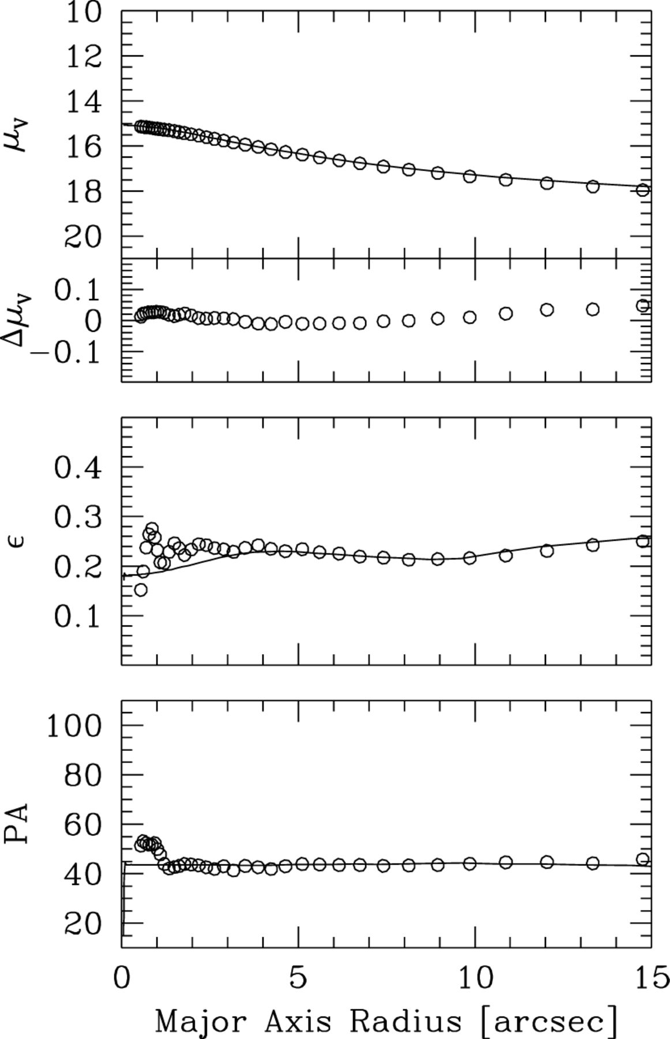
Figure 12. A comparison of two photometric analyses of NGC 4365. The first (solid line) was obtained using ellipse ...
Notes:
Figure 12. A comparison of two photometric analyses of NGC 4365. The first (solid line) was obtained using ellipse fitting on HSTWFPC2 F555W data convolved with a 2.1 arcsec PSF. The second (open circles) was derived in the same way from the SAURON reconstructed flux image in the wavelength range. Top to bottom: profiles of surface brightness in magnitudes (μv), , ellipticity (ε) and position angle of the major axis (PA).
Unless provided in the caption above, the following copyright applies to the content of this slide: © 2001 RAS

Slide 14
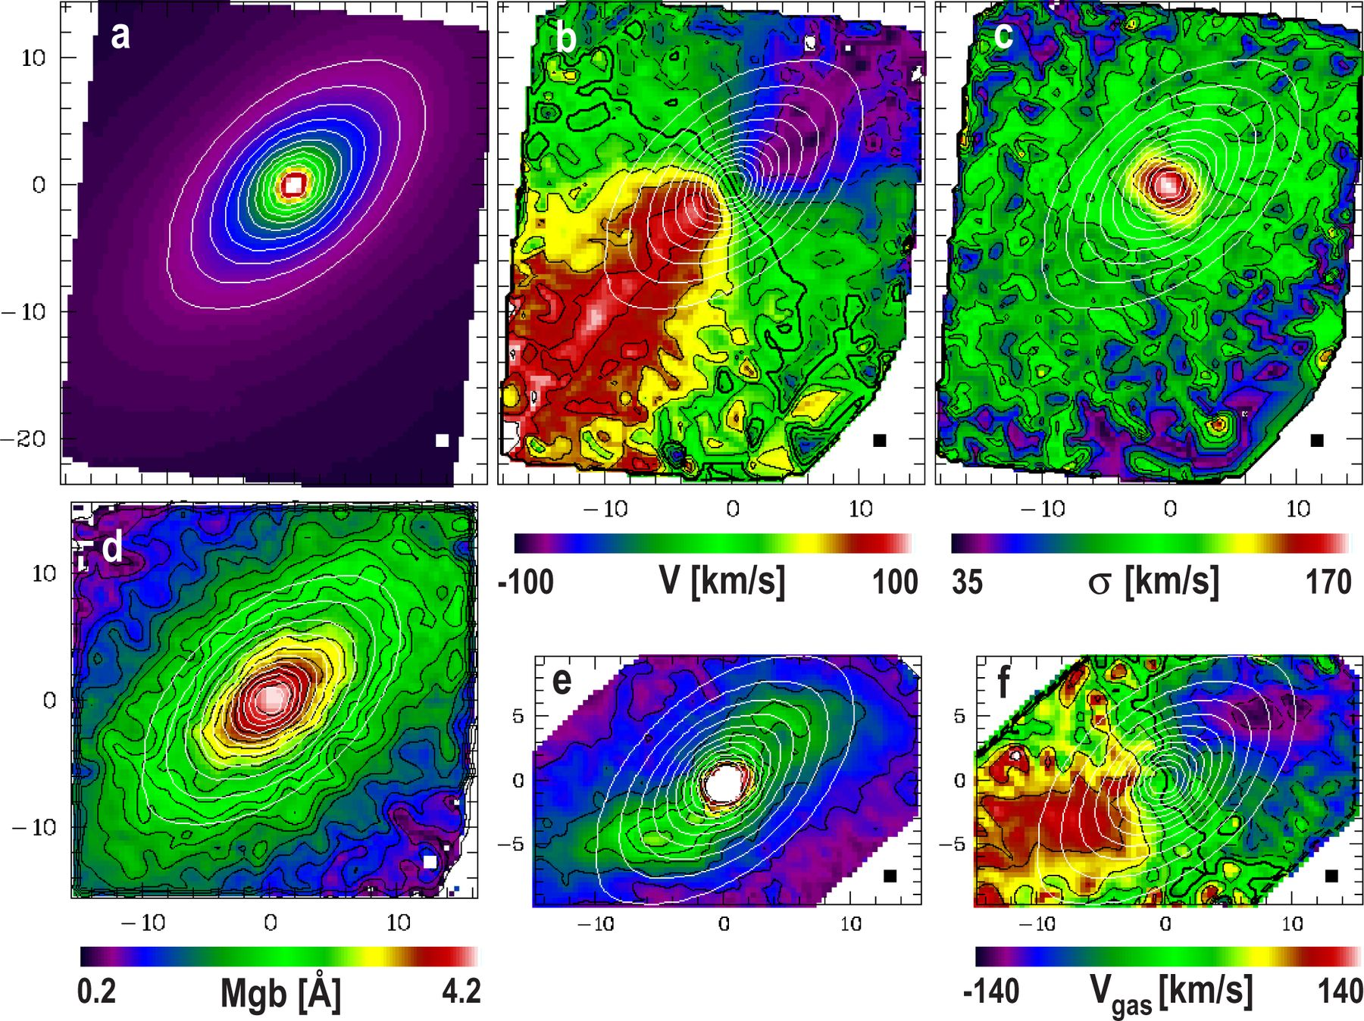
Figure 13. SAURON observations of the E6 galaxy NGC 3377. (a) Reconstructed total intensity. (b) Mean velocity V. (c) ...
Notes:
Figure 13. SAURON observations of the E6 galaxy NGC 3377. (a) Reconstructed total intensity. (b) Mean velocity V. (c) Velocity dispersion σ. (d) Stellar Mgb index. (e) Gaseous total intensity ([O iii] λ5007). (f) Gas velocity field. Isophotes of the reconstructed image are superimposed on each frame. The small square at the lower right corner of each frame gives the size of the lenslets , and the field shown is . These maps are based on a exposure. No spatial binning has been applied at this stage. The stars show a striking rotating disc pattern with the spin axis misaligned about 10° from the photometric minor axis, indicating that the galaxy is triaxial. The gas also reveals strong non-axisymmetric structures and motions. The Mgb isophotes follow the continuum light.
Unless provided in the caption above, the following copyright applies to the content of this slide: © 2001 RAS

