Slide 1
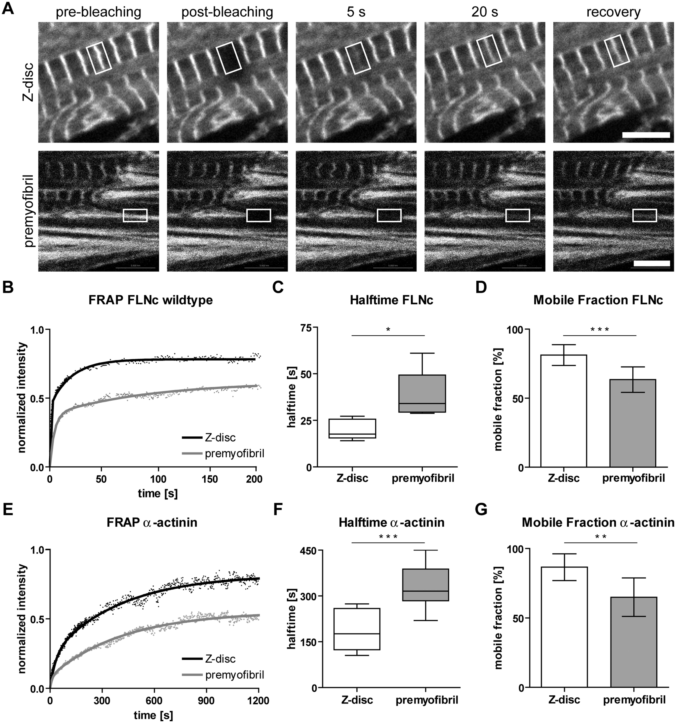
Figure 1. FRAP analysis of dynamics of FLNc and α-actinin in Z-discs and premyofibrils. Neonatal mouse cardiomyocytes ...
Notes:
Figure 1. FRAP analysis of dynamics of FLNc and α-actinin in Z-discs and premyofibrils. Neonatal mouse cardiomyocytes were transfected with cDNAs encoding FLNc-EGFP or α-actinin2-EGFP, respectively, and analyzed by FRAP. (A) Time series of fluorescence micrographs indicating the localization of FLNc-EGFP in Z-discs (upper panel) or premyofibrils (lower panel), respectively. ROI (indicated by white boxes) were followed over time, and are shown prior to bleaching, immediately subsequent to bleaching and at distinct time points during the fluorescence recovery phase (see also Supplementary Material, video1, Supplementary Material, video2). Bars: 5 µm. (B) Typical recovery profile of FLNc in Z-discs and premyofibrils. (C) Box plots of halftimes of all experiments show a slow halftime of 18 s (median) in Z-discs and 34 s in premyofibrils, respectively (n = 8, shown ± absolute values, *P < 0.0101). (D) Bar plots summarizing mobile fractions of FLNc in Z-discs and premyofibrils. Note the increase of mobile fraction from 63% in premyofibrils to 81% in mature Z-discs (n = 8, shown ± SD, ***P < 0.0005). (E) Typical recovery profile of α-actinin2-EGFP in Z-discs and premyofibrils. (F) Box plots of halftimes of all experiments show a slow halftime of 176 s (median) in Z-discs and 316 s in premyofibrils, respectively (n = 9, shown ± absolute values, ***P < 0.0004). (G) Bar plot summarizing mobile fractions of α-actinin2 in Z-discs (87%) and premyofibrils (65%), (n = 9, shown ± SD, **P < 0.0011). Note the considerably higher dynamics of FLNc in comparison to α-actinin2, both in Z-discs and premyofibrils. Exchange half-lives (t1/2) and mobile fractions (Mf) of transfected EGFP-fusion protein related to region of photobleaching (Z-discs or premyofibrils) and model system (± SD) ModelTransfected proteinBleached regiont 1/2 [s]Mf [%]wild-type mouseFLNcZ-discs18 ± 581 ± 8Premyofibrils34 ± 1363 ± 9wild-type mouseα-actinin2Z-discs176 ± 6887 ± 10Premyofibrils316 ± 6765 ± 14Xin KO mouseFLNcZ-discs14 ± 375 ± 7Premyofibrils21 ± 563 ± 7Xin/XIRP2 dKO mouseFLNcZ-discs21 ± 1384 ± 5Premyofibrils26 ± 1287 ±18cardiac Z-discs2495 ± 12zebrafishFLNcskeletal Z-discs2899 ± 4Myosepta9494 ± 9
Unless provided in the caption above, the following copyright applies to the content of this slide: © The Author 2016. Published by Oxford University Press. All rights reserved. For permissions, please e-mail: journals.permissions@oup.com

Slide 2
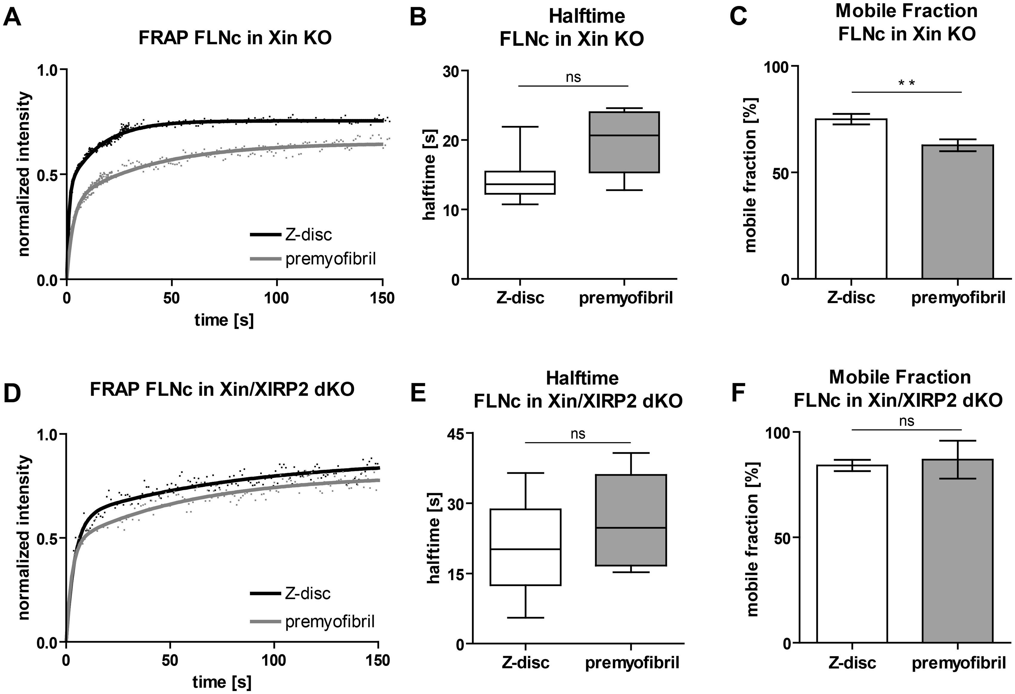
Figure 2. FRAP analysis of FLNc in cardiomyocytes deficient for Xin or both Xin and XIRP2. (A) FRAP recovery curves and ...
Notes:
Figure 2. FRAP analysis of FLNc in cardiomyocytes deficient for Xin or both Xin and XIRP2. (A) FRAP recovery curves and (B) deduced slow halftimes obtained in neonatal mouse cardiomyocytes deficient for Xin and transfected with FLNc-EGFP did not show significantly increased dynamics in premyofibrils or Z-discs when compared with wild-type cardiomyocytes (n = 7, shown ± absolute values). Note however, that in contrast to wild-type cells, FLNc dynamics in Z-discs and premyofibrils are not significantly different. (C) Mobile fractions in these cells [63% in premyofibrils and 75% in Z-discs (n = 7, shown ± SD, **P < 0.0062)] were comparable to those in wild-type cells. FRAP experiments in embryonic mouse cardiomyocytes deficient for Xin and XIRP2 transfected with FLNc. (D, E) In the absence of both XIRPs, FLNc slow half-lives in mature Z-discs were comparable to those of wild-type cells, whereas also in these cells slow half-lives in premyofibrils were not significantly different from those in Z-discs (n = 5, shown ± absolute values). (F) The mobile fraction in premyofibrils without XIRPs was significantly increased (87 ± 18%, compared with 63 ± 7% in Xin-deficient and 63 ± 9% in wild-type cells) to values almost identical to Z-disc levels (84 ± 5%, n = 5). In contrast, mobility in Z-discs was similar in cardiomyocytes derived from all genotypes.
Unless provided in the caption above, the following copyright applies to the content of this slide: © The Author 2016. Published by Oxford University Press. All rights reserved. For permissions, please e-mail: journals.permissions@oup.com

Slide 3
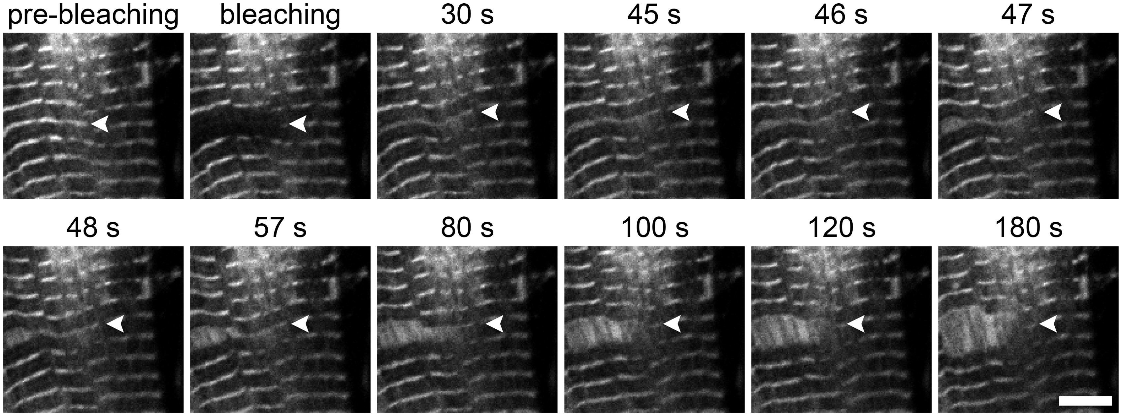
Figure 3. FLNc is involved in early remodeling processes. Laser-induced Z-disc splitting in cardiomyocytes transfected ...
Notes:
Figure 3. FLNc is involved in early remodeling processes. Laser-induced Z-disc splitting in cardiomyocytes transfected with FLNc-EGFP. Z-disc splitting started 45 s after bleaching at the periphery of the bleached area and continued until the whole Z-disc was split. FLNc was revealed in damage areas in increased amounts relative to normal Z-discs and can therefore be used as a sensitive marker for myofibrillar remodeling. Arrowheads indicate a Z-disc that was split and extended upon bleaching. Bar: 5 μm.
Unless provided in the caption above, the following copyright applies to the content of this slide: © The Author 2016. Published by Oxford University Press. All rights reserved. For permissions, please e-mail: journals.permissions@oup.com

Slide 4
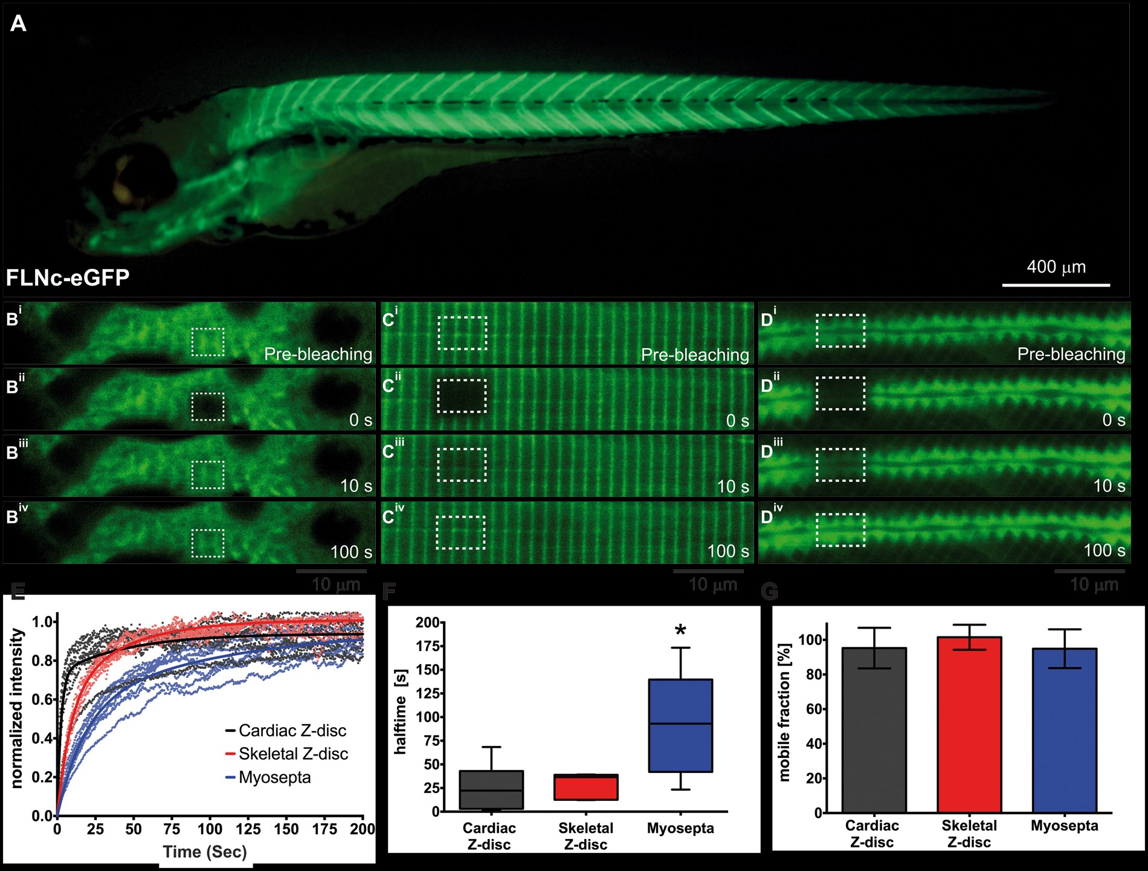
Figure 6. FLNc dynamics in the zebrafish embryo. (A) Transgenic zebrafish embryo at 5 days post-fertilization ...
Notes:
Figure 6. FLNc dynamics in the zebrafish embryo. (A) Transgenic zebrafish embryo at 5 days post-fertilization expressing human FLNc tagged to EGFP (FLNc-EGFP) under the acta1 promoter. Timelapse images documenting fluorescence of FLNc-EGFP before bleaching (pre-bleach), immediately after (0 s), 10 and 100 s after bleaching in (B) cardiac muscle. (C) Z-discs of the skeletal muscle, and (D) in the myosepta of the skeletal muscle. (E) Fitted curve of recovery profiles of FLNc-EGFP in cardiac Z-discs (black), skeletal Z-discs (red), and myosepta (blue) shown by solid line. Individual replicates and time points shown in their respective colors (cardiac Z-disc: n = 6; skeletal Z-disc: n = 5; myosepta: n = 10). (F) Tukey box plots depicting the median, 25 and 75th percentile, and upper and lower limits of FLNc slow half-lives in cardiac Z-discs (black), skeletal Z-discs (red), and myosepta (blue), with a significantly longer half-life for myosepta localized FLNc (*P < 0.05). (G) There is no significant difference in the mobile fraction of FLNc between locations (cardiac Z-disc: 95%; skeletal muscle Z-disc: 99%; skeletal myosepta: 94%, shown ± SD).
Unless provided in the caption above, the following copyright applies to the content of this slide: © The Author 2016. Published by Oxford University Press. All rights reserved. For permissions, please e-mail: journals.permissions@oup.com

Slide 5
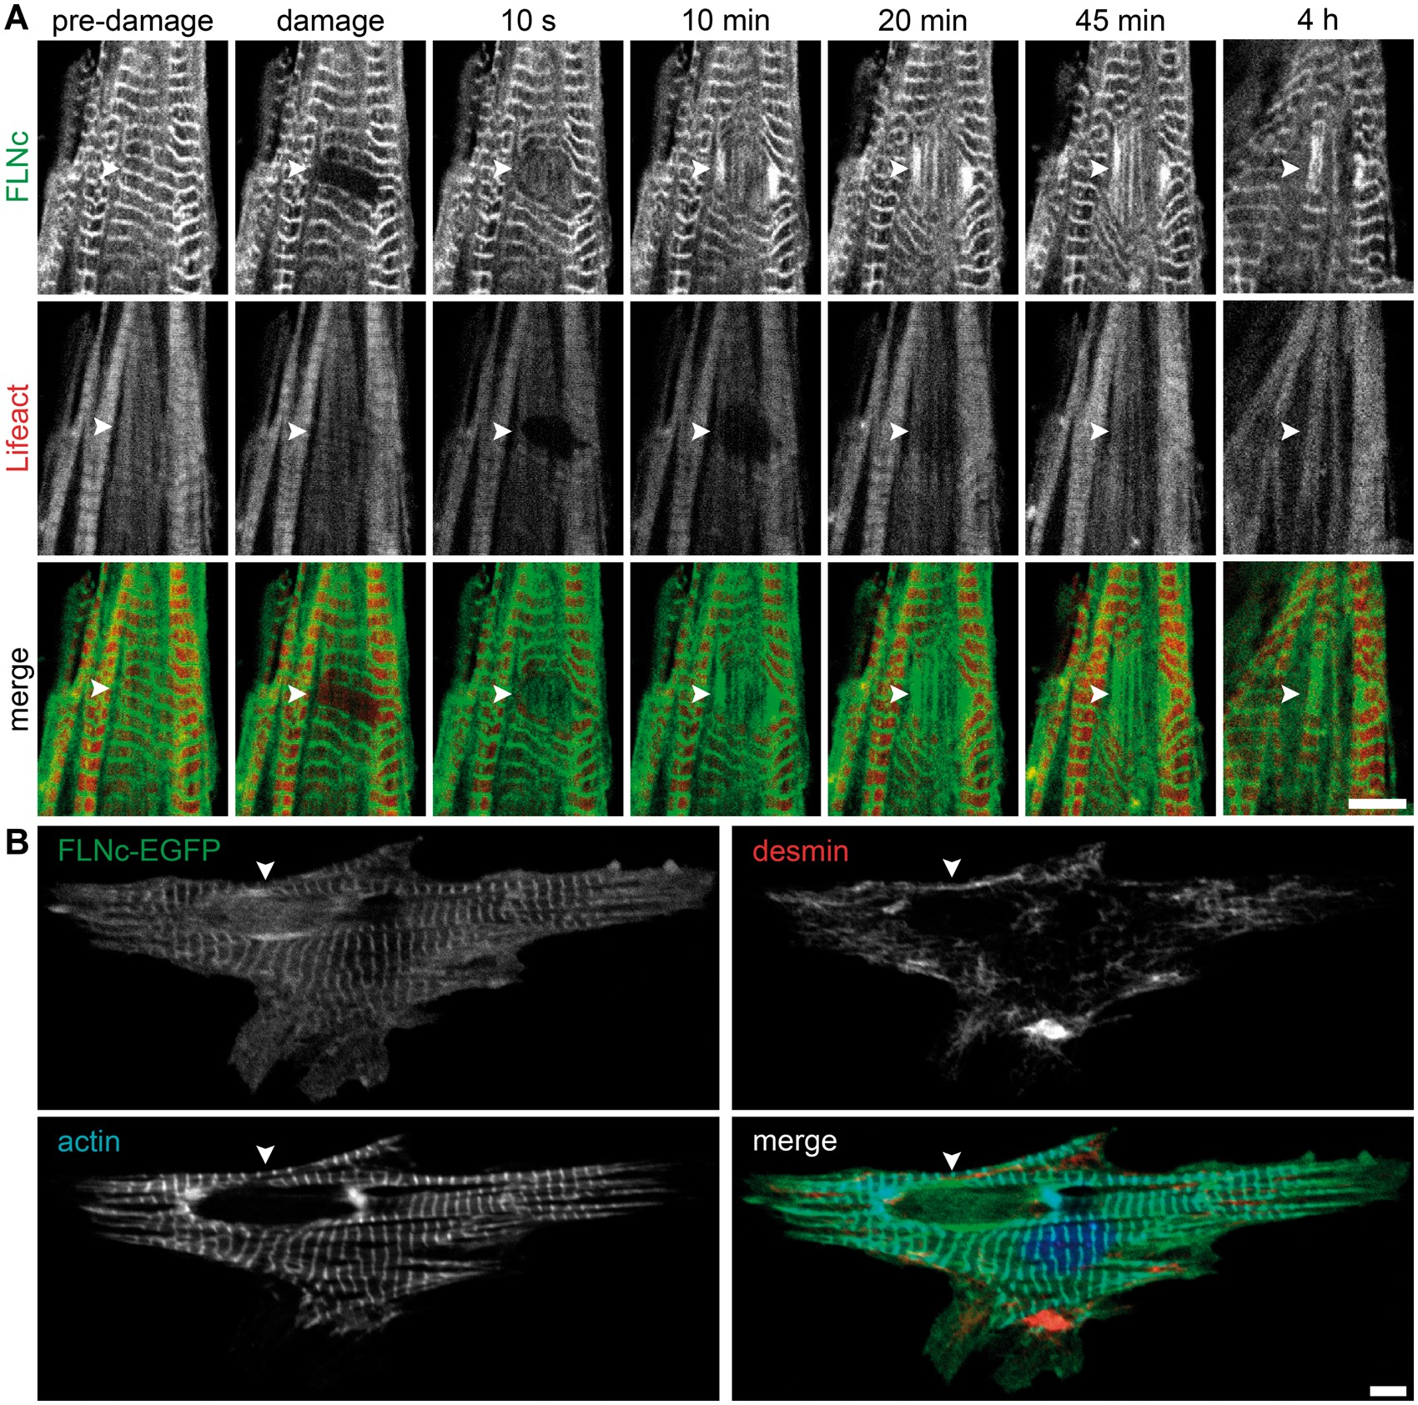
Figure 5. Actin and desmin are not involved in early repair processes. (A) Laser-induced microdamage in cardiomyocytes ...
Notes:
Figure 5. Actin and desmin are not involved in early repair processes. (A) Laser-induced microdamage in cardiomyocytes transfected with FLNc-EGFP and Lifeact-Ruby to visualize actin. Although FLNc was immediately recruited to the damaged areas, actin was not found during the earliest stages of myofibrillar repair (10 s, arrowheads) and became detectable only after 10–20 min (Supplementary Material, video4). (B) Staining with coumarin-labelled phalloidin and anti-desmin antibody confirmed absence of F-actin and showed the exclusion of desmin intermediate filaments from damaged areas. Cell was fixed 5 min after damage. Bars: 5 μm.
Unless provided in the caption above, the following copyright applies to the content of this slide: © The Author 2016. Published by Oxford University Press. All rights reserved. For permissions, please e-mail: journals.permissions@oup.com

Slide 6
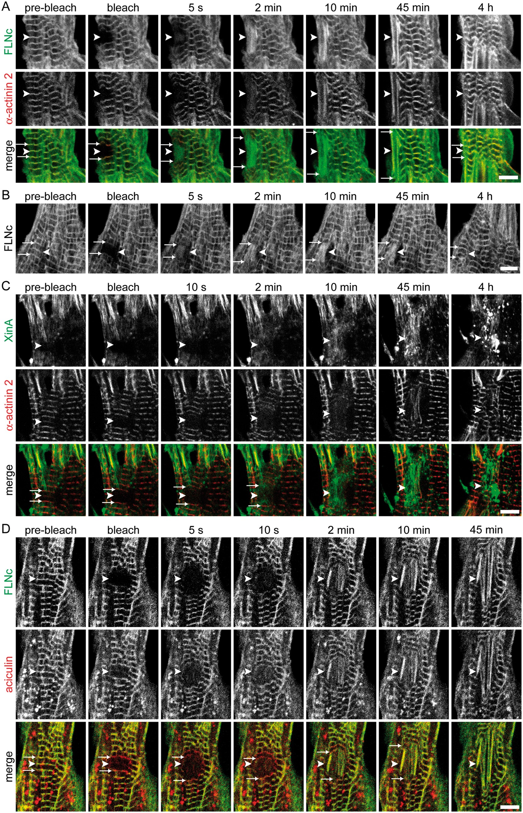
Figure 4. Cytoskeletal proteins are differentially involved in myofibrillar repair. Laser-induced microdamage in ...
Notes:
Figure 4. Cytoskeletal proteins are differentially involved in myofibrillar repair. Laser-induced microdamage in cardiomyocytes transfected with either (A) FLNc-EGFP and α-actinin2-RFP, (B) FLNc-EGFP alone in the presence of cycloheximide, (C) XinA-EGFP and α-actinin2-RFP or (D) FLNc-EGFP and RFP-aciculin. (A) FLNc was recruited to regions of damage (arrowheads) within seconds, whereas α-actinin2 appeared only after 2–10 min, implying distinct contributions of both proteins to repair processes. After 3–4 h sarcomeres had recovered and myofibrillar repair was completed (Supplementary Material, video3). (B) Inhibition of protein synthesis with cycloheximide does not alter the occurence and time course of myofibril repair in microdamaged cardiomyocytes. Shown is a representative example of four individual experiments. (C) Similar to α-actinin2, XinA was recruited to lesions (arrowheads) after 2–10 min. After four hours XinA was still strongly enriched in the affected region despite apparently complete myofibrillar repair. (D) In contrast to α-actinin2 and XinA, but similar to FLNc, aciculin appeared almost immediately in the damaged areas. In this specific experiment aciculin-RFP was not completely bleached and only seems to appear earlier in the damaged area than FLNc. Arrows mark the unaffected Z-discs flanking the damaged, split Z-discs in (B) and in merged panels of (A,C,D). Bars: 5 μm.
Unless provided in the caption above, the following copyright applies to the content of this slide: © The Author 2016. Published by Oxford University Press. All rights reserved. For permissions, please e-mail: journals.permissions@oup.com

